Slide 1
CHAPTER 13 Part 2 of 3
All photographic and graphic images (henceforth referred to as images) posted on this site are copyright of the persons and/or institutions indicated in the caption directly associated with each image. The copyright holders have agreed that you may use their images for educational, non-commercial purposes only and provided that they are credited in each instance of use. For all other uses you must contact the copyright holder.

Slide 2
Notes:
The Banff Springs Hotel in Banff, Alberta, is largely constructed of Triassic Rundlestone. In the background the Bow River cascades over Triassic strata at Bow Falls. KEITH VAUGHAN.
_______________________________
All photographic and graphic images (henceforth referred to as images) posted on this site are copyright of the persons and/or institutions indicated in the caption directly associated with each image. The copyright holders have agreed that you may use their images for educational, non-commercial purposes only and provided that they are credited in each instance of use. For all other uses you must contact the copyright holder.

Slide 3
Notes:
Detail of the TCU Financial Group Building (2003) in Saskatoon, Saskatchewan, which is partly constructed of late Ordovician Tyndall Stone, one block of which shows a section through a nautiloid. KIM MYSYK.
_______________________________
All photographic and graphic images (henceforth referred to as images) posted on this site are copyright of the persons and/or institutions indicated in the caption directly associated with each image. The copyright holders have agreed that you may use their images for educational, non-commercial purposes only and provided that they are credited in each instance of use. For all other uses you must contact the copyright holder.

Slide 4
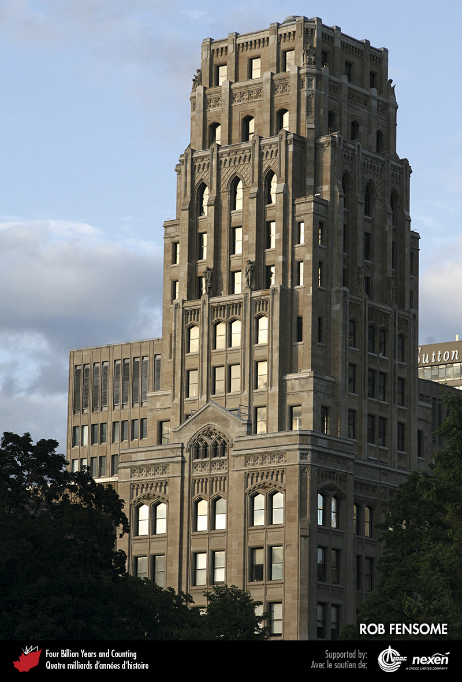
Notes:
Reinforced concrete of the Whitney Block (1925–1928), Toronto, Ontario, is faced with Silurian Queenston Limestone. ROB FENSOME.
_______________________________
All photographic and graphic images (henceforth referred to as images) posted on this site are copyright of the persons and/or institutions indicated in the caption directly associated with each image. The copyright holders have agreed that you may use their images for educational, non-commercial purposes only and provided that they are credited in each instance of use. For all other uses you must contact the copyright holder.

Slide 5
Notes:
Detail of the Whitney Block (1925–1928), showing the finish of the Queenston Limestone. ROB FENSOME.
_______________________________
All photographic and graphic images (henceforth referred to as images) posted on this site are copyright of the persons and/or institutions indicated in the caption directly associated with each image. The copyright holders have agreed that you may use their images for educational, non-commercial purposes only and provided that they are credited in each instance of use. For all other uses you must contact the copyright holder.

Slide 6
Notes:
Part of the Ontario Legislative Building (1886–1893), Toronto, Ontario. The principal building stone is Silurian Whirlpool Sandstone, quarried near the forks of the Credit and Orangeville rivers. ROB FENSOME.
_______________________________
All photographic and graphic images (henceforth referred to as images) posted on this site are copyright of the persons and/or institutions indicated in the caption directly associated with each image. The copyright holders have agreed that you may use their images for educational, non-commercial purposes only and provided that they are credited in each instance of use. For all other uses you must contact the copyright holder.

Slide 7
Notes:
Detail of the Ontario Parliament Buildings (1886–1893) showing an intricately carved detail in a Whirlpool Sandstone block. Note the cross-bedding in the sandstone. ROB FENSOME.
_______________________________
All photographic and graphic images (henceforth referred to as images) posted on this site are copyright of the persons and/or institutions indicated in the caption directly associated with each image. The copyright holders have agreed that you may use their images for educational, non-commercial purposes only and provided that they are credited in each instance of use. For all other uses you must contact the copyright holder.

Slide 8
Notes:
Government House (1831) in St. John’s, Newfoundland, is built mainly of red Ediacaran sandstone quarried from the slopes of nearby Signal Hill. The granite trim is of unknown origin. LAWSON DICKSON.
_______________________________
All photographic and graphic images (henceforth referred to as images) posted on this site are copyright of the persons and/or institutions indicated in the caption directly associated with each image. The copyright holders have agreed that you may use their images for educational, non-commercial purposes only and provided that they are credited in each instance of use. For all other uses you must contact the copyright holder.

Slide 9
Notes:
The MacDonald Farmhouse (1820), Bartibog, New Brunswick, is built of local Carboniferous sandstone. GWEN MARTIN.
_______________________________
All photographic and graphic images (henceforth referred to as images) posted on this site are copyright of the persons and/or institutions indicated in the caption directly associated with each image. The copyright holders have agreed that you may use their images for educational, non-commercial purposes only and provided that they are credited in each instance of use. For all other uses you must contact the copyright holder.

Slide 10
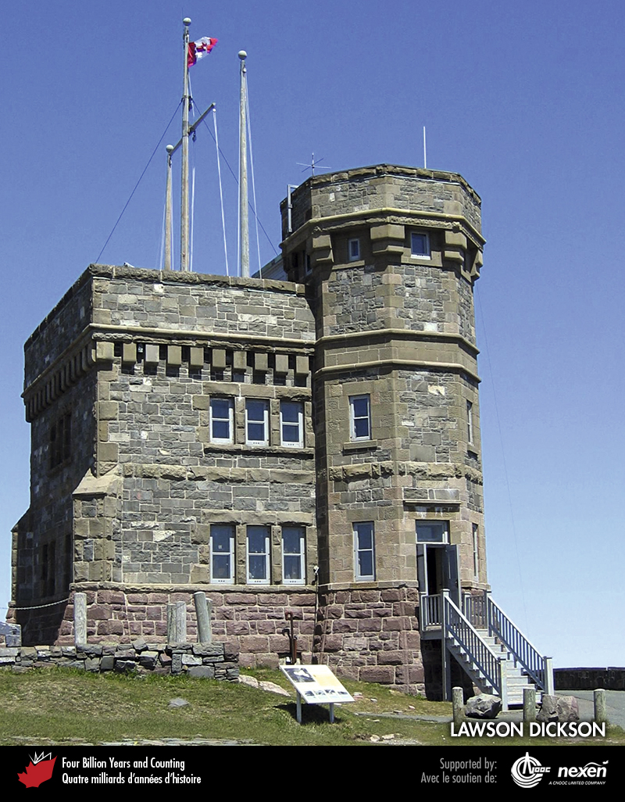
Notes:
The sandstone blocks used to build the Cabot Tower (1897) at Signal Hill in St. John’s were in part salvaged from the ruins of a former barracks and hospital built on the site in 1842–1843 and destroyed by fire in 1892. The lower part of the structure is local Ediacaran conglomerate. The upper part is mainly of local Ediacaran grey sandstone, with Nova Scotian sandstone (probably Carboniferous Wallace Sandstone) used around the windows and for trim. LAWSON DICKSON.
_______________________________
All photographic and graphic images (henceforth referred to as images) posted on this site are copyright of the persons and/or institutions indicated in the caption directly associated with each image. The copyright holders have agreed that you may use their images for educational, non-commercial purposes only and provided that they are credited in each instance of use. For all other uses you must contact the copyright holder.

Slide 11
Notes:
Detail of the Hotel Vancouver, on West Georgia Street, Vancouver, British Columbia. Construction on this elegant building began in 1929 but, because of delays caused by the Depression, was not completed until 1939. The exterior is finished with Haddington Island Andesite, shown here. The well-preserved decorations demonstrate this stone’s suitability for carving. LINDA CAMPBELL.
_______________________________
All photographic and graphic images (henceforth referred to as images) posted on this site are copyright of the persons and/or institutions indicated in the caption directly associated with each image. The copyright holders have agreed that you may use their images for educational, non-commercial purposes only and provided that they are credited in each instance of use. For all other uses you must contact the copyright holder.

Slide 12
Notes:
Polished anorthosite (a mafic igneous rock) with coarse iridescent plagioclase feldspar crystals and fewer dark pyroxene crystals is used as facing on pillars at Constitution Square (1987), on Albert Street in Ottawa, Ontario. ROB FENSOME.
_______________________________
All photographic and graphic images (henceforth referred to as images) posted on this site are copyright of the persons and/or institutions indicated in the caption directly associated with each image. The copyright holders have agreed that you may use their

Slide 13
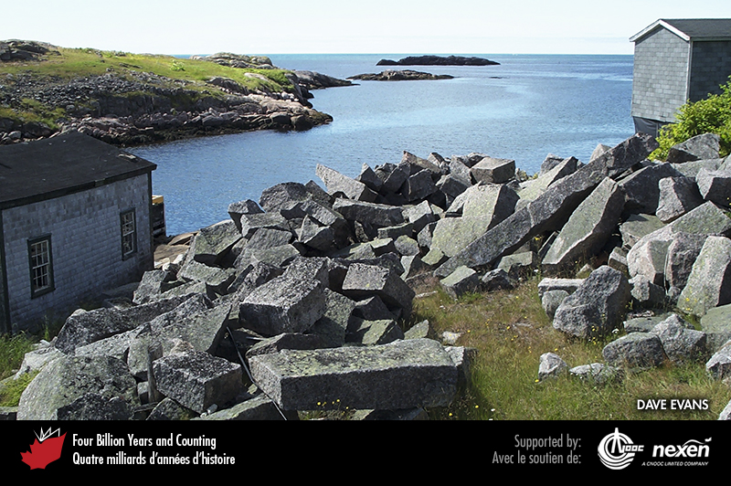
Notes:
The granite quarry near the shoreline at Petites, southwestern Newfoundland. DAVE EVANS.
_______________________________
All photographic and graphic images (henceforth referred to as images) posted on this site are copyright of the persons and/or institutions indicated in the caption directly associated with each image. The copyright holders have agreed that you may use their images for educational, non-commercial purposes only and provided that they are credited in each instance of use. For all other uses you must contact the copyright holder.

Slide 14
Notes:
Detail of the Frost Building North (1954), Toronto, Ontario. The exterior is mainly Queenston Limestone (right), with Stanstead Grey Granite (immediately right of the door frame). ROB FENSOME.
_______________________________
All photographic and graphic images (henceforth referred to as images) posted on this site are copyright of the persons and/or institutions indicated in the caption directly associated with each image. The copyright holders have agreed that you may use their images for educational, non-commercial purposes only and provided that they are credited in each instance of use. For all other uses you must contact the copyright holder.

Slide 15
Notes:
Blue Eyes or Reflect Blue, Mesoproterozoic anorthosite quarried near Nain, Labrador, is one of Canada’s most recognizable building stones: the trade names refer to the presence of striking blue labradorite crystals. LAWSON DICKSON.
_______________________________
All photographic and graphic images (henceforth referred to as images) posted on this site are copyright of the persons and/or institutions indicated in the caption directly associated with each image. The copyright holders have agreed that you may use their images for educational, non-commercial purposes only and provided that they are credited in each instance of use. For all other uses you must contact the copyright holder.

