Slide 1
CHAPTER 8 Part 1 of 4
All photographic and graphic images (henceforth referred to as images) posted on this site are copyright of the persons and/or institutions indicated in the caption directly associated with each image. The copyright holders have agreed that you may use their images for educational, non-commercial purposes only and provided that they are credited in each instance of use. For all other uses you must contact the copyright holder.

Slide 2
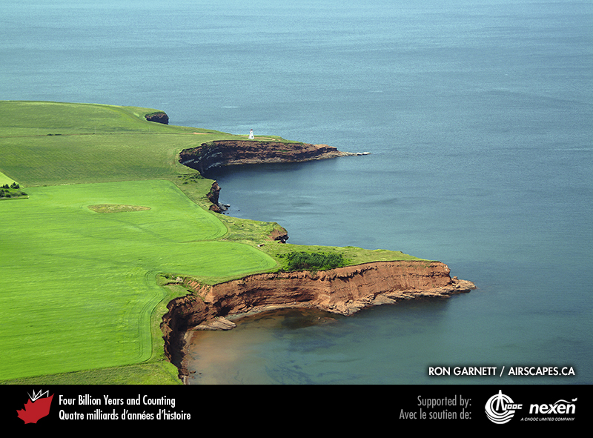
Notes:
Cape Tryon, Prince Edward Island, where the cliffs consist of Permian red fluvial sandstone. RON GARNETT / AIRSCAPES.CA.
_______________________________
All photographic and graphic images (henceforth referred to as images) posted on this site are copyright of the persons and/or institutions indicated in the caption directly associated with each image. The copyright holders have agreed that you may use their images for educational, non-commercial purposes only and provided that they are credited in each instance of use. For all other uses you must contact the copyright holder.

Slide 3
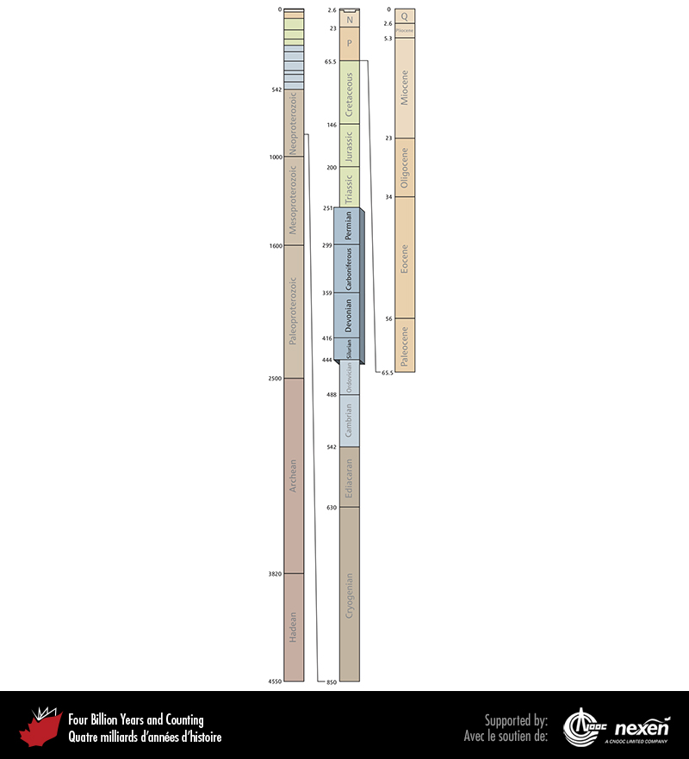
Notes:
Geologic time scale, showing the interval covered in this chapter. Numbers indicate millions of years ago. P = Paleogene (Paleocene to Oligocene), N = Neogene (Miocene and Pliocene), and Q = Quaternary.
_______________________________
All photographic and graphic images (henceforth referred to as images) posted on this site are copyright of the persons and/or institutions indicated in the caption directly associated with each image. The copyright holders have agreed that you may use their images for educational, non-commercial purposes only and provided that they are credited in each instance of use. For all other uses you must contact the copyright holder.

Slide 4
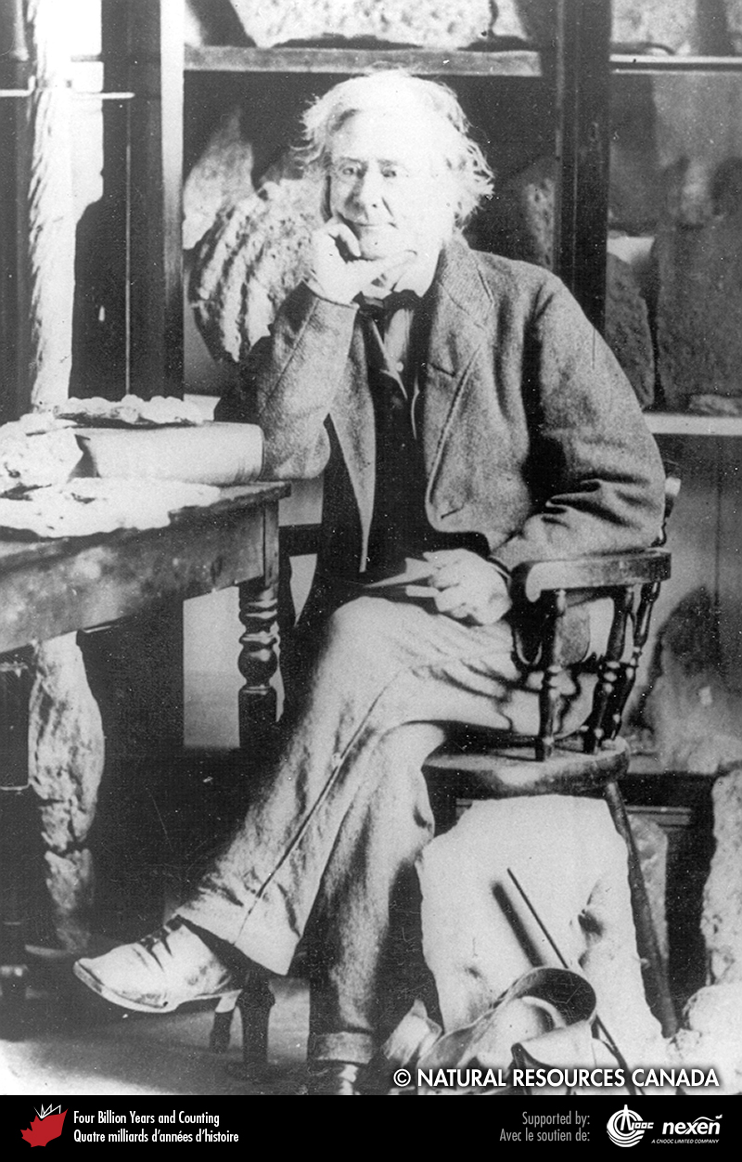
Notes:
William Logan in his laboratory in Montréal. REPRODUCED WITH THE PERMISSION OF NATURAL RESOURCES CANADA 2013, COURTESY OF THE GEOLOGICAL SURVEY OF CANADA.
_______________________________
All photographic and graphic images (henceforth referred to as images) posted on this site are copyright of the persons and/or institutions indicated in the caption directly associated with each image. The copyright holders have agreed that you may use their images for educational, non-commercial purposes only and provided that they are credited in each instance of use. For all other uses you must contact the copyright holder.

Slide 5
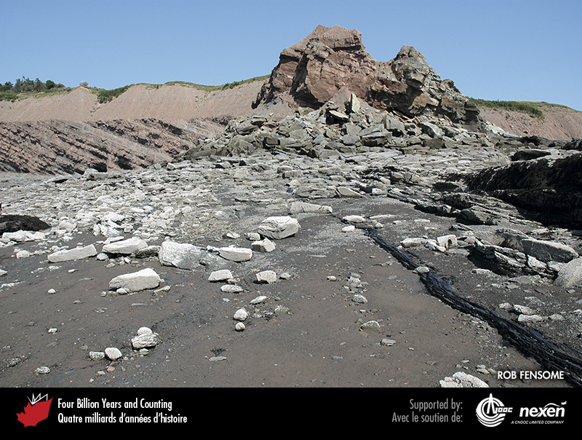
Notes:
Tilted late Carboniferous rocks are exposed in the cliffs and on the beach at Coal Mine Point, Joggins, Nova Scotia. Note the coal seam extending from bottom right. ROB FENSOME.
_______________________________
All photographic and graphic images (henceforth referred to as images) posted on this site are copyright of the persons and/or institutions indicated in the caption directly associated with each image. The copyright holders have agreed that you may use their images for educational, non-commercial purposes only and provided that they are credited in each instance of use. For all other uses you must contact the copyright holder.

Slide 6
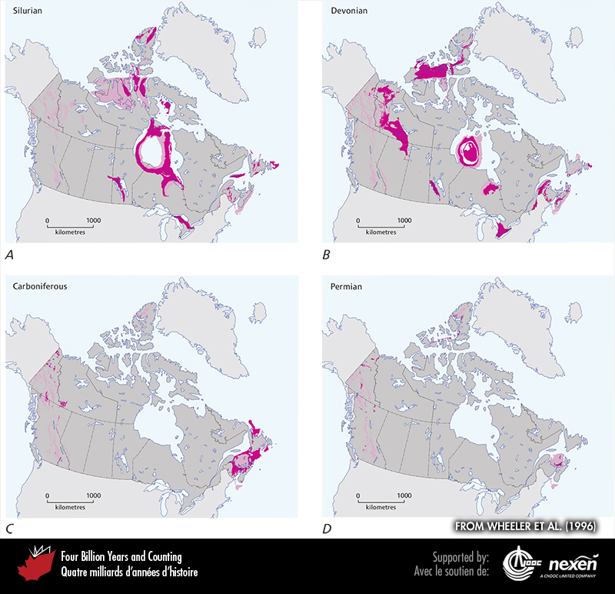
Notes:
General extent of Silurian (A), Devonian (B), Carboniferous (C), and Permian (D) rocks at the surface (beneath glacial deposits), onshore and offshore. The lighter shaded areas denote either uncertainty or areas where rocks of the particular age have been confirmed but are intimately associated with rocks of other ages and the scale of the map doesn’t allow us to show them separately. ADAPTED FROM WHEELER ET AL. (1996).
_______________________________
All photographic and graphic images (henceforth referred to as images) posted on this site are copyright of the persons and/or institutions indicated in the caption directly associated with each image. The copyright holders have agreed that you may use their images for educational, non-commercial purposes only and provided that they are credited in each instance of use. For all other uses you must contact the copyright holder.

Slide 7
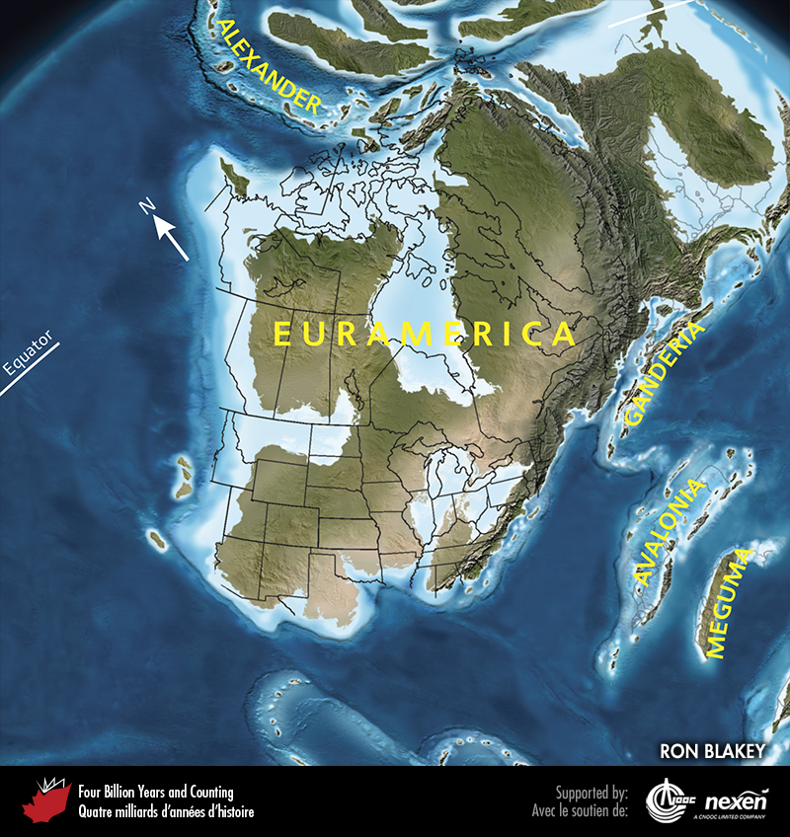
Notes:
Paleogeography of what was to become North America and adjacent regions in the Silurian, 420 million years ago. Land is shown in brown, with shading showing topography. The lighter blue areas represent possible coastal or nearshore areas, darker blue represents deeper ocean waters, and black indicates trenches. Aspects of modern geography are shown for orientation.
_______________________________
All photographic and graphic images (henceforth referred to as images) posted on this site are copyright of the persons and/or institutions indicated in the caption directly associated with each image. The copyright holders have agreed that you may use their images for educational, non-commercial purposes only and provided that they are credited in each instance of use. For all other uses you must contact the copyright holder.

Slide 8
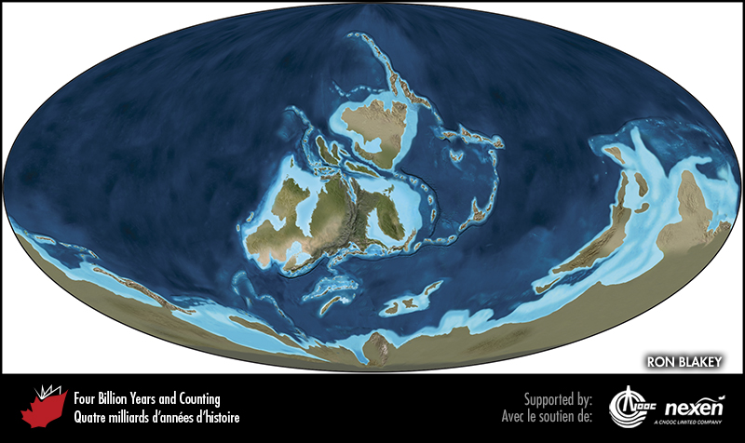
Notes:
Global paleogeography 420 million years ago, during the Silurian. Colours as for previous figure.
_______________________________
All photographic and graphic images (henceforth referred to as images) posted on this site are copyright of the persons and/or institutions indicated in the caption directly associated with each image. The copyright holders have agreed that you may use their images for educational, non-commercial purposes only and provided that they are credited in each instance of use. For all other uses you must contact the copyright holder.

Slide 9
Notes:
Colonies of the Silurian coral Favosites in strata at Quinn Point, near Jacquet River, New Brunswick. ROB FENSOME.
_______________________________
All photographic and graphic images (henceforth referred to as images) posted on this site are copyright of the persons and/or institutions indicated in the caption directly associated with each image. The copyright holders have agreed that you may use their images for educational, non-commercial purposes only and provided that they are credited in each instance of use. For all other uses you must contact the copyright holder.

Slide 10
Notes:
The relationships of the various Appalachian terranes and seaways with Laurentia during part of the early Silurian (A); and with Euramerica during the late Silurian to early Devonian (B), the middle to late Devonian (C), and the early Carboniferous (D). The white lines indicate sea level.
_______________________________
All photographic and graphic images (henceforth referred to as images) posted on this site are copyright of the persons and/or institutions indicated in the caption directly associated with each image. The copyright holders have agreed that you may use their images for educational, non-commercial purposes only and provided that they are credited in each instance of use. For all other uses you must contact the copyright holder.

Slide 11
Notes:
Sugarloaf Mountain near Campbellton, New Brunswick, is an eroded volcanic plug, reflecting magmatic activity in Ganderia during the early Devonian. ROB FENSOME.
_______________________________
All photographic and graphic images (henceforth referred to as images) posted on this site are copyright of the persons and/or institutions indicated in the caption directly associated with each image. The copyright holders have agreed that you may use their images for educational, non-commercial purposes only and provided that they are credited in each instance of use. For all other uses you must contact the copyright holder.

Slide 12
Notes:
These late Ordovician to early Silurian muddy limestone beds are exposed in the gorge of the Saint John River at Grand Falls, New Brunswick. The original sediments were deposited in a sedimentary basin on former Ganderia, and were deformed between about 440 and 390 million years ago, during the Salinic and Acadian orogenies. ROB FENSOME.
_______________________________
All photographic and graphic images (henceforth referred to as images) posted on this site are copyright of the persons and/or institutions indicated in the caption directly associated with each image. The copyright holders have agreed that you may use their images for educational, non-commercial purposes only and provided that they are credited in each instance of use. For all other uses you must contact the copyright holder.

Slide 13
Notes:
Ediacaran strata deposited on Avalonia and tilted during the Acadian Orogeny, St. John’s, Newfoundland. KEITH VAUGHAN.
_______________________________
All photographic and graphic images (henceforth referred to as images) posted on this site are copyright of the persons and/or institutions indicated in the caption directly associated with each image. The copyright holders have agreed that you may use their images for educational, non-commercial purposes only and provided that they are credited in each instance of use. For all other uses you must contact the copyright holder.

Slide 14
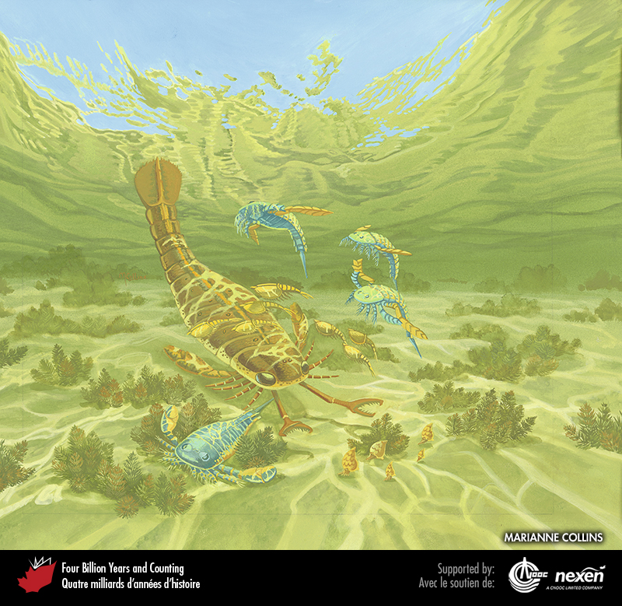
Notes:
Life in a sheltered Silurian lagoon about 420 million years ago. Shallow, warm embayments were havens for eurypterids (sea scorpions), swimming predators up to 2 metres long and among the largest arthropods known. Their segmented bodies were usually streamlined and tapered to a tail end variably developed into a narrow spike or broad leaf-like structure. Their jointed limbs, which bore spines, pincers, and paddles, were attached beneath the head shield. Also shown are several small shrimp-like crustaceans, swimming across the path of the eurypterids, and a cluster of snails grazing among clumps of green algae on the seabed. Painting copyright Marianne Collins, artist.
_______________________________
All photographic and graphic images (henceforth referred to as images) posted on this site are copyright of the persons and/or institutions indicated in the caption directly associated with each image. The copyright holders have agreed that you may use their images for educational, non-commercial purposes only and provided that they are credited in each instance of use. For all other uses you must contact the copyright holder.

Slide 15
Notes:
By the middle Devonian, large areas of the Appalachian Orogen were land and washed by rivers that left redbeds as their legacy, as here west of Miguasha, on Quebec’s Gaspé Peninsula. MIKE MELCHIN.
_______________________________
All photographic and graphic images (henceforth referred to as images) posted on this site are copyright of the persons and/or institutions indicated in the caption directly associated with each image. The copyright holders have agreed that you may use their images for educational, non-commercial purposes only and provided that they are credited in each instance of use. For all other uses you must contact the copyright holder.

Slide 16
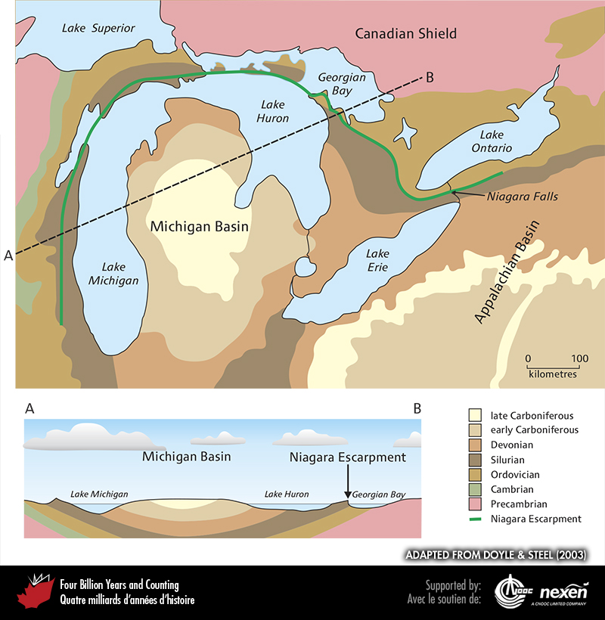
Notes:
At the top is a geological map of the Michigan Basin and adjacent areas showing the ages of the rocks exposed at the surface (after glacial deposits have been removed) and the course of the Niagara Escarpment. Below is a section across the basin from west of Lake Michigan to the Canadian Shield as shown by the line from A to B in the map. ADAPTED FROM DOYLE AND STEEL (2003).
_______________________________
All photographic and graphic images (henceforth referred to as images) posted on this site are copyright of the persons and/or institutions indicated in the caption directly associated with each image. The copyright holders have agreed that you may use their images for educational, non-commercial purposes only and provided that they are credited in each instance of use. For all other uses you must contact the copyright holder.

Slide 17
Notes:
Looking out through the entrance of a cave cut in Silurian carbonate of the Niagara Escarpment. This cave faces Georgian Bay at Halfway Rock Point, Bruce Peninsula National Park of Canada, Ontario. D. A. WILKES, COPYRIGHT PARKS CANADA.
_______________________________
All photographic and graphic images (henceforth referred to as images) posted on this site are copyright of the persons and/or institutions indicated in the caption directly associated with each image. The copyright holders have agreed that you may use their images for educational, non-commercial purposes only and provided that they are credited in each instance of use. For all other uses you must contact the copyright holder.

