Slide 1
CHAPTER 8 Part 4 of 4
All photographic and graphic images (henceforth referred to as images) posted on this site are copyright of the persons and/or institutions indicated in the caption directly associated with each image. The copyright holders have agreed that you may use their images for educational, non-commercial purposes only and provided that they are credited in each instance of use. For all other uses you must contact the copyright holder.

Slide 2
Notes:
Colourful but complex geology is evident in this photograph of Strand Fiord, Axel Heiberg Island. At the upper right is a diapir of white Carboniferous salt, originally deposited in the Sverdrup Seaway. In the foreground are near-vertical, grey, fine-grained clastic Jurassic rocks; and on the slopes to the left are Triassic redbeds. CHRISTOPHER HARRISON.
_______________________________
All photographic and graphic images (henceforth referred to as images) posted on this site are copyright of the persons and/or institutions indicated in the caption directly associated with each image. The copyright holders have agreed that you may use their images for educational, non-commercial purposes only and provided that they are credited in each instance of use. For all other uses you must contact the copyright holder.

Slide 3
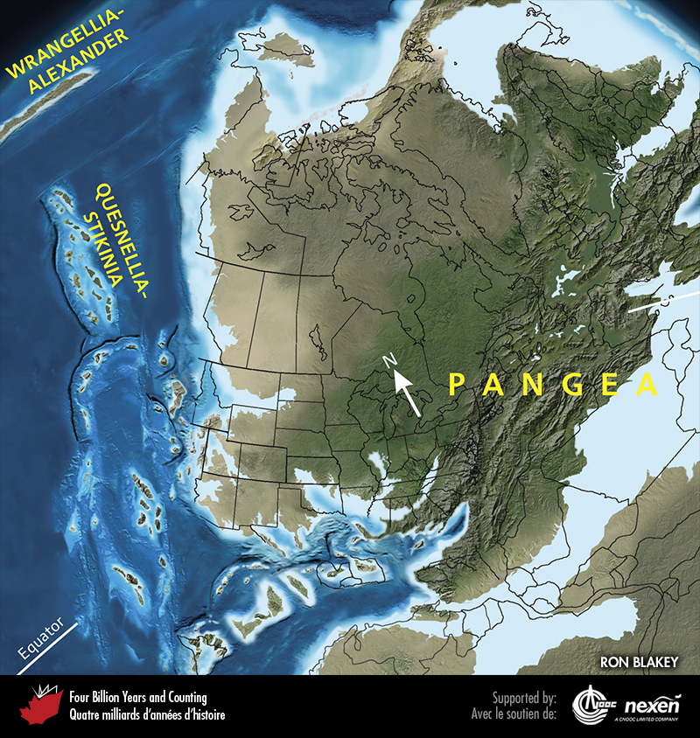
Notes:
Paleogeography of what was to become North America and adjacent regions in the late Carboniferous, 315 million years ago. Land is shown in brown, with shading showing topography. The lighter blue areas represent possible coastal or nearshore areas, darker blue represents deeper ocean waters, and black indicates trenches. Aspects of modern geography are shown for orientation.
_______________________________
All photographic and graphic images (henceforth referred to as images) posted on this site are copyright of the persons and/or institutions indicated in the caption directly associated with each image. The copyright holders have agreed that you may use their images for educational, non-commercial purposes only and provided that they are credited in each instance of use. For all other uses you must contact the copyright holder.

Slide 4
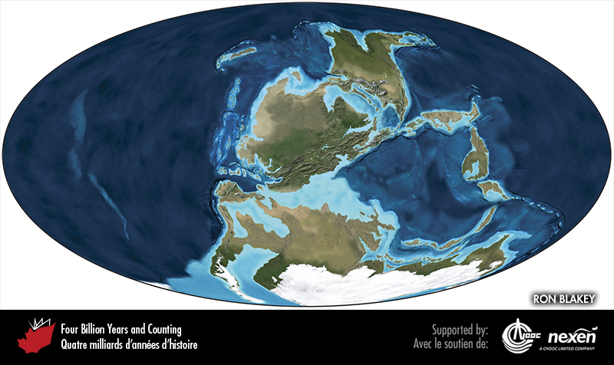
Notes:
Global paleogeography 315 million years ago, during the late Carboniferous. Colours as for previous figure.
_______________________________
All photographic and graphic images (henceforth referred to as images) posted on this site are copyright of the persons and/or institutions indicated in the caption directly associated with each image. The copyright holders have agreed that you may use their images for educational, non-commercial purposes only and provided that they are credited in each instance of use. For all other uses you must contact the copyright holder.

Slide 5
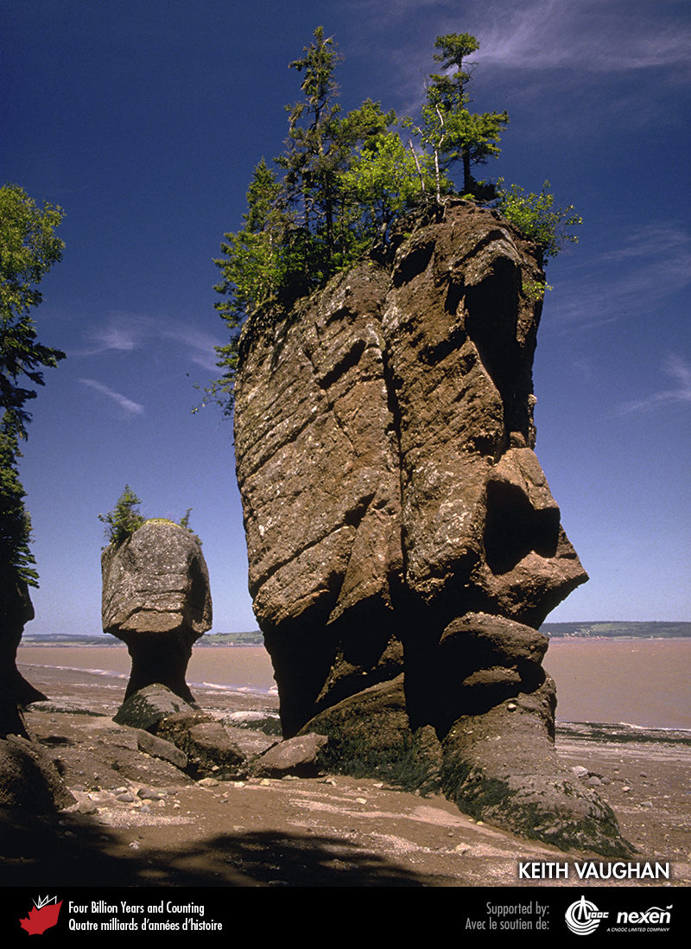
Notes:
Late Carboniferous fluvial conglomerate and sandstone form the “flowerpot” sea stacks at Hopewell Cape, New Brunswick. The powerful Bay of Fundy tides undercut the rocks to form the unusual shapes. KEITH VAUGHAN.
_______________________________
All photographic and graphic images (henceforth referred to as images) posted on this site are copyright of the persons and/or institutions indicated in the caption directly associated with each image. The copyright holders have agreed that you may use their images for educational, non-commercial purposes only and provided that they are credited in each instance of use. For all other uses you must contact the copyright holder.

Slide 6
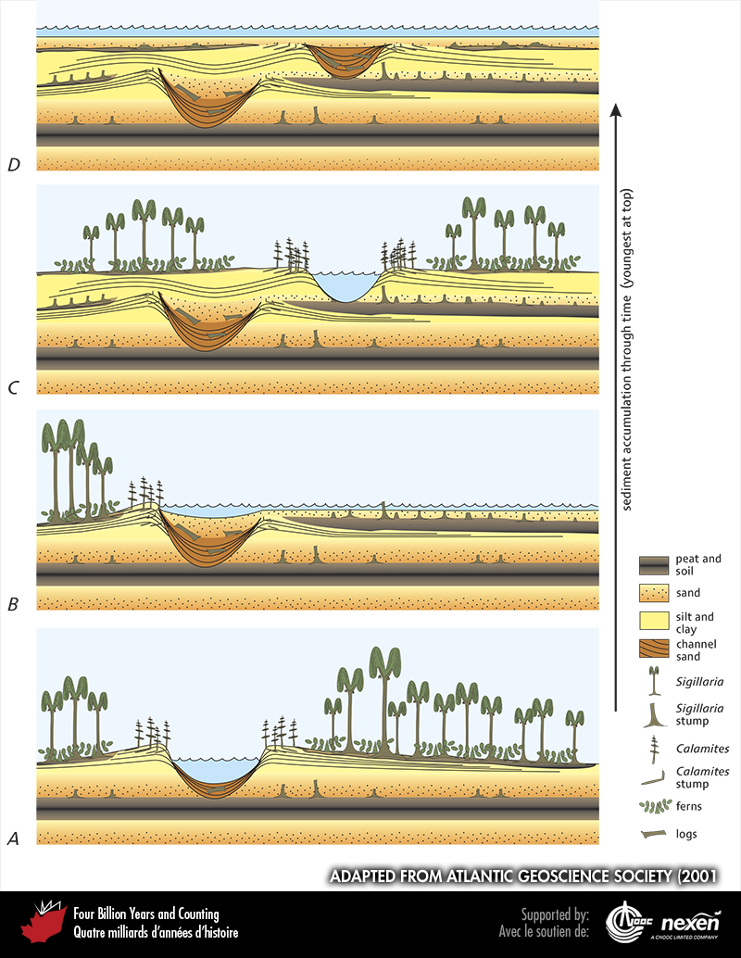
Notes:
Deposits and environments associated with cyclothems in the late Carboniferous. A depicts a river cutting into older sediments and depositing sand and gravel in its channel. The horsetail Calamites is growing along the banks, beyond which is a flood plain supporting a forest of clubmoss (Sigillaria) trees and ferns. Organic debris from the forest is building up a layer of peat that may eventually form coal. B shows the river overflowing its banks during a flood. Sand is deposited by the flood waters, choking the forest, covering the peat, and filling the old channel. Only the stumps of the trees are preserved, protected by the new layer of flood-deposited sand. In C, a new river channel is established and a new forest is growing on the flood plain. Periodically this cycle is broken by more general aquatic flooding, as shown in D, with possibly brackish waters marginal to a sea whose level rose because of melting ice in distant former Protogondwana; during this aquatic phase, thin, dark limestones full of bivalves (so-called clam coals, not shown) were sometimes deposited. Through time, this process builds up repeating layers of peat, sand, silt, clay, and limestone to produce the cyclothems. ADAPTED FROM ATLANTIC GEOSCIENCE SOCIETY (2001).
_______________________________
All photographic and graphic images (henceforth referred to as images) posted on this site are copyright of the persons and/or institutions indicated in the caption directly associated with each image. The copyright holders have agreed that you may use their images for educational, non-commercial purposes only and provided that they are credited in each instance of use. For all other uses you must contact the copyright holder.

Slide 7
Notes:
Late Carboniferous foliage including horsetail (Sphenophyllum; centre), clubmoss branches (right), and a fern (lower left) from Clifton, New Brunswick. RANDALL MILLER, COURTESY OF THE NEW BRUNSWICK MUSEUM.
_______________________________
All photographic and graphic images (henceforth referred to as images) posted on this site are copyright of the persons and/or institutions indicated in the caption directly associated with each image. The copyright holders have agreed that you may use their images for educational, non-commercial purposes only and provided that they are credited in each instance of use. For all other uses you must contact the copyright holder.

Slide 8
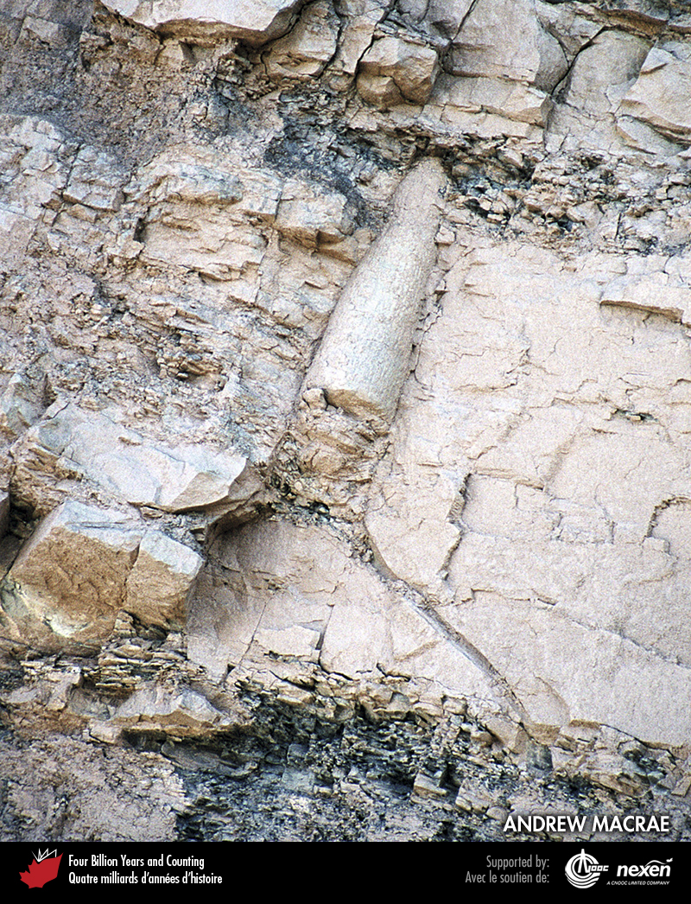
Notes:
Clubmoss tree stump in the cliff at Joggins, Nova Scotia. ANDREW MACRAE.
_______________________________
All photographic and graphic images (henceforth referred to as images) posted on this site are copyright of the persons and/or institutions indicated in the caption directly associated with each image. The copyright holders have agreed that you may use their images for educational, non-commercial purposes only and provided that they are credited in each instance of use. For all other uses you must contact the copyright holder.

Slide 9
Notes:
Artificial cast of trackways of the giant myriapod Arthropleura from late Carboniferous strata at Joggins, Nova Scotia. This myriapod was a giant, up to 2 metres long. LAING FERGUSON.
_______________________________
All photographic and graphic images (henceforth referred to as images) posted on this site are copyright of the persons and/or institutions indicated in the caption directly associated with each image. The copyright holders have agreed that you may use their images for educational, non-commercial purposes only and provided that they are credited in each instance of use. For all other uses you must contact the copyright holder.

Slide 10
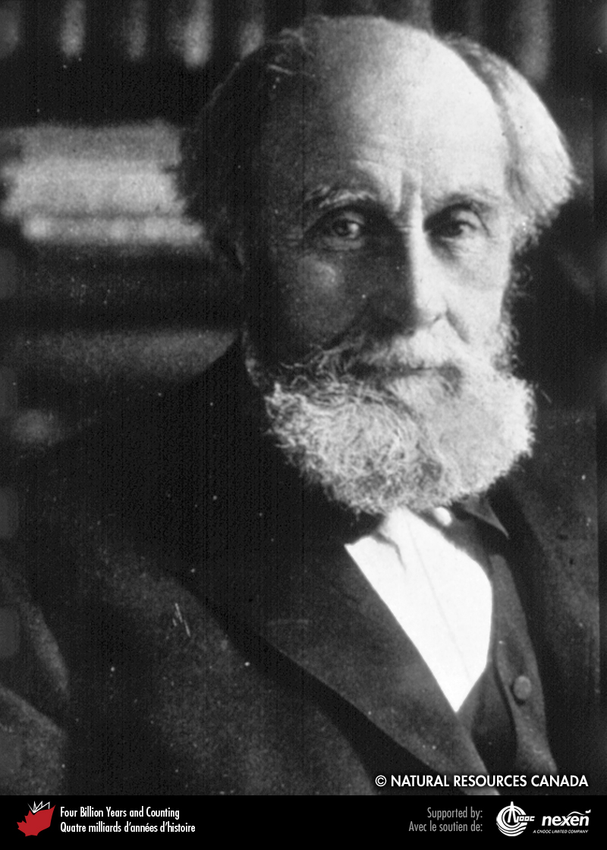
Notes:
J. William Dawson from Pictou, Nova Scotia. Among many illustrious accomplishments, he was one of the first to interpret fossil plants in an ecological context. REPRODUCED WITH THE PERMISSION OF NATURAL RESOURCES CANADA 2013, COURTESY OF THE GEOLOGICAL SURVEY OF CANADA.
_______________________________
All photographic and graphic images (henceforth referred to as images) posted on this site are copyright of the persons and/or institutions indicated in the caption directly associated with each image. The copyright holders have agreed that you may use their images for educational, non-commercial purposes only and provided that they are credited in each instance of use. For all other uses you must contact the copyright holder.

Slide 11
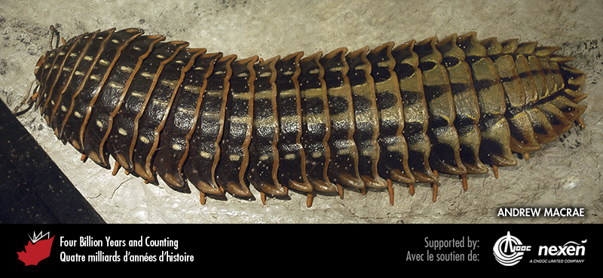
Notes:
Model of Arthropleura, on display at the Fundy Geological Museum, Parrsboro, Nova Scotia. ANDREW MACRAE, SPECIMEN COURTESY OF THE FUNDY GEOLOGICAL MUSEUM.
_______________________________
All photographic and graphic images (henceforth referred to as images) posted on this site are copyright of the persons and/or institutions indicated in the caption directly associated with each image. The copyright holders have agreed that you may use their images for educational, non-commercial purposes only and provided that they are credited in each instance of use. For all other uses you must contact the copyright holder.

Slide 12
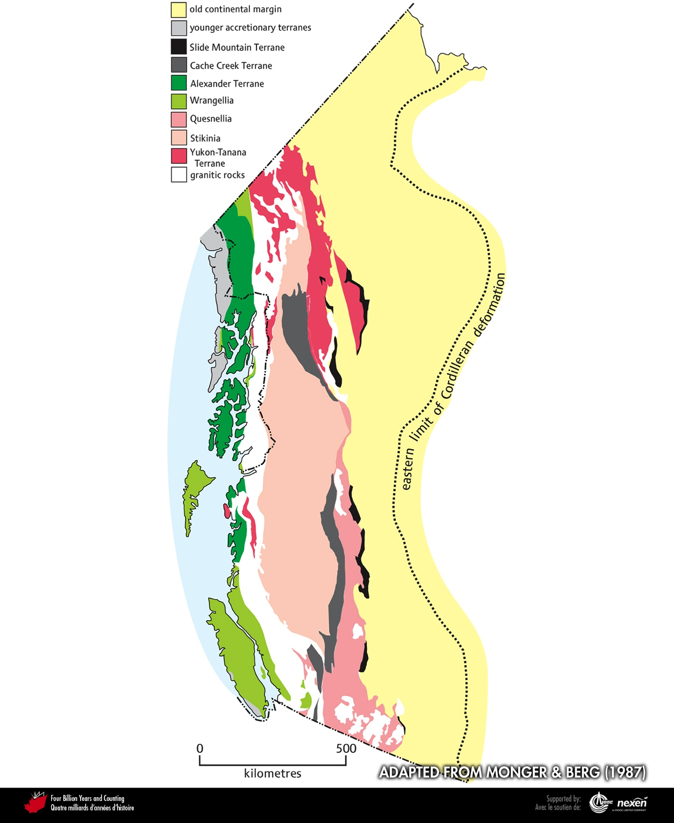
Notes:
The present-day Cordilleran collage of terranes. ADAPTED FROM MONGER AND BERG (1987), COURTESY OF THE US GEOLOGICAL SURVEY.
_______________________________
All photographic and graphic images (henceforth referred to as images) posted on this site are copyright of the persons and/or institutions indicated in the caption directly associated with each image. The copyright holders have agreed that you may use their images for educational, non-commercial purposes only and provided that they are credited in each instance of use. For all other uses you must contact the copyright holder.

Slide 13
Notes:
This road cut in Cache Creek, British Columbia, exposes jumbled rocks of the Cache Creek Terrane. JIM MONGER.
_______________________________
All photographic and graphic images (henceforth referred to as images) posted on this site are copyright of the persons and/or institutions indicated in the caption directly associated with each image. The copyright holders have agreed that you may use their images for educational, non-commercial purposes only and provided that they are credited in each instance of use. For all other uses you must contact the copyright holder.

Slide 14
Notes:
A 500-metre-high cliff on the north side of Marble Canyon, British Columbia, exposes massive middle Permian to late Triassic carbonate, part of the Cache Creek Terrane. JIM MONGER.
_______________________________
All photographic and graphic images (henceforth referred to as images) posted on this site are copyright of the persons and/or institutions indicated in the caption directly associated with each image. The copyright holders have agreed that you may use their images for educational, non-commercial purposes only and provided that they are credited in each instance of use. For all other uses you must contact the copyright holder.

Slide 15
Notes:
Dark brown oceanic or back-arc-basin rocks of the Slide Mountain Terrane cap a ridge near Cassiar, British Columbia. The rocks have been thrust over light-coloured middle Devonian carbonate deposited on the Euramerican continental margin. MAURICE COLPRON.
_______________________________
All photographic and graphic images (henceforth referred to as images) posted on this site are copyright of the persons and/or institutions indicated in the caption directly associated with each image. The copyright holders have agreed that you may use their images for educational, non-commercial purposes only and provided that they are credited in each instance of use. For all other uses you must contact the copyright holder.

Slide 16
Notes:
Eclogite containing a sliver of blueschist from the Cache Cheek Terrane, near Fort St. James, British Columbia. These distinctive metamorphic rocks result from deep burial in an accretionary complex. MIKE CHURKIN.
_______________________________
All photographic and graphic images (henceforth referred to as images) posted on this site are copyright of the persons and/or institutions indicated in the caption directly associated with each image. The copyright holders have agreed that you may use their images for educational, non-commercial purposes only and provided that they are credited in each instance of use. For all other uses you must contact the copyright holder.

Slide 17
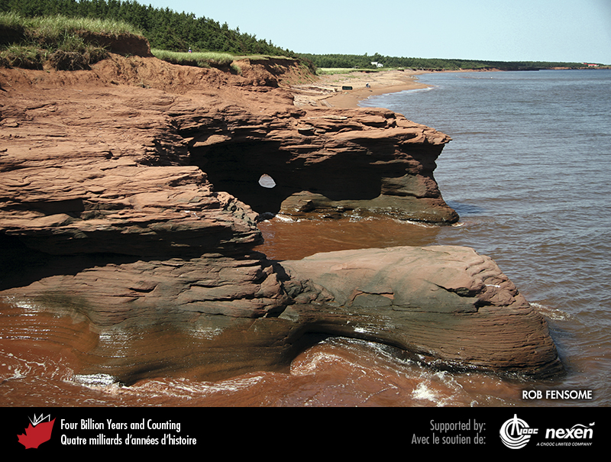
Notes:
At Kildare Capes, Prince Edward Island, red cliffs expose the deposits of Permian rivers that flowed in the region soon after it had crossed into the Northern Hemisphere. ROB FENSOME.
_______________________________
All photographic and graphic images (henceforth referred to as images) posted on this site are copyright of the persons and/or institutions indicated in the caption directly associated with each image. The copyright holders have agreed that you may use their images for educational, non-commercial purposes only and provided that they are credited in each instance of use. For all other uses you must contact the copyright holder.

Slide 18
Notes:
Permian chert in the Otto Fiord area, northwestern Ellesmere Island, Nunavut. BENOIT BEAUCHAMP.
_______________________________
All photographic and graphic images (henceforth referred to as images) posted on this site are copyright of the persons and/or institutions indicated in the caption directly associated with each image. The copyright holders have agreed that you may use their images for educational, non-commercial purposes only and provided that they are credited in each instance of use. For all other uses you must contact the copyright holder.

Slide 19
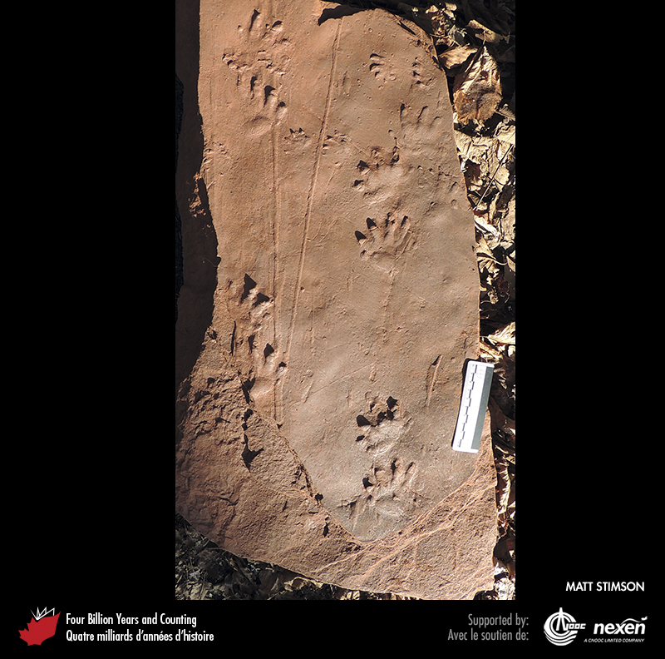
Notes:
The underside of a sandstone block from Lord Selkirk Provincial Park, Prince Edward Island, reveals the trackway of a Permian tetrapod, dating from about 290 million years ago. MATT STIMSON.
_______________________________
All photographic and graphic images (henceforth referred to as images) posted on this site are copyright of the persons and/or institutions indicated in the caption directly associated with each image. The copyright holders have agreed that you may use their images for educational, non-commercial purposes only and provided that they are credited in each instance of use. For all other uses you must contact the copyright holder.

Slide 20
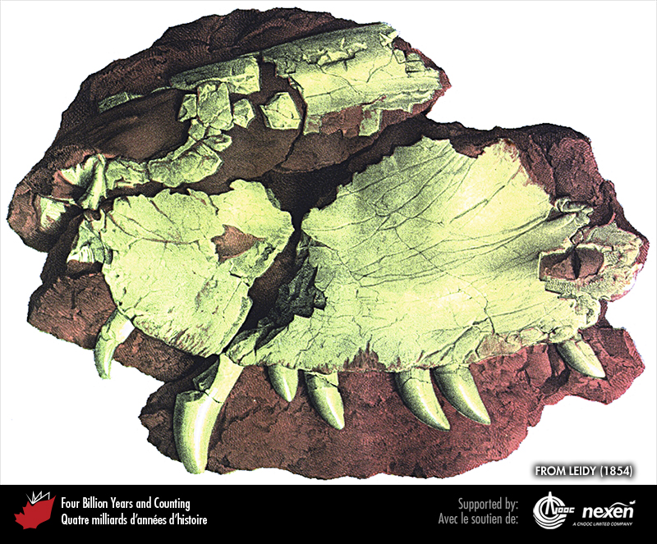
Notes:
A large skull fragment of Bathygnathus found in Permian strata at New London, Prince Edward Island. The specimen was once thought to be Canada’s oldest dinosaur, but it is now known to be a mammal-like reptile. FROM LEIDY (1854), WITH PERMISSION FROM THE ACADEMY OF NATURAL SCIENCES, PHILADELPHIA.
_______________________________
All photographic and graphic images (henceforth referred to as images) posted on this site are copyright of the persons and/or institutions indicated in the caption directly associated with each image. The copyright holders have agreed that you may use their images for educational, non-commercial purposes only and provided that they are credited in each instance of use. For all other uses you must contact the copyright holder.

