Slide 1
BOX 11 Part 1 of 1
All photographic and graphic images (henceforth referred to as images) posted on this site are copyright of the persons and/or institutions indicated in the caption directly associated with each image. The copyright holders have agreed that you may use their images for educational, non-commercial purposes only and provided that they are credited in each instance of use. For all other uses you must contact the copyright holder.

Slide 2
Notes:
Stony meteorite from Peace River, Alberta. ROB FENSOME, SPECIMEN COURTESY OF NATURAL RESOURCES CANADA.
_______________________________
All photographic and graphic images (henceforth referred to as images) posted on this site are copyright of the persons and/or institutions indicated in the caption directly associated with each image. The copyright holders have agreed that you may use their images for educational, non-commercial purposes only and provided that they are credited in each instance of use. For all other uses you must contact the copyright holder.

Slide 3
Notes:
Cut and polished section through a stony-iron meteorite from Springwater, Saskatchewan. ROB FENSOME, SPECIMEN COURTESY OF NATURAL RESOURCES CANADA.
_______________________________
All photographic and graphic images (henceforth referred to as images) posted on this site are copyright of the persons and/or institutions indicated in the caption directly associated with each image. The copyright holders have agreed that you may use their images for educational, non-commercial purposes only and provided that they are credited in each instance of use. For all other uses you must contact the copyright holder.

Slide 4
Notes:
Iron meteorite from Annaheim, Saskatchewan. ROB FENSOME, SPECIMEN COURTESY OF NATURAL RESOURCES CANADA.
_______________________________
All photographic and graphic images (henceforth referred to as images) posted on this site are copyright of the persons and/or institutions indicated in the caption directly associated with each image. The copyright holders have agreed that you may use their images for educational, non-commercial purposes only and provided that they are credited in each instance of use. For all other uses you must contact the copyright holder.

Slide 5
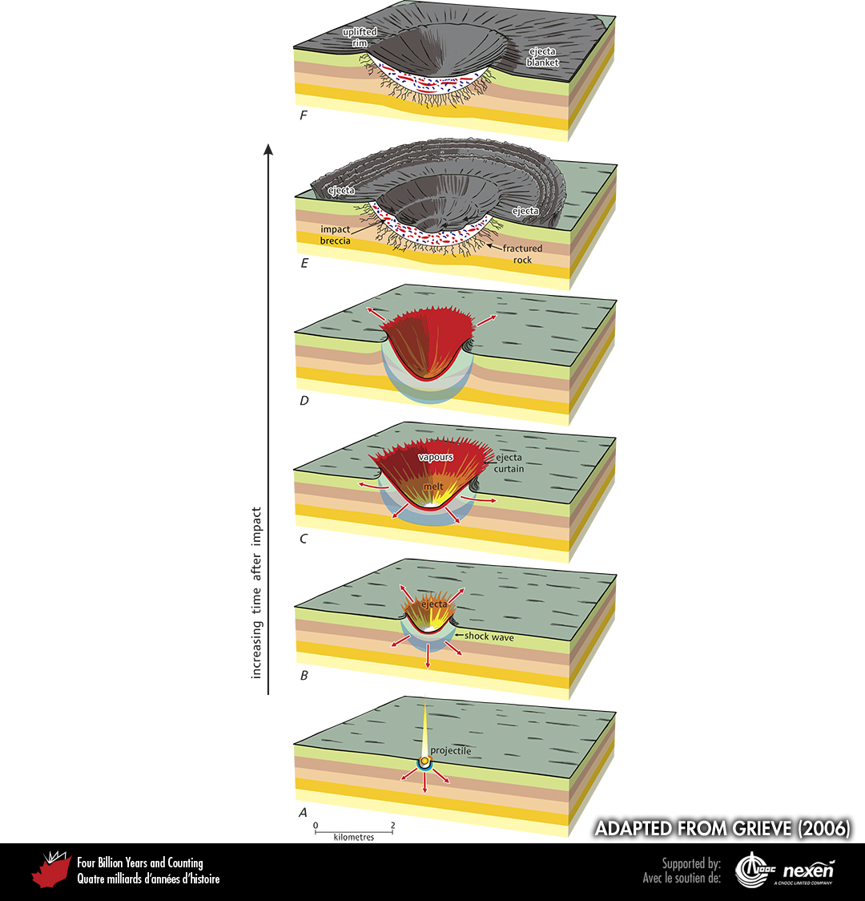
Notes:
Simple terrestrial impact structures, which can be up to 4 kilometres across, are produced by the collision, or impact, of an extraterrestrial projectile with the Earth’s surface. An impact event can be thought of in a series of stages: impact (A), excavation (B–D), and modification (E–F). The collision initiates a shock wave (A). Then excavation (B) starts to form the impact structure. Surface and projectile materials are shot into the air (as ejecta or a curtain of ejecta), vaporized, pulverized, melted, and shocked; some of the ejecta and melted material line the growing cavity (C). At the end of excavation (D), which is when the original bowl-shaped impact structure has reached its maximum size, the walls start to collapse inward (E). This collapse transports impact melt, melt-rich material, and shocked material to form an impact breccia lens (the red and blue blobs represent melt and wall material clasts) over the floor of the impact structure. The ejecta curtain distributes material around the crater (ejecta blanket), and some material may fall back into the crater (F). As the shock wave moves through the rocks, it loses its intensity but forms a zone of fractured rocks below the crater floor (E, F). Materials blasted out of the impact structure during the impact result in an uplifted rim (F). The result of the impact is thus a bowl-shaped depression with a depth about twice that of the apparent depth and about a third of the diameter. Events shown in A–F occur in a matter of seconds. ADAPTED FROM GRIEVE, USED WITH PERMISSION OF THE AUTHORS AND THE GEOLOGICAL ASSOCIATION OF CANADA.
_______________________________
All photographic and graphic images (henceforth referred to as images) posted on this site are copyright of the persons and/or institutions indicated in the caption directly associated with each image. The copyright holders have agreed that you may use their images for educational, non-commercial purposes only and provided that they are credited in each instance of use. For all other uses you must contact the copyright holder.

Slide 6
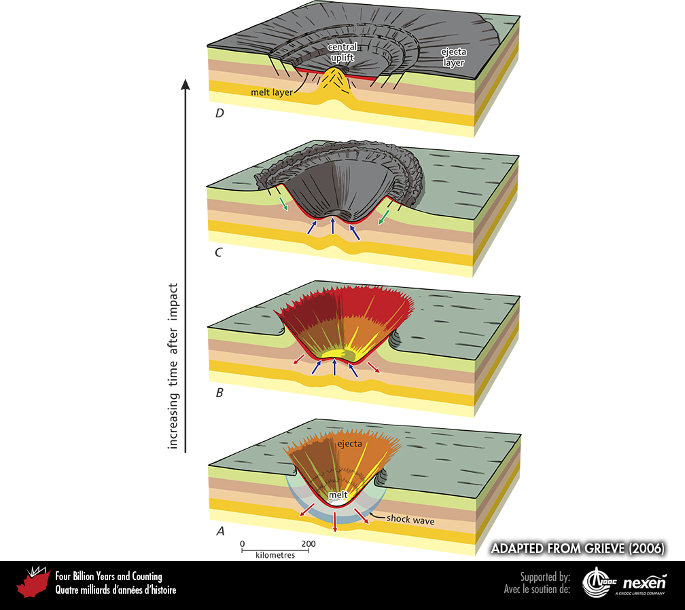
Notes:
Complex terrestrial impact structures, which range from 3 to hundreds of kilometres in diameter, take from seconds to minutes to develop, longer than their simple counterparts, although the stages of development are similar: impact (A), excavation (B), and modification (C–D). After the impact, the shock wave propagates into the rocks below (red arrows) and excavation of the impact structure results in surface and projectile material being blown into the air (as ejecta or a curtain of ejecta), vaporized, pulverized, melted, and shocked (A). After excavation ends, an initially deep central portion of the depression starts to rise (blue arrows) while the cavity continues to broaden (B). The central uplift continues to grow, accompanied by downward and inward collapse of the cavity walls (C —green arrows). The impact structure and surrounding area, perhaps tens of kilometres across, are unstable and must adjust via large fractures (C, D). In its final form (D), which may take many years to attain, the impact structure has a flat floor, structurally faulted rim terraces, a moat-like trough, and a central uplift that may stand up as a central peak. Ejecta are distributed on top of and around the structure as a layer. The depth-to-diameter ratio is variable but less than for simple impact structures; it decreases with increasing diameter. Flooring the structure are fractured and shocked rocks, breccia deposits, and melt rocks, which may also radiate outward from the structure as dykes. Depending on its thickness, the impact melt layer may take hundreds to millions of years to fully crystallize. ADAPTED FROM GRIEVE (2006), USED WITH PERMISSION OF THE AUTHORS AND THE
GEOLOGICAL ASSOCIATION OF CANADA.
______________________________
All photographic and graphic images (henceforth referred to as images) posted on this site are copyright of the persons and/or institutions indicated in the caption directly associated with each image. The copyright holders have agreed that you may use their images for educational, non-commercial purposes only and provided that they are credited in each instance of use. For all other uses you must contact the copyright holder.

Slide 7
Notes:
Aerial view of a gorge exposing tilted and faulted Cambrian dolostone in the centre of the Prince Albert impact structure, northwestern Victoria Island, Northwest Territories. The strata were uplifted and tilted immediately after the impact. All the overlying broken and melted rock and the crater itself have been eroded away. BRIAN PRATT.
_______________________________
All photographic and graphic images (henceforth referred to as images) posted on this site are copyright of the persons and/or institutions indicated in the caption directly associated with each image. The copyright holders have agreed that you may use their images for educational, non-commercial purposes only and provided that they are credited in each instance of use. For all other uses you must contact the copyright holder.

Slide 8
Notes:
Arrays of shatter cones, produced by the meteorite that formed the Prince Albert impact crater, northwestern Victoria Island, Northwest Territories. BRIAN PRATT.
_______________________________
All photographic and graphic images (henceforth referred to as images) posted on this site are copyright of the persons and/or institutions indicated in the caption directly associated with each image. The copyright holders have agreed that you may use their images for educational, non-commercial purposes only and provided that they are credited in each instance of use. For all other uses you must contact the copyright holder.

Slide 9
Notes:
The light-coloured quartz crystal shows features such as fractures and bubble trains produced by the Charlevoix, Quebec, impact event. The field of view is about 2 millimetres across. ANN THERRIAULT.
_______________________________
All photographic and graphic images (henceforth referred to as images) posted on this site are copyright of the persons and/or institutions indicated in the caption directly associated with each image. The copyright holders have agreed that you may use their images for educational, non-commercial purposes only and provided that they are credited in each instance of use. For all other uses you must contact the copyright holder.

Slide 10
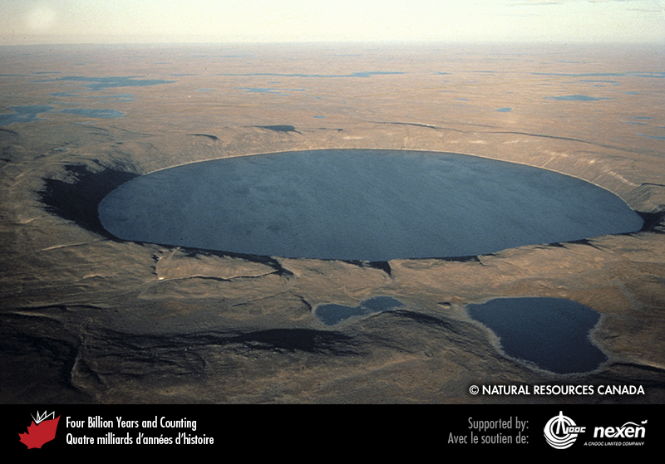
Notes:
Pingualuit Crater in northern Quebec is an impact structure almost 3.5 kilometres in diameter, now occupied by a lake over 250 metres deep. Estimated to be about 1.4 million years old, this is the youngest-known impact structure in Canada, and is excavated into 2,700-to-2,800-million-year-old gneisses of the Superior Craton. REPRODUCED WITH THE PERMISSION OF NATURAL RESOURCES CANADA 2013, COURTESY OF THE GEOLOGICAL SURVEY OF CANADA.
_______________________________
All photographic and graphic images (henceforth referred to as images) posted on this site are copyright of the persons and/or institutions indicated in the caption directly associated with each image. The copyright holders have agreed that you may use their images for educational, non-commercial purposes only and provided that they are credited in each instance of use. For all other uses you must contact the copyright holder.

Slide 11
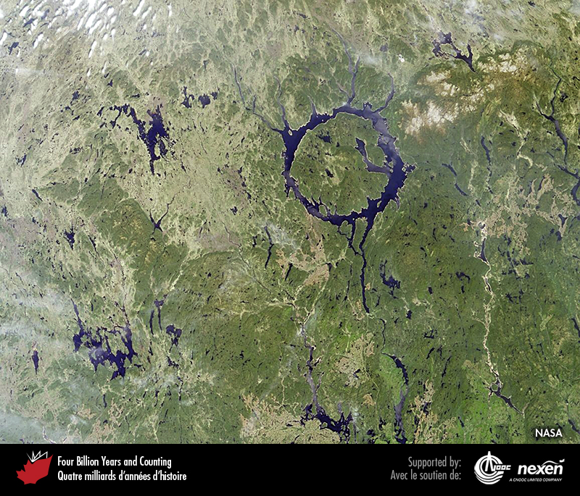
Notes:
Manicouagan impact structure, northern Quebec. COURTESY OF NASA.
_______________________________
All photographic and graphic images (henceforth referred to as images) posted on this site are copyright of the persons and/or institutions indicated in the caption directly associated with each image. The copyright holders have agreed that you may use their images for educational, non-commercial purposes only and provided that they are credited in each instance of use. For all other uses you must contact the copyright holder.

Slide 12
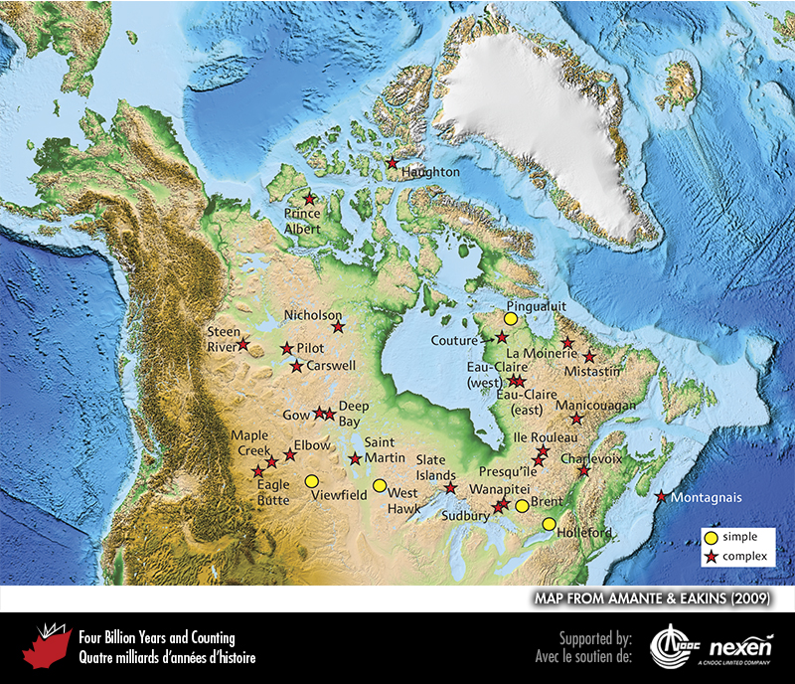
Notes:
Map showing the distribution of impact structures in Canada. BASE MAP FROM AMANTE AND EAKINS (2009).
_______________________________
All photographic and graphic images (henceforth referred to as images) posted on this site are copyright of the persons and/or institutions indicated in the caption directly associated with each image. The copyright holders have agreed that you may use their images for educational, non-commercial purposes only and provided that they are credited in each instance of use. For all other uses you must contact the copyright holder.

