Slide 1
CHAPTER 13 Part 2 of 2
All photographic and graphic images (henceforth referred to as images) posted on this site are copyright of the persons and/or institutions indicated in the caption directly associated with each image. The copyright holders have agreed that you may use their images for educational, non-commercial purposes only and provided that they are credited in each instance of use. For all other uses you must contact the copyright holder.

Slide 2
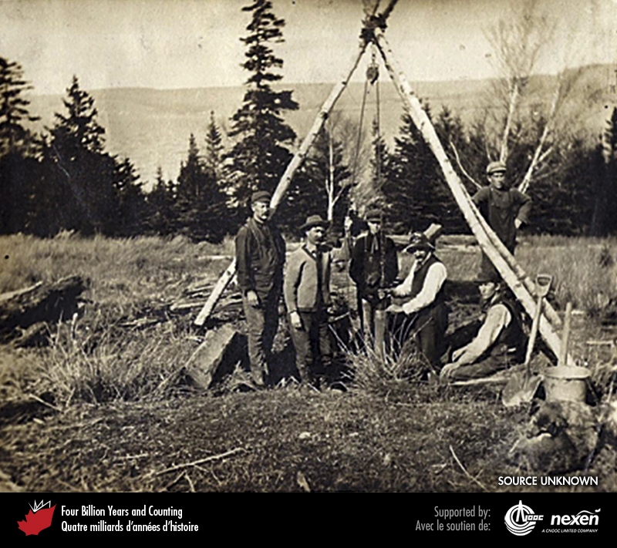
Notes:
Oil well at Lake Ainslie on Cape Breton Island around 1913. PROVIDED BY GRANT WACH, SOURCE UNKNOWN.
_______________________________
All photographic and graphic images (henceforth referred to as images) posted on this site are copyright of the persons and/or institutions indicated in the caption directly associated with each image. The copyright holders have agreed that you may use their images for educational, non-commercial purposes only and provided that they are credited in each instance of use. For all other uses you must contact the copyright holder.

Slide 3
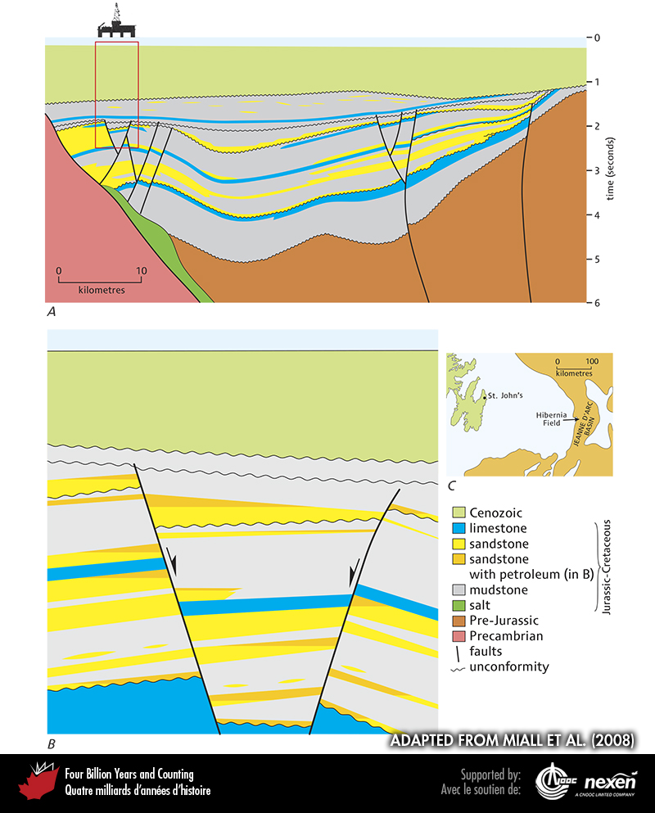
Notes:
A. Generalized section across the Jeanne d’Arc Basin on the Grand Banks off Newfoundland, in which there are several oil fields, including Hibernia. B. Detail of the Hibernia Oil Field (as approximately shown in red in A); the geology in B is idealized and so does not exactly match that shown in A as the sections are slightly offset. The vertical scale represents the time it takes for seismic waves to travel down to a particular surface, then back up again to the recording instrument. ADAPTED FROM MIALL ET AL. (2008), WITH HELP FROM MICHAEL ENACHESCU.
_______________________________
All photographic and graphic images (henceforth referred to as images) posted on this site are copyright of the persons and/or institutions indicated in the caption directly associated with each image. The copyright holders have agreed that you may use their images for educational, non-commercial purposes only and provided that they are credited in each instance of use. For all other uses you must contact the copyright holder.

Slide 4
Notes:
Semi-submersible rig in the foreground and jack-up rig in the background, Halifax Harbour, Nova Scotia. KEITH VAUGHAN.
_______________________________
All photographic and graphic images (henceforth referred to as images) posted on this site are copyright of the persons and/or institutions indicated in the caption directly associated with each image. The copyright holders have agreed that you may use their images for educational, non-commercial purposes only and provided that they are credited in each instance of use. For all other uses you must contact the copyright holder.

Slide 5
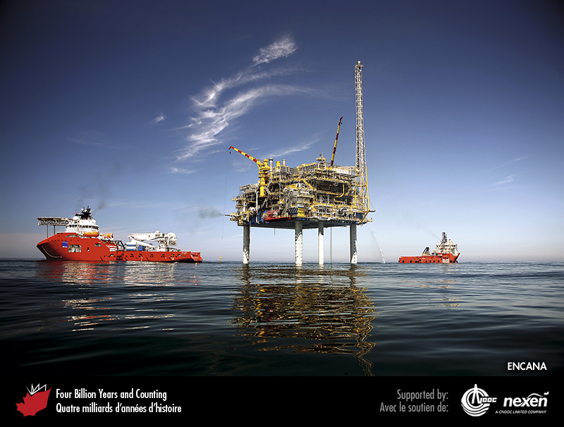
Notes:
The Deep Panuke Platform off Nova Scotia. COURTESY OF ENCANA.
_______________________________
All photographic and graphic images (henceforth referred to as images) posted on this site are copyright of the persons and/or institutions indicated in the caption directly associated with each image. The copyright holders have agreed that you may use their images for educational, non-commercial purposes only and provided that they are credited in each instance of use. For all other uses you must contact the copyright holder.

Slide 6
Notes:
Remnants of a 4-inch (10.5-centimetre) diameter pipeline laid during the Canol Project in the 1940s, near Norman Wells, Northwest Territories. HANS WIELENS.
_______________________________
All photographic and graphic images (henceforth referred to as images) posted on this site are copyright of the persons and/or institutions indicated in the caption directly associated with each image. The copyright holders have agreed that you may use their images for educational, non-commercial purposes only and provided that they are credited in each instance of use. For all other uses you must contact the copyright holder.

Slide 7
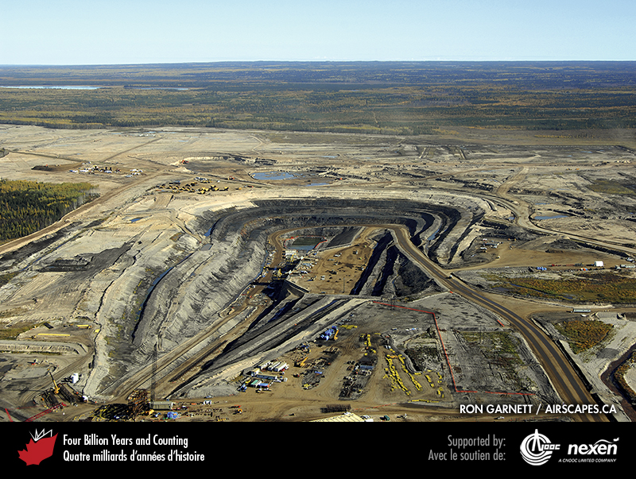
Notes:
Jackpine Mine oil sands operation, about 110 kilometres north of Fort McMurray, Alberta. RON GARNETT / AIRSCAPES.CA.
_______________________________
All photographic and graphic images (henceforth referred to as images) posted on this site are copyright of the persons and/or institutions indicated in the caption directly associated with each image. The copyright holders have agreed that you may use their images for educational, non-commercial purposes only and provided that they are credited in each instance of use. For all other uses you must contact the copyright holder.

Slide 8
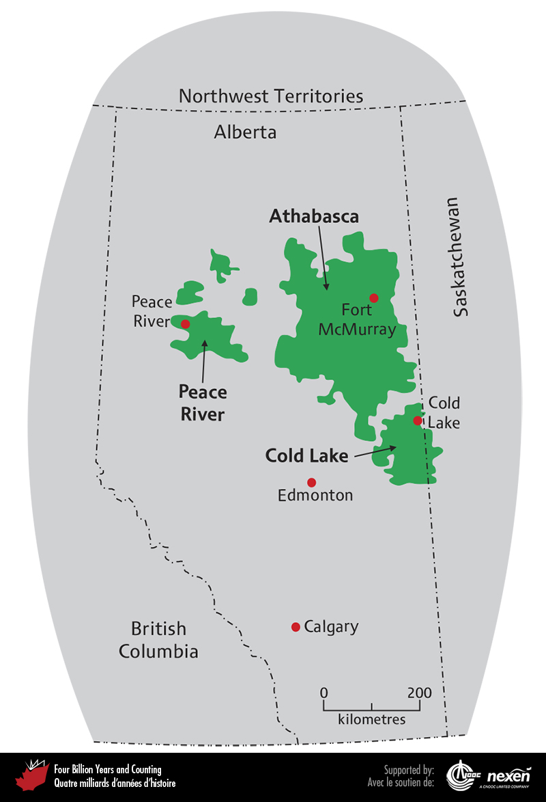
Notes:
Location of the three major oil-sands deposits: Athabasca, Cold Lake, and Peace River. ADAPTED FROM VARIOUS SOURCES.
_______________________________
All photographic and graphic images (henceforth referred to as images) posted on this site are copyright of the persons and/or institutions indicated in the caption directly associated with each image. The copyright holders have agreed that you may use their images for educational, non-commercial purposes only and provided that they are credited in each instance of use. For all other uses you must contact the copyright holder.

Slide 9
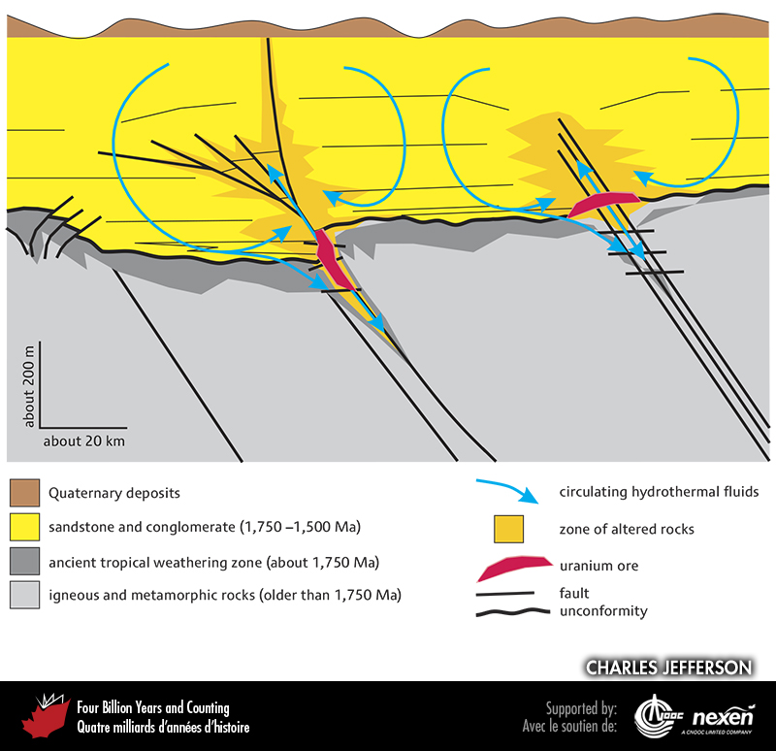
Notes:
A simplified model of uranium deposits associated with unconformities in the Athabasca Basin of northern Saskatchewan and Alberta. Arrows show the interpreted paths of hydrothermal fluids that dissolved and carried the uranium to the deposit site. The hot waters also altered the surrounding rocks, providing clues to the discovery of these deposits. Hot water flow was driven by temperature differences (convection) and by repeated movements along the faults.
_______________________________
All photographic and graphic images (henceforth referred to as images) posted on this site are copyright of the persons and/or institutions indicated in the caption directly associated with each image. The copyright holders have agreed that you may use their images for educational, non-commercial purposes only and provided that they are credited in each instance of use. For all other uses you must contact the copyright holder.

Slide 10
Notes:
Headframes at the Cigar Lake Mine, a uranium mine in northern Saskatchewan. CHARLES JEFFERSON.
_______________________________
All photographic and graphic images (henceforth referred to as images) posted on this site are copyright of the persons and/or institutions indicated in the caption directly associated with each image. The copyright holders have agreed that you may use their images for educational, non-commercial purposes only and provided that they are credited in each instance of use. For all other uses you must contact the copyright holder.

Slide 11
Notes:
Sue C open uranium pit at the McClean Lake Mine, just west of Wollaston Lake, northern Saskatchewan. CHARLES JEFFERSON.
_______________________________
All photographic and graphic images (henceforth referred to as images) posted on this site are copyright of the persons and/or institutions indicated in the caption directly associated with each image. The copyright holders have agreed that you may use their images for educational, non-commercial purposes only and provided that they are credited in each instance of use. For all other uses you must contact the copyright holder.

Slide 12
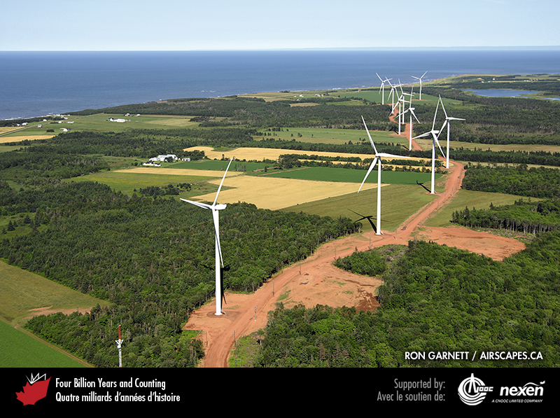
Notes:
Powering with wind, the modern way: wind turbines at North Cape, Prince Edward Island. RON GARNETT / AIRSCAPES.CA.
_______________________________
All photographic and graphic images (henceforth referred to as images) posted on this site are copyright of the persons and/or institutions indicated in the caption directly associated with each image. The copyright holders have agreed that you may use their images for educational, non-commercial purposes only and provided that they are credited in each instance of use. For all other uses you must contact the copyright holder.

Slide 13
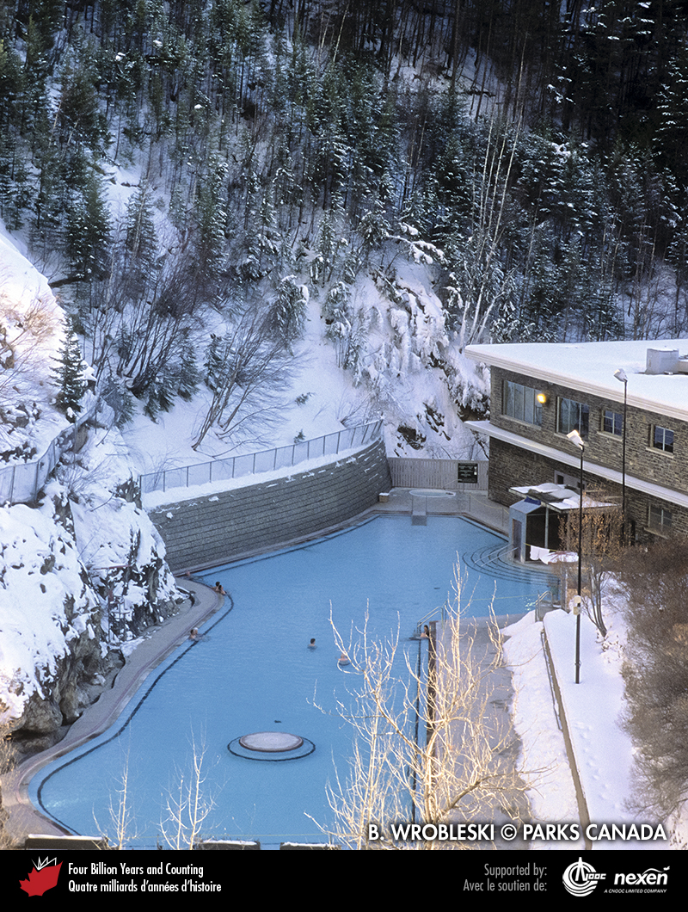
Notes:
The pool at Radium Hot Springs, Kootenay National Park of Canada, British Columbia, is heated to 39°C by geothermal energy; the water moves upward to the surface along a fault. B. WROBLESKI, COPYRIGHT PARKS CANADA.
_______________________________
All photographic and graphic images (henceforth referred to as images) posted on this site are copyright of the persons and/or institutions indicated in the caption directly associated with each image. The copyright holders have agreed that you may use their images for educational, non-commercial purposes only and provided that they are credited in each instance of use. For all other uses you must contact the copyright holder.

