Slide 1
CHAPTER 2
Part 1 of 2
All photographic and graphic images (henceforth referred to as images) posted on this site are copyright of the persons and/or institutions indicated in the caption directly associated with each image. The copyright holders have agreed that you may use their images for educational, non-commercial purposes only and provided that they are credited in each instance of use. For all other uses you must contact the copyright holder.

Slide 2
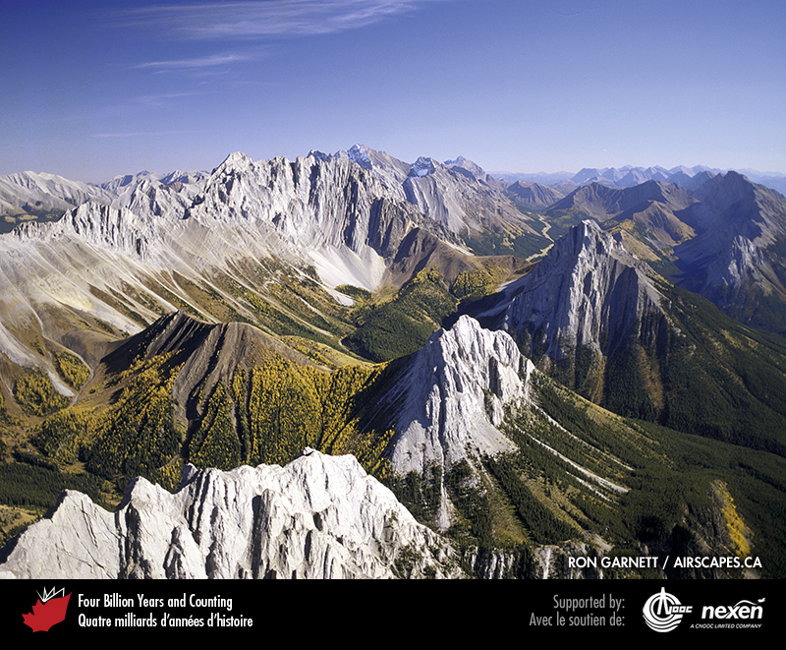
Notes:
Without tectonic forces within the Earth’s lithosphere we would not have magnificent mountain ranges such as the Rockies. This is a view of the Kananaskis Country of southwestern Alberta. RON GARNETT / AIRSCAPES.CA.
_______________________________
All photographic and graphic images (henceforth referred to as images) posted on this site are copyright of the persons and/or institutions indicated in the caption directly associated with each image. The copyright holders have agreed that you may use their images for educational, non-commercial purposes only and provided that they are credited in each instance of use. For all other uses you must contact the copyright holder.

Slide 3
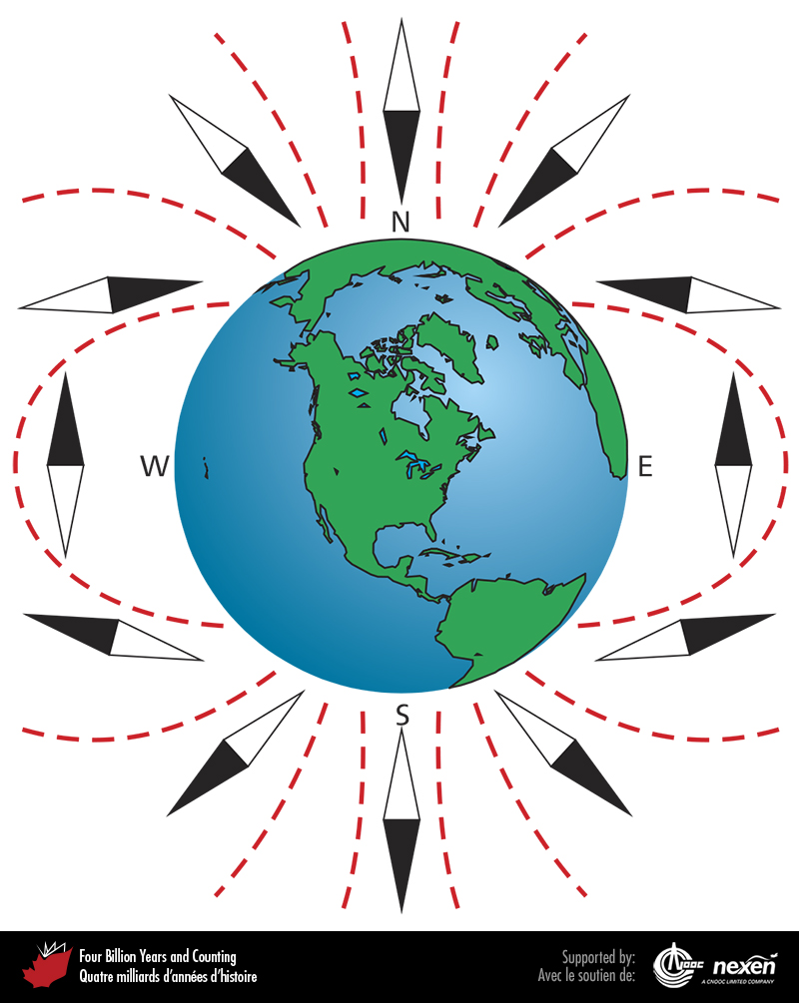
Notes:
A compass works because in all magnetic fields, including that of the Earth, electrons flow from one magnetic pole to the other, causing the needle to point toward the magnetic north. The Earth’s magnetic field also shows varying degrees of inclination to the ground depending on latitude. As shown here, a free-standing compass needle will point vertically at the magnetic poles and parallel to the ground at the Equator, with gradations in between. An analysis of a rock’s magnetic signature, frozen-in at the time of formation, thus indicates the approximate latitude at which the rock originated.
_______________________________
All photographic and graphic images (henceforth referred to as images) posted on this site are copyright of the persons and/or institutions indicated in the caption directly associated with each image. The copyright holders have agreed that you may use their images for educational, non-commercial purposes only and provided that they are credited in each instance of use. For all other uses you must contact the copyright holder.

Slide 4
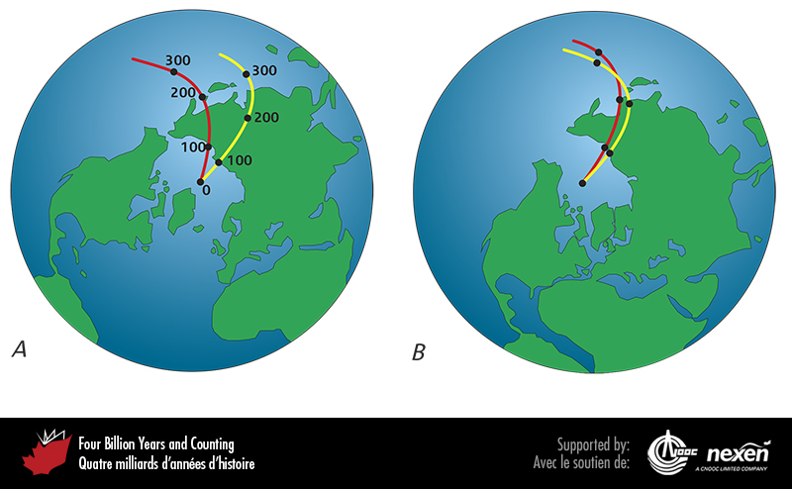
Notes:
A shows apparent polar-wandering curves for two continents, plotted on a present-day map. The curves were determined by measuring magnetic inclinations from different-aged rocks in each continent. The numbers refer to ages in millions of years. Because only one magnetic north pole can exist at any one time, the fact that two curves result from plotting such data is strong evidence for continental drift. When the curves are drawn together and the continents “pulled” with them, as in B, we can reconstruct what the Earth’s geography looked like before the Atlantic Ocean opened. Adapted from various sources.
_______________________________
All photographic and graphic images (henceforth referred to as images) posted on this site are copyright of the persons and/or institutions indicated in the caption directly associated with each image. The copyright holders have agreed that you may use their images for educational, non-commercial purposes only and provided that they are credited in each instance of use. For all other uses you must contact the copyright holder.

Slide 5
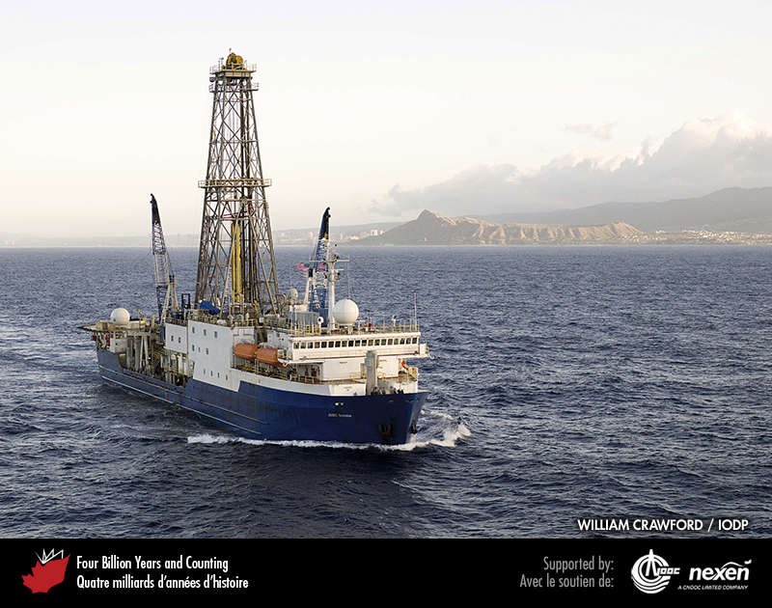
Notes:
The JOIDES Resolution, which was built in Halifax, Nova Scotia, departs Honolulu on May 9, 2009. The JOIDES Resolution is one of several ships dedicated to exploring the geology of the oceans. WILLIAM CRAWFORD, COURTESY OF THE INTEGRATED OCEAN DRILLING PROGRAM US IMPLEMENTING ORGANIZATION.
_______________________________
All photographic and graphic images (henceforth referred to as images) posted on this site are copyright of the persons and/or institutions indicated in the caption directly associated with each image. The copyright holders have agreed that you may use their images for educational, non-commercial purposes only and provided that they are credited in each instance of use. For all other uses you must contact the copyright holder.

Slide 6
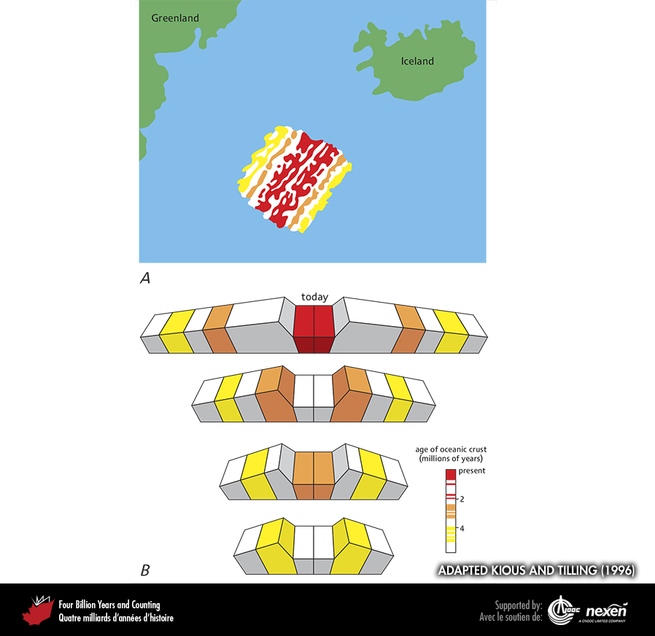
Notes:
A shows magnetic anomalies on the Mid-Atlantic Ridge southwest of Iceland. B shows an idealized series of cross sections representing stages in the development of the pattern of anomalies shown in A. Adapted from Jane Russell in Kious and Tilling (1996), with permission from the US Department of the Interior (USGS).
_______________________________
All photographic and graphic images (henceforth referred to as images) posted on this site are copyright of the persons and/or institutions indicated in the caption directly associated with each image. The copyright holders have agreed that you may use their images for educational, non-commercial purposes only and provided that they are credited in each instance of use. For all other uses you must contact the copyright holder.

Slide 7
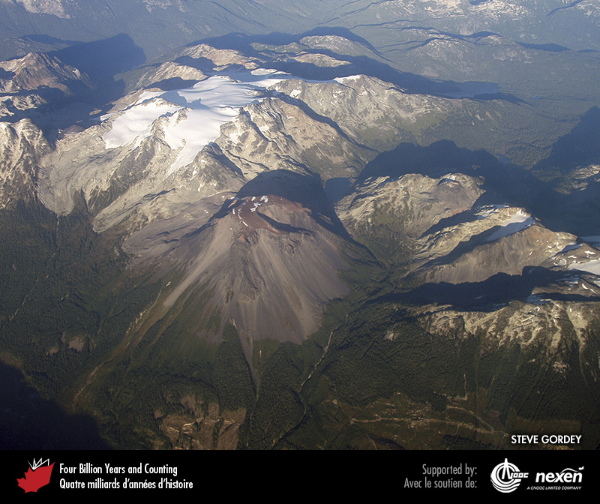
Notes:
Ring Mountain, British Columbia, a subglacial volcano known as a tuya (see Chapter 11) that was active sometime during the past 2.5 million years. This mountain is one of the volcanoes forming the Cascade Range, a continental magmatic arc above the Cascadia Subduction Zone. STEVE GORDEY.
_______________________________
All photographic and graphic images (henceforth referred to as images) posted on this site are copyright of the persons and/or institutions indicated in the caption directly associated with each image. The copyright holders have agreed that you may use their images for educational, non-commercial purposes only and provided that they are credited in each instance of use. For all other uses you must contact the copyright holder.

Slide 8
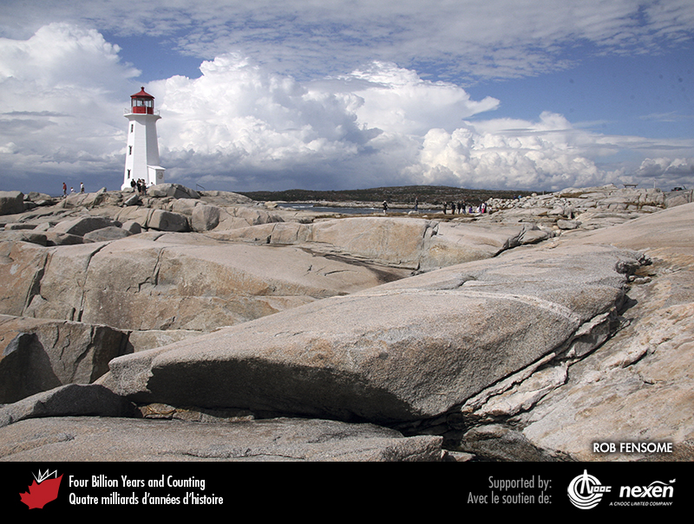
Notes:
This 375-million-year-old granite at Peggys Cove, Nova Scotia, is associated with the closing of the long-lost Rheic Ocean (Chapter 8). ROB FENSOME.
_______________________________
All photographic and graphic images (henceforth referred to as images) posted on this site are copyright of the persons and/or institutions indicated in the caption directly associated with each image. The copyright holders have agreed that you may use their images for educational, non-commercial purposes only and provided that they are credited in each instance of use. For all other uses you must contact the copyright holder.

Slide 9
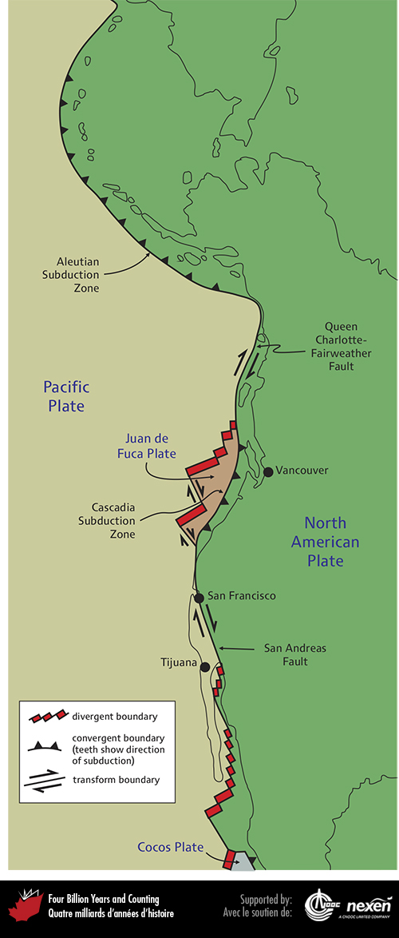
Notes:
The composite nature of the western boundary of the North American Plate, showing plates and plate boundaries. Adapted from various sources.
_______________________________
All photographic and graphic images (henceforth referred to as images) posted on this site are copyright of the persons and/or institutions indicated in the caption directly associated with each image. The copyright holders have agreed that you may use their images for educational, non-commercial purposes only and provided that they are credited in each instance of use. For all other uses you must contact the copyright holder.

Slide 10
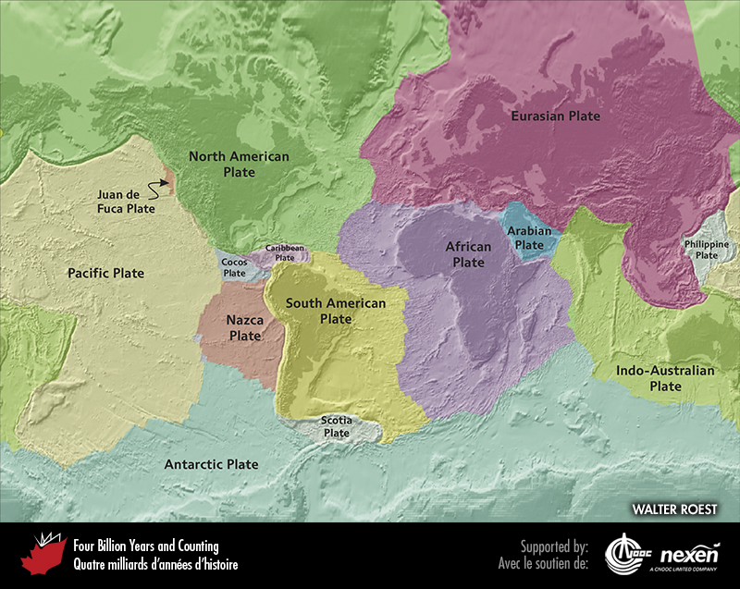
Notes:
The present global distribution of tectonic plates. WALTER ROEST.
_______________________________
All photographic and graphic images (henceforth referred to as images) posted on this site are copyright of the persons and/or institutions indicated in the caption directly associated with each image. The copyright holders have agreed that you may use their images for educational, non-commercial purposes only and provided that they are credited in each instance of use. For all other uses you must contact the copyright holder.

Slide 11
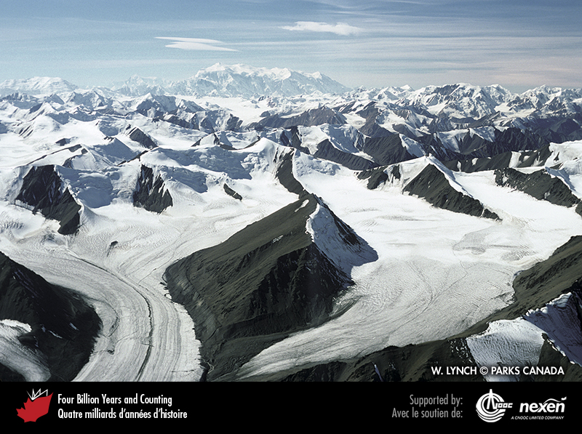
Notes:
Plate tectonics explains the distribution of major physical features on the Earth’s surface, including Canada’s highest mountains in the St. Elias Range of northern British Columbia and Yukon. In the distance is Mount Logan, Canada’s highest peak. W. LYNCH , COPYRIGHT PARKS CANADA.
_______________________________
All photographic and graphic images (henceforth referred to as images) posted on this site are copyright of the persons and/or institutions indicated in the caption directly associated with each image. The copyright holders have agreed that you may use their images for educational, non-commercial purposes only and provided that they are credited in each instance of use. For all other uses you must contact the copyright holder.

Slide 12
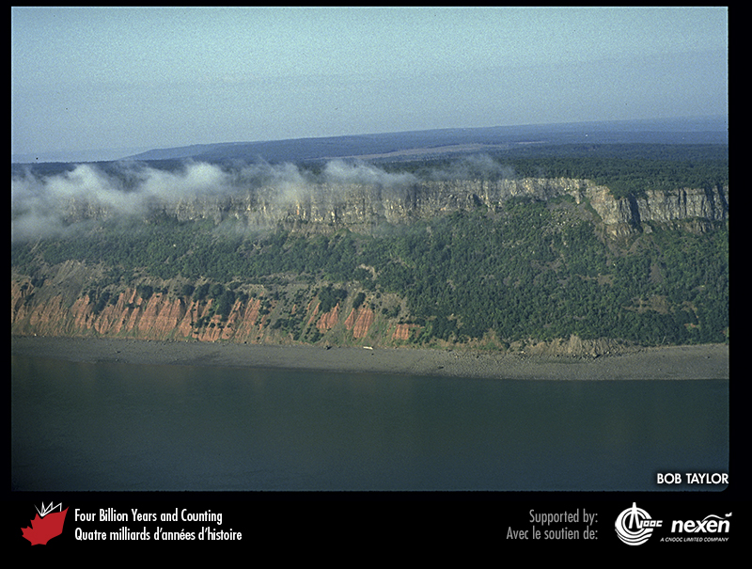
Notes:
Rift basins form when continents begin to break up. The basins become filled with non-marine sediments such as the redbeds in this cliff at Cape Blomidon in Nova Scotia. The overlying darker layers are of basalt similar to that underlying the ocean floors. BOB TAYLOR.
_______________________________
All photographic and graphic images (henceforth referred to as images) posted on this site are copyright of the persons and/or institutions indicated in the caption directly associated with each image. The copyright holders have agreed that you may use their images for educational, non-commercial purposes only and provided that they are credited in each instance of use. For all other uses you must contact the copyright holder.

Slide 13
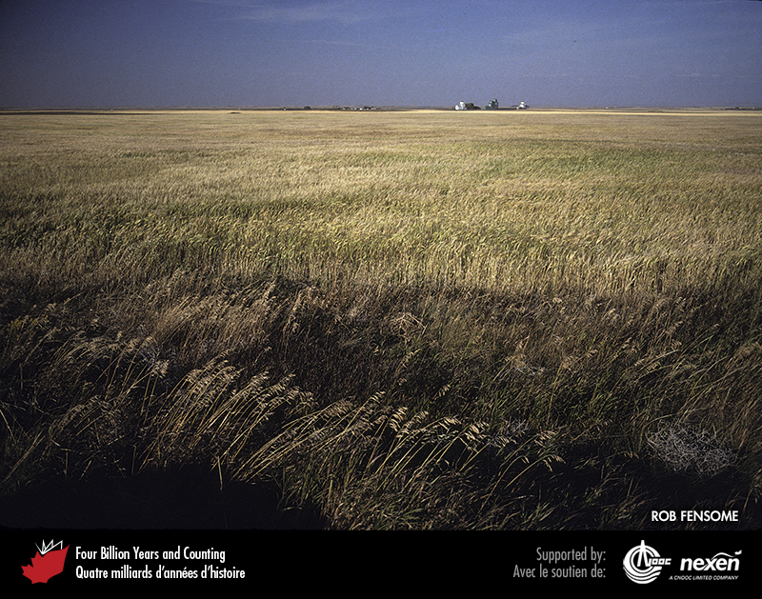
Notes:
Away from plate boundaries, the interiors of continents are dominated by flat to gently rolling landscapes, as here near Foremost, Alberta. ROB FENSOME.
_______________________________
All photographic and graphic images (henceforth referred to as images) posted on this site are copyright of the persons and/or institutions indicated in the caption directly associated with each image. The copyright holders have agreed that you may use their images for educational, non-commercial purposes only and provided that they are credited in each instance of use. For all other uses you must contact the copyright holder.

