Slide 1
CHAPTER 17 Part 2 of 2
All photographic and graphic images (henceforth referred to as images) posted on this site are copyright of the persons and/or institutions indicated in the caption directly associated with each image. The copyright holders have agreed that you may use their images for educational, non-commercial purposes only and provided that they are credited in each instance of use. For all other uses you must contact the copyright holder.

Slide 2
Notes:
Seen here from Saturna Island, British Columbia, Mount Baker in Washington is an active volcano, one of many in the Cascade Magmatic Arc. The Arc extends into southwestern British Columbia and includes mounts Garibaldi and Meager. C. CHEADLE, COPYRIGHT PARKS CANADA.
_______________________________
All photographic and graphic images (henceforth referred to as images) posted on this site are copyright of the persons and/or institutions indicated in the caption directly associated with each image. The copyright holders have agreed that you may use their images for educational, non-commercial purposes only and provided that they are credited in each instance of use. For all other uses you must contact the copyright holder.

Slide 3
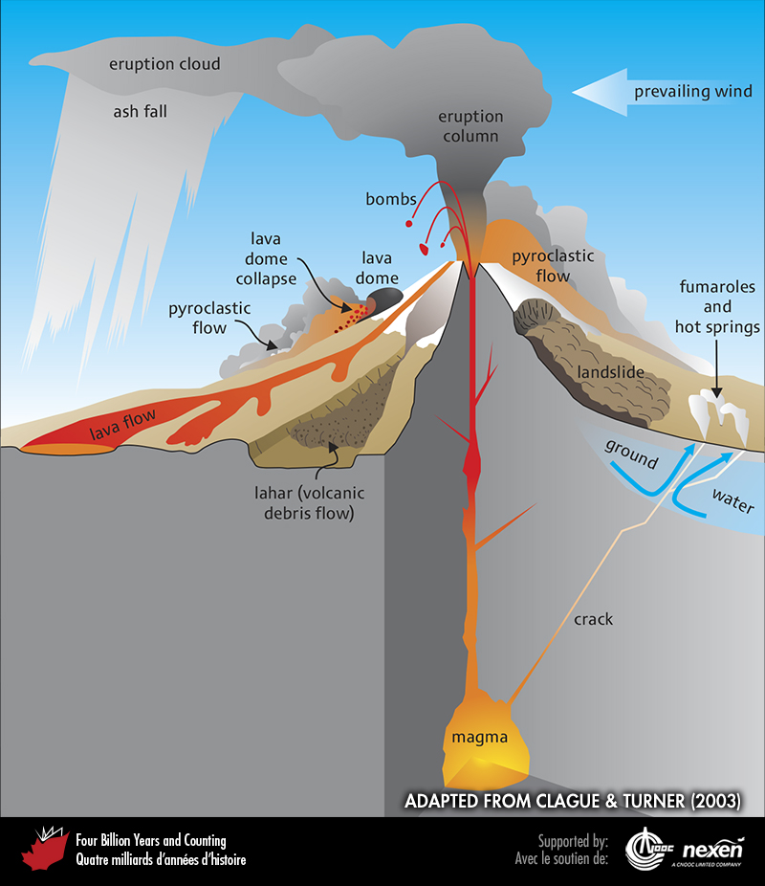
Notes:
Types of hazards associated with explosive eruptions of stratovolcanoes such as Mount Garibaldi and Mount Meager. Fumaroles are surface openings that emit steam and other gases such as sulphur dioxide and carbon dioxide. ADAPTED FROM CLAGUE AND TURNER (2003); USED WITH PERMISSION OF THE AUTHORS AND TRICOUNI PRESS.
_______________________________
All photographic and graphic images (henceforth referred to as images) posted on this site are copyright of the persons and/or institutions indicated in the caption directly associated with each image. The copyright holders have agreed that you may use their images for educational, non-commercial purposes only and provided that they are credited in each instance of use. For all other uses you must contact the copyright holder.

Slide 4
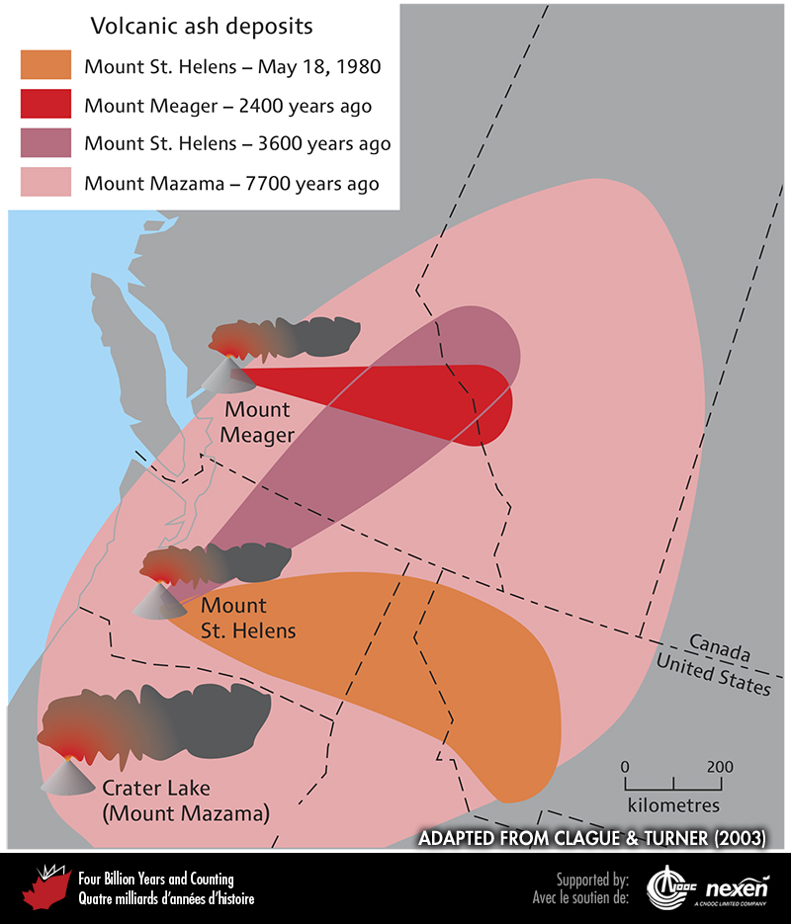
Notes:
Ash deposits associated with selected volcanic eruptions from Cascade volcanoes. The illustration shows only areas where the ash deposits are thick enough to be visible. ADAPTED FROM CLAGUE AND TURNER (2003); USED WITH PERMISSION OF THE AUTHORS AND TRICOUNI PRESS.
_______________________________
All photographic and graphic images (henceforth referred to as images) posted on this site are copyright of the persons and/or institutions indicated in the caption directly associated with each image. The copyright holders have agreed that you may use their images for educational, non-commercial purposes only and provided that they are credited in each instance of use. For all other uses you must contact the copyright holder.

Slide 5
Notes:
Exposed in a road cut along Highway 3 near Keremeos, British Columbia, the white layer is volcanic ash from the eruption of Mount Mazama in Oregon, 7,700 years ago. DALE GREGORY.
_______________________________
All photographic and graphic images (henceforth referred to as images) posted on this site are copyright of the persons and/or institutions indicated in the caption directly associated with each image. The copyright holders have agreed that you may use their images for educational, non-commercial purposes only and provided that they are credited in each instance of use. For all other uses you must contact the copyright holder.

Slide 6
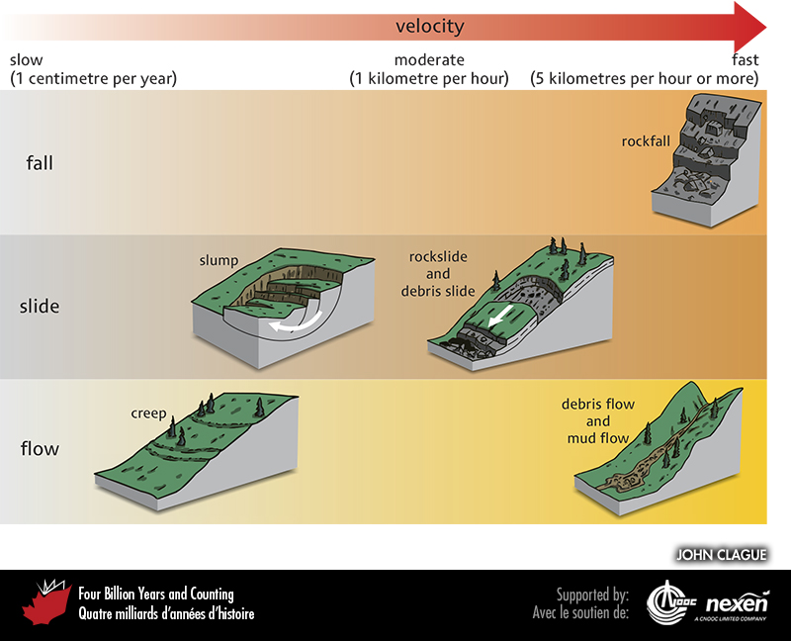
Notes:
Types of landslides. Landslides are classified according to type of movement (fall, slide, or flow); type of material that fails (i.e., rock or unconsolidated sediment); amount of water or air involved in the movement; and velocity.
_______________________________
All photographic and graphic images (henceforth referred to as images) posted on this site are copyright of the persons and/or institutions indicated in the caption directly associated with each image. The copyright holders have agreed that you may use their images for educational, non-commercial purposes only and provided that they are credited in each instance of use. For all other uses you must contact the copyright holder.

Slide 7
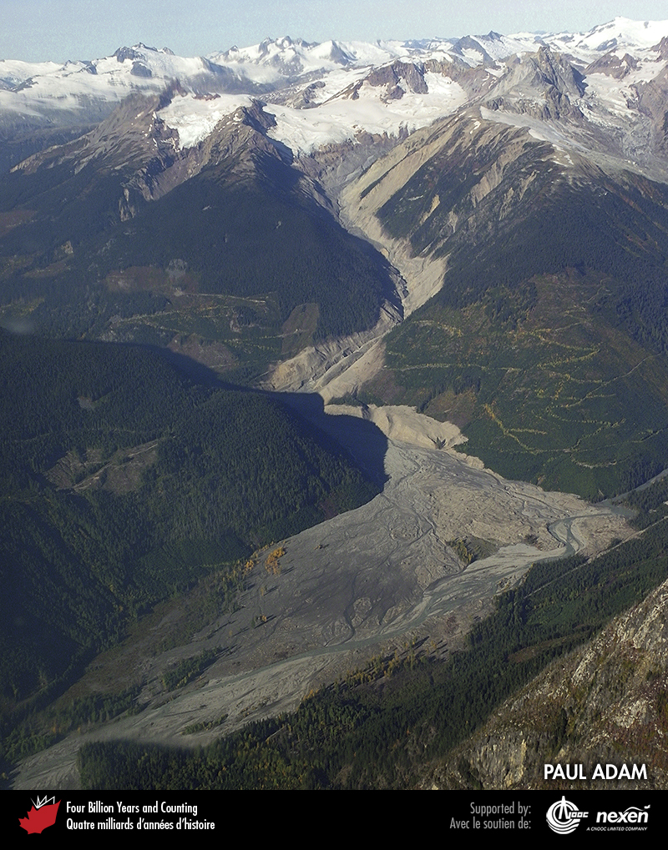
Notes:
Large landslide resulting from the collapse of the south flank of Mount Meager, British Columbia, in August 2010. PAUL ADAM.
_______________________________
All photographic and graphic images (henceforth referred to as images) posted on this site are copyright of the persons and/or institutions indicated in the caption directly associated with each image. The copyright holders have agreed that you may use their images for educational, non-commercial purposes only and provided that they are credited in each instance of use. For all other uses you must contact the copyright holder.

Slide 8
Notes:
Landslide south of Lytton, British Columbia, in March 1997. The landslide severed the Canadian National Railway line, causing a freight train to derail with the loss of two lives. JOHN CLAGUE.
_______________________________
All photographic and graphic images (henceforth referred to as images) posted on this site are copyright of the persons and/or institutions indicated in the caption directly associated with each image. The copyright holders have agreed that you may use their images for educational, non-commercial purposes only and provided that they are credited in each instance of use. For all other uses you must contact the copyright holder.

Slide 9
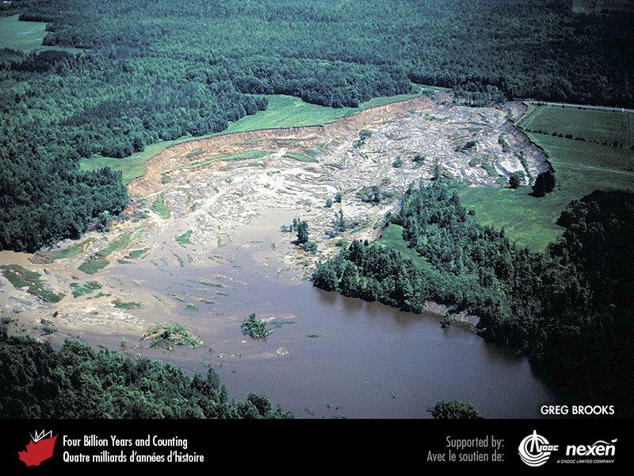
Notes:
The 1993 Lemieux Landslide in the valley of the South Nation River, Ontario. Such landslides resulting from the sudden liquefaction of Leda Clay, a deposit of the Champlain Sea. GREG BROOKS, REPRODUCED WITH THE PERMISSION OF NATURAL RESOURCES CANADA 2013, COURTESY OF THE GEOLOGICAL SURVEY OF CANADA.
_______________________________
All photographic and graphic images (henceforth referred to as images) posted on this site are copyright of the persons and/or institutions indicated in the caption directly associated with each image. The copyright holders have agreed that you may use their images for educational, non-commercial purposes only and provided that they are credited in each instance of use. For all other uses you must contact the copyright holder.

Slide 10
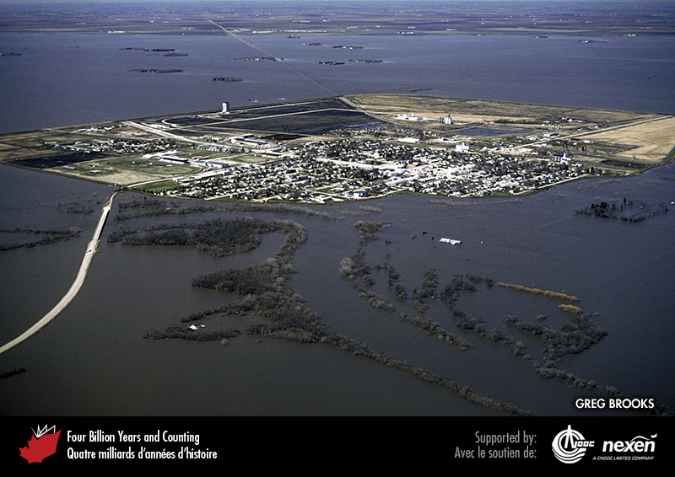
Notes:
The town of Morris, Manitoba, surrounded by floodwaters during the 1997 Red River flood. Although it resembles an island, the ground surface in Morris is lower than the level of the water; a ring dyke around the town prevents it from being inundated. GREG BROOKS.
_______________________________
All photographic and graphic images (henceforth referred to as images) posted on this site are copyright of the persons and/or institutions indicated in the caption directly associated with each image. The copyright holders have agreed that you may use their images for educational, non-commercial purposes only and provided that they are credited in each instance of use. For all other uses you must contact the copyright holder.

Slide 11
Notes:
Flooding in the Lillooet River valley at Pemberton, British Columbia, in October 2003. BRIAN MENOUNOS.
_______________________________
All photographic and graphic images (henceforth referred to as images) posted on this site are copyright of the persons and/or institutions indicated in the caption directly associated with each image. The copyright holders have agreed that you may use their images for educational, non-commercial purposes only and provided that they are credited in each instance of use. For all other uses you must contact the copyright holder.

Slide 12
Notes:
Damage caused by the devastating Saguenay flood in Quebec in July 1996. Waters overflowing the Jonquiere Dam on Riviére aux Sables produced a breach about 20 metres wide within the concrete wing of the dam, thereby lowering the reservoir by several metres. Flood waters also severely damaged the powerhouse immediately downstream. GREG BROOKS.
_______________________________
All photographic and graphic images (henceforth referred to as images) posted on this site are copyright of the persons and/or institutions indicated in the caption directly associated with each image. The copyright holders have agreed that you may use their images for educational, non-commercial purposes only and provided that they are credited in each instance of use. For all other uses you must contact the copyright holder.

