Slide 1
Box 9
All photographic and graphic images (henceforth referred to as images) posted on this site are copyright of the persons and/or institutions indicated in the caption directly associated with each image. The copyright holders have agreed that you may use their images for educational, non-commercial purposes only and provided that they are credited in each instance of use. For all other uses you must contact the copyright holder.

Slide 2
Notes:
Storm over the Bessborough Hotel, Saskatoon, Saskatchewan. ROB FENSOME.
_______________________________
All photographic and graphic images (henceforth referred to as images) posted on this site are copyright of the persons and/or institutions indicated in the caption directly associated with each image. The copyright holders have agreed that you may use their images for educational, non-commercial purposes only and provided that they are credited in each instance of use. For all other uses you must contact the copyright holder.

Slide 3
Notes:
L’Anse aux Meadows, Newfoundland, which was settled by Vikings during the Medieval Warm Period. LYNDA DREDGE.
_______________________________
All photographic and graphic images (henceforth referred to as images) posted on this site are copyright of the persons and/or institutions indicated in the caption directly associated with each image. The copyright holders have agreed that you may use their images for educational, non-commercial purposes only and provided that they are credited in each instance of use. For all other uses you must contact the copyright holder.

Slide 4
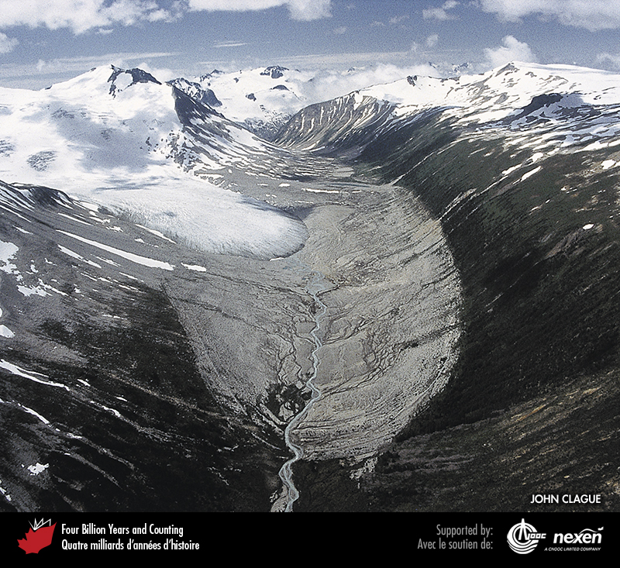
Notes:
In this aerial view of the southern Coast Mountains of British Columbia, the linear break in vegetation (trimline) delineates the margin of the Icemaker Glacier at the end of the nineteenth century. The glacier has thinned and retreated considerably since then. JOHN CLAGUE.
_______________________________
All photographic and graphic images (henceforth referred to as images) posted on this site are copyright of the persons and/or institutions indicated in the caption directly associated with each image. The copyright holders have agreed that you may use their images for educational, non-commercial purposes only and provided that they are credited in each instance of use. For all other uses you must contact the copyright holder.

Slide 5
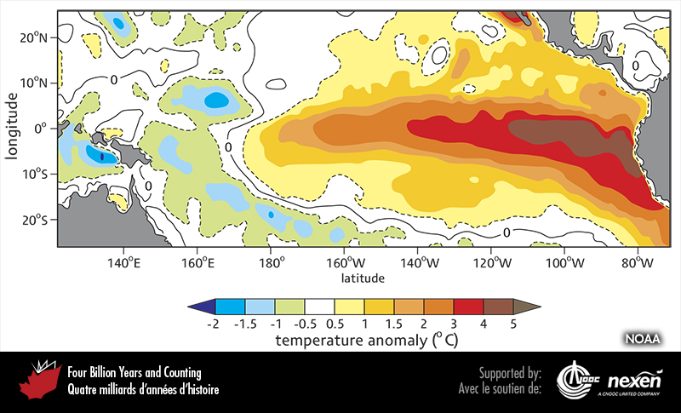
Notes:
Sea-surface temperature anomalies (in degrees Celsius) in the equatorial Pacific during a strong El Nino event (1997–1998) show how temperatures vary from the long-term average temperature. The anomalies are based on a 7-day average around September 17, 1997. The bar beneath the map shows the temperature differences for the 7-day interval compared to long-term averages. Green and blues represent colder water temperatures than average and yellows through reds to browns represent warmer water temperatures than average. COURTESY OF THE US NATIONAL OCEANIC AND ATMOSPHERIC ADMINISTRATION (NOAA), CLIMATE PREDICTION CENTER/NECP/NWS.
_______________________________
All photographic and graphic images (henceforth referred to as images) posted on this site are copyright of the persons and/or institutions indicated in the caption directly associated with each image. The copyright holders have agreed that you may use their images for educational, non-commercial purposes only and provided that they are credited in each instance of use. For all other uses you must contact the copyright holder.

Slide 6
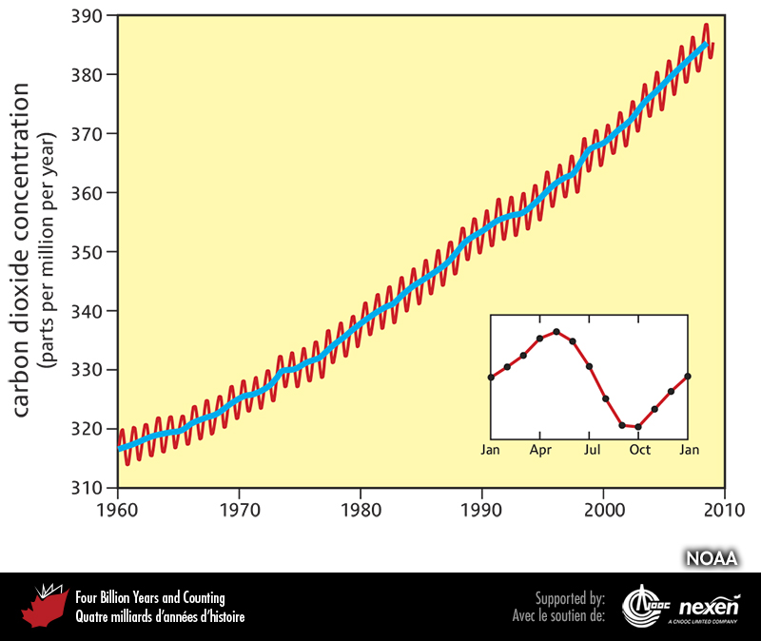
Notes:
Concentrations of atmospheric carbon dioxide for the years 1960 to 2010 at Mauna Loa in Hawaii. The blue line shows the long-term trend; the red line reflects this trend also, but in addition shows shorter-term annual variations. The insert shows the variability in concentrations of atmospheric carbon dioxide during a single year. IMAGE CREATED BY ROBERT ROHDE FROM DATA PUBLISHED BY THE US NATIONAL OCEANIC AND ATMOSPHERIC ADMINISTRATION (NOAA).
_______________________________
All photographic and graphic images (henceforth referred to as images) posted on this site are copyright of the persons and/or institutions indicated in the caption directly associated with each image. The copyright holders have agreed that you may use their images for educational, non-commercial purposes only and provided that they are credited in each instance of use. For all other uses you must contact the copyright holder.

Slide 7
Notes:
Storm waves pounding the shore of West Vancouver, British Columbia. BOB TURNER.
_______________________________
All photographic and graphic images (henceforth referred to as images) posted on this site are copyright of the persons and/or institutions indicated in the caption directly associated with each image. The copyright holders have agreed that you may use their images for educational, non-commercial purposes only and provided that they are credited in each instance of use. For all other uses you must contact the copyright holder.

Slide 8
Notes:
Damage at Sambro, Nova Scotia, caused by Hurricane Juan in September 2003. BOB TAYLOR.
_______________________________
All photographic and graphic images (henceforth referred to as images) posted on this site are copyright of the persons and/or institutions indicated in the caption directly associated with each image. The copyright holders have agreed that you may use their images for educational, non-commercial purposes only and provided that they are credited in each instance of use. For all other uses you must contact the copyright holder.

Slide 9
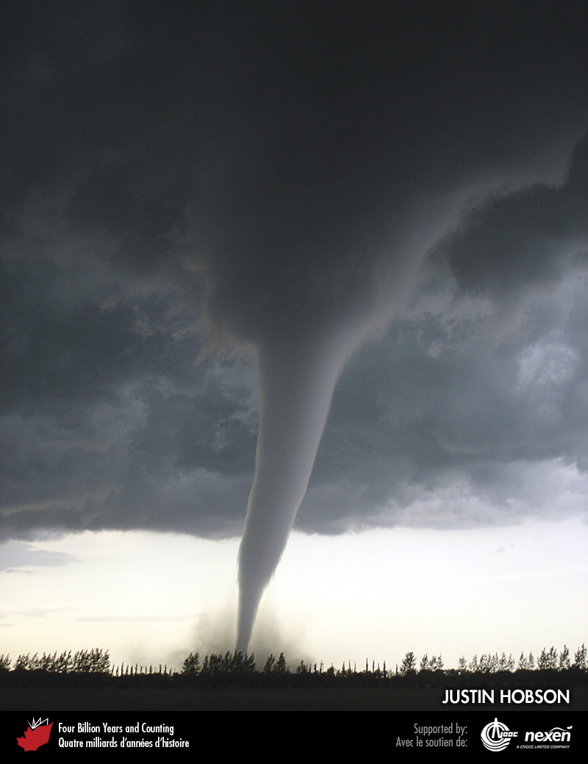
Notes:
Tornadoes are rapidly rotating columns of air that can leave a path of destruction on the ground. This photo shows a category F5 tornado that struck Elie, Manitoba, in June 2007. JUSTIN HOBSON.
_______________________________
All photographic and graphic images (henceforth referred to as images) posted on this site are copyright of the persons and/or institutions indicated in the caption directly associated with each image. The copyright holders have agreed that you may use their images for educational, non-commercial purposes only and provided that they are credited in each instance of use. For all other uses you must contact the copyright holder.

Slide 10
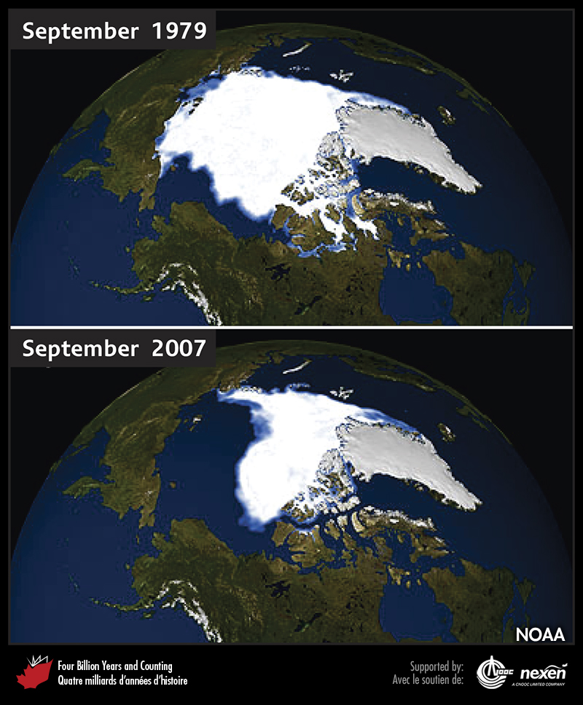
Notes:
Change in Arctic sea ice cover between 1979 and 2007. Perennial sea ice decreased at a rate of 9 percent over this period. COURTESY OF THE US NATIONAL OCEANIC AND ATMOSPHERIC ADMINISTRATION (NOAA).
_______________________________
All photographic and graphic images (henceforth referred to as images) posted on this site are copyright of the persons and/or institutions indicated in the caption directly associated with each image. The copyright holders have agreed that you may use their images for educational, non-commercial purposes only and provided that they are credited in each instance of use. For all other uses you must contact the copyright holder.

