Slide 1
CHAPTER 13 Part 1 of 2
All photographic and graphic images (henceforth referred to as images) posted on this site are copyright of the persons and/or institutions indicated in the caption directly associated with each image. The copyright holders have agreed that you may use their images for educational, non-commercial purposes only and provided that they are credited in each instance of use. For all other uses you must contact the copyright holder.

Slide 2
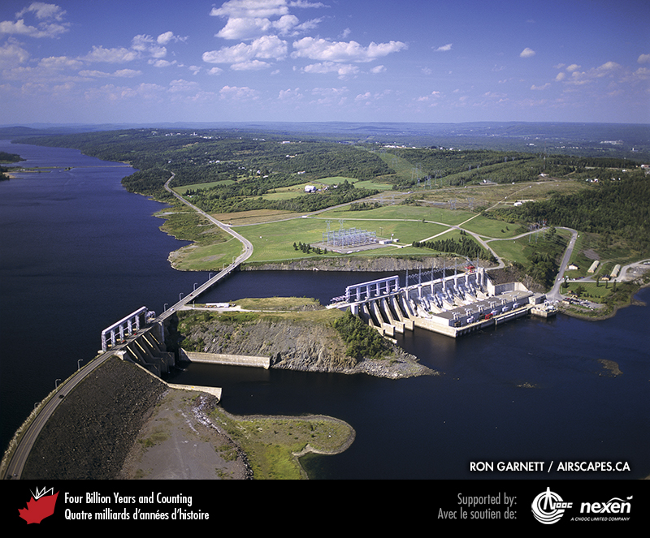
Notes:
The Mactaquac Dam generates hydroelectricity from the flow of the Saint John River in New Brunswick. It generates about 20 percent of the province’s power needs. RON GARNETT /AIR SCAPE S.CA
_______________________________
All photographic and graphic images (henceforth referred to as images) posted on this site are copyright of the persons and/or institutions indicated in the caption directly associated with each image. The copyright holders have agreed that you may use their images for educational, non-commercial purposes only and provided that they are credited in each instance of use. For all other uses you must contact the copyright holder.

Slide 3
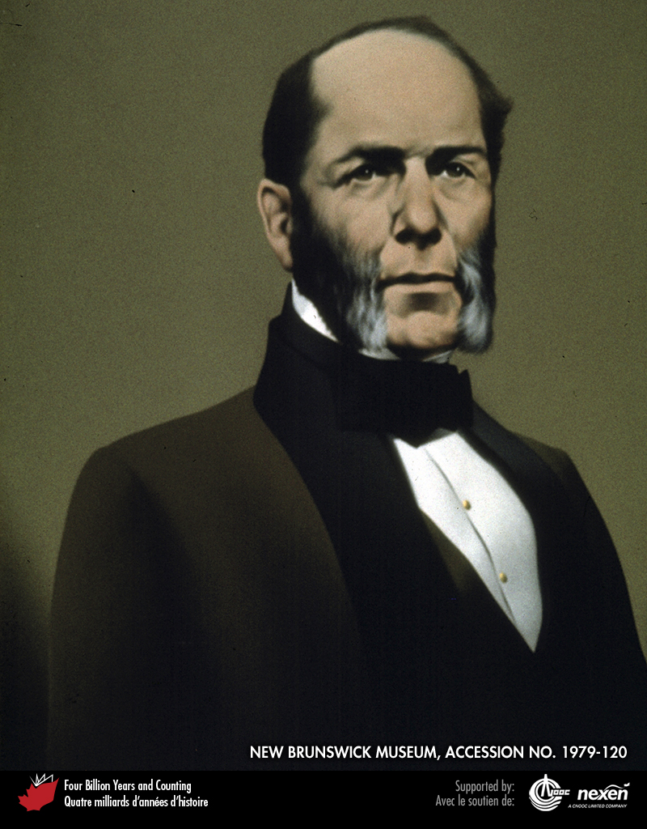
Notes:
Abraham Gesner is acknowledged as the founder of the petroleum industry. Born in Nova Scotia’s Annapolis Valley, Gesner became a medical doctor in Parrsboro and, later, provincial geologist for New Brunswick (the first such post in the British Empire). COURTESY OF THE NEW BRUNSWICK MUSEUM, ACCESSION NO. 1979-120
_______________________________
All photographic and graphic images (henceforth referred to as images) posted on this site are copyright of the persons and/or institutions indicated in the caption directly associated with each image. The copyright holders have agreed that you may use their images for educational, non-commercial purposes only and provided that they are credited in each instance of use. For all other uses you must contact the copyright holder.

Slide 4
Notes:
Black gum, naturally occurring bitumen seeping from the ground at Oil Springs, near Sarnia, Ontario. GRANT WACH.
_______________________________
All photographic and graphic images (henceforth referred to as images) posted on this site are copyright of the persons and/or institutions indicated in the caption directly associated with each image. The copyright holders have agreed that you may use their images for educational, non-commercial purposes only and provided that they are credited in each instance of use. For all other uses you must contact the copyright holder.

Slide 5
Notes:
The dark layer in this sequence of rocks from Chimney Corner, Cape Breton Island, Nova Scotia, is a late Carboniferous coal bed. MARTIN GIBLING.
_______________________________
All photographic and graphic images (henceforth referred to as images) posted on this site are copyright of the persons and/or institutions indicated in the caption directly associated with each image. The copyright holders have agreed that you may use their images for educational, non-commercial purposes only and provided that they are credited in each instance of use. For all other uses you must contact the copyright holder.

Slide 6
Notes:
Open-pit coal mine, Sparwood, British Columbia. Coal in this part of southeastern British Columbia is of Cretaceous age and was deposited in the foreland basin to the east of the advancing Rocky Mountains thrust-and-fold belt (Chapter 9). RON GARNETT / AIRSCAPES.CA.
_______________________________
All photographic and graphic images (henceforth referred to as images) posted on this site are copyright of the persons and/or institutions indicated in the caption directly associated with each image. The copyright holders have agreed that you may use their images for educational, non-commercial purposes only and provided that they are credited in each instance of use. For all other uses you must contact the copyright holder.

Slide 7
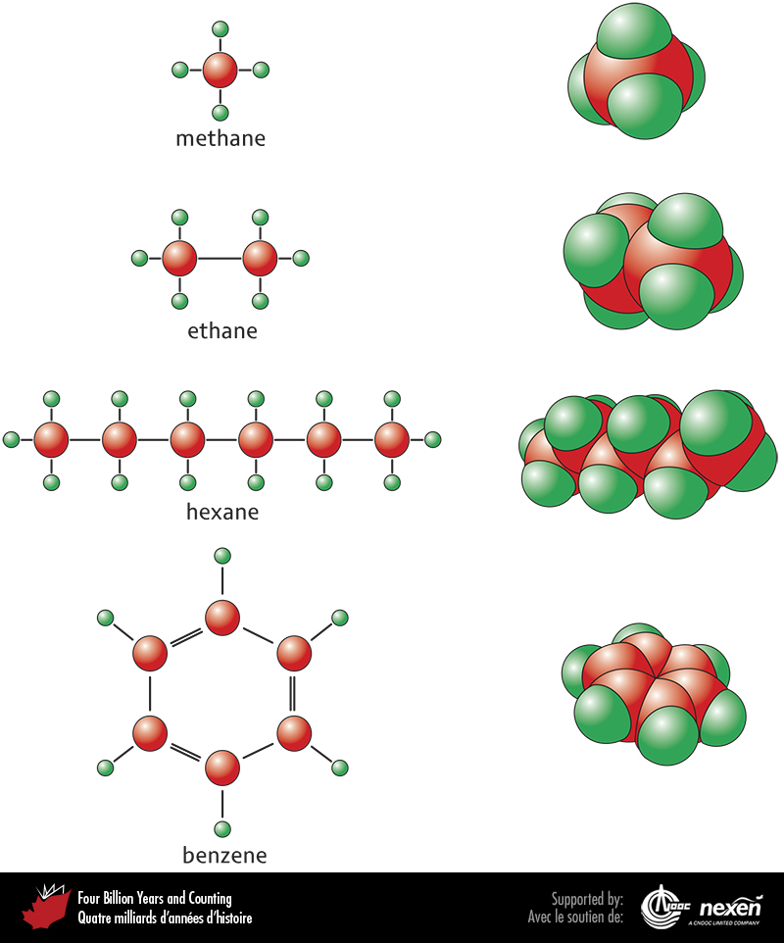
Notes:
Molecular structure of some of the lighter petroleum compounds. The larger atoms, coloured red, represent carbon and the smaller atoms, coloured green, represent hydrogen. Figures on the left show molecular structure schematically and those on the right, representing the same compounds, show the true relationships of the atoms within each molecule, with the hydrogen and carbon atoms in direct contact. All the molecules shown, except benzene, have a linear structure and single bonds between carbon atoms. Methane is a gas, ethane is a wet gas, and hexane is a condensate. Molecules of benzene are formed of a ring of six atoms and have double bonds between some of these atoms.
_______________________________
All photographic and graphic images (henceforth referred to as images) posted on this site are copyright of the persons and/or institutions indicated in the caption directly associated with each image. The copyright holders have agreed that you may use their images for educational, non-commercial purposes only and provided that they are credited in each instance of use. For all other uses you must contact the copyright holder.

Slide 8
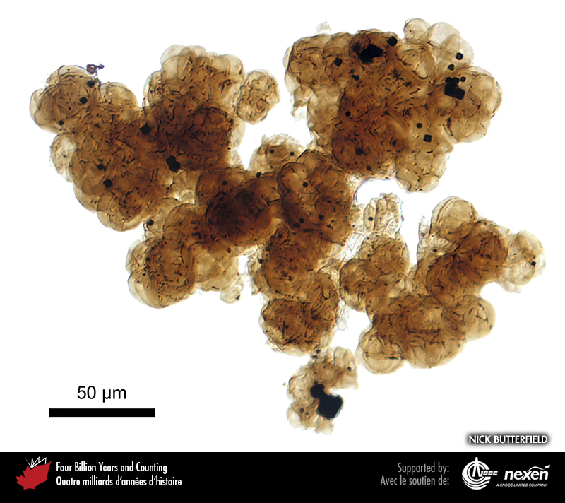
Notes:
Cluster of organic-walled fossils of Gloecapsomorpha, an organism thought to have been a source of petroleum in early Paleozoic rocks. This specimen is from Cambrian rocks in the Saskatchewan subsurface and is about 0.27 millimetres wide. NICK BUTTERFIELD.
_______________________________
All photographic and graphic images (henceforth referred to as images) posted on this site are copyright of the persons and/or institutions indicated in the caption directly associated with each image. The copyright holders have agreed that you may use their images for educational, non-commercial purposes only and provided that they are credited in each instance of use. For all other uses you must contact the copyright holder.

Slide 9
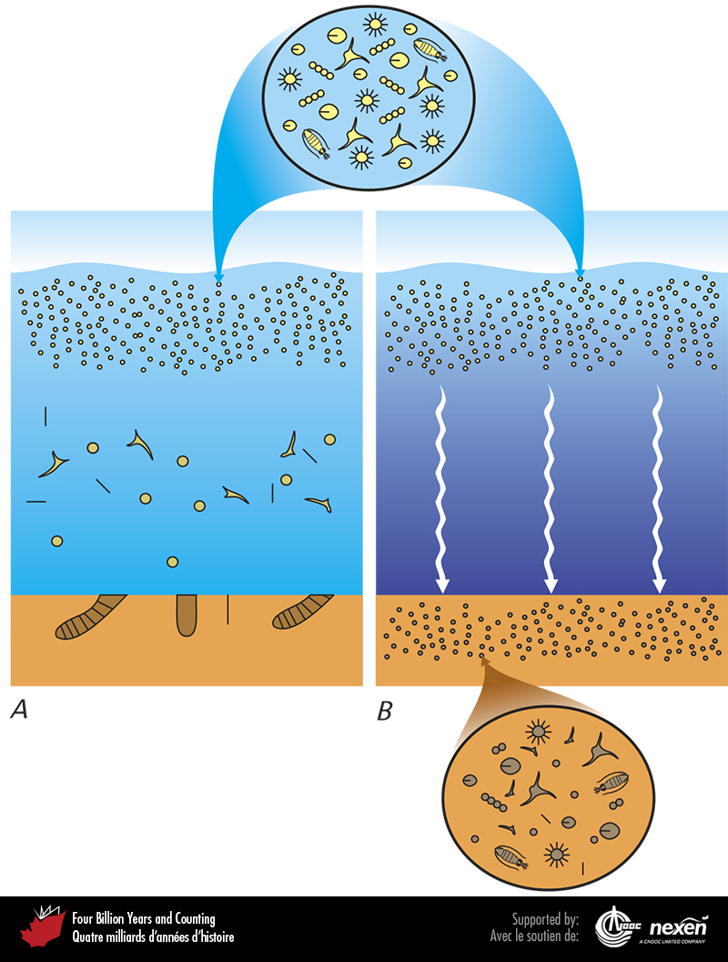
Notes:
Trillions of microscopic marine organisms can live in a cubic metre of water within the photic zone (where sunlight penetrates). When the organisms die, their bodies sink. If the waters are rich in oxygen, as in A, the remains are not preserved. But if the water has low levels of oxygen, as in B, a large proportion of the organic remains is preserved and buried in the bottom sediments. Within the upper circle are some of the micro-organisms, greatly magnified, that live in the photic zone. Within the lower circle are some of the remains of the micro-organisms preserved in the sediments.
_______________________________
All photographic and graphic images (henceforth referred to as images) posted on this site are copyright of the persons and/or institutions indicated in the caption directly associated with each image. The copyright holders have agreed that you may use their images for educational, non-commercial purposes only and provided that they are credited in each instance of use. For all other uses you must contact the copyright holder.

Slide 10
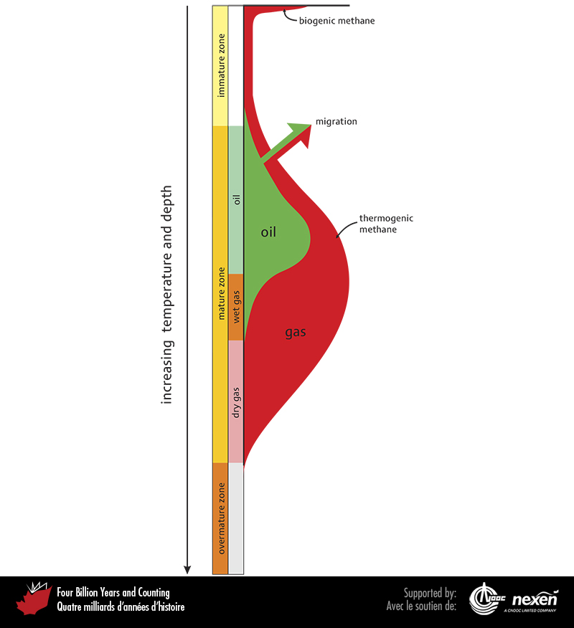
Notes:
Conversion of organic matter to different kinds of petroleum over time and with increasing temperature and depth. The mature zone denotes where oil and thermogenic gas form. At low temperatures and minimal burial, only biogenic methane is produced. As organic matter matures, oil may be produced along with thermogenic methane and other gases. At still deeper horizons and higher temperatures, all oil has been expelled or is broken down into simpler molecules and only thermogenic methane is produced. The variation in width of the oil (green) and gas (red) curves reflects the relative amounts of each produced at different depths and temperatures.
_______________________________
All photographic and graphic images (henceforth referred to as images) posted on this site are copyright of the persons and/or institutions indicated in the caption directly associated with each image. The copyright holders have agreed that you may use their images for educational, non-commercial purposes only and provided that they are credited in each instance of use. For all other uses you must contact the copyright holder.

Slide 11
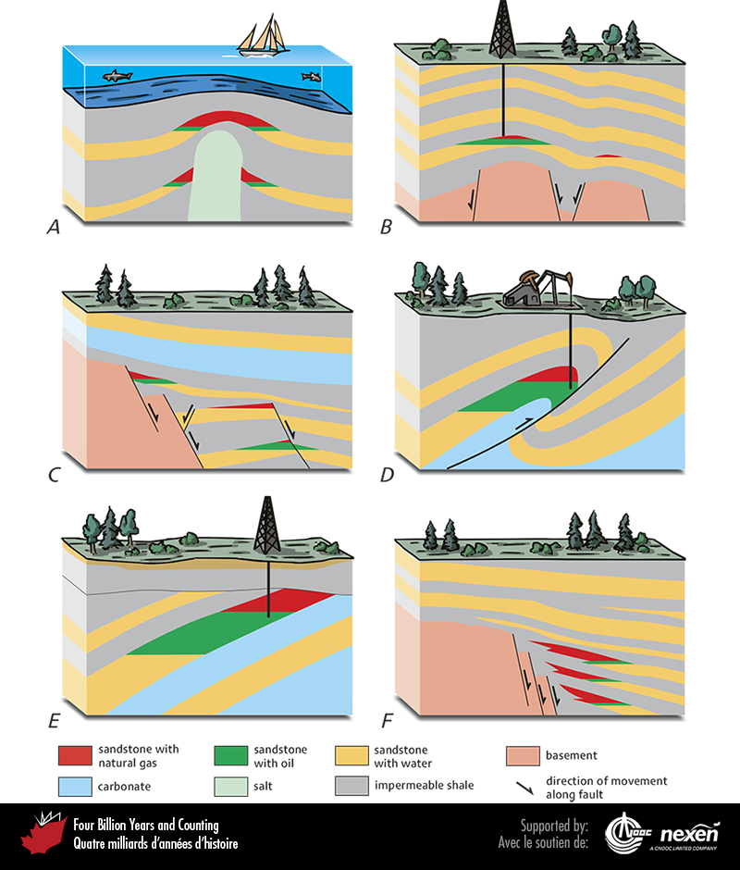
Notes:
Some types of hydrocarbon traps. Most of the traps shown are structural (A to D) and involve folding and/or faulting of strata. One trap (E) is a combined structural and stratigraphic trap. The last trap (F) is stratigraphic—the rock changes in character laterally. ADAPTED FROM VARIOUS SOURCES.
_______________________________
All photographic and graphic images (henceforth referred to as images) posted on this site are copyright of the persons and/or institutions indicated in the caption directly associated with each image. The copyright holders have agreed that you may use their images for educational, non-commercial purposes only and provided that they are credited in each instance of use. For all other uses you must contact the copyright holder.

Slide 12
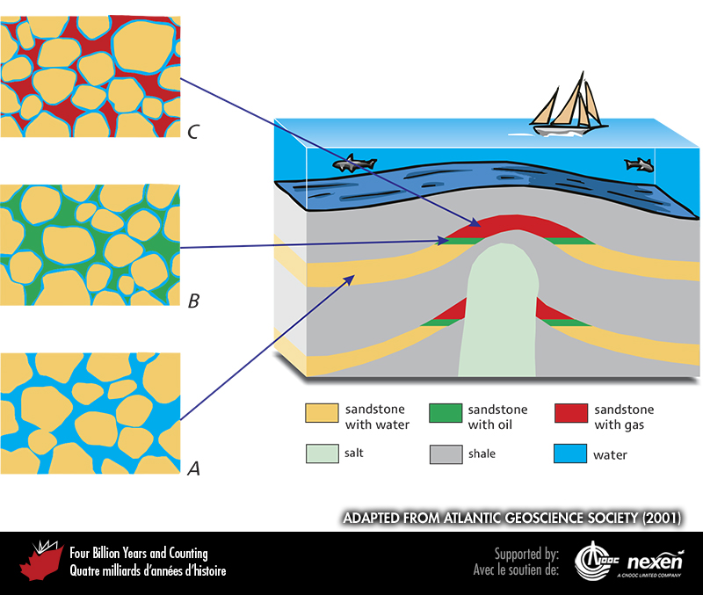
Notes:
Porosity in sandstone. Liquids and gases occupying the spaces between grains in sandstone are able to migrate upwards until their movement is stopped by an impervious layer, such as shale. In A, pore spaces are filled with water. In B and C, a thin film of water coats each grain, but the rest of the spaces is filled with oil and gas, respectively. ADAPTED FROM ATLANTIC GEOSCIENCE SOCIETY (2001).
_______________________________
All photographic and graphic images (henceforth referred to as images) posted on this site are copyright of the persons and/or institutions indicated in the caption directly associated with each image. The copyright holders have agreed that you may use their images for educational, non-commercial purposes only and provided that they are credited in each instance of use. For all other uses you must contact the copyright holder.

Slide 13
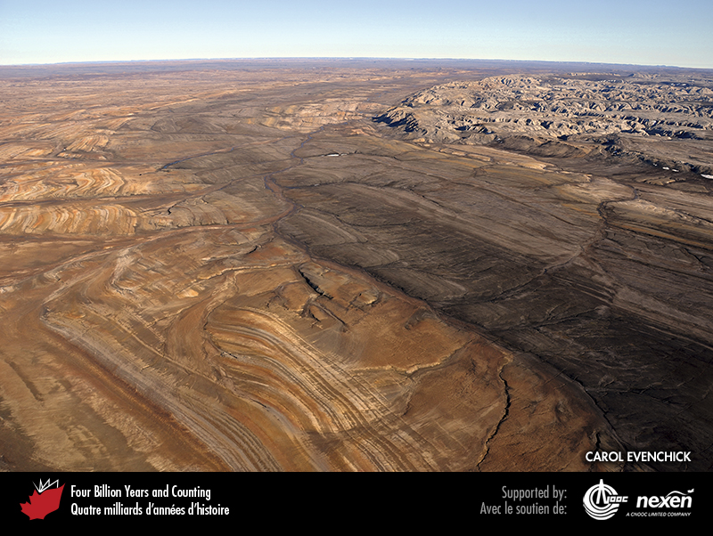
Notes:
Cretaceous deltaic and marine strata tipped up around a diapir of Carboniferous evaporite, Ellef Ringnes Island, Nunavut. Below the surface, petroleum is commonly trapped in structures created by salt domes. CAROL EVENCHICK.
_______________________________
All photographic and graphic images (henceforth referred to as images) posted on this site are copyright of the persons and/or institutions indicated in the caption directly associated with each image. The copyright holders have agreed that you may use their images for educational, non-commercial purposes only and provided that they are credited in each instance of use. For all other uses you must contact the copyright holder.

Slide 14
Notes:
Part of the cairn in front of the Geological Survey of Canada office in Calgary. The rock is from a late Devonian carbonate reef at White Man Gap near Canmore, Alberta, in the Front Ranges of the Rocky Mountains. Its high porosity is typical of many Devonian oil and gas reservoirs beneath Alberta. The holes represent the former positions of stromatoporoids, now dissolved. GODFREY NOWLAN.
_______________________________
All photographic and graphic images (henceforth referred to as images) posted on this site are copyright of the persons and/or institutions indicated in the caption directly associated with each image. The copyright holders have agreed that you may use their images for educational, non-commercial purposes only and provided that they are credited in each instance of use. For all other uses you must contact the copyright holder.

Slide 15
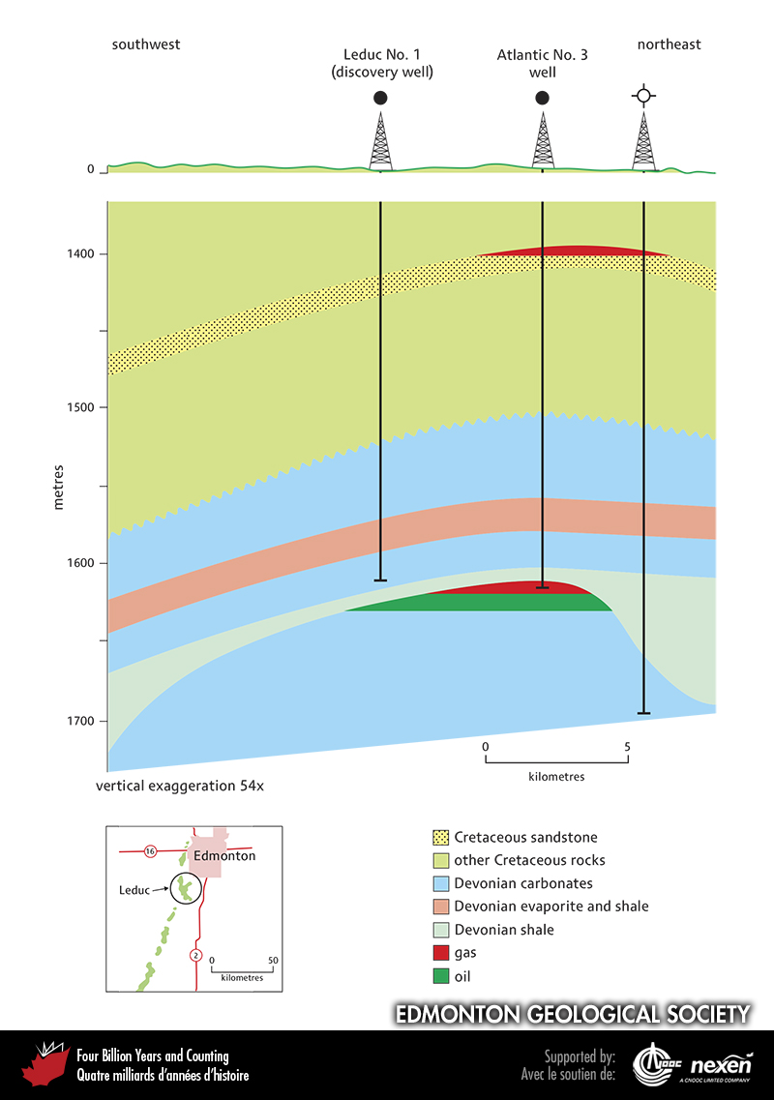
Notes:
Cross-section through the Leduc Oil Field southwest of Edmonton, Alberta. What became the discovery well for this field (Leduc No. 1) was “spudded” (started) in the fall of 1946 and struck oil in a relatively small Devonian coral reef (not shown) in early 1947. Subsequent wells at Leduc that reached slightly older, but much more substantial, reefs that yielded large volumes of oil and gas. ADAPTED AND USED WITH PERMISSION FROM THE EDMONTON GEOLOGICAL SOCIETY.
_______________________________
All photographic and graphic images (henceforth referred to as images) posted on this site are copyright of the persons and/or institutions indicated in the caption directly associated with each image. The copyright holders have agreed that you may use their images for educational, non-commercial purposes only and provided that they are credited in each instance of use. For all other uses you must contact the copyright holder.

Slide 16
Notes:
Derelict equipment used when oil was being produced at Parson’s Pond, western Newfoundland. Between 1907 and 1909, some 800 to 900 barrels of oil were shipped from there to St. John’s. MARTIN FOWLER.
_______________________________
All photographic and graphic images (henceforth referred to as images) posted on this site are copyright of the persons and/or institutions indicated in the caption directly associated with each image. The copyright holders have agreed that you may use their images for educational, non-commercial purposes only and provided that they are credited in each instance of use. For all other uses you must contact the copyright holder.

