Slide 1
CHAPTER 12 Part 1 of 3
All photographic and graphic images (henceforth referred to as images) posted on this site are copyright of the persons and/or institutions indicated in the caption directly associated with each image. The copyright holders have agreed that you may use their images for educational, non-commercial purposes only and provided that they are credited in each instance of use. For all other uses you must contact the copyright holder.

Slide 2
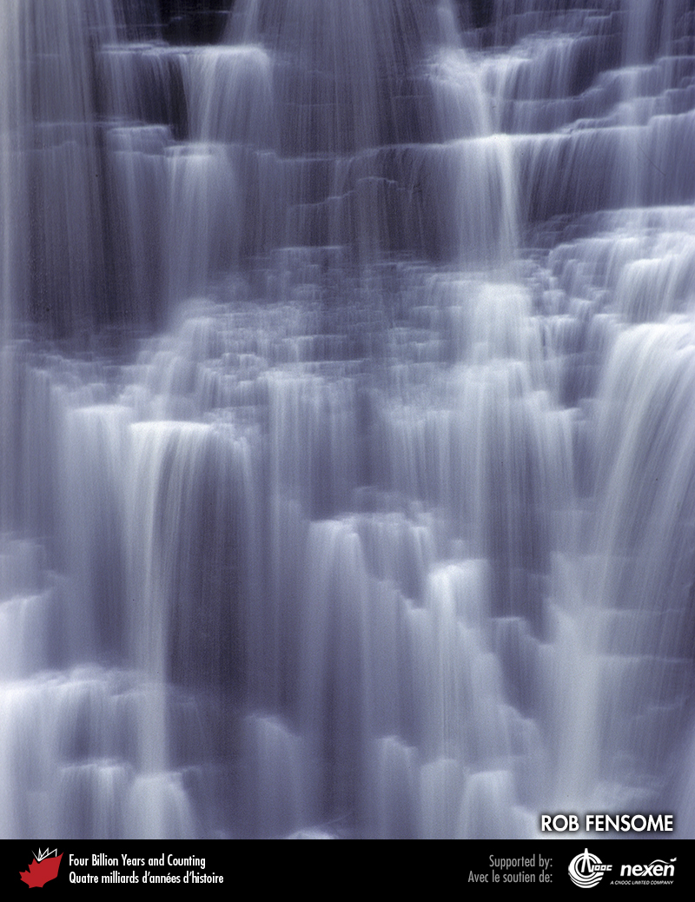
Notes:
The flow over Kakabeka Falls in northern Ontario reminds us of the vital role water, in large part a geological resource, plays in our daily lives. ROB FENSOME
_______________________________
All photographic and graphic images (henceforth referred to as images) posted on this site are copyright of the persons and/or institutions indicated in the caption directly associated with each image. The copyright holders have agreed that you may use their images for educational, non-commercial purposes only and provided that they are credited in each instance of use. For all other uses you must contact the copyright holder.

Slide 3
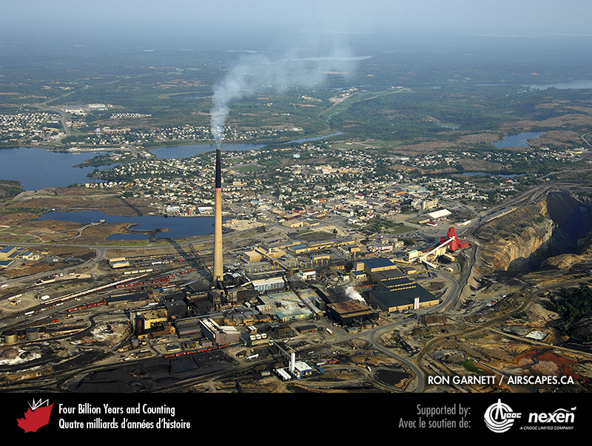
Notes:
Aerial view of Flin Flon, Manitoba, a major centre for mining VMS deposits hosted by rocks of the Trans-Hudson Orogen. RON GARNETT / AIRSCAPES.CA.
_______________________________
All photographic and graphic images (henceforth referred to as images) posted on this site are copyright of the persons and/or institutions indicated in the caption directly associated with each image. The copyright holders have agreed that you may use their images for educational, non-commercial purposes only and provided that they are credited in each instance of use. For all other uses you must contact the copyright holder.

Slide 4
Notes:
Potential prospectors climb the trail to the Chilkoot Pass at the Alaska-British Columbia border on their way to the Klondike.
_______________________________
All photographic and graphic images (henceforth referred to as images) posted on this site are copyright of the persons and/or institutions indicated in the caption directly associated with each image. The copyright holders have agreed that you may use their images for educational, non-commercial purposes only and provided that they are credited in each instance of use. For all other uses you must contact the copyright holder.

Slide 5
Notes:
A dense billowing plume of mineral-laden water (a black smoker) gushes from a hydrothermal vent on the Juan de Fuca Ridge off the coast of British Columbia. As the hydrothermal fluid meets the near-freezing seawater, minerals precipitate to form chimney structures. The vents are home to an unusual fauna, including tube worms shown in the foreground. VERENA TUNNICLIFFE.
_______________________________
All photographic and graphic images (henceforth referred to as images) posted on this site are copyright of the persons and/or institutions indicated in the caption directly associated with each image. The copyright holders have agreed that you may use their images for educational, non-commercial purposes only and provided that they are credited in each instance of use. For all other uses you must contact the copyright holder.

Slide 6
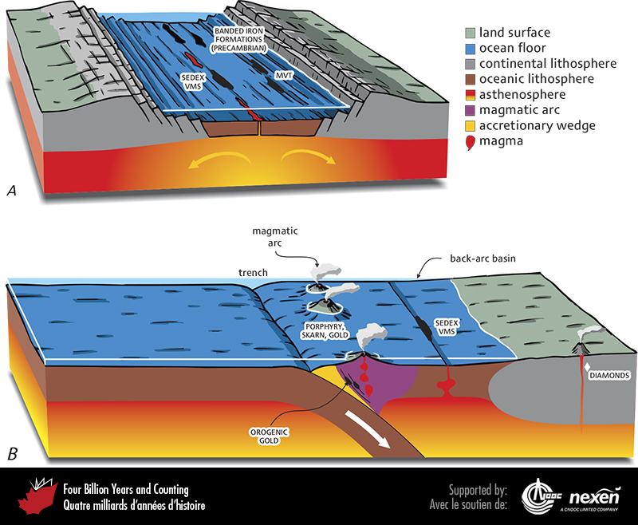
Notes:
The tectonic settings of some major ore-deposit types broadly associated with divergent (A) and convergent (B) plate boundaries. VMS (volcanogenic massive sulphide) and SEDEX (sedimentary-exhalative) deposits are commonly associated with spreading ridge and back-arc-basin settings. Porphyry and skarn deposits, including many gold deposits, are associated with convergent plate-tectonic settings. MVT (Mississippi Valley Type) deposits are associated with carbonate rocks and occur on passive margins and other settings conducive to carbonate deposition. Kimberlites and their contained diamonds are associated with stable and ancient continental crust away from plate boundaries.
_______________________________
All photographic and graphic images (henceforth referred to as images) posted on this site are copyright of the persons and/or institutions indicated in the caption directly associated with each image. The copyright holders have agreed that you may use their images for educational, non-commercial purposes only and provided that they are credited in each instance of use. For all other uses you must contact the copyright holder.

Slide 7
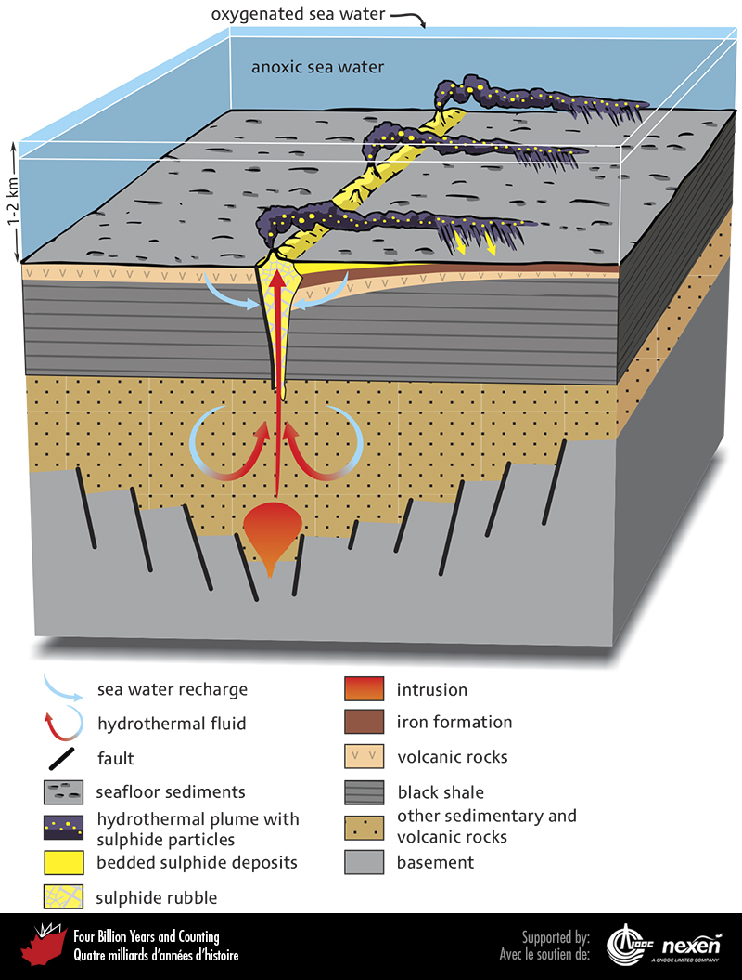
Notes:
VMS deposits are formed from hydrothermal fluids vented from black smokers commonly associated with oceanic spreading ridges. For the deposits to be preserved, the bottom waters must be anoxic.
_______________________________
All photographic and graphic images (henceforth referred to as images) posted on this site are copyright of the persons and/or institutions indicated in the caption directly associated with each image. The copyright holders have agreed that you may use their images for educational, non-commercial purposes only and provided that they are credited in each instance of use. For all other uses you must contact the copyright holder.

Slide 8
Notes:
Chalcopyrite-rich VMS deposit at a depth of 2,400 metres in the Kidd Creek Mine, Timmins, Ontario. The ore occurs in Archean rocks about 2,700 million years old. JACOB HANLEY.
_______________________________
All photographic and graphic images (henceforth referred to as images) posted on this site are copyright of the persons and/or institutions indicated in the caption directly associated with each image. The copyright holders have agreed that you may use their images for educational, non-commercial purposes only and provided that they are credited in each instance of use. For all other uses you must contact the copyright holder.

Slide 9
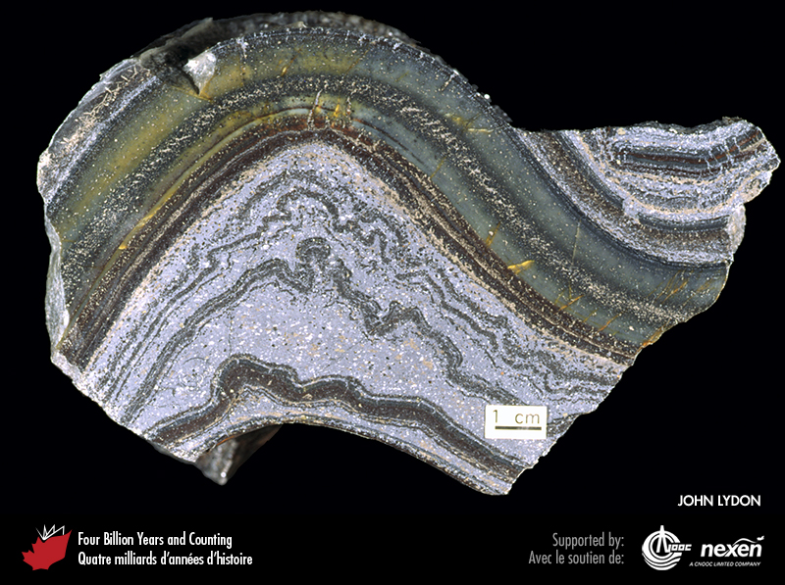
Notes:
Folded SEDEX deposit from the Sullivan Mine, Kimberley, British Columbia, originally deposited in the Mesoproterozoic Belt-Purcell Basin. The brown bands and associated thin cream layers are of sphalerite; the mostly thick light-blue-grey bands are galena interbedded with “wrinkled” argillite layers; and the green- to yellow-grey bands toward the top of the specimen are chert. COURTESY OF JOHN LYDON.
_______________________________
All photographic and graphic images (henceforth referred to as images) posted on this site are copyright of the persons and/or institutions indicated in the caption directly associated with each image. The copyright holders have agreed that you may use their images for educational, non-commercial purposes only and provided that they are credited in each instance of use. For all other uses you must contact the copyright holder.

Slide 10
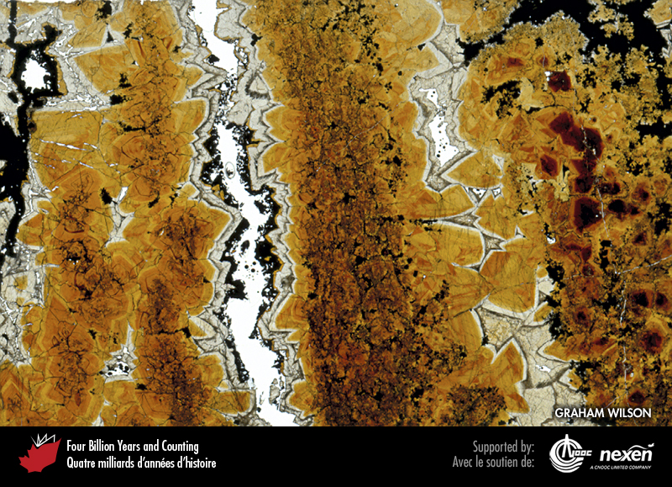
Notes:
The browny-orange to clear crystals in this thin section are of sphalerite, and form part of a high-grade zinc ore in a middle Ordovician MVT deposit in the former Nanisivik Mine, Baffin Island, Nunavut. GRAHAM WILSON, SPECIMEN COURTESY OF ROSS SHERLOCK.
_______________________________
All photographic and graphic images (henceforth referred to as images) posted on this site are copyright of the persons and/or institutions indicated in the caption directly associated with each image. The copyright holders have agreed that you may use their images for educational, non-commercial purposes only and provided that they are credited in each instance of use. For all other uses you must contact the copyright holder.

Slide 11
Notes:
Zinc-lead ore from the Pine Point MVT deposit in the Devonian Presqu’ile Barrier reef system, Northwest Territories. This deposit consists of cream and brown sphalerite in a matrix of cream-coloured dolomite. WAYNE GOODFELLOW.
_______________________________
All photographic and graphic images (henceforth referred to as images) posted on this site are copyright of the persons and/or institutions indicated in the caption directly associated with each image. The copyright holders have agreed that you may use their images for educational, non-commercial purposes only and provided that they are credited in each instance of use. For all other uses you must contact the copyright holder.

Slide 12
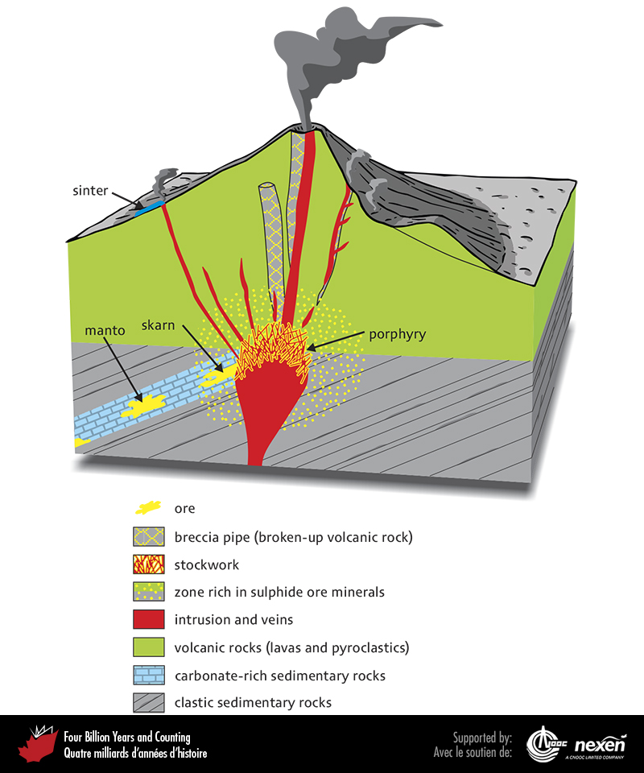
Notes:
Porphyry and related ore deposits are generally associated with intermediate to felsic igneous activity. This figure shows how different types of ore bodies are related to such volcanic and intrusive settings.
_______________________________
All photographic and graphic images (henceforth referred to as images) posted on this site are copyright of the persons and/or institutions indicated in the caption directly associated with each image. The copyright holders have agreed that you may use their images for educational, non-commercial purposes only and provided that they are credited in each instance of use. For all other uses you must contact the copyright holder.

Slide 13
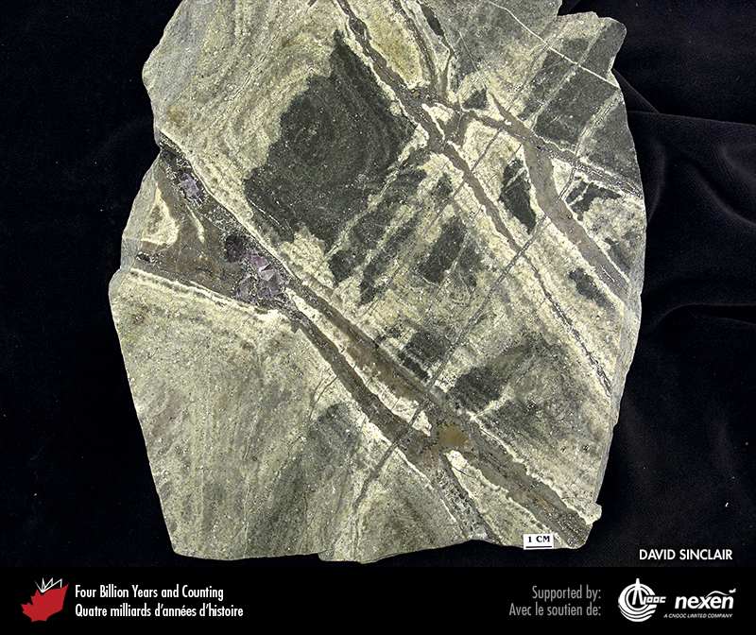
Notes:
Rocks within a single porphyry deposit can be varied. In this photo, the first of three from the Mount Pleasant deposit in New Brunswick, granitic rock is cut by veins containing quartz, fluorite, arsenopyrite, and cassiterite, a source of tin. The granitic rock is of Devonian age. DAVID SINCLAIR.
_______________________________
All photographic and graphic images (henceforth referred to as images) posted on this site are copyright of the persons and/or institutions indicated in the caption directly associated with each image. The copyright holders have agreed that you may use their images for educational, non-commercial purposes only and provided that they are credited in each instance of use. For all other uses you must contact the copyright holder.

Slide 14
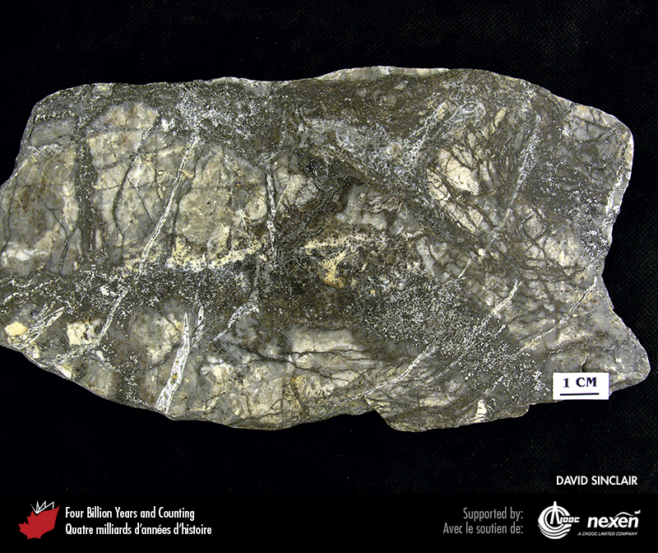
Notes:
In this sample from the Mount Pleasant deposit in New Brunswick, arsenopyrite- and cassiterite-bearing veins cut fractured and altered granitic host rock. The veins were mined for tin. DAVID SINCLAIR.
_______________________________
All photographic and graphic images (henceforth referred to as images) posted on this site are copyright of the persons and/or institutions indicated in the caption directly associated with each image. The copyright holders have agreed that you may use their images for educational, non-commercial purposes only and provided that they are credited in each instance of use. For all other uses you must contact the copyright holder.

Slide 15
Notes:
This breccia from the Mount Pleasant deposit, New Brunswick, consists of fragments of granitic rock that have been altered to silica in a dark matrix of sphalerite and cassiterite, a source of zinc and tin. DAVID SINCLAIR.
_______________________________
All photographic and graphic images (henceforth referred to as images) posted on this site are copyright of the persons and/or institutions indicated in the caption directly associated with each image. The copyright holders have agreed that you may use their images for educational, non-commercial purposes only and provided that they are credited in each instance of use. For all other uses you must contact the copyright holder.

Slide 16
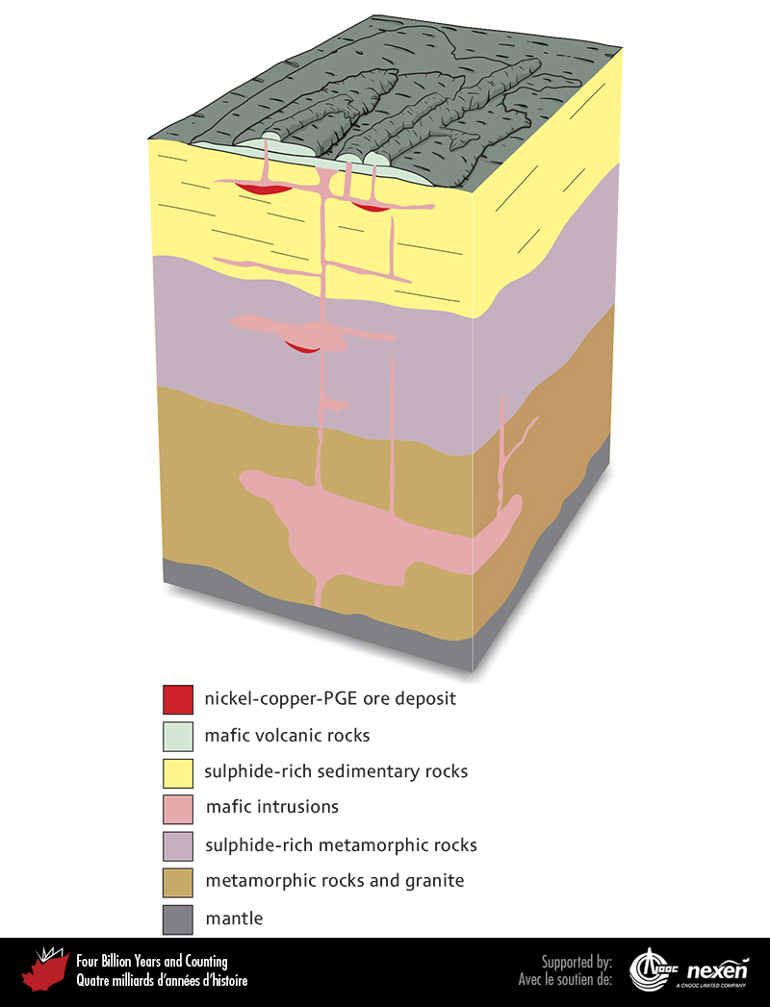
Notes:
Nickel-copper-PGE deposits are generally associated with mafic igneous activity. This figure shows how different types of ore bodies are related to such volcanic and intrusive settings.
_______________________________
All photographic and graphic images (henceforth referred to as images) posted on this site are copyright of the persons and/or institutions indicated in the caption directly associated with each image. The copyright holders have agreed that you may use their images for educational, non-commercial purposes only and provided that they are credited in each instance of use. For all other uses you must contact the copyright holder.

