Slide 1
CHAPTER 12 Part 2 of 3
All photographic and graphic images (henceforth referred to as images) posted on this site are copyright of the persons and/or institutions indicated in the caption directly associated with each image. The copyright holders have agreed that you may use their images for educational, non-commercial purposes only and provided that they are credited in each instance of use. For all other uses you must contact the copyright holder.

Slide 2
Notes:
Breccia from below the ore and impact melt layers of the Sudbury impact structure, Ontario. PHOTO COURTESY OF THE ONTARIO GEOLOGICAL SURVEY: COPYRIGHT QUEEN'S PRINTER FOR ONTARIO, 2013.
_______________________________
All photographic and graphic images (henceforth referred to as images) posted on this site are copyright of the persons and/or institutions indicated in the caption directly associated with each image. The copyright holders have agreed that you may use their images for educational, non-commercial purposes only and provided that they are credited in each instance of use. For all other uses you must contact the copyright holder.

Slide 3
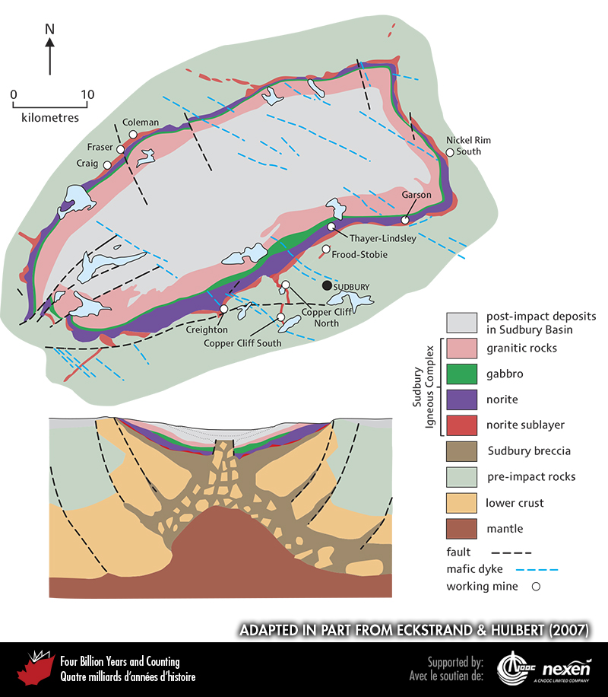
Notes:
The Sudbury impact structure. The upper diagram shows the bedrock geology (beneath glacial deposits) and the lower diagram shows a generalized cross-section, with glacial deposits outside the impact structure included as post-impact deposits. Upper diagram ADAPTED FROM ECKSTRAND AND HULBERT (2007).
_______________________________
All photographic and graphic images (henceforth referred to as images) posted on this site are copyright of the persons and/or institutions indicated in the caption directly associated with each image. The copyright holders have agreed that you may use their images for educational, non-commercial purposes only and provided that they are credited in each instance of use. For all other uses you must contact the copyright holder.

Slide 4
Notes:
Detail of rocks derived from the upper, granitic melt (top) and from the lower, noritic melt (bottom), of the Sudbury impact structure, Ontario. PHOTO COURTESY OF THE ONTARIO GEOLOGICAL SURVEY: COPYRIGHT QUEEN'S PRINTER FOR ONTARIO, 2013.
_______________________________
All photographic and graphic images (henceforth referred to as images) posted on this site are copyright of the persons and/or institutions indicated in the caption directly associated with each image. The copyright holders have agreed that you may use their images for educational, non-commercial purposes only and provided that they are credited in each instance of use. For all other uses you must contact the copyright holder.

Slide 5
Notes:
Shatter cones (Box 11) developed in Paleoproterozoic (Huronian) metasandstone, Sudbury impact structure, Ontario. PHOTO COURTESY OF THE ONTARIO GEOLOGICAL SURVEY: COPYRIGHT QUEEN'S PRINTER FOR ONTARIO, 2013.
_______________________________
All photographic and graphic images (henceforth referred to as images) posted on this site are copyright of the persons and/or institutions indicated in the caption directly associated with each image. The copyright holders have agreed that you may use their images for educational, non-commercial purposes only and provided that they are credited in each instance of use. For all other uses you must contact the copyright holder.

Slide 6
Notes:
Ore containing copper and platinum-group elements from the Strathcona Mine in the Sudbury impact structure, Ontario. PHOTO COURTESY OF THE ONTARIO GEOLOGICAL SURVEY: COPYRIGHT QUEEN'S PRINTER FOR ONTARIO, 2013.
_______________________________
All photographic and graphic images (henceforth referred to as images) posted on this site are copyright of the persons and/or institutions indicated in the caption directly associated with each image. The copyright holders have agreed that you may use their images for educational, non-commercial purposes only and provided that they are credited in each instance of use. For all other uses you must contact the copyright holder.

Slide 7
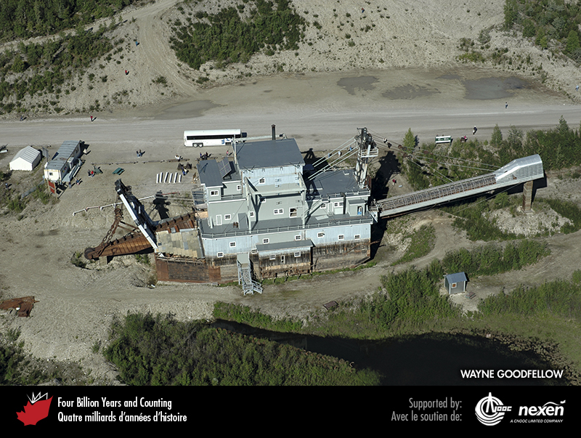
Notes:
Aerial view of a dredge used to mine placer gold, Bonanza Creek, Klondike, Yukon. WAYNE GOODFELLOW.
_______________________________
All photographic and graphic images (henceforth referred to as images) posted on this site are copyright of the persons and/or institutions indicated in the caption directly associated with each image. The copyright holders have agreed that you may use their images for educational, non-commercial purposes only and provided that they are credited in each instance of use. For all other uses you must contact the copyright holder.

Slide 8
Notes:
Quartz vein with gold in the Musselwhite Mine of northern Ontario. This mine is within a greenstone belt in the Superior Craton. The ore occurs as veins and as a quartz-pyrrhotite-rich replacement within folded banded-iron formations. BENOÎT DUBÉ.
_______________________________
All photographic and graphic images (henceforth referred to as images) posted on this site are copyright of the persons and/or institutions indicated in the caption directly associated with each image. The copyright holders have agreed that you may use their images for educational, non-commercial purposes only and provided that they are credited in each instance of use. For all other uses you must contact the copyright holder.

Slide 9
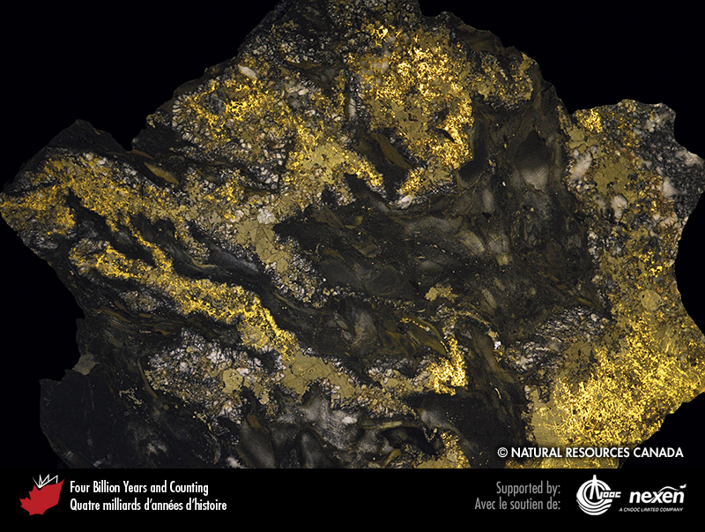
Notes:
Gold in conglomerate from the Dome Mine, Ontario. The weight of this specimen is 61.8 kilograms, of which about 20 percent is gold. IGOR BILOT, SPECIMEN COURTESY OF NATURAL RESOURCES CANADA (NATIONAL MINERAL COLLECTION NO. 10003).
_______________________________
All photographic and graphic images (henceforth referred to as images) posted on this site are copyright of the persons and/or institutions indicated in the caption directly associated with each image. The copyright holders have agreed that you may use their images for educational, non-commercial purposes only and provided that they are credited in each instance of use. For all other uses you must contact the copyright holder.
.

Slide 10
Notes:
1,880-million-year-old banded iron formation near Schefferville, Quebec. The rock consists of layers of fine-grained hematite and magnetite (bluish grey), jasper (red), and siliceous iron carbonate (brown). ALAIN LECLAIR.
_______________________________
All photographic and graphic images (henceforth referred to as images) posted on this site are copyright of the persons and/or institutions indicated in the caption directly associated with each image. The copyright holders have agreed that you may use their images for educational, non-commercial purposes only and provided that they are credited in each instance of use. For all other uses you must contact the copyright holder.

Slide 11
Notes:
Disused and flooded open-pit iron mine near Schefferville, Quebec. The pit walls show the multicoloured hues associated with the residual iron ore mined here. This ore is termed residual because groundwater leached silica from the original banded iron formation during the Cretaceous, a process that increased the concentration of iron in the rock. ALAIN LECLAIR.
_______________________________
All photographic and graphic images (henceforth referred to as images) posted on this site are copyright of the persons and/or institutions indicated in the caption directly associated with each image. The copyright holders have agreed that you may use their images for educational, non-commercial purposes only and provided that they are credited in each instance of use. For all other uses you must contact the copyright holder.

Slide 12
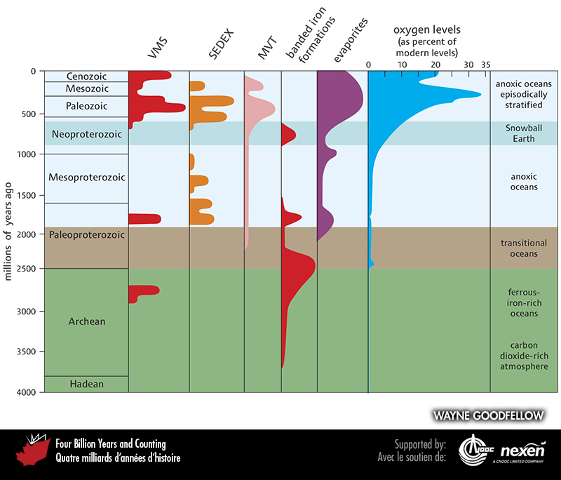
Notes:
The timing of some major ore-deposit types and evaporites in relation to major events and changes in the Earth’s atmosphere and evolution.
_______________________________
All photographic and graphic images (henceforth referred to as images) posted on this site are copyright of the persons and/or institutions indicated in the caption directly associated with each image. The copyright holders have agreed that you may use their images for educational, non-commercial purposes only and provided that they are credited in each instance of use. For all other uses you must contact the copyright holder.

Slide 13
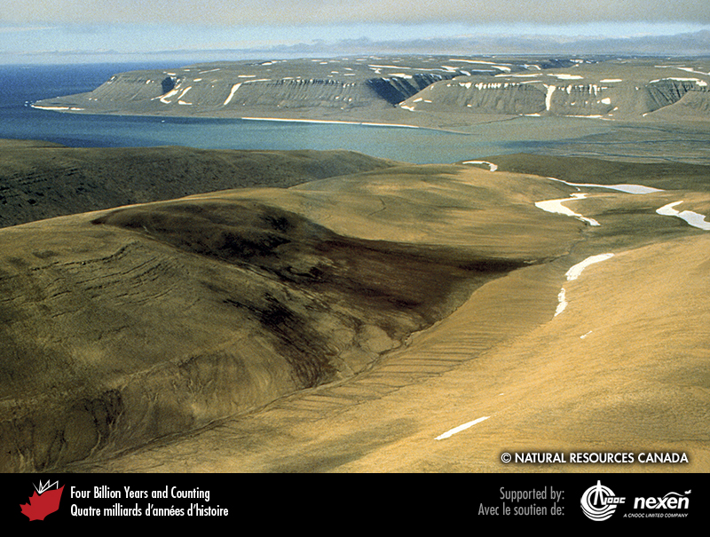
Notes:
The brown area marks the presence of a kimberlite diatreme at Elwyn Bay, northeastern Somerset Island, Nunavut. The kimberlite intruded Silurian dolostones (seen in the distant cliffs) during the middle Cretaceous. The brown colour is due to specialized vegetation associated with phosphorus- and potassium-rich soil derived from the kimberlite. BRUCE KJARSGAARD, REPRODUCED WITH THE PERMISSION OF NATURAL RESOURCES CANADA 2013, COURTESY OF THE GEOLOGICAL SURVEY OF CANADA.
_______________________________
All photographic and graphic images (henceforth referred to as images) posted on this site are copyright of the persons and/or institutions indicated in the caption directly associated with each image. The copyright holders have agreed that you may use their images for educational, non-commercial purposes only and provided that they are credited in each instance of use. For all other uses you must contact the copyright holder.

Slide 14
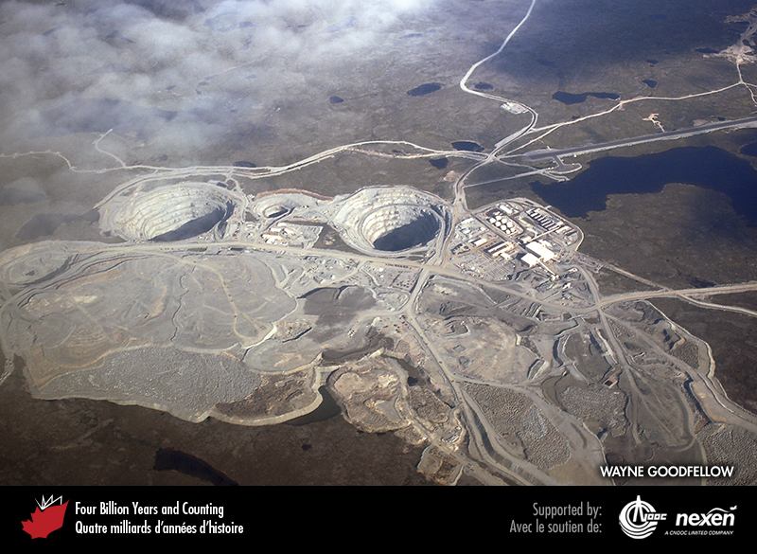
Notes:
Several open pits mark the locations of kimberlite pipes being mined for diamonds at the Ekati Mine, Northwest Territories. WAYNE GOODFELLOW.
_______________________________
All photographic and graphic images (henceforth referred to as images) posted on this site are copyright of the persons and/or institutions indicated in the caption directly associated with each image. The copyright holders have agreed that you may use their images for educational, non-commercial purposes only and provided that they are credited in each instance of use. For all other uses you must contact the copyright holder.

Slide 15
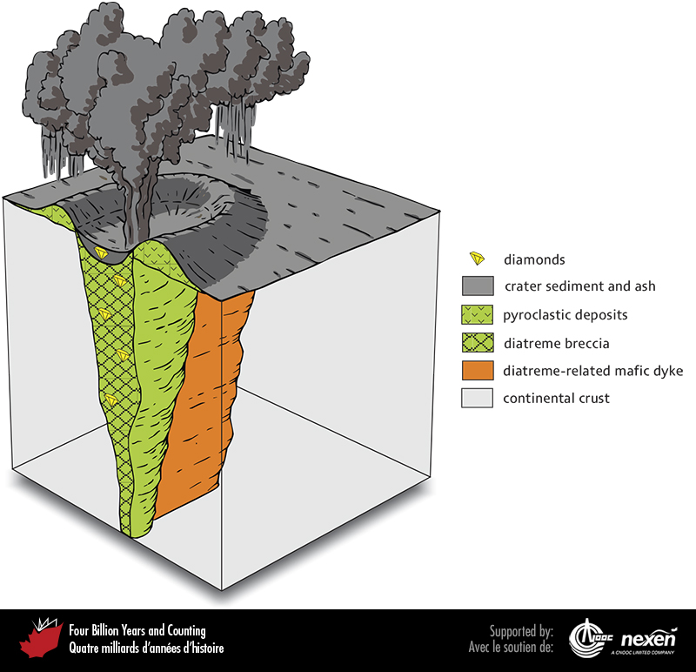
Notes:
A kimberlite pipe and the related volcanic features at the Earth’s surface.
_______________________________
All photographic and graphic images (henceforth referred to as images) posted on this site are copyright of the persons and/or institutions indicated in the caption directly associated with each image. The copyright holders have agreed that you may use their images for educational, non-commercial purposes only and provided that they are credited in each instance of use. For all other uses you must contact the copyright holder.

Slide 16
Notes:
Head frame at the abandoned Enterprise Mine, southeastern British Columbia. The mine produced primarily silver, lead, and zinc intermittently from 1896 to 1977. MIKE PARSONS.
_______________________________
All photographic and graphic images (henceforth referred to as images) posted on this site are copyright of the persons and/or institutions indicated in the caption directly associated with each image. The copyright holders have agreed that you may use their images for educational, non-commercial purposes only and provided that they are credited in each instance of use. For all other uses you must contact the copyright holder.

