Slide 1
CHAPTER 8 Part 2 of 4
All photographic and graphic images (henceforth referred to as images) posted on this site are copyright of the persons and/or institutions indicated in the caption directly associated with each image. The copyright holders have agreed that you may use their images for educational, non-commercial purposes only and provided that they are credited in each instance of use. For all other uses you must contact the copyright holder.

Slide 2
Notes:
An aerial view of the Niagara Escarpment in Bruce Peninsula National Park of Canada, Ontario. The Escarpment is formed of erosion-resistant Silurian carbonate deposited in the Michigan Basin. J. BUTTERILL, COPYRIGHT PARKS CANADA.
_______________________________
All photographic and graphic images (henceforth referred to as images) posted on this site are copyright of the persons and/or institutions indicated in the caption directly associated with each image. The copyright holders have agreed that you may use their images for educational, non-commercial purposes only and provided that they are credited in each instance of use. For all other uses you must contact the copyright holder.

Slide 3
Notes:
Specimens of the Silurian brachiopod Virgiana surrounding a coral, in a carbonate rock from east of Churchill, Manitoba, within the ancient Hudson Bay Basin. GRAHAM YOUNG.
_______________________________
All photographic and graphic images (henceforth referred to as images) posted on this site are copyright of the persons and/or institutions indicated in the caption directly associated with each image. The copyright holders have agreed that you may use their images for educational, non-commercial purposes only and provided that they are credited in each instance of use. For all other uses you must contact the copyright holder.

Slide 4
Notes:
Stromatolite in Silurian carbonates, Prince Leopold Island, off the northeastern corner of Somerset Island, Nunavut. NORA SPENCER.
_______________________________
All photographic and graphic images (henceforth referred to as images) posted on this site are copyright of the persons and/or institutions indicated in the caption directly associated with each image. The copyright holders have agreed that you may use their images for educational, non-commercial purposes only and provided that they are credited in each instance of use. For all other uses you must contact the copyright holder.

Slide 5
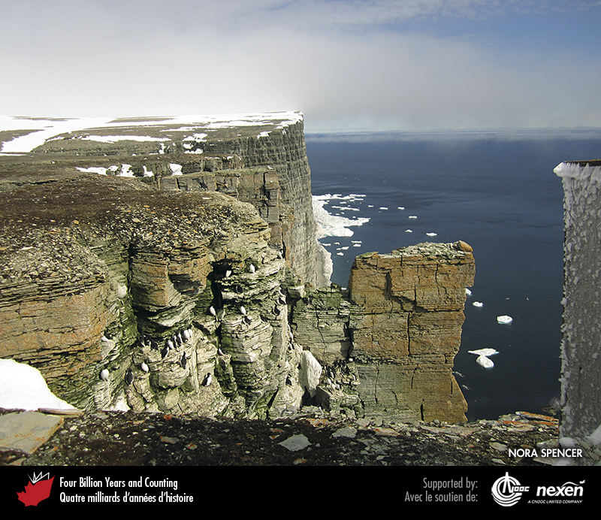
Notes:
Silurian carbonates deposited on the Euramerican margin of the Ural Ocean, now exposed on Prince Leopold Island, off the northeastern corner of Somerset Island, Nunavut. NORA SPENCER.
_______________________________
All photographic and graphic images (henceforth referred to as images) posted on this site are copyright of the persons and/or institutions indicated in the caption directly associated with each image. The copyright holders have agreed that you may use their images for educational, non-commercial purposes only and provided that they are credited in each instance of use. For all other uses you must contact the copyright holder.

Slide 6
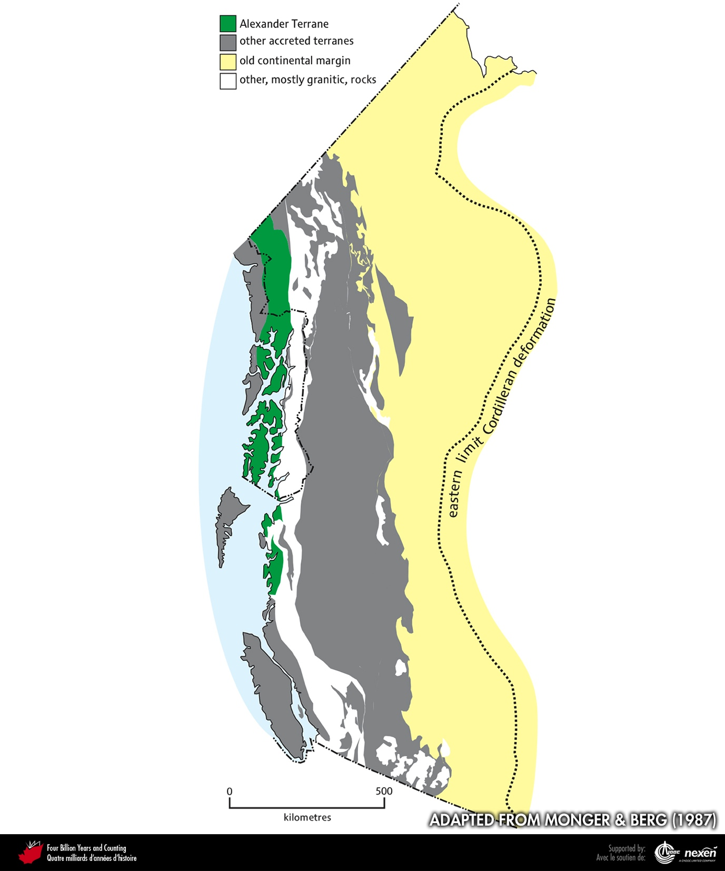
Notes:
Modern distribution of rocks of the Alexander Terrane. ADAPTED FROM MONGER AND BERG (1987), COURTESY OF THE US GEOLOGICAL SURVEY.
_______________________________
All photographic and graphic images (henceforth referred to as images) posted on this site are copyright of the persons and/or institutions indicated in the caption directly associated with each image. The copyright holders have agreed that you may use their images for educational, non-commercial purposes only and provided that they are credited in each instance of use. For all other uses you must contact the copyright holder.

Slide 7
Notes:
Mud cracks in Devonian mudstone of the Alexander Terrane on Prince of Wales Island, southeastern Alaska. This rock is similar to parts of the Devonian “Old Red Sandstone” of northwestern Europe. Metamorphosed equivalents of these strata occur in the southwestern Coast Mountains of British Columbia. JIM MONGER.
_______________________________
All photographic and graphic images (henceforth referred to as images) posted on this site are copyright of the persons and/or institutions indicated in the caption directly associated with each image. The copyright holders have agreed that you may use their images for educational, non-commercial purposes only and provided that they are credited in each instance of use. For all other uses you must contact the copyright holder.

Slide 8
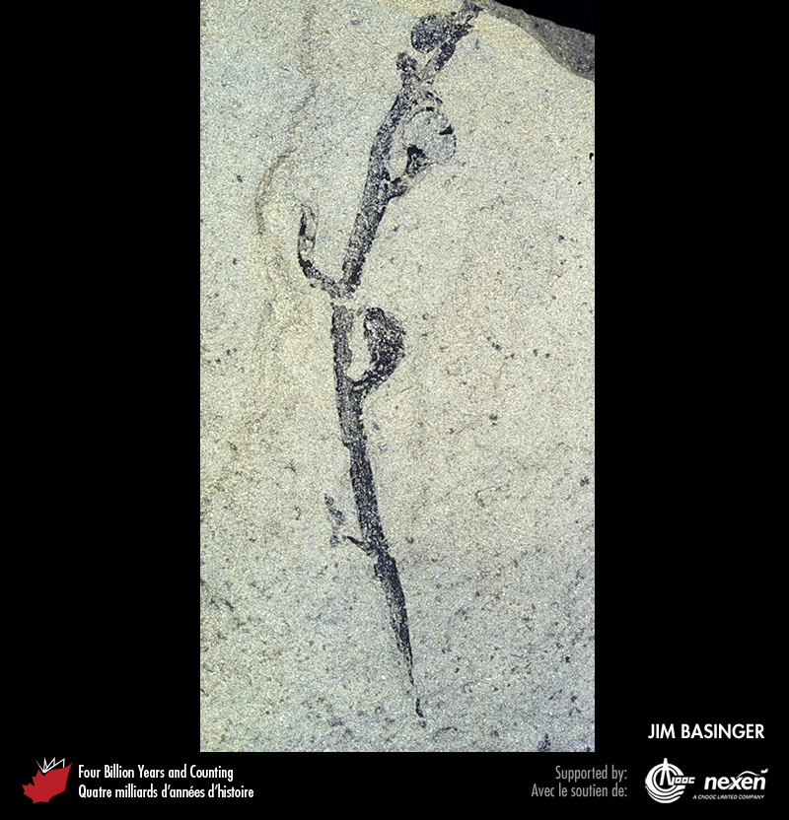
Notes:
An early land plant from late Silurian rocks on Bathurst Island, Nunavut. JIM BASINGER.
_______________________________
All photographic and graphic images (henceforth referred to as images) posted on this site are copyright of the persons and/or institutions indicated in the caption directly associated with each image. The copyright holders have agreed that you may use their images for educational, non-commercial purposes only and provided that they are credited in each instance of use. For all other uses you must contact the copyright holder.

Slide 9
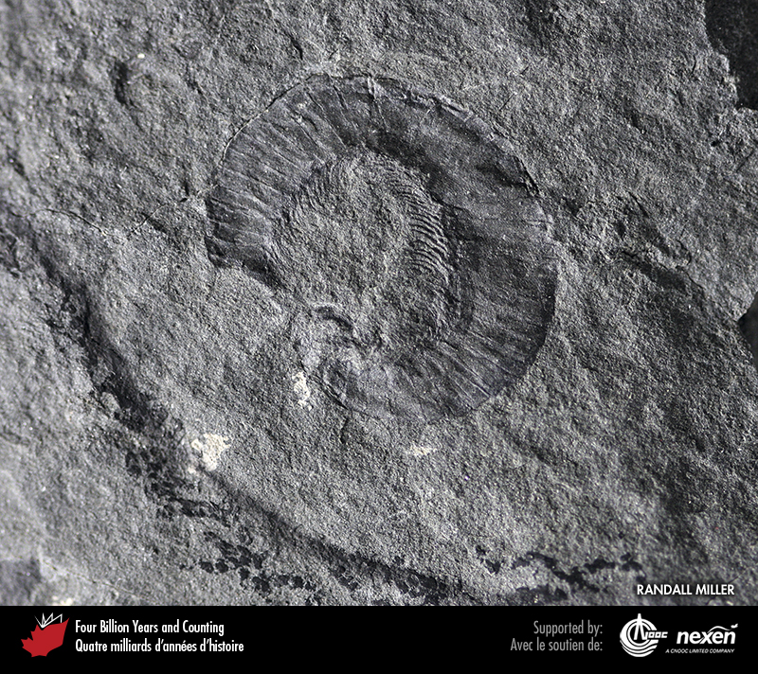
Notes:
An early Devonian millipede, Gaspestria genselorum, from Point La Nim, near Dalhousie Junction, New Brunswick. This specimen is one of the oldest-known land animals in North America. RANDALL MILLER, COURTESY OF THE NEW BRUNSWICK MUSEUM.
_______________________________
All photographic and graphic images (henceforth referred to as images) posted on this site are copyright of the persons and/or institutions indicated in the caption directly associated with each image. The copyright holders have agreed that you may use their images for educational, non-commercial purposes only and provided that they are credited in each instance of use. For all other uses you must contact the copyright holder.

Slide 10
Notes:
View to the northwest of Devonian strata in the Columbia Mountains of British Columbia. Detailed mapping of these Devonian strata has yielded evidence of compression, marking the change from a passive intraplate margin to an active plate margin on the west side of Euramerica about 390 million years ago. KEVIN ROOT.
_______________________________
All photographic and graphic images (henceforth referred to as images) posted on this site are copyright of the persons and/or institutions indicated in the caption directly associated with each image. The copyright holders have agreed that you may use their images for educational, non-commercial purposes only and provided that they are credited in each instance of use. For all other uses you must contact the copyright holder.

Slide 11
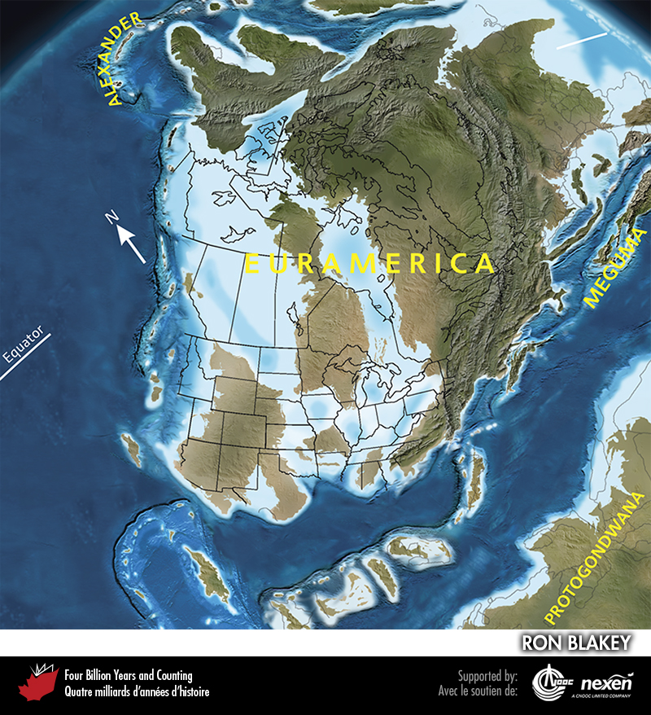
Notes:
Paleogeography of what was to become North America and adjacent regions in the middle Devonian, 385 million years ago. Land is shown in brown, with shading showing topography. The lighter blue areas represent possible coastal or nearshore areas, darker blue represents deeper ocean waters, and black indicates trenches. Aspects of modern geography are shown for orientation.
_______________________________
All photographic and graphic images (henceforth referred to as images) posted on this site are copyright of the persons and/or institutions indicated in the caption directly associated with each image. The copyright holders have agreed that you may use their images for educational, non-commercial purposes only and provided that they are credited in each instance of use. For all other uses you must contact the copyright holder.

Slide 12
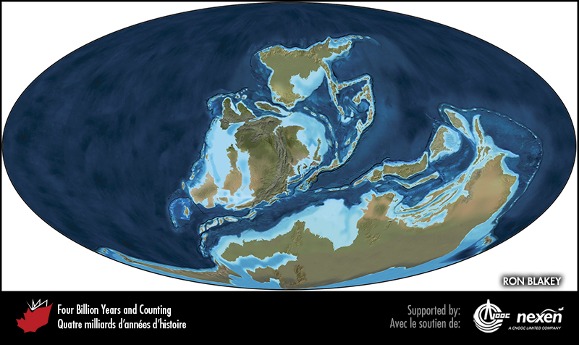
Notes:
Global paleogeography 385 million years ago, during the middle Devonian. Colours as for previous figure.
_______________________________
All photographic and graphic images (henceforth referred to as images) posted on this site are copyright of the persons and/or institutions indicated in the caption directly associated with each image. The copyright holders have agreed that you may use their images for educational, non-commercial purposes only and provided that they are credited in each instance of use. For all other uses you must contact the copyright holder.

Slide 13
Notes:
Late Devonian strata at Miguasha National Park, Quebec. These rocks contain beautifully preserved fossil fish, and other animals and plants. JEAN-PIERRE SYLVESTRE, COURTESY OF MIGUASHA NATIONAL PARK.
_______________________________
All photographic and graphic images (henceforth referred to as images) posted on this site are copyright of the persons and/or institutions indicated in the caption directly associated with each image. The copyright holders have agreed that you may use their images for educational, non-commercial purposes only and provided that they are credited in each instance of use. For all other uses you must contact the copyright holder.

Slide 14
Notes:
Fern-like foliage of Archaeopteris halliana, an early tree from late Devonian strata at Miguasha National Park, Quebec. Archaeopteris trees were up to 7 metres tall and formed the first forests. STEVE DESCHÊNES, COURTESY OF MIGUASHA NATIONAL PARK.
_______________________________
All photographic and graphic images (henceforth referred to as images) posted on this site are copyright of the persons and/or institutions indicated in the caption directly associated with each image. The copyright holders have agreed that you may use their images for educational, non-commercial purposes only and provided that they are credited in each instance of use. For all other uses you must contact the copyright holder.

Slide 15
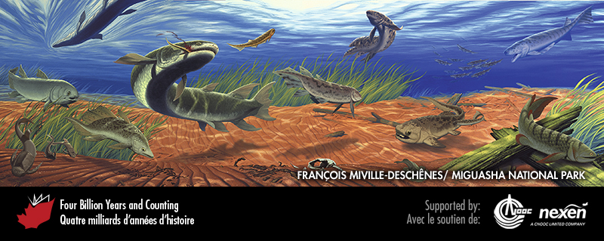
Notes:
A Devonian underwater scene based on fossil fish found at Miguasha National Park in Quebec. Swimming toward the surface, to the right of centre and above the grass-like plants, is Scaumenacia, a member of the group of lobe-fins called lungfish. Dominating the scene and in the process of finishing a snack, Eusthenopteron is circling in search of additional prey. Eusthenopteron is also a lobe-fin but belongs to the group that gave rise to the tetrapods. Hugging the estuary bottom to the right and relatively small is the jawless Escuminaspis, and above it the much larger Plourdosteus, a voracious carnivore with jaws. FROM CLOUTIER (2001), USED WITH PERMISSION; PAINTING BY FRANÇOIS MIVILLE-DESCHÊNES.
_______________________________
All photographic and graphic images (henceforth referred to as images) posted on this site are copyright of the persons and/or institutions indicated in the caption directly associated with each image. The copyright holders have agreed that you may use their images for educational, non-commercial purposes only and provided that they are credited in each instance of use. For all other uses you must contact the copyright holder.

Slide 16
Notes:
Specimen of the Devonian lobe-finned fish Eusthenopteron foordi from Miguasha National Park, Quebec. This fish had pectoral fins similar to tetrapod limbs, lungs and gills, and internal nostrils that allowed it to breathe with its mouth closed. JEAN-PIERRE SYLVESTRE, COURTESY OF MIGUASHA NATIONAL PARK.
_______________________________
All photographic and graphic images (henceforth referred to as images) posted on this site are copyright of the persons and/or institutions indicated in the caption directly associated with each image. The copyright holders have agreed that you may use their images for educational, non-commercial purposes only and provided that they are credited in each instance of use. For all other uses you must contact the copyright holder.

Slide 17
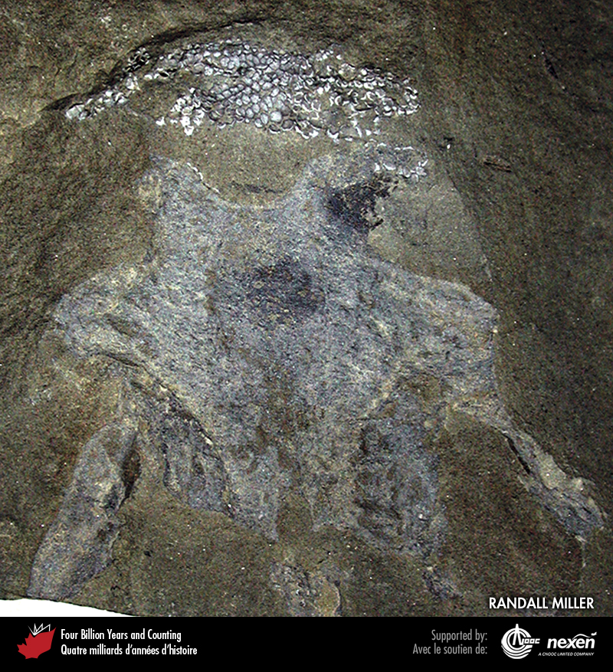
Notes:
Braincase of the earliest-known shark, Doliodus, from early Devonian rocks at Atholville, New Brunswick. RANDALL MILLER, COURTESY OF THE NEW BRUNSWICK MUSEUM.
_______________________________
All photographic and graphic images (henceforth referred to as images) posted on this site are copyright of the persons and/or institutions indicated in the caption directly associated with each image. The copyright holders have agreed that you may use their images for educational, non-commercial purposes only and provided that they are credited in each instance of use. For all other uses you must contact the copyright holder.

