Slide 1
CHAPTER 11 Part 2 of 3
All photographic and graphic images (henceforth referred to as images) posted on this site are copyright of the persons and/or institutions indicated in the caption directly associated with each image. The copyright holders have agreed that you may use their images for educational, non-commercial purposes only and provided that they are credited in each instance of use. For all other uses you must contact the copyright holder.

Slide 2
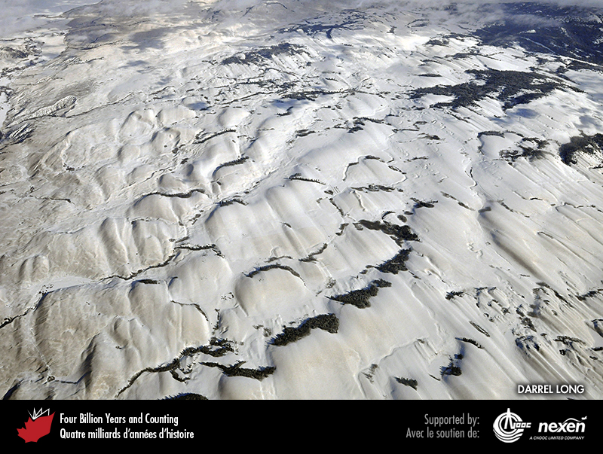
Notes:
These snow-covered drumlins near Nicola Lake, south of Kamloops, British Columbia, were formed beneath the Cordilleran Ice Sheet. From the shape of the drumlins, we can infer that the ice flowed toward the lower right. DARREL LONG.
_______________________________
All photographic and graphic images (henceforth referred to as images) posted on this site are copyright of the persons and/or institutions indicated in the caption directly associated with each image. The copyright holders have agreed that you may use their images for educational, non-commercial purposes only and provided that they are credited in each instance of use. For all other uses you must contact the copyright holder.

Slide 3
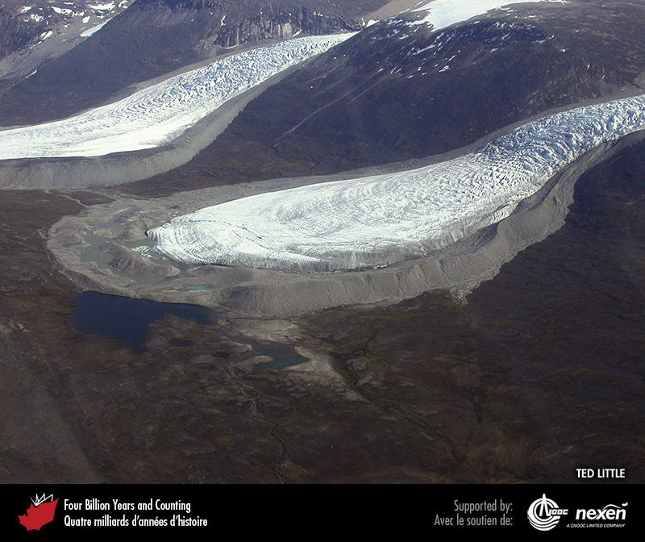
Notes:
Aerial view of a glacier on Baffin Island, Nunavut, surrounded by moraines. TED LITTLE.
_______________________________
All photographic and graphic images (henceforth referred to as images) posted on this site are copyright of the persons and/or institutions indicated in the caption directly associated with each image. The copyright holders have agreed that you may use their images for educational, non-commercial purposes only and provided that they are credited in each instance of use. For all other uses you must contact the copyright holder.

Slide 4
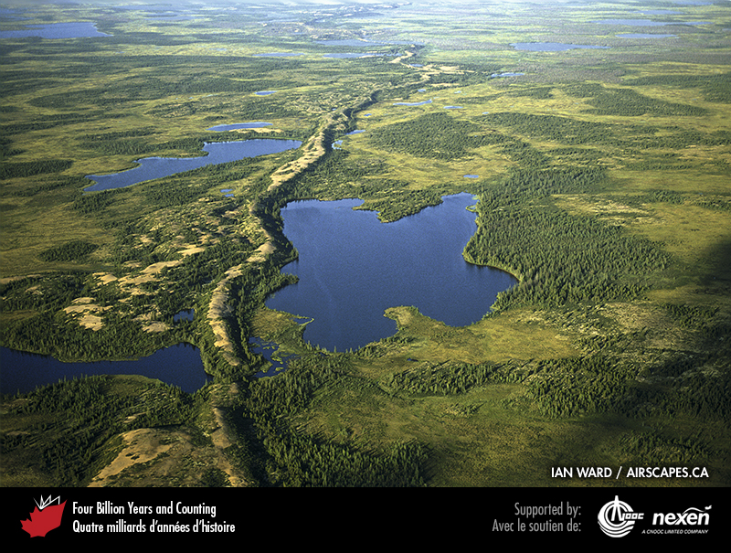
Notes:
An esker snakes across the landscape in the Northwest Territories. IAN WARD / AIRSCAPES.CA.
_______________________________
All photographic and graphic images (henceforth referred to as images) posted on this site are copyright of the persons and/or institutions indicated in the caption directly associated with each image. The copyright holders have agreed that you may use their images for educational, non-commercial purposes only and provided that they are credited in each instance of use. For all other uses you must contact the copyright holder.

Slide 5
Notes:
Moraine-dammed lake at the foot of Bishop Glacier in the southern Coast Mountains of British Columbia. JOHN CLAGUE.
_______________________________
All photographic and graphic images (henceforth referred to as images) posted on this site are copyright of the persons and/or institutions indicated in the caption directly associated with each image. The copyright holders have agreed that you may use their images for educational, non-commercial purposes only and provided that they are credited in each instance of use. For all other uses you must contact the copyright holder.

Slide 6
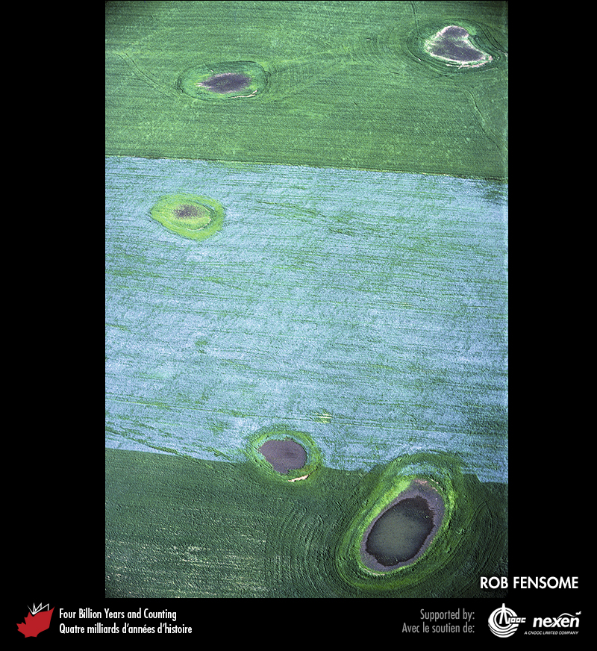
Notes:
Kettle holes punctuate the farmland in this aerial view taken east of Saskatoon, Saskatchewan. The blue-flowering crop is flax. ROB FENSOME
_______________________________
All photographic and graphic images (henceforth referred to as images) posted on this site are copyright of the persons and/or institutions indicated in the caption directly associated with each image. The copyright holders have agreed that you may use their images for educational, non-commercial purposes only and provided that they are credited in each instance of use. For all other uses you must contact the copyright holder.

Slide 7
Notes:
These cyclic layers of mud deposited in a former glacial lake and now exposed along the shore of Lac Temiscamingue, Quebec, represent annual accumulations and are known as varves. JEAN VEILLETTE, REPRODUCED WITH THE PERMISSION OF NATURAL RESOURCES CANADA 2013, COURTESY OF THE GEOLOGICAL SURVEY OF CANADA.
_______________________________
All photographic and graphic images (henceforth referred to as images) posted on this site are copyright of the persons and/or institutions indicated in the caption directly associated with each image. The copyright holders have agreed that you may use their images for educational, non-commercial purposes only and provided that they are credited in each instance of use. For all other uses you must contact the copyright holder.

Slide 8
Notes:
Ice lens in permafrost in the Katherine River valley, Torngat Mountains, Labrador. M. J. VAN KRANENDONK, REPRODUCED WITH THE PERMISSION OF NATURAL RESOURCES CANADA 2013, COURTESY OF THE GEOLOGICAL SURVEY OF CANADA.
_______________________________
All photographic and graphic images (henceforth referred to as images) posted on this site are copyright of the persons and/or institutions indicated in the caption directly associated with each image. The copyright holders have agreed that you may use their images for educational, non-commercial purposes only and provided that they are credited in each instance of use. For all other uses you must contact the copyright holder.

Slide 9
Notes:
Aerial view of polygonal patterned ground, produced by ice wedges, on Ellef Ringnes Island, Nunavut. CAROL EVENCHICK.
_______________________________
All photographic and graphic images (henceforth referred to as images) posted on this site are copyright of the persons and/or institutions indicated in the caption directly associated with each image. The copyright holders have agreed that you may use their images for educational, non-commercial purposes only and provided that they are credited in each instance of use. For all other uses you must contact the copyright holder.

Slide 10
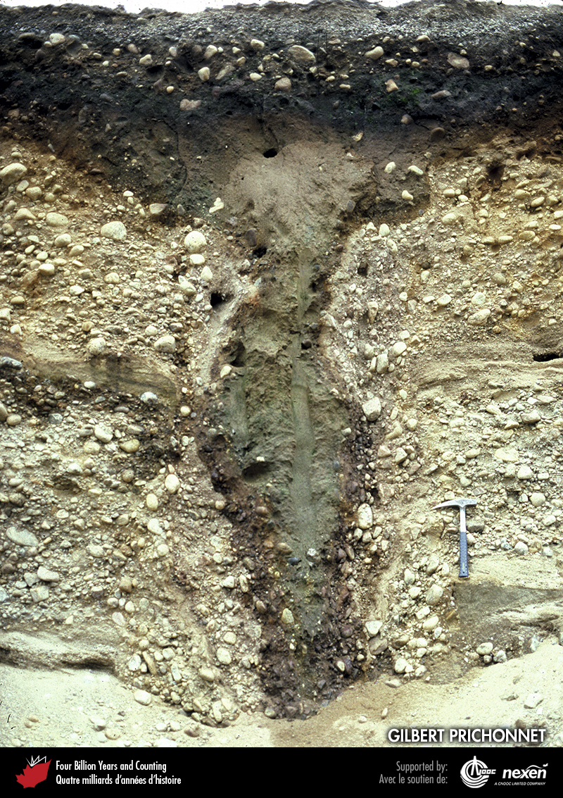
Notes:
An ice wedge, near Arundel, Quebec, formed about 11,500 years ago. After ice had opened the wedge and melted, probably several times, gravel partially filled the hole, followed later by windblown dust. More recent gravel has been deposited over the top of the structure. GILBERT PRICHONNET.
_______________________________
All photographic and graphic images (henceforth referred to as images) posted on this site are copyright of the persons and/or institutions indicated in the caption directly associated with each image. The copyright holders have agreed that you may use their images for educational, non-commercial purposes only and provided that they are credited in each instance of use. For all other uses you must contact the copyright holder.

Slide 11
Notes:
Pingo near Erly Lake, Tuktut Nogait National Park of Canada, Northwest Territories. I. K. MACNEIL, COPYRIGHT PARKS CANADA.
_______________________________
All photographic and graphic images (henceforth referred to as images) posted on this site are copyright of the persons and/or institutions indicated in the caption directly associated with each image. The copyright holders have agreed that you may use their images for educational, non-commercial purposes only and provided that they are credited in each instance of use. For all other uses you must contact the copyright holder.

Slide 12
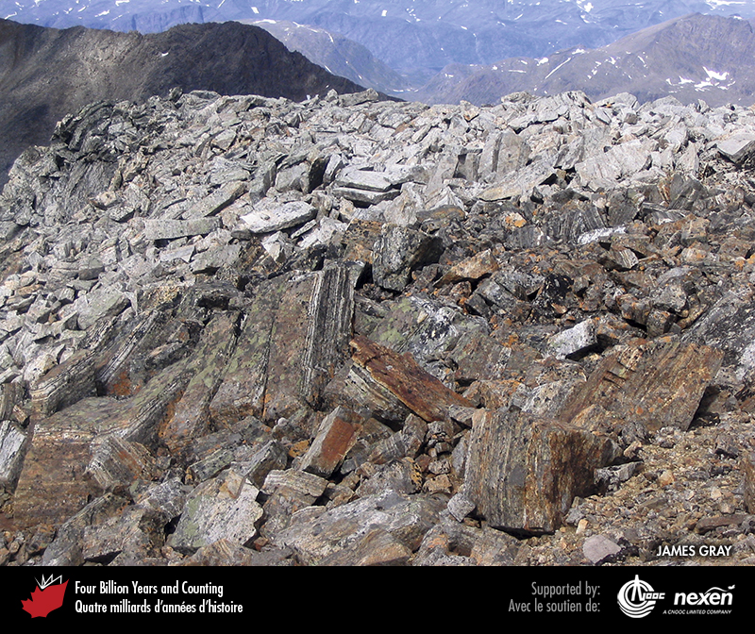
Notes:
Felsenmeer on a small plateau high in the Torngat Mountains, close to the Quebec-Labrador border. The frost-shattered bedrock is composed of Archean gneisses from the eastern margin of the Superior Craton. JAMES GRAY.
_______________________________
All photographic and graphic images (henceforth referred to as images) posted on this site are copyright of the persons and/or institutions indicated in the caption directly associated with each image. The copyright holders have agreed that you may use their images for educational, non-commercial purposes only and provided that they are credited in each instance of use. For all other uses you must contact the copyright holder.

Slide 13
Notes:
Aerial view of thermokarst, Wapusk National Park of Canada, Manitoba. N. ROSING, COPYRIGHT PARKS CANADA.
_______________________________
All photographic and graphic images (henceforth referred to as images) posted on this site are copyright of the persons and/or institutions indicated in the caption directly associated with each image. The copyright holders have agreed that you may use their images for educational, non-commercial purposes only and provided that they are credited in each instance of use. For all other uses you must contact the copyright holder.

Slide 14
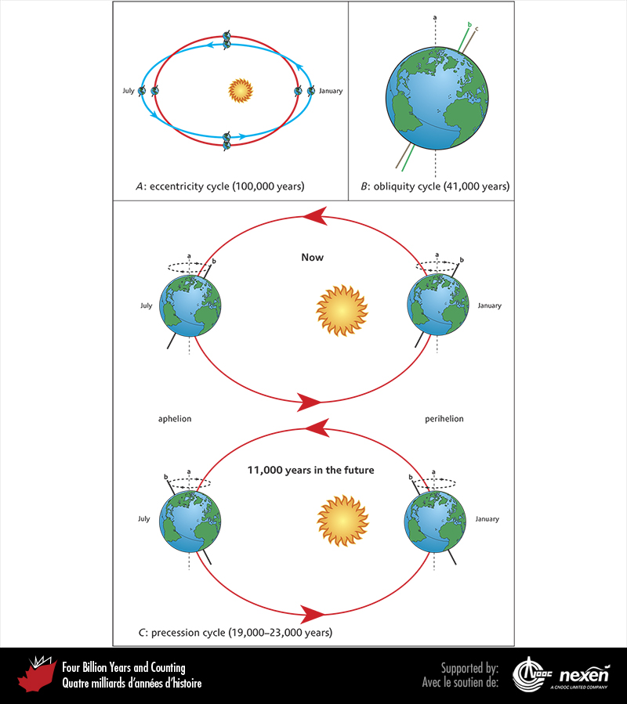
Notes:
A. The orbit of the Earth around the Sun changes from strongly ellipsoidal to almost circular and back to strongly ellipsoidal every 100,000 years; this is the eccentricity cycle. B. The ecliptic axis (a) is an imaginary line perpendicular to the Earth’s orbit around the Sun. The angle between the Earth’s rotational axis (b and c) and the ecliptic axis varies between 22.1° (b) and 24.5° (c) and back every 41,000 years. This is the obliquity cycle. C. Earth’s rotational axis (b) completes a precession cycle by circling the ecliptic axis (a) every 19,000 to 23,000 years. The upper diagram represents today, with the Northern Hemisphere tilted towards the Sun in July and away from it in January. The bottom diagram shows the halfway stage in the cycle, about 11,000 years in the future, when the Northern Hemisphere will be tilted away from the Sun in July and toward it in January. To avoid confusion, the shape of the Earth’s orbit and the position of the Sun are shown unchanged in this diagram.
_______________________________
All photographic and graphic images (henceforth referred to as images) posted on this site are copyright of the persons and/or institutions indicated in the caption directly associated with each image. The copyright holders have agreed that you may use their images for educational, non-commercial purposes only and provided that they are credited in each instance of use. For all other uses you must contact the copyright holder.

