Slide 1
CHAPTER 5 Part 1 of 2
All photographic and graphic images (henceforth referred to as images) posted on this site are copyright of the persons and/or institutions indicated in the caption directly associated with each image. The copyright holders have agreed that you may use their images for educational, non-commercial purposes only and provided that they are credited in each instance of use. For all other uses you must contact the copyright holder.

Slide 2
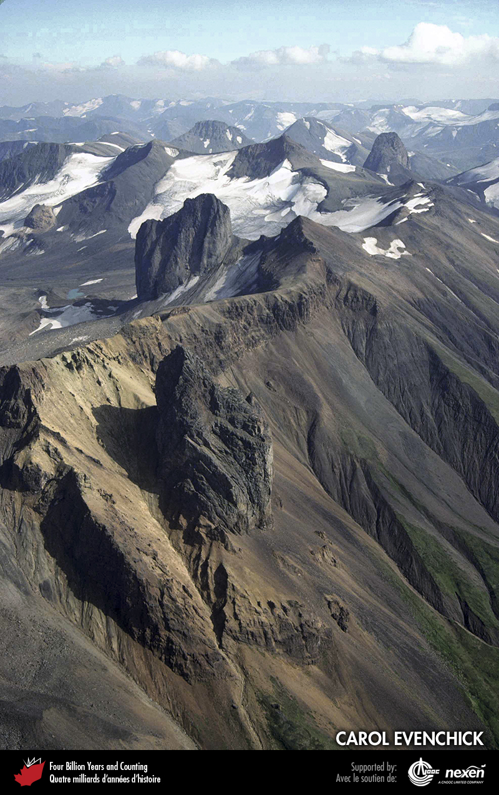
Notes:
The steep-sided isolated peaks in this scene, at the head of Maitland Creek, Skeena Mountains, British Columbia, are Pliocene volcanic necks of the Stikine Volcanic Belt (Chapter 10). They were intruded into Jurassic sedimentary rocks. CAROL EVENCHICK.
_______________________________
All photographic and graphic images (henceforth referred to as images) posted on this site are copyright of the persons and/or institutions indicated in the caption directly associated with each image. The copyright holders have agreed that you may use their images for educational, non-commercial purposes only and provided that they are credited in each instance of use. For all other uses you must contact the copyright holder.

Slide 3
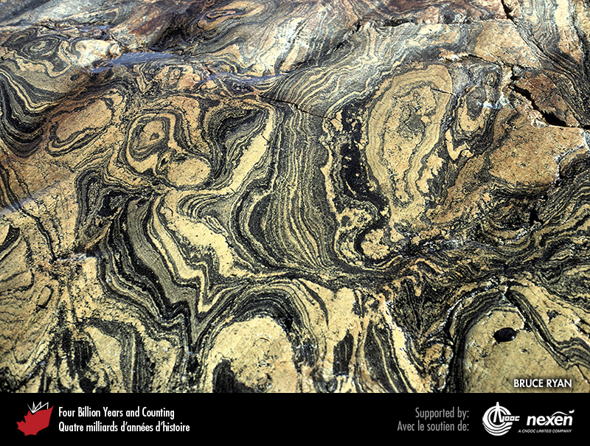
Notes:
Convoluted Archean gneiss at Fords Harbour, near Nain, Labrador. This rock, part of what geologists call the North Atlantic Craton, formed under very high pressures and temperatures in the lower continental crust. BRUCE RYAN.
_______________________________
All photographic and graphic images (henceforth referred to as images) posted on this site are copyright of the persons and/or institutions indicated in the caption directly associated with each image. The copyright holders have agreed that you may use their images for educational, non-commercial purposes only and provided that they are credited in each instance of use. For all other uses you must contact the copyright holder.

Slide 4
Notes:
Geologic time scale, showing the interval covered in this chapter. Numbers indicate millions of years ago. P = Paleogene (Paleocene to Oligocene), N = Neogene (Miocene and Pliocene), and Q = Quaternary.
_______________________________
All photographic and graphic images (henceforth referred to as images) posted on this site are copyright of the persons and/or institutions indicated in the caption directly associated with each image. The copyright holders have agreed that you may use their images for educational, non-commercial purposes only and provided that they are credited in each instance of use. For all other uses you must contact the copyright holder.

Slide 5
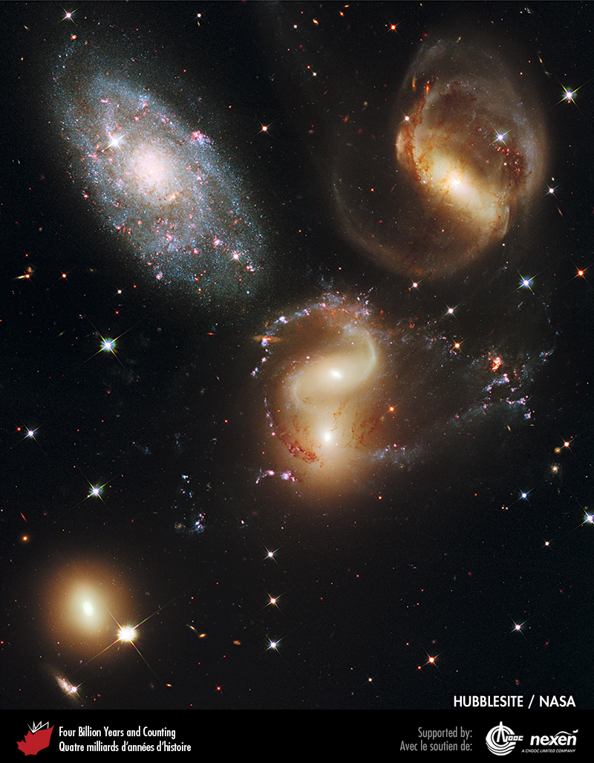
Notes:
A group of five galaxies known as Stephan’s Quintet, viewed through the Hubble Space Telescope. Individual members of the Quintet are prominent, but many of the other “stars” in the background are in fact more distant galaxies. Galaxies are a result of the Big Bang, which occurred 14,000 to 13,500 million years ago. FROM THE HUBBLESITE, COURTESY OF NASA AND STSCI.
_______________________________
All photographic and graphic images (henceforth referred to as images) posted on this site are copyright of the persons and/or institutions indicated in the caption directly associated with each image. The copyright holders have agreed that you may use their images for educational, non-commercial purposes only and provided that they are credited in each instance of use. For all other uses you must contact the copyright holder.

Slide 6
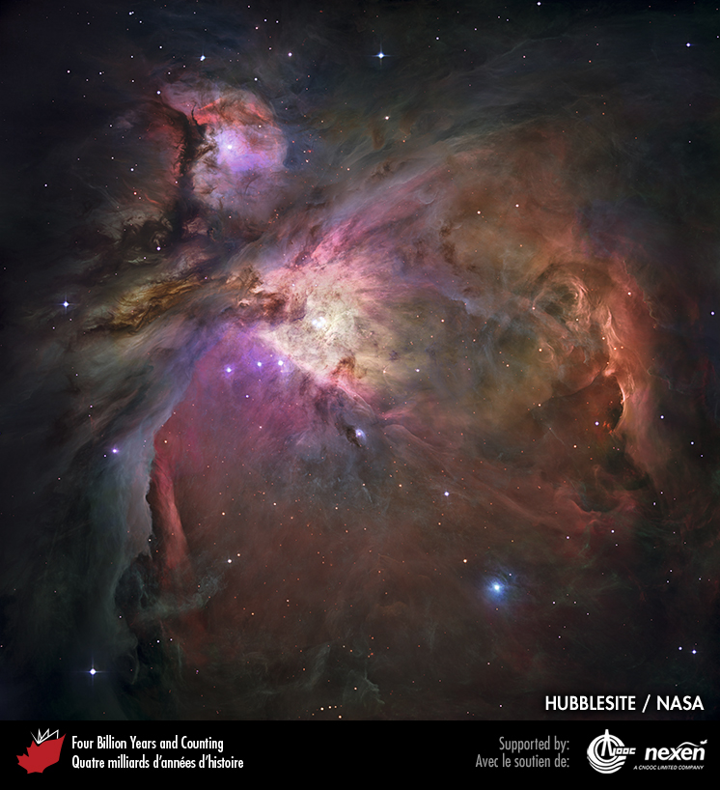
Notes:
The Orion Nebula, a nebula within our Milky Way Galaxy, as seen through the Hubble Space Telescope. Nebulae are accumulations of gas and dust that glow due to radiation from nearby stars, and are the nurseries for new solar systems. FROM THE HUBBLESITE, COURTESY OF NASA AND STSCI.
_______________________________
All photographic and graphic images (henceforth referred to as images) posted on this site are copyright of the persons and/or institutions indicated in the caption directly associated with each image. The copyright holders have agreed that you may use their images for educational, non-commercial purposes only and provided that they are credited in each instance of use. For all other uses you must contact the copyright holder.

Slide 7
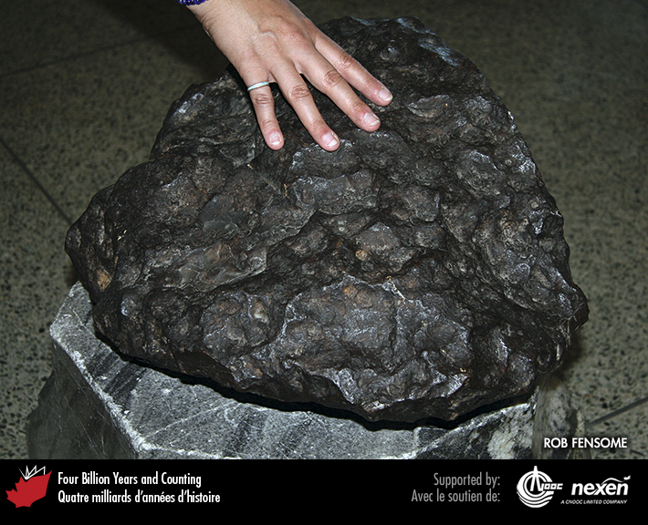
Notes:
The largest intact meteorite ever found in Canada fell near Madoc, Ontario, perhaps in the early nineteenth century, and was discovered by William Logan in 1854. It is a single mass of iron weighing over 150 kilograms, twice the weight of an average adult person. ROB FENSOME, SPECIMEN COURTESY OF NATURAL RESOURCES CANADA. _______________________________
All photographic and graphic images (henceforth referred to as images) posted on this site are copyright of the persons and/or institutions indicated in the caption directly associated with each image. The copyright holders have agreed that you may use their images for educational, non-commercial purposes only and provided that they are credited in each instance of use. For all other uses you must contact the copyright holder.

Slide 8
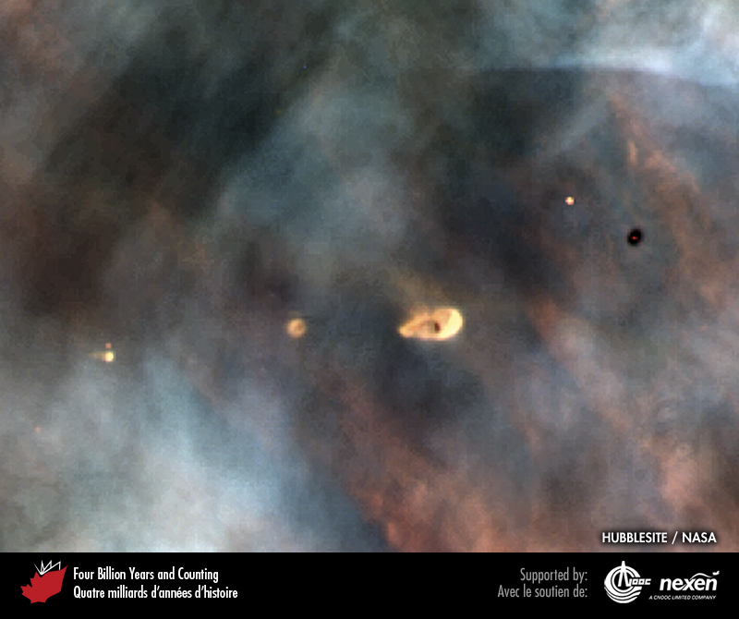
Notes:
The bright and dark spots respectively shining out from or silhouetted against the Orion Nebula are planetary discs. Such discs are nascent solar systems, clouds of gas and dust surrounding a youthful star. FROM THE HUBBLESITE, COURTESY OF NASA AND STSCI.
_______________________________
All photographic and graphic images (henceforth referred to as images) posted on this site are copyright of the persons and/or institutions indicated in the caption directly associated with each image. The copyright holders have agreed that you may use their images for educational, non-commercial purposes only and provided that they are credited in each instance of use. For all other uses you must contact the copyright holder.

Slide 9
Notes:
A thin-section of basalt from the Moon, shown in cross-polarized light. The black mineral is ilmenite, the multi-coloured mineral is pyroxene, and the grey-green striped mineral is plagioclase feldspar. The field of view is 4 millimetres across. BARRIE CLARKE.
_______________________________
All photographic and graphic images (henceforth referred to as images) posted on this site are copyright of the persons and/or institutions indicated in the caption directly associated with each image. The copyright holders have agreed that you may use their images for educational, non-commercial purposes only and provided that they are credited in each instance of use. For all other uses you must contact the copyright holder.

Slide 10
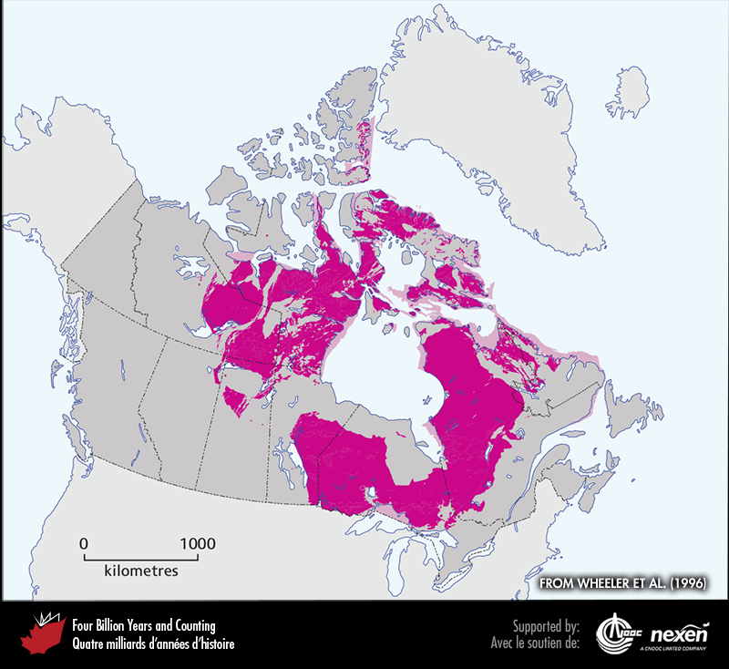
Notes:
General extent of Hadean and Archean rocks at the surface (after glacial deposits are removed) of onshore and offshore Canada. The lighter shaded areas denote either uncertainty or areas where rocks of the particular age have been confirmed but are intimately associated with rocks of other ages and the scale of the map doesn’t let us show them separately. ADAPTED FROM WHEELER ET AL. (1996).
_______________________________
All photographic and graphic images (henceforth referred to as images) posted on this site are copyright of the persons and/or institutions indicated in the caption directly associated with each image. The copyright holders have agreed that you may use their images for educational, non-commercial purposes only and provided that they are credited in each instance of use. For all other uses you must contact the copyright holder.

Slide 11
Notes:
Specimen of Acasta Gneiss from the Northwest Territories, the world’s oldest-known rock at 4,030 million years. The Hadean date is of the original felsic igneous rock, which was metamorphosed to gneiss during the Archean. GODFREY NOWLAN.
_______________________________
All photographic and graphic images (henceforth referred to as images) posted on this site are copyright of the persons and/or institutions indicated in the caption directly associated with each image. The copyright holders have agreed that you may use their images for educational, non-commercial purposes only and provided that they are credited in each instance of use. For all other uses you must contact the copyright holder.

Slide 12
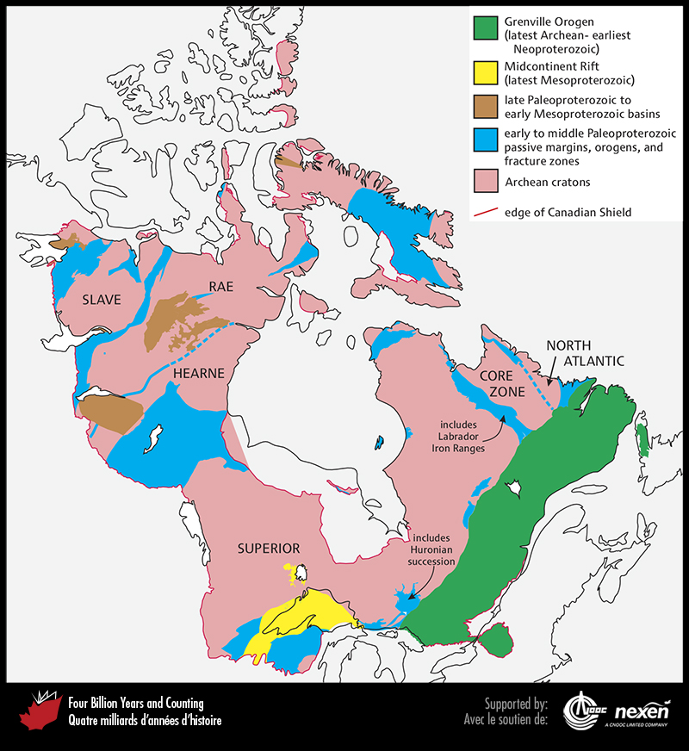
Notes:
The geology of the Canadian Shield.
_______________________________
All photographic and graphic images (henceforth referred to as images) posted on this site are copyright of the persons and/or institutions indicated in the caption directly associated with each image. The copyright holders have agreed that you may use their images for educational, non-commercial purposes only and provided that they are credited in each instance of use. For all other uses you must contact the copyright holder.

Slide 13
Notes:
Part of a komatiite lava flow dated to about 2,700 million years, showing spinifex texture. This exposure is in the Abitibi Greenstone Belt of the Superior Craton, near Rouyn-Noranda, Quebec. DAVID CORRIGAN.
_______________________________
All photographic and graphic images (henceforth referred to as images) posted on this site are copyright of the persons and/or institutions indicated in the caption directly associated with each image. The copyright holders have agreed that you may use their images for educational, non-commercial purposes only and provided that they are credited in each instance of use. For all other uses you must contact the copyright holder.

