Slide 1
CHAPTER 9 Part 4 of 4
All photographic and graphic images (henceforth referred to as images) posted on this site are copyright of the persons and/or institutions indicated in the caption directly associated with each image. The copyright holders have agreed that you may use their images for educational, non-commercial purposes only and provided that they are credited in each instance of use. For all other uses you must contact the copyright holder.

Slide 2
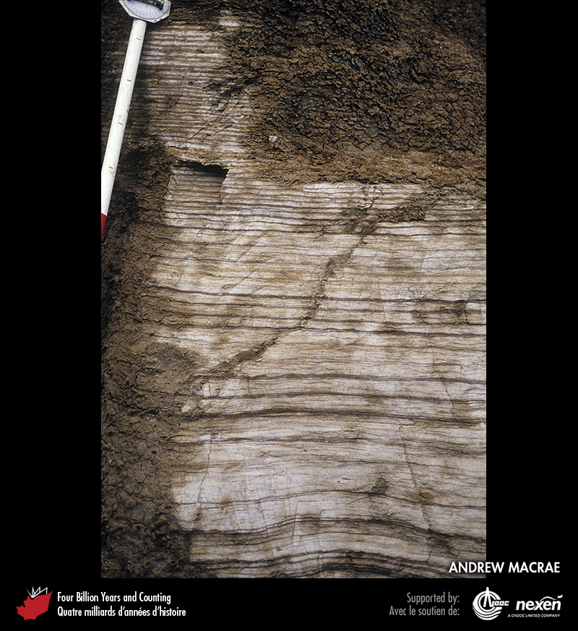
Notes:
Cretaceous tidal deposits associated with the Bearpaw Sea, near Drumheller, Alberta. The rhythmic layering of the sediment reflects daily tidal cycles. ANDREW MACRAE.
_______________________________
All photographic and graphic images (henceforth referred to as images) posted on this site are copyright of the persons and/or institutions indicated in the caption directly associated with each image. The copyright holders have agreed that you may use their images for educational, non-commercial purposes only and provided that they are credited in each instance of use. For all other uses you must contact the copyright holder.

Slide 3
Notes:
Tilted late Jurassic strata along the Trans-Canada Highway, just east of Banff, Alberta. These rocks were deposited in the Western Interior Basin. They represent a transition from marine to non-marine environments and are part of the first major influx of clastic sediments eroded from the rising Cordillera to the west. JIM MONGER.
_______________________________
All photographic and graphic images (henceforth referred to as images) posted on this site are copyright of the persons and/or institutions indicated in the caption directly associated with each image. The copyright holders have agreed that you may use their images for educational, non-commercial purposes only and provided that they are credited in each instance of use. For all other uses you must contact the copyright holder.

Slide 4
Notes:
Late Cretaceous strata in Dinosaur Provincial Park, Alberta, have been sculpted into interesting shapes by erosion. M. FINKELSTEIN, COPYRIGHT PARKS CANADA.
_______________________________
All photographic and graphic images (henceforth referred to as images) posted on this site are copyright of the persons and/or institutions indicated in the caption directly associated with each image. The copyright holders have agreed that you may use their images for educational, non-commercial purposes only and provided that they are credited in each instance of use. For all other uses you must contact the copyright holder.

Slide 5
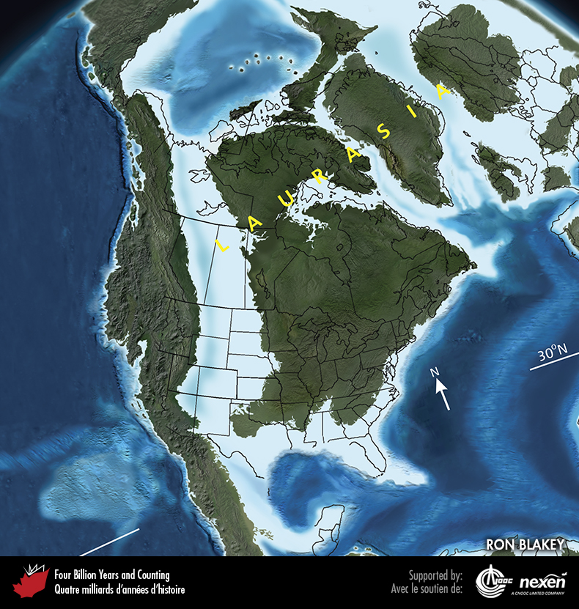
Notes:
Paleogeography of what was to become North America and adjacent regions in the late Cretaceous, 85 million years ago. Land is shown in brown, with shading showing topography. The lighter blue areas represent possible coastal or nearshore areas, darker blue represents deeper ocean waters, and black indicates trenches. Aspects of modern geography are shown for orientation.
_______________________________
All photographic and graphic images (henceforth referred to as images) posted on this site are copyright of the persons and/or institutions indicated in the caption directly associated with each image. The copyright holders have agreed that you may use their images for educational, non-commercial purposes only and provided that they are credited in each instance of use. For all other uses you must contact the copyright holder.

Slide 6
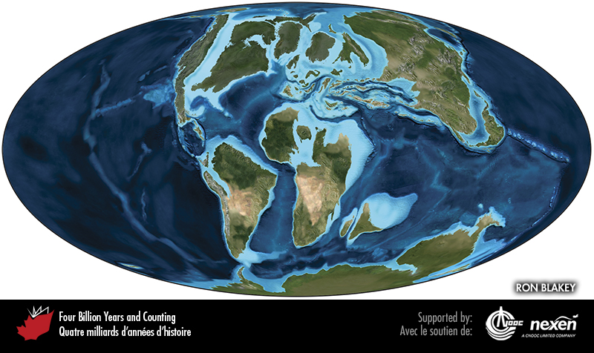
Notes:
Global paleogeography 85 million years ago, during the late Cretaceous. Colours as for previous figure.
_______________________________
All photographic and graphic images (henceforth referred to as images) posted on this site are copyright of the persons and/or institutions indicated in the caption directly associated with each image. The copyright holders have agreed that you may use their images for educational, non-commercial purposes only and provided that they are credited in each instance of use. For all other uses you must contact the copyright holder.

Slide 7
Notes:
Small pockets of early Cretaceous deposits, rarely exposed at the surface, occur in the Maritimes. Some of the white fluvial sand and gravel from this quarry, south of Sussex, New Brunswick, is used for sand traps on golf courses. ROB FENSOME.
_______________________________
All photographic and graphic images (henceforth referred to as images) posted on this site are copyright of the persons and/or institutions indicated in the caption directly associated with each image. The copyright holders have agreed that you may use their images for educational, non-commercial purposes only and provided that they are credited in each instance of use. For all other uses you must contact the copyright holder.

Slide 8
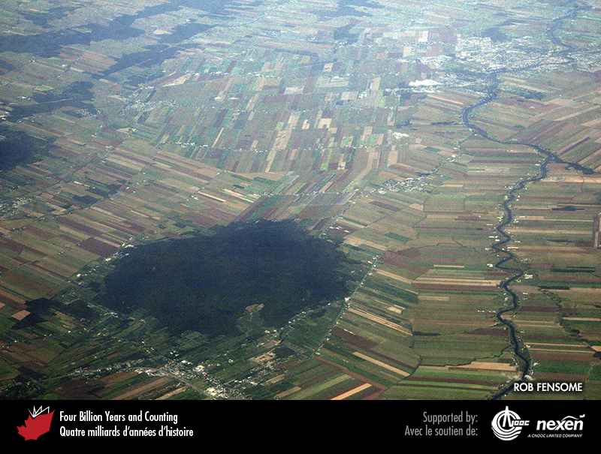
Notes:
Aerial view of Mont Rougemont (the forested area at bottom left), one of the Monteregian Hills of Quebec. ROB FENSOME.
_______________________________
All photographic and graphic images (henceforth referred to as images) posted on this site are copyright of the persons and/or institutions indicated in the caption directly associated with each image. The copyright holders have agreed that you may use their images for educational, non-commercial purposes only and provided that they are credited in each instance of use. For all other uses you must contact the copyright holder.

Slide 9
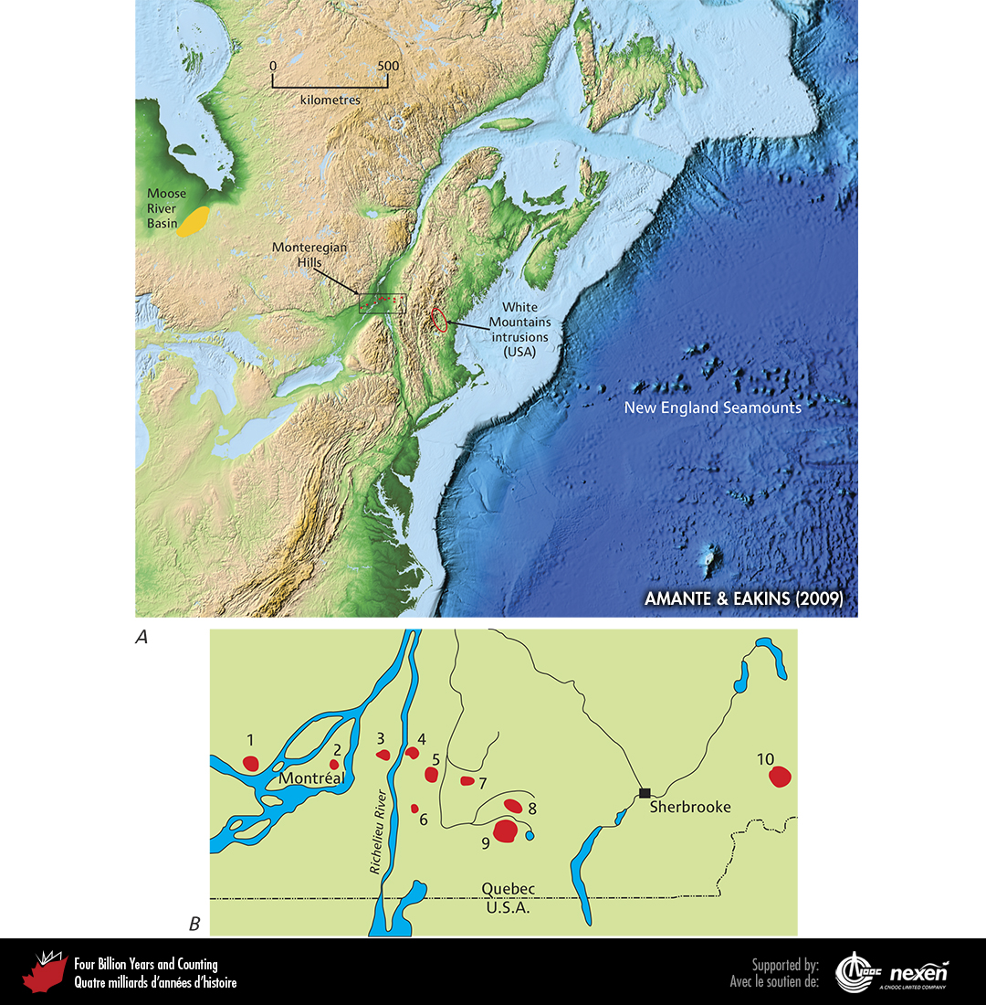
Notes:
A shows parts of eastern North America and the western North Atlantic including the location of the offshore New England Seamounts, the White Mountain intrusions in New England, the Monteregian Hills in Quebec, and the Moose River Basin in northern Ontario. B, represented by the box in A, shows the distribution in southern Quebec of the Monteregian Hills: 1 = Oka, 2 = Mount Royal, 3 = Mont Saint-Bruno, 4 = Mont Saint-Hilaire, 5 = Mont Rougemont, 6 = Mont Saint-Grégoire, 7 = Mont Yamaska, 8 = Mont Shefford, 9 = Mont Brome, 10 = Mont Mégantic. ADAPTED FROM VARIOUS SOURCES.
_______________________________
All photographic and graphic images (henceforth referred to as images) posted on this site are copyright of the persons and/or institutions indicated in the caption directly associated with each image. The copyright holders have agreed that you may use their images for educational, non-commercial purposes only and provided that they are credited in each instance of use. For all other uses you must contact the copyright holder.

Slide 10
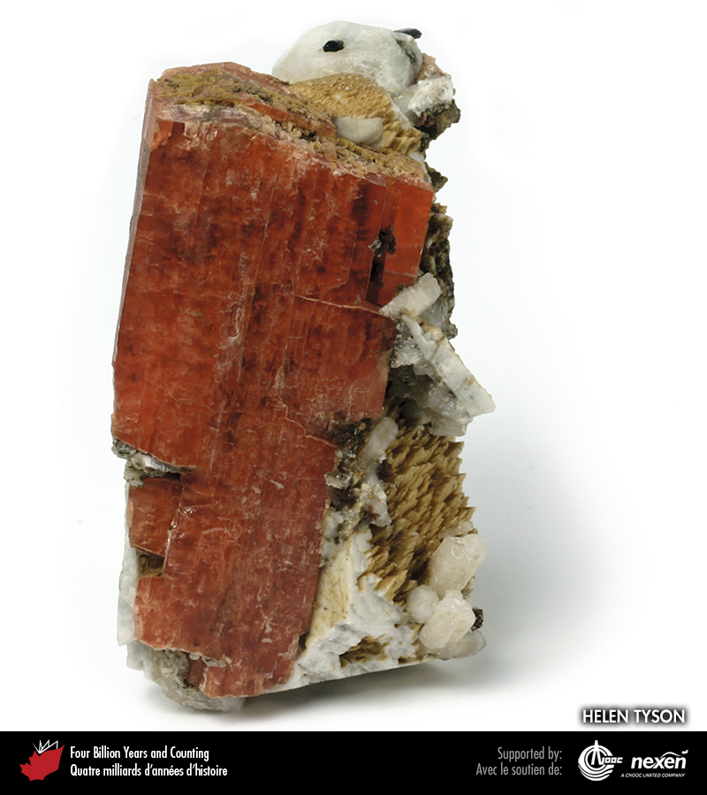
Notes:
The igneous rocks that form the Monteregian Hills are a source of rare minerals, such as this specimen of orange serandite from Mont Saint-Hilaire, Quebec. HELEN TYSON, FROM THE COLLECTION OF HELEN AND ROD TYSON.
_______________________________
All photographic and graphic images (henceforth referred to as images) posted on this site are copyright of the persons and/or institutions indicated in the caption directly associated with each image. The copyright holders have agreed that you may use their images for educational, non-commercial purposes only and provided that they are credited in each instance of use. For all other uses you must contact the copyright holder.

Slide 11
Notes:
An excavated bone bed in Dinosaur Provincial Park, Alberta. DAVID EBERTH.
_______________________________
All photographic and graphic images (henceforth referred to as images) posted on this site are copyright of the persons and/or institutions indicated in the caption directly associated with each image. The copyright holders have agreed that you may use their images for educational, non-commercial purposes only and provided that they are credited in each instance of use. For all other uses you must contact the copyright holder.

Slide 12
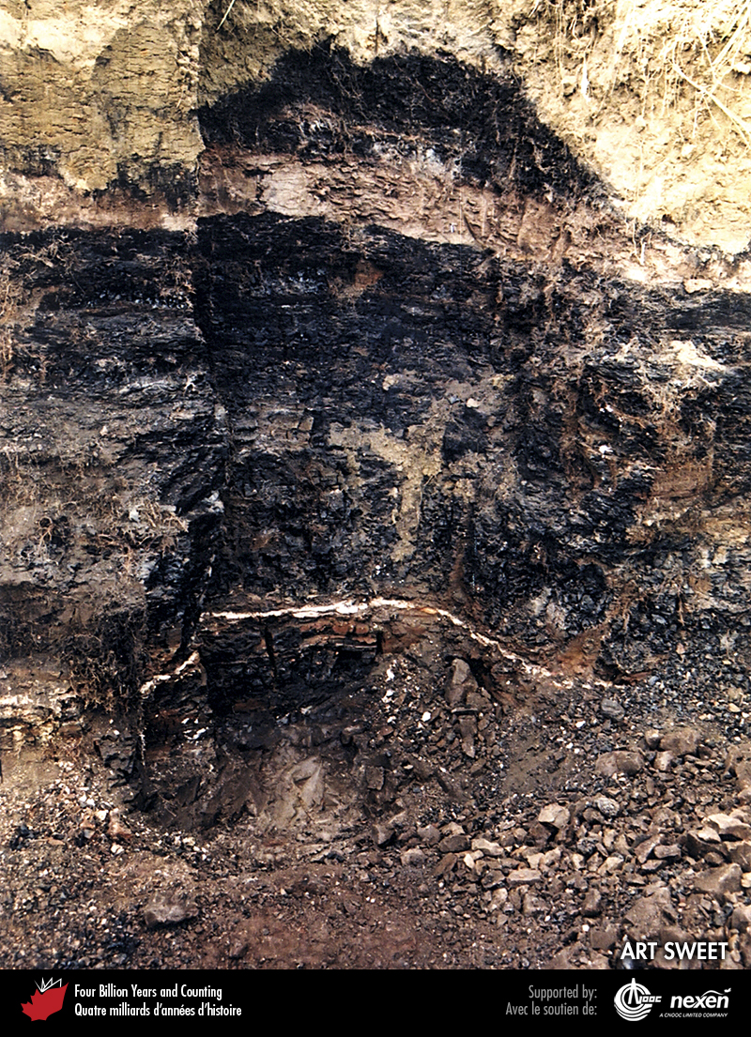
Notes:
Cretaceous-Tertiary boundary layers at the base of a coal bed, Wood Mountain Creek, south-central Saskatchewan. The thin white layer, which marks the boundary, was originally a layer of glass beads derived from rock that melted during the asteroid impact event but is now weathered to kaolin clay, a white aluminum-rich clay. The overlying rusty-brown to dark grey impact layers (1 to 1.5 centimetres thick) are enriched in iridium and contain shocked quartz (Box 11). ART SWEET.
_______________________________
All photographic and graphic images (henceforth referred to as images) posted on this site are copyright of the persons and/or institutions indicated in the caption directly associated with each image. The copyright holders have agreed that you may use their images for educational, non-commercial purposes only and provided that they are credited in each instance of use. For all other uses you must contact the copyright holder.

Slide 13
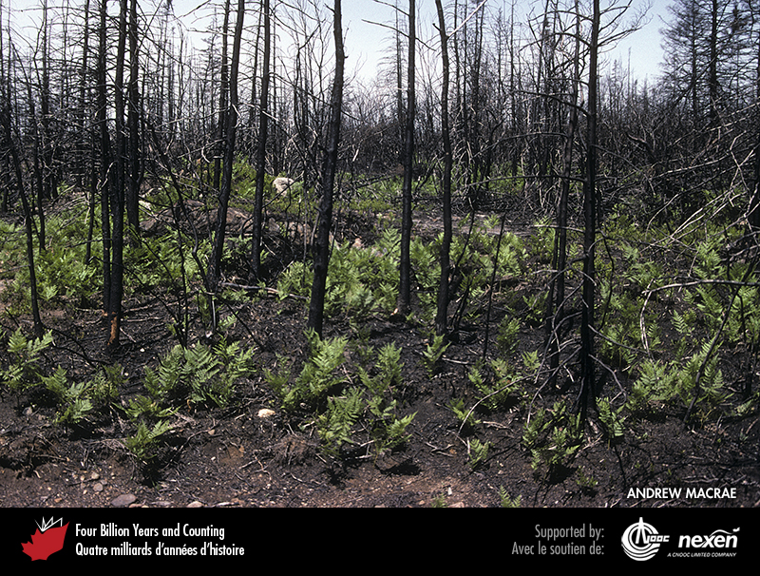
Notes:
Ferns proliferated within weeks to months following the asteroid strike at the end of the Cretaceous, much as they do today after a forest fire. This scene is near Halifax, Nova Scotia. ANDREW MACRAE.
_______________________________
All photographic and graphic images (henceforth referred to as images) posted on this site are copyright of the persons and/or institutions indicated in the caption directly associated with each image. The copyright holders have agreed that you may use their images for educational, non-commercial purposes only and provided that they are credited in each instance of use. For all other uses you must contact the copyright holder.

