Slide 1
CHAPTER 1 Part 2 of 3
All photographic and graphic images (henceforth referred to as images) posted on this site are copyright of the persons and/or institutions indicated in the caption directly associated with each image. The copyright holders have agreed that you may use their images for educational, non-commercial purposes only and provided that they are credited in each instance of use. For all other uses you must contact the copyright holder.

Slide 2
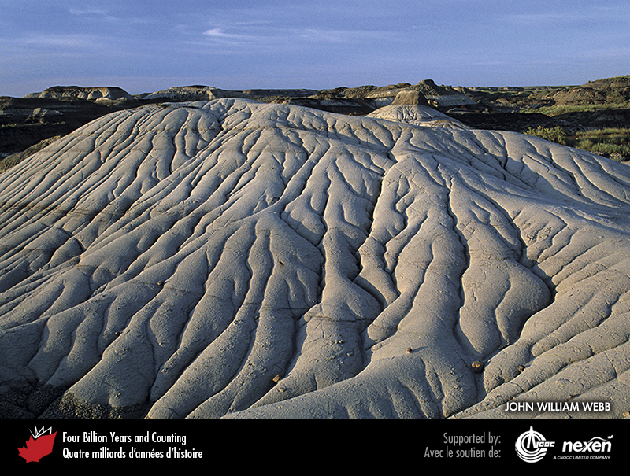
Notes:
Erosion in the badlands of Dinosaur Provincial Park, near Brooks, Alberta. Weathering breaks down the rocks into sediment, which is moved downhill by gravity and water. The sediment accumulates in small rills as shown here, but may eventually end up in rivers feeding into lakes, seas, or oceans. JOHN WILLIAM WEBB.
_______________________________
All photographic and graphic images (henceforth referred to as images) posted on this site are copyright of the persons and/or institutions indicated in the caption directly associated with each image. The copyright holders have agreed that you may use their images for educational, non-commercial purposes only and provided that they are credited in each instance of use. For all other uses you must contact the copyright holder.

Slide 3
Notes:
A plume of sediment entering Hudson Bay from Witchekat Creek, Wapusk National Park of Canada, Manitoba. N. ROSING, COPYRIGHT PARKS CANADA .
_______________________________
All photographic and graphic images (henceforth referred to as images) posted on this site are copyright of the persons and/or institutions indicated in the caption directly associated with each image. The copyright holders have agreed that you may use their images for educational, non-commercial purposes only and provided that they are credited in each instance of use. For all other uses you must contact the copyright holder.

Slide 4
Notes:
Erosion has created these “hoodoos” in sedimentary rocks in the badlands near Drumheller, Alberta. The layering, or bedding, was continuous before erosion sculpted the landscape. The lower brown marine shales are about 75 million years old; the white sandstone above is a slightly younger fluvial deposit. the Royal Tyrrell Museum of Palaeontology.
_______________________________
All photographic and graphic images (henceforth referred to as images) posted on this site are copyright of the persons and/or institutions indicated in the caption directly associated with each image. The copyright holders have agreed that you may use their images for educational, non-commercial purposes only and provided that they are credited in each instance of use. For all other uses you must contact the copyright holder.

Slide 5
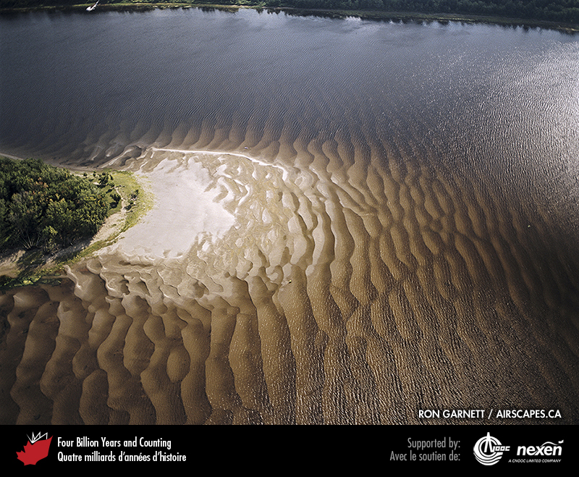
Notes:
Modern dunes underwater and on the banks of the Saint John River, New Brunswick. RON GARNETT / AIRSCAPES.CA.
_______________________________
All photographic and graphic images (henceforth referred to as images) posted on this site are copyright of the persons and/or institutions indicated in the caption directly associated with each image. The copyright holders have agreed that you may use their images for educational, non-commercial purposes only and provided that they are credited in each instance of use. For all other uses you must contact the copyright holder.

Slide 6
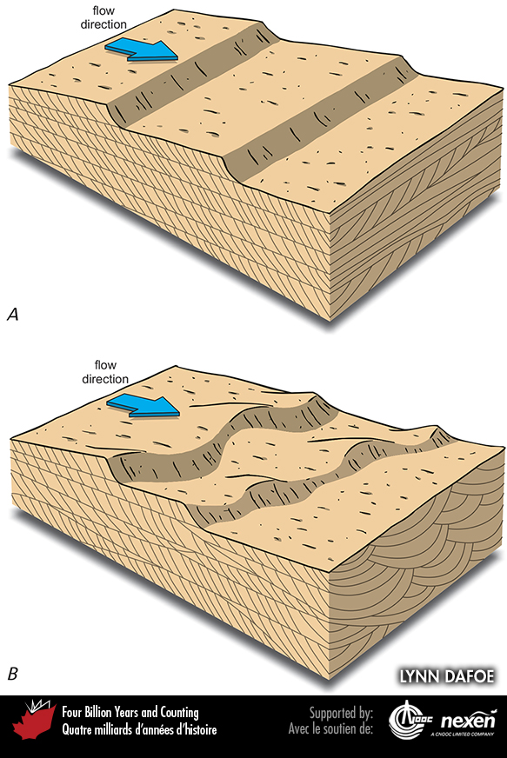
Notes:
The flow of water and air over loose sediment results in the formation of ripples and dunes on the sediment surface. Factors such as current speed, direction, and variability, as well as the size of sediment particles (grain size) result in the formation of different styles of ripples and dunes. This diagram illustrates two such styles and the respective styles of cross-bedding seen in cross-section. ADAPTE D FROM VARIOUS SOURCES BY LYNN DAFOE.
______________________________
All photographic and graphic images (henceforth referred to as images) posted on this site are copyright of the persons and/or institutions indicated in the caption directly associated with each image. The copyright holders have agreed that you may use their images for educational, non-commercial purposes only and provided that they are credited in each instance of use. For all other uses you must contact the copyright holder.

Slide 7
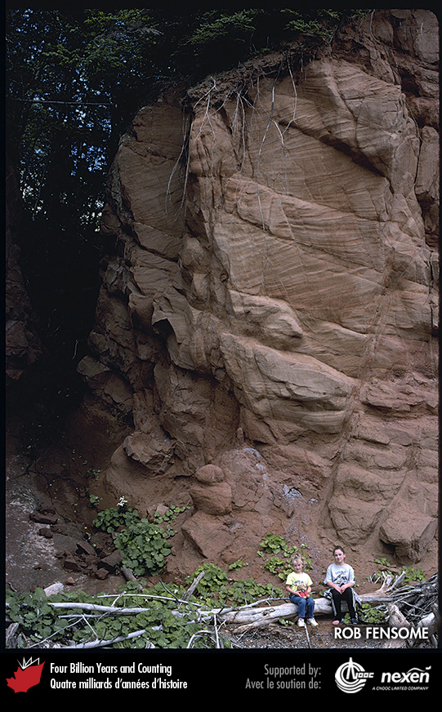
Notes:
Cross-bedding in 200-million-year-old sandstones (redbeds) of eolian (wind-blown rather than subaqueous) origin, Wasson Bluff near Parrsboro, Nova Scotia. ROB FENSOME.
_______________________________
All photographic and graphic images (henceforth referred to as images) posted on this site are copyright of the persons and/or institutions indicated in the caption directly associated with each image. The copyright holders have agreed that you may use their images for educational, non-commercial purposes only and provided that they are credited in each instance of use. For all other uses you must contact the copyright holder.

Slide 8
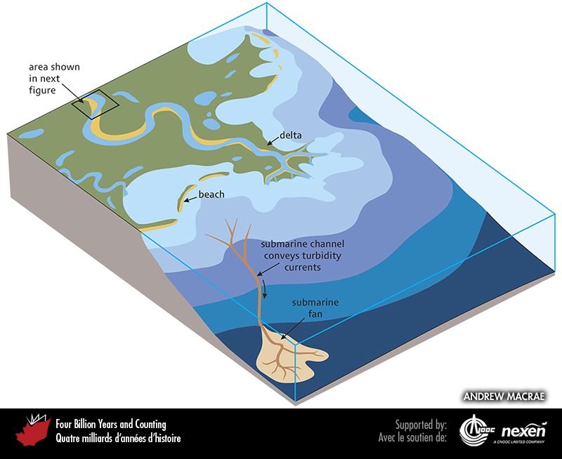
Notes:
Shown here are a variety of sedimentary environments, including fluvial, lacustrine, deltaic, shoreline, and marine. Upon reaching the sea, a river may build out a delta by dropping its sediment load. Waves and tidal currents then redistribute some of the sediment to form beaches and other coastal features. Generally, the farther out from shore, the finer the sediment deposited, reflecting weaker currents offshore. Turbidity currents will transport sediment down undersea canyons or valleys, where they form deposits known as turbidites. Multiple turbidites form a submarine fan at the mouth of a deep undersea channel. The area outlined by the black box is enlarged in the next figure. Andrew MacRae.
_______________________________
All photographic and graphic images (henceforth referred to as images) posted on this site are copyright of the persons and/or institutions indicated in the caption directly associated with each image. The copyright holders have agreed that you may use their images for educational, non-commercial purposes only and provided that they are credited in each instance of use. For all other uses you must contact the copyright holder.

Slide 9
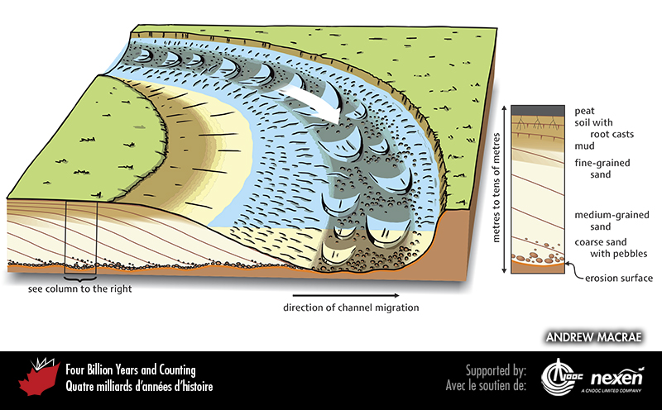
Notes:
An example of what happens at a river bend. The main diagram shows the bend with a cutaway view facing the reader. Momentum carries the main river current around the outside of the bend, towards the right side of the drawing. The strength of the current there erodes the river bank, and only coarser material settles to the bottom; the stronger current also leads to the development of large dunes on the channel floor. On the inside bend of the channel, the weaker current deposits finer sand and mud, building out an arc-shaped platform called a point bar. Because of undercutting on the outside bend and deposition on the point bar, the channel migrates, leaving a sediment record of shifting environments and processes. Eventually vegetation and soil may develop on the point bar. The column at right gives an idea of what a vertical section through the sediments would look like at the location shown by the box in the main diagram. ANDREW MACRAE.
_______________________________
All photographic and graphic images (henceforth referred to as images) posted on this site are copyright of the persons and/or institutions indicated in the caption directly associated with each image. The copyright holders have agreed that you may use their images for educational, non-commercial purposes only and provided that they are credited in each instance of use. For all other uses you must contact the copyright holder.

Slide 10
Notes:
Ripples on tidal flats, Five Islands, Nova Scotia. ROB FENSOME.
_______________________________
All photographic and graphic images (henceforth referred to as images) posted on this site are copyright of the persons and/or institutions indicated in the caption directly associated with each image. The copyright holders have agreed that you may use their images for educational, non-commercial purposes only and provided that they are credited in each instance of use. For all other uses you must contact the copyright holder.

Slide 11
Notes:
Ripples in about 325-million-year-old sedimentary rock from West Bay, near Parrsboro, Nova Scotia. ROB FENSOME.
_______________________________
All photographic and graphic images (henceforth referred to as images) posted on this site are copyright of the persons and/or institutions indicated in the caption directly associated with each image. The copyright holders have agreed that you may use their images for educational, non-commercial purposes only and provided that they are credited in each instance of use. For all other uses you must contact the copyright holder.

Slide 12
Notes:
Mudcracks in modern muds, western Cape Breton Island, Nova Scotia. MARTIN GIBLING.
_______________________________
All photographic and graphic images (henceforth referred to as images) posted on this site are copyright of the persons and/or institutions indicated in the caption directly associated with each image. The copyright holders have agreed that you may use their images for educational, non-commercial purposes only and provided that they are credited in each instance of use. For all other uses you must contact the copyright holder.

Slide 13
Notes:
A 300-million-year-old channel filled with layers of sand, now preserved as sandstone, cuts into older sedimentary rock near the village of Jacquet River, New Brunswick. ROB FENSOME.
_______________________________
All photographic and graphic images (henceforth referred to as images) posted on this site are copyright of the persons and/or institutions indicated in the caption directly associated with each image. The copyright holders have agreed that you may use their images for educational, non-commercial purposes only and provided that they are credited in each instance of use. For all other uses you must contact the copyright holder.

Slide 14
Notes:
This sequence of sedimentary rocks at L’Islet-sur-Mer, Quebec, deposited about 505 million years ago, have been steeply tilted, so imagine the original sea floor coming vertically out of the ground. The grey, regularly bedded rocks to the left represent turbidites, and the blockier, less well-bedded rocks in the foreground are sandstone and conglomerate that originated as sediment in a deep-sea channel. ROB FENSOME
_______________________________
All photographic and graphic images (henceforth referred to as images) posted on this site are copyright of the persons and/or institutions indicated in the caption directly associated with each image. The copyright holders have agreed that you may use their images for educational, non-commercial purposes only and provided that they are credited in each instance of use. For all other uses you must contact the copyright holder.

Slide 15
Notes:
Mudcracks in 350-million-year-old mudstone, Clarke Head, near Parrsboro, Nova Scotia. ROB FENSOME.
_______________________________
All photographic and graphic images (henceforth referred to as images) posted on this site are copyright of the persons and/or institutions indicated in the caption directly associated with each image. The copyright holders have agreed that you may use their images for educational, non-commercial purposes only and provided that they are credited in each instance of use. For all other uses you must contact the copyright holder.

Slide 16
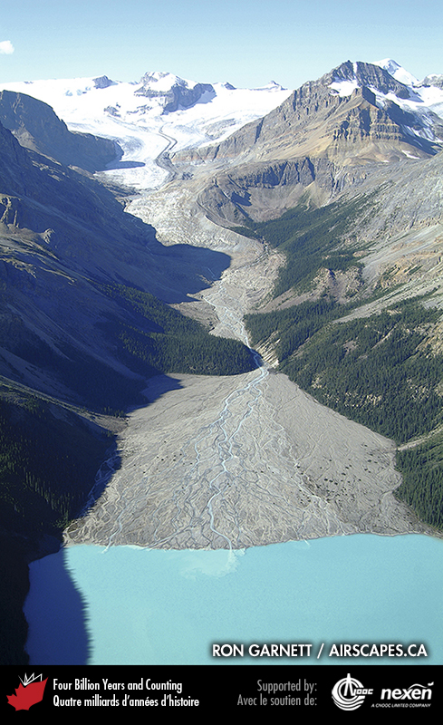
Notes:
Deltas form where rivers enter the sea or a lake and deposit their sediment load, as here at Peyto Lake in Banff National Park of Canada, Alberta. RON GARNETT / AIRSCAPES.CA.
_______________________________
All photographic and graphic images (henceforth referred to as images) posted on this site are copyright of the persons and/or institutions indicated in the caption directly associated with each image. The copyright holders have agreed that you may use their images for educational, non-commercial purposes only and provided that they are credited in each instance of use. For all other uses you must contact the copyright holder.

