Slide 1
CHAPTER 12 Part 3 of 3
All photographic and graphic images (henceforth referred to as images) posted on this site are copyright of the persons and/or institutions indicated in the caption directly associated with each image. The copyright holders have agreed that you may use their images for educational, non-commercial purposes only and provided that they are credited in each instance of use. For all other uses you must contact the copyright holder.

Slide 2
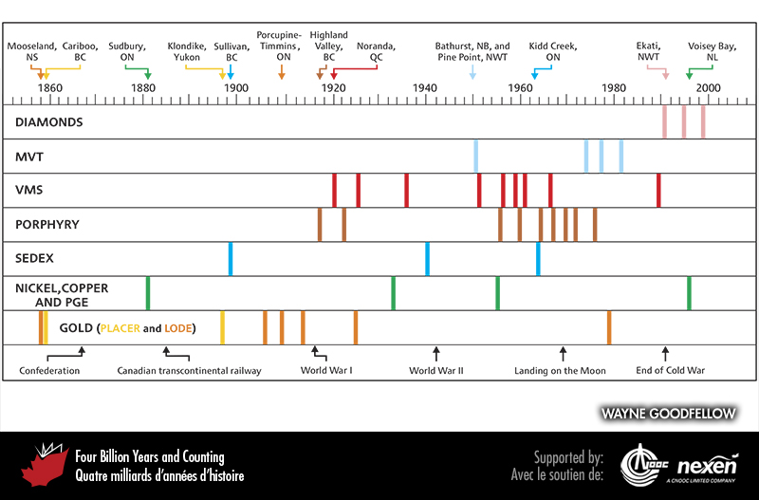
Notes:
The discovery dates of major Canadian ore deposits and their relationship to some major historical milestones (shown at bottom). BC = British Columbia, NB = New Brunswick, NL = Newfoundland and Labrador, NS = Nova Scotia, NWT = Northwest Territories, ON = Ontario, and QC = Quebec.
_______________________________
All photographic and graphic images (henceforth referred to as images) posted on this site are copyright of the persons and/or institutions indicated in the caption directly associated with each image. The copyright holders have agreed that you may use their images for educational, non-commercial purposes only and provided that they are credited in each instance of use. For all other uses you must contact the copyright holder.

Slide 3
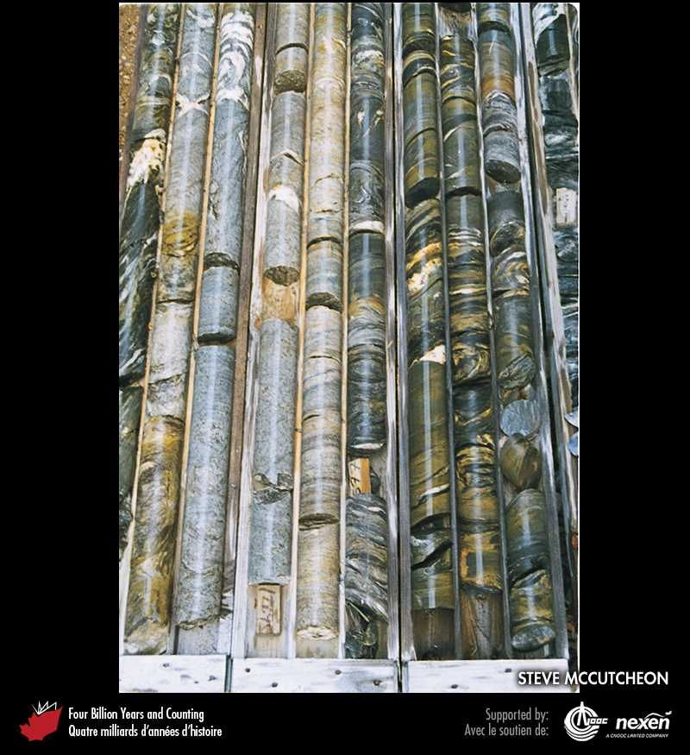
Notes:
Cores of Ordovician rocks from the Bathurst Mining Camp, southwest of Devils Elbow Brook, New Brunswick. STEVE MCCUTCHEON.
_______________________________
All photographic and graphic images (henceforth referred to as images) posted on this site are copyright of the persons and/or institutions indicated in the caption directly associated with each image. The copyright holders have agreed that you may use their images for educational, non-commercial purposes only and provided that they are credited in each instance of use. For all other uses you must contact the copyright holder.

Slide 4
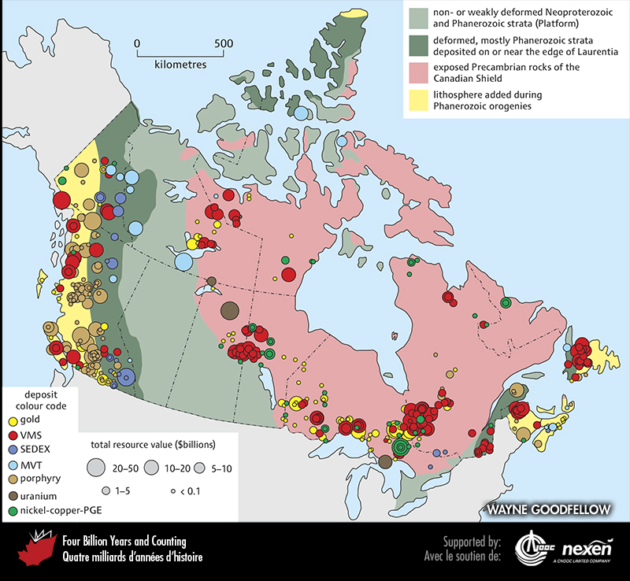
Notes:
The location and value of Canada’s major deposits for 2005 superimposed on a geological map of Canada. Note how almost all mining operations are located on the Canadian Shield (especially its margins, which are closer to potential markets) or in the Appalachian and Cordilleran orogens.
_______________________________
All photographic and graphic images (henceforth referred to as images) posted on this site are copyright of the persons and/or institutions indicated in the caption directly associated with each image. The copyright holders have agreed that you may use their images for educational, non-commercial purposes only and provided that they are credited in each instance of use. For all other uses you must contact the copyright holder.

Slide 5
Notes:
The rusty red feature, a gossan, stands out in this aerial view over Baffin Island, Nunavut, Gossans are produced by oxidation of metal sulphide deposits. Because they can be recognized readily on the ground and from aircraft and satellites, gossans are a useful indicator of mineralization. Y. MAURICE, REPRODUCED WITH THE PERMISSION OF NATURAL RESOURCES CANADA 2013, COURTESY OF THE GEOLOGICAL SURVEY OF CANADA.
_______________________________
All photographic and graphic images (henceforth referred to as images) posted on this site are copyright of the persons and/or institutions indicated in the caption directly associated with each image. The copyright holders have agreed that you may use their images for educational, non-commercial purposes only and provided that they are credited in each instance of use. For all other uses you must contact the copyright holder.

