Slide 1
BOX 1 Part 2 of 2
All photographic and graphic images (henceforth referred to as images) posted on this site are copyright of the persons and/or institutions indicated in the caption directly associated with each image. The copyright holders have agreed that you may use their images for educational, non-commercial purposes only and provided that they are credited in each instance of use. For all other uses you must contact the copyright holder.

Slide 2
Notes:
Crystals of calcite or dolomite from Wawa, Ontario. HELEN TYSON, FROM THE COLLECTION OF ROD AND HELEN TYSON.
______________________________
All photographic and graphic images (henceforth referred to as images) posted on this site are copyright of the persons and/or institutions indicated in the caption directly associated with each image. The copyright holders have agreed that you may use their images for educational, non-commercial purposes only and provided that they are credited in each instance of use. For all other uses you must contact the copyright holder.

Slide 3
Notes:
Crystals of aragonite from Thetford, Quebec. HELEN TYSON, FROM THE COLLECTION OF ROD AND HELEN TYSON.
_______________________________
All photographic and graphic images (henceforth referred to as images) posted on this site are copyright of the persons and/or institutions indicated in the caption directly associated with each image. The copyright holders have agreed that you may use their images for educational, non-commercial purposes only and provided that they are credited in each instance of use. For all other uses you must contact the copyright holder.

Slide 4
Notes:
Satin spar, a variety of gypsum, from Nova Scotia. HEINZ WIELE, COURTESY OF THE ATLANTIC GEOSCIENCE SOCIETY; SPECIMEN COURTESY OF THE FUNDY GEOLOGICAL MUSEUM.
_______________________________
All photographic and graphic images (henceforth referred to as images) posted on this site are copyright of the persons and/or institutions indicated in the caption directly associated with each image. The copyright holders have agreed that you may use their images for educational, non-commercial purposes only and provided that they are credited in each instance of use. For all other uses you must contact the copyright holder.

Slide 5
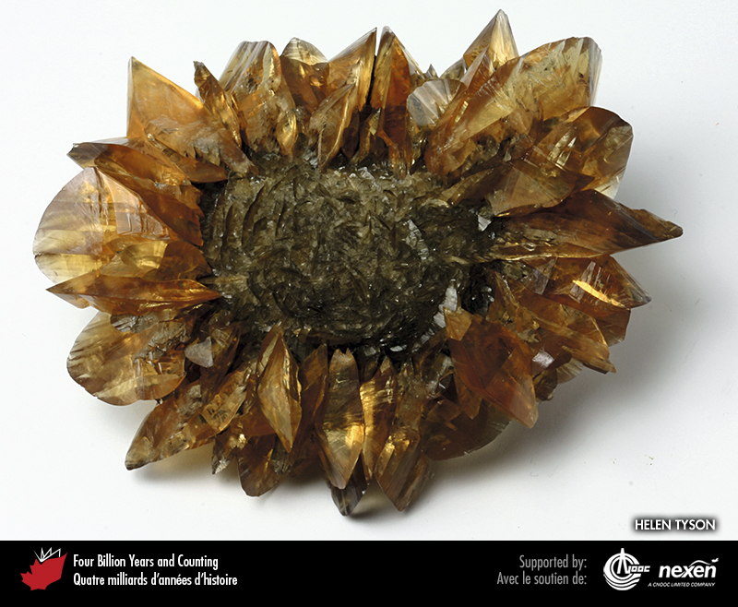
Notes:
Selenite, a variety of gypsum, from Winnipeg, Manitoba. Helen Tyson, from the collection of Rod and Helen Tyson.
_______________________________
All photographic and graphic images (henceforth referred to as images) posted on this site are copyright of the persons and/or institutions indicated in the caption directly associated with each image. The copyright holders have agreed that you may use their images for educational, non-commercial purposes only and provided that they are credited in each instance of use. For all other uses you must contact the copyright holder.

Slide 6
Notes:
Goethite, an iron oxide mineral, from Bridgeville, Nova Scotia. HEINZ WIELE, COURTESY OF THE ATLANTIC GEOSCIENCE SOCIETY; SPECIMEN COURTESY OF THE NOVA SCOTIA MUSEUM.
_______________________________
All photographic and graphic images (henceforth referred to as images) posted on this site are copyright of the persons and/or institutions indicated in the caption directly associated with each image. The copyright holders have agreed that you may use their images for educational, non-commercial purposes only and provided that they are credited in each instance of use. For all other uses you must contact the copyright holder.

Slide 7
Notes:
Pyrite from the former Nanisivik Mine, northern Baffin Island, Nunavut. Helen Tyson, from the collection of Rod and Helen Tyson.
_______________________________
All photographic and graphic images (henceforth referred to as images) posted on this site are copyright of the persons and/or institutions indicated in the caption directly associated with each image. The copyright holders have agreed that you may use their images for educational, non-commercial purposes only and provided that they are credited in each instance of use. For all other uses you must contact the copyright holder.

Slide 8
Notes:
Chalcopyrite from Vancouver Island, British Columbia. HELEN TYSON, FROM THE COLLECTION OF ROD AND HELEN TYSON.
_______________________________
All photographic and graphic images (henceforth referred to as images) posted on this site are copyright of the persons and/or institutions indicated in the caption directly associated with each image. The copyright holders have agreed that you may use their images for educational, non-commercial purposes only and provided that they are credited in each instance of use. For all other uses you must contact the copyright holder.

Slide 9
Notes:
Galena from Watson Lake, Yukon. Helen TYSON, FROM THE COLLECTION OF ROD AND HELEN TYSON.
_______________________________
All photographic and graphic images (henceforth referred to as images) posted on this site are copyright of the persons and/or institutions indicated in the caption directly associated with each image. The copyright holders have agreed that you may use their images for educational, non-commercial purposes only and provided that they are credited in each instance of use. For all other uses you must contact the copyright holder.

Slide 10
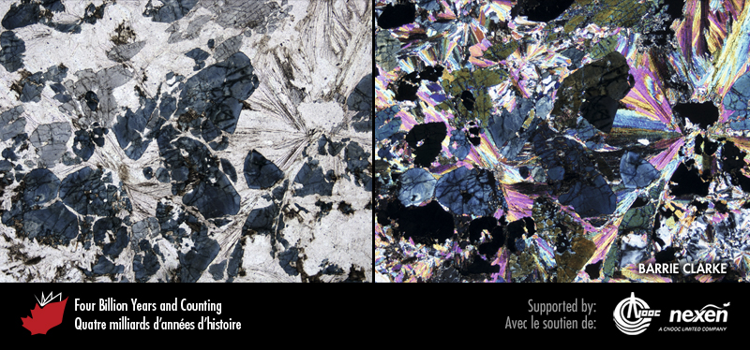
Notes:
Thin section of a granitic rock from Nova Scotia’s South Mountain Batholith (Chapter 8) viewed under a microscope. The photo to the left is in normal light and reveals blue tourmaline in a matrix of mica and quartz. The photo to the right was taken with polarized light. The area of view is 5 millimetres across. Thin sections are primary tools for determining the mineral composition of rocks and consist of paper-thin polished slices. BARRIE CLARKE.
_______________________________
All photographic and graphic images (henceforth referred to as images) posted on this site are copyright of the persons and/or institutions indicated in the caption directly associated with each image. The copyright holders have agreed that you may use their images for educational, non-commercial purposes only and provided that they are credited in each instance of use. For all other uses you must contact the copyright holder.

Slide 11
Notes:
Malachite (green) and azurite (blue) from Whitehorse, Yukon. Helen Tyson, FROM THE COLLECTION OF ROD AND HELEN TYSON.
_______________________________
All photographic and graphic images (henceforth referred to as images) posted on this site are copyright of the persons and/or institutions indicated in the caption directly associated with each image. The copyright holders have agreed that you may use their images for educational, non-commercial purposes only and provided that they are credited in each instance of use. For all other uses you must contact the copyright holder.

Slide 12
Notes:
Fluorite from Daniel’s Harbour, Newfoundland. Helen Tyson, from the collection of Rod and Helen Tyson.
_______________________________
All photographic and graphic images (henceforth referred to as images) posted on this site are copyright of the persons and/or institutions indicated in the caption directly associated with each image. The copyright holders have agreed that you may use their images for educational, non-commercial purposes only and provided that they are credited in each instance of use. For all other uses you must contact the copyright holder.

