Slide 1
CHAPTER 16 Part 2 of 3
All photographic and graphic images (henceforth referred to as images) posted on this site are copyright of the persons and/or institutions indicated in the caption directly associated with each image. The copyright holders have agreed that you may use their images for educational, non-commercial purposes only and provided that they are credited in each instance of use. For all other uses you must contact the copyright holder.

Slide 2
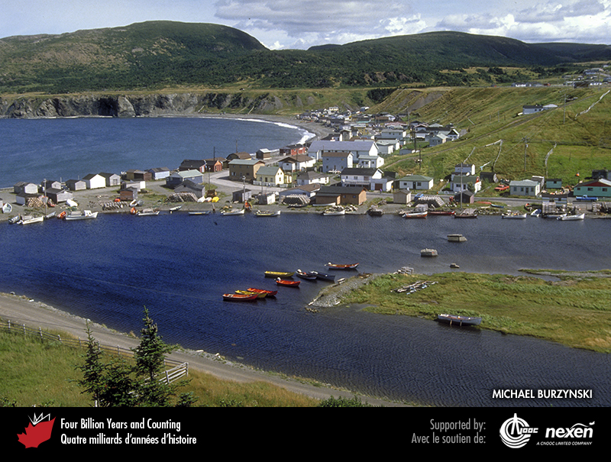
Notes:
The backdrop for the village of Trout River, Newfoundland, includes beach terraces (the flat, ledge-like area in front of the hills) that indicate higher sea levels in the past. MICHAEL BURZYNSKI.
_______________________________
All photographic and graphic images (henceforth referred to as images) posted on this site are copyright of the persons and/or institutions indicated in the caption directly associated with each image. The copyright holders have agreed that you may use their images for educational, non-commercial purposes only and provided that they are credited in each instance of use. For all other uses you must contact the copyright holder.

Slide 3
Notes:
Raised beach ridges, Wapusk National Park of Canada, Manitoba. N. ROSING, COPYRIGHT PARKS CANADA.
_______________________________
All photographic and graphic images (henceforth referred to as images) posted on this site are copyright of the persons and/or institutions indicated in the caption directly associated with each image. The copyright holders have agreed that you may use their images for educational, non-commercial purposes only and provided that they are credited in each instance of use. For all other uses you must contact the copyright holder.

Slide 4
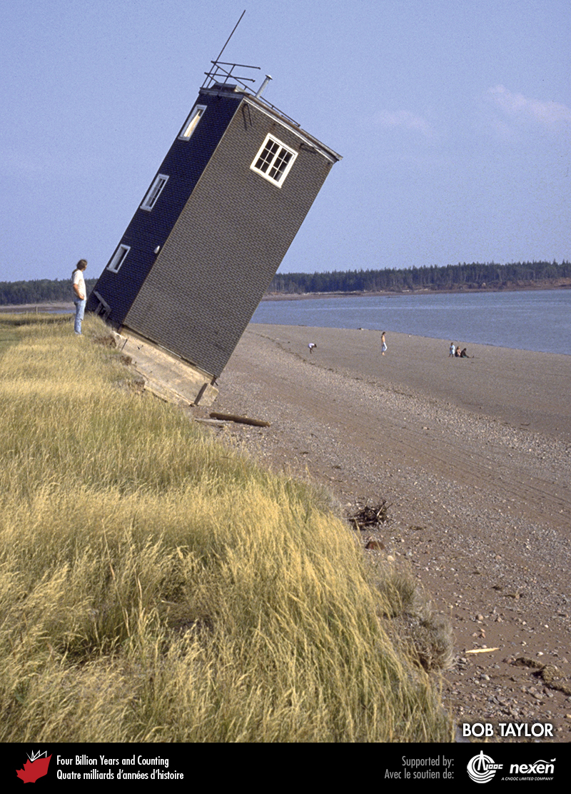
Notes:
This World War II observation tower (now demolished) near Economy, Nova Scotia, has been undermined by the tides and waves of the Bay of Fundy. BOB TAYLOR .
_______________________________
All photographic and graphic images (henceforth referred to as images) posted on this site are copyright of the persons and/or institutions indicated in the caption directly associated with each image. The copyright holders have agreed that you may use their images for educational, non-commercial purposes only and provided that they are credited in each instance of use. For all other uses you must contact the copyright holder.

Slide 5
Notes:
Pileups of sea ice are created in winter when currents push the thin sea ice onshore, as here at Saint-Simeon, Gaspe Peninsula, Quebec. CHRISTIAN FRASER.
_______________________________
All photographic and graphic images (henceforth referred to as images) posted on this site are copyright of the persons and/or institutions indicated in the caption directly associated with each image. The copyright holders have agreed that you may use their images for educational, non-commercial purposes only and provided that they are credited in each instance of use. For all other uses you must contact the copyright holder.

Slide 6
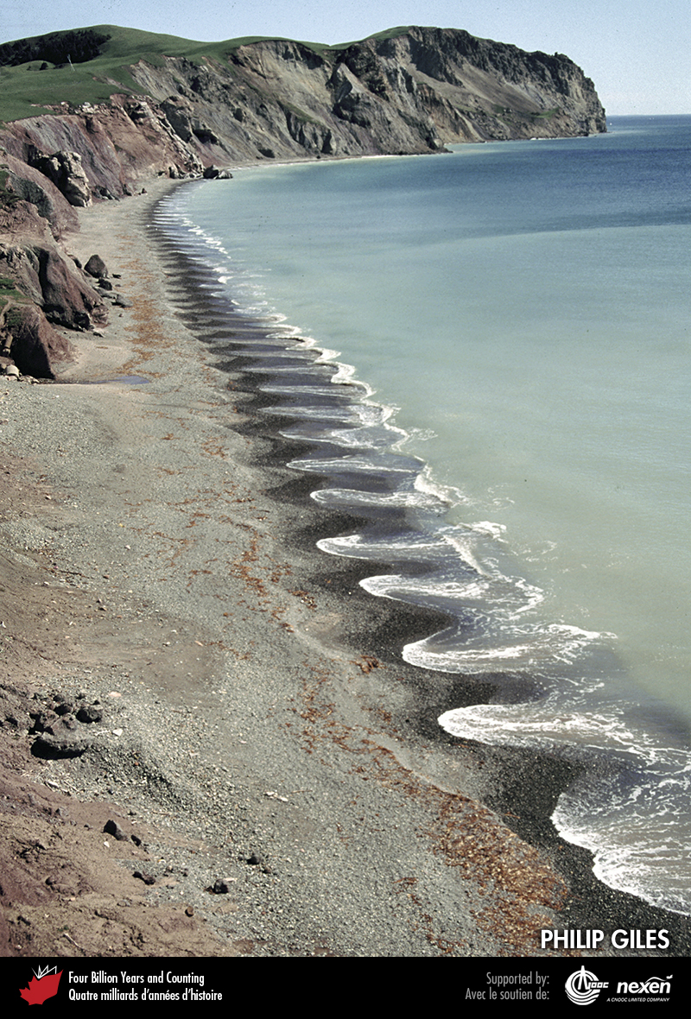
Notes:
The features forming this repeating pattern of regular small embayments and protrusions or “horns” are known as beach cusps. These are common and result from the interaction of shoaling waves with beach materials. This example is from the Magdalen Islands, Quebec. PHILIP GILES.
_______________________________
All photographic and graphic images (henceforth referred to as images) posted on this site are copyright of the persons and/or institutions indicated in the caption directly associated with each image. The copyright holders have agreed that you may use their images for educational, non-commercial purposes only and provided that they are credited in each instance of use. For all other uses you must contact the copyright holder.

Slide 7
Notes:
Waves surge onto the shore at Ingonish Beach, Cape Breton Highlands National Park of Canada, Nova Scotia. A. CORNELLIER, COPYRIGHT PARKS CANADA.
_______________________________
All photographic and graphic images (henceforth referred to as images) posted on this site are copyright of the persons and/or institutions indicated in the caption directly associated with each image. The copyright holders have agreed that you may use their images for educational, non-commercial purposes only and provided that they are credited in each instance of use. For all other uses you must contact the copyright holder.

Slide 8
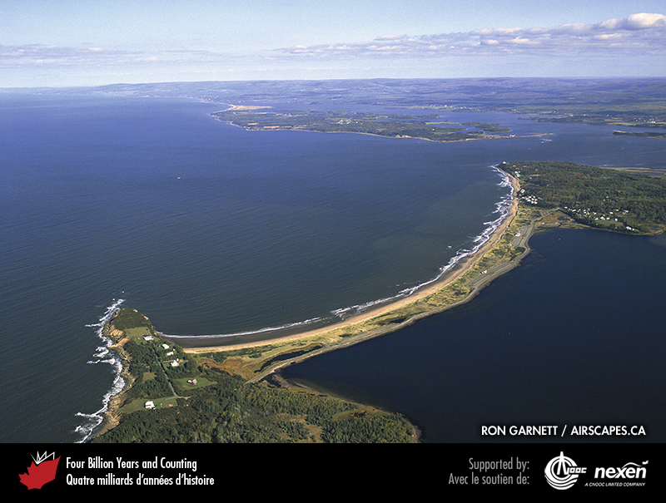
Notes:
Melmerby Beach, Nova Scotia, an example of a baymouth barrier beach formed by a spit extending to meet the opposite side of the bay: this creates a lagoon on the landward side. RON GARNETT / AIRSCAPES.CA.
_______________________________
All photographic and graphic images (henceforth referred to as images) posted on this site are copyright of the persons and/or institutions indicated in the caption directly associated with each image. The copyright holders have agreed that you may use their images for educational, non-commercial purposes only and provided that they are credited in each instance of use. For all other uses you must contact the copyright holder.

Slide 9
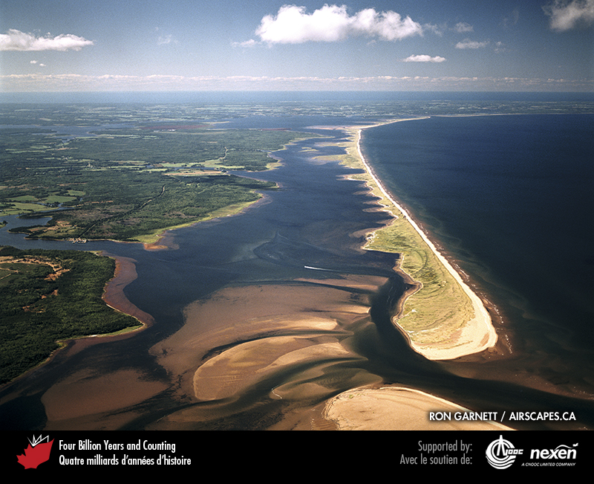
Notes:
A barrier island, such as this one at Conway Narrows, Prince Edward Island, is similar to a baymouth barrier except that it is separated from the mainland by tidal channels. RON GARNETT / AIRSCAPES.CA.
_______________________________
All photographic and graphic images (henceforth referred to as images) posted on this site are copyright of the persons and/or institutions indicated in the caption directly associated with each image. The copyright holders have agreed that you may use their images for educational, non-commercial purposes only and provided that they are credited in each instance of use. For all other uses you must contact the copyright holder.

Slide 10
Notes:
A mainly granite boulder beach at Kejimkujik National Park of Canada Seaside, Nova Scotia. The boulders are derived form local Devonian granite. ROB FENSOME.
_______________________________
All photographic and graphic images (henceforth referred to as images) posted on this site are copyright of the persons and/or institutions indicated in the caption directly associated with each image. The copyright holders have agreed that you may use their images for educational, non-commercial purposes only and provided that they are credited in each instance of use. For all other uses you must contact the copyright holder.

