Slide 1
BOX 4
All photographic and graphic images (henceforth referred to as images) posted on this site are copyright of the persons and/or institutions indicated in the caption directly associated with each image. The copyright holders have agreed that you may use their images for educational, non-commercial purposes only and provided that they are credited in each instance of use. For all other uses you must contact the copyright holder.

Slide 2
Notes:
The atmosphere is our planet’s outermost sphere. ROB FENSOME.
_______________________________
All photographic and graphic images (henceforth referred to as images) posted on this site are copyright of the persons and/or institutions indicated in the caption directly associated with each image. The copyright holders have agreed that you may use their images for educational, non-commercial purposes only and provided that they are credited in each instance of use. For all other uses you must contact the copyright holder.

Slide 3
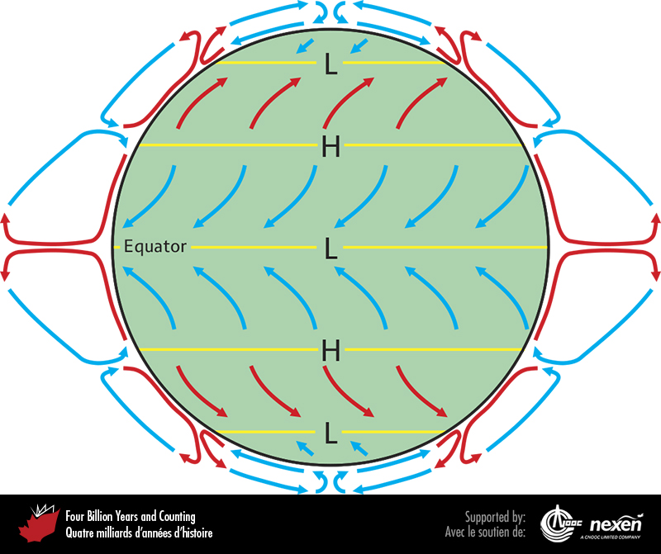
Notes:
Earth’s wind patterns showing the prevalence of easterlies (blue arrows denoting cooler air) in the tropics and at the poles, and westerlies (red arrows denoting warmer air) in temperate latitudes. The loops depict air circulation in the troposphere, with hot air rising in the lower and middle latitudes. L and H refer to latitudes of generally low and high pressure, respectively. ADAPTED FROM VARIOUS SOURCES.
_______________________________
All photographic and graphic images (henceforth referred to as images) posted on this site are copyright of the persons and/or institutions indicated in the caption directly associated with each image. The copyright holders have agreed that you may use their images for educational, non-commercial purposes only and provided that they are credited in each instance of use. For all other uses you must contact the copyright holder.

Slide 4
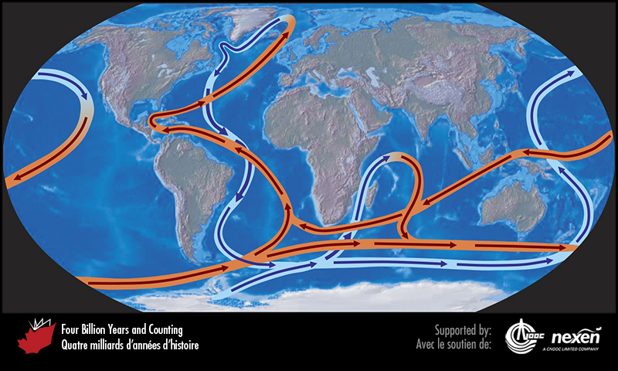
Notes:
Ocean circulation: warm currents are in red, cold currents are in blue. ADAPTED FROM VARIOUS SOURCES.
_______________________________
All photographic and graphic images (henceforth referred to as images) posted on this site are copyright of the persons and/or institutions indicated in the caption directly associated with each image. The copyright holders have agreed that you may use their images for educational, non-commercial purposes only and provided that they are credited in each instance of use. For all other uses you must contact the copyright holder.

Slide 5
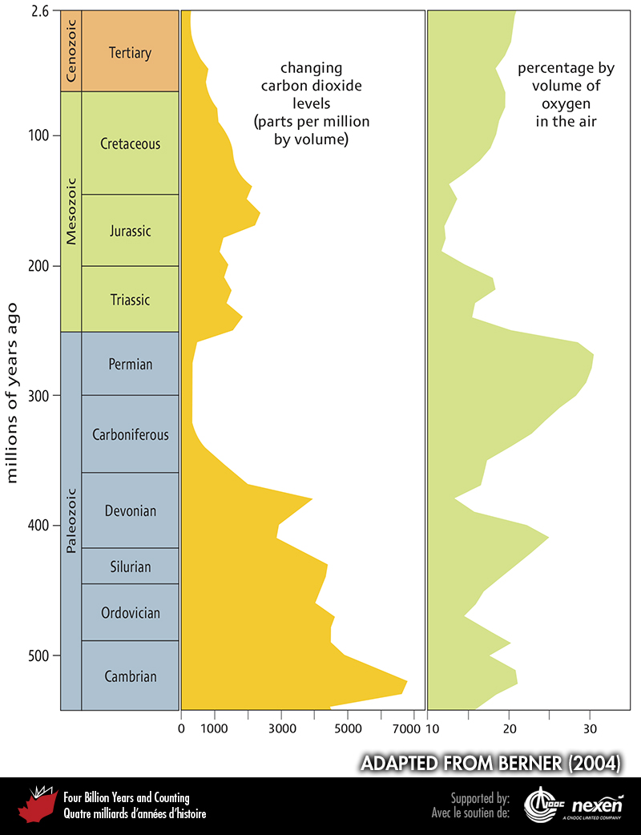
Notes:
Variations in oxygen and carbon-dioxide levels in the atmosphere during the Phanerozoic. Both carbon-dioxide and oxygen levels have been much higher in the past—and oxygen sometimes also much lower. Note the strong inverse relationship between the two curves. ADAPTED FROM BERNER (2004).
_______________________________
All photographic and graphic images (henceforth referred to as images) posted on this site are copyright of the persons and/or institutions indicated in the caption directly associated with each image. The copyright holders have agreed that you may use their images for educational, non-commercial purposes only and provided that they are credited in each instance of use. For all other uses you must contact the copyright holder.

Slide 6
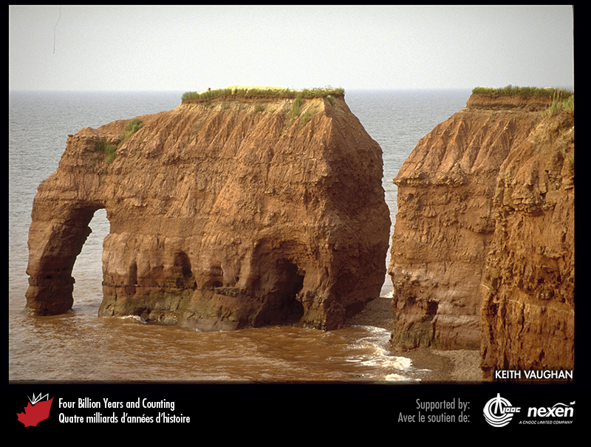
Notes:
Redbeds, such as the Permian strata seen here at Elephant Rock, near Tignish, Prince Edward Island, form only when there is free oxygen in the atmosphere. Since this photo was taken, the “elephant” has lost its trunk. KEITH VAUGHAN.
_______________________________
All photographic and graphic images (henceforth referred to as images) posted on this site are copyright of the persons and/or institutions indicated in the caption directly associated with each image. The copyright holders have agreed that you may use their images for educational, non-commercial purposes only and provided that they are credited in each instance of use. For all other uses you must contact the copyright holder.

Slide 7
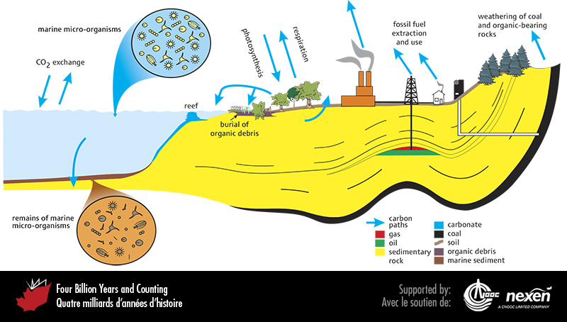
Notes:
The carbon cycle. In addition to the factors shown in this figure, plate tectonics has a major role: carbon (bound in minerals) is carried by subduction down to the mantle and is returned, for example, via volcanoes.
_______________________________
All photographic and graphic images (henceforth referred to as images) posted on this site are copyright of the persons and/or institutions indicated in the caption directly associated with each image. The copyright holders have agreed that you may use their images for educational, non-commercial purposes only and provided that they are credited in each instance of use. For all other uses you must contact the copyright holder.

