Slide 1
CHAPTER 16 Part 3 of 3
All photographic and graphic images (henceforth referred to as images) posted on this site are copyright of the persons and/or institutions indicated in the caption directly associated with each image. The copyright holders have agreed that you may use their images for educational, non-commercial purposes only and provided that they are credited in each instance of use. For all other uses you must contact the copyright holder.

Slide 2
Notes:
Coastline with sand dunes, Greenwich Dunes, Prince Edward Island National Park of Canada, Prince Edward Island. J. PLEAU, COPYRIGHT PARKS CANADA.
_______________________________
All photographic and graphic images (henceforth referred to as images) posted on this site are copyright of the persons and/or institutions indicated in the caption directly associated with each image. The copyright holders have agreed that you may use their images for educational, non-commercial purposes only and provided that they are credited in each instance of use. For all other uses you must contact the copyright holder.

Slide 3
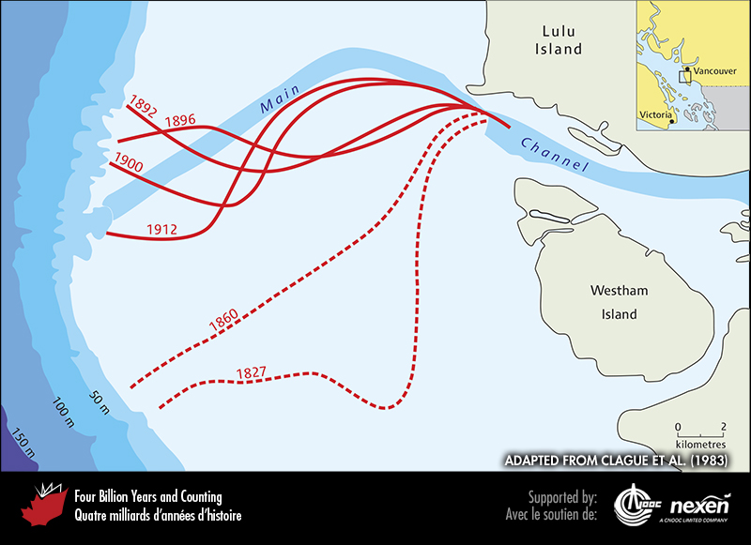
Notes:
Changes in the Main Channel of the Fraser Delta from 1827 to 1912. Since 1912, advanced engineering has stabilized the Main Channel in the position shown. ADAPTED FROM CLAGUE ET AL. (1983).
_______________________________
All photographic and graphic images (henceforth referred to as images) posted on this site are copyright of the persons and/or institutions indicated in the caption directly associated with each image. The copyright holders have agreed that you may use their images for educational, non-commercial purposes only and provided that they are credited in each instance of use. For all other uses you must contact the copyright holder.

Slide 4
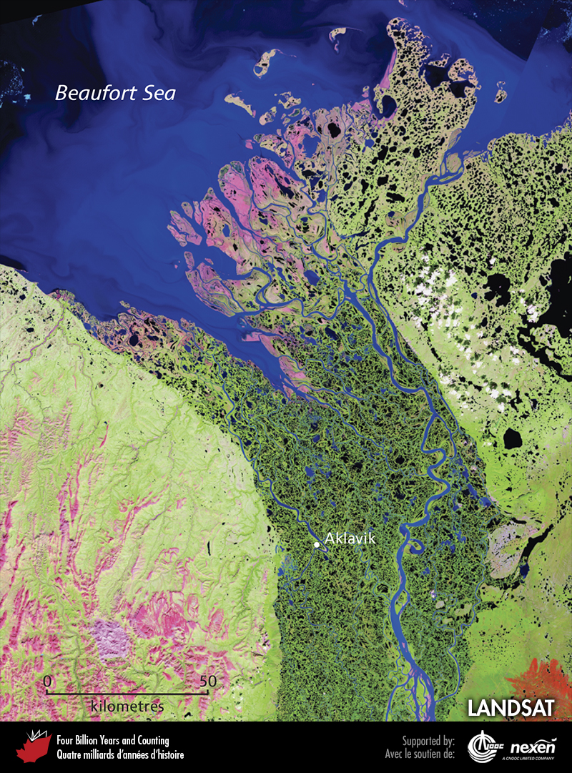
Notes:
Satellite image of the Mackenzie Delta and adjacent parts of the Northwest Territories and Yukon. The second largest Arctic delta, the Mackenzie covers more than 12,000 square kilometres and has almost 50,000 lakes. The outer part of the delta forms a low floodplain north of the treeline. Its channels are bounded by low levees and its front, facing the Beaufort Sea, is largely retreating as coastal erosion currently outpaces sediment supply across much of the delta. LANDSAT.
_______________________________
All photographic and graphic images (henceforth referred to as images) posted on this site are copyright of the persons and/or institutions indicated in the caption directly associated with each image. The copyright holders have agreed that you may use their images for educational, non-commercial purposes only and provided that they are credited in each instance of use. For all other uses you must contact the copyright holder.

Slide 5
Notes:
Tidal marsh on the Fraser Delta south of Vancouver, British Columbia. REPRODUCED WITH THE PERMISSION OF NATURAL RESOURCES CANADA 2013, COURTESY OF THE GEOLOGICAL SURVEY OF CANADA.
_______________________________
All photographic and graphic images (henceforth referred to as images) posted on this site are copyright of the persons and/or institutions indicated in the caption directly associated with each image. The copyright holders have agreed that you may use their images for educational, non-commercial purposes only and provided that they are credited in each instance of use. For all other uses you must contact the copyright holder.

Slide 6
Notes:
Peel Channel on the Mackenzie Delta, with Mount Gifford (or Red Mountain) in the distance. LARRY LANE.
_______________________________
All photographic and graphic images (henceforth referred to as images) posted on this site are copyright of the persons and/or institutions indicated in the caption directly associated with each image. The copyright holders have agreed that you may use their images for educational, non-commercial purposes only and provided that they are credited in each instance of use. For all other uses you must contact the copyright holder.

Slide 7
Notes:
The St. Lawrence Estuary at Kamouraska, Quebec, is still tidal at this location. That we have a St. Lawrence Estuary rather than a St. Lawrence delta is in part due to the sediment-trapping capacity of the Great Lakes. ROB FENSOME.
_______________________________
All photographic and graphic images (henceforth referred to as images) posted on this site are copyright of the persons and/or institutions indicated in the caption directly associated with each image. The copyright holders have agreed that you may use their images for educational, non-commercial purposes only and provided that they are credited in each instance of use. For all other uses you must contact the copyright holder.

Slide 8
Notes:
Fishing boats at low tide, Hampton, Nova Scotia. The large tidal range is evident from the height of the wharf and the changes in colour on its wall. PHILIP GILES.
_______________________________
All photographic and graphic images (henceforth referred to as images) posted on this site are copyright of the persons and/or institutions indicated in the caption directly associated with each image. The copyright holders have agreed that you may use their images for educational, non-commercial purposes only and provided that they are credited in each instance of use. For all other uses you must contact the copyright holder.

Slide 9
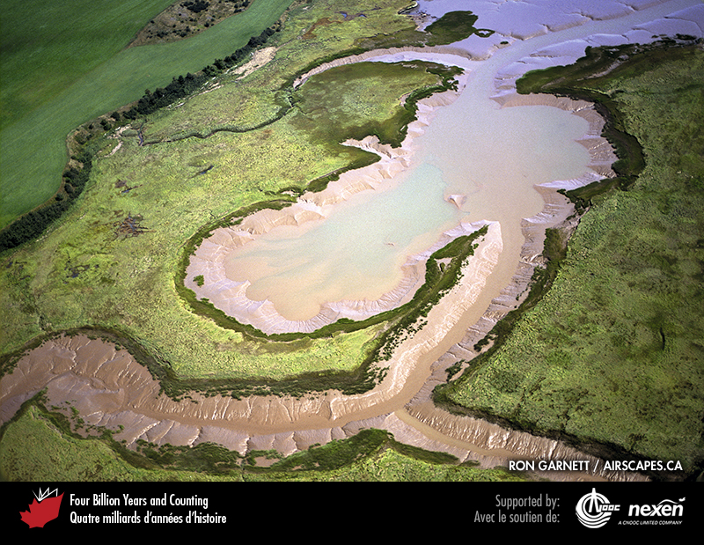
Notes:
Tidal mud and marshes, Shepody Bay on the Bay of Fundy, New Brunswick. RON GARNETT / AIRSCAPES.CA.
_______________________________
All photographic and graphic images (henceforth referred to as images) posted on this site are copyright of the persons and/or institutions indicated in the caption directly associated with each image. The copyright holders have agreed that you may use their images for educational, non-commercial purposes only and provided that they are credited in each instance of use. For all other uses you must contact the copyright holder.

Slide 10
Notes:
Rock used to armour shorelines against water or ice erosion is known as riprap. The riprap in this example has been introduced to protect summer cottages at Evangeline Beach, Nova Scotia. ROB FENSOME.
_______________________________
All photographic and graphic images (henceforth referred to as images) posted on this site are copyright of the persons and/or institutions indicated in the caption directly associated with each image. The copyright holders have agreed that you may use their images for educational, non-commercial purposes only and provided that they are credited in each instance of use. For all other uses you must contact the copyright holder.

Slide 11
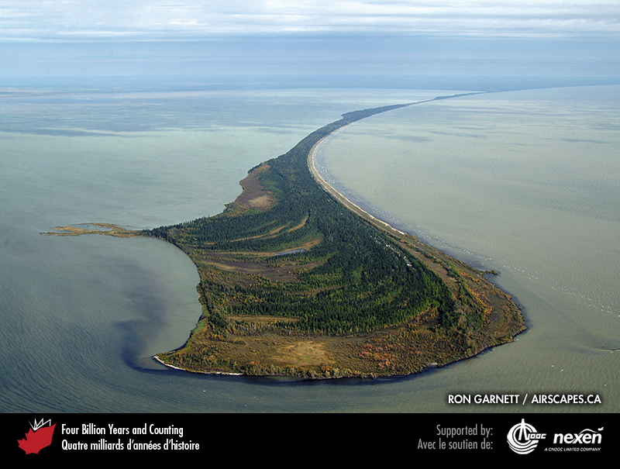
Notes:
Erosion by waves and currents is not restricted to the sea coast. This spit at Limestone Point, Manitoba, is on the northwestern shore of Lake Winnipeg. RON GARNETT / AIRSCAPES.CA.
_______________________________
All photographic and graphic images (henceforth referred to as images) posted on this site are copyright of the persons and/or institutions indicated in the caption directly associated with each image. The copyright holders have agreed that you may use their images for educational, non-commercial purposes only and provided that they are credited in each instance of use. For all other uses you must contact the copyright holder.

