Slide 1
CHAPTER 14 Part 1 of 3
All photographic and graphic images (henceforth referred to as images) posted on this site are copyright of the persons and/or institutions indicated in the caption directly associated with each image. The copyright holders have agreed that you may use their images for educational, non-commercial purposes only and provided that they are credited in each instance of use. For all other uses you must contact the copyright holder.

Slide 2
Notes:
The Chateau Laurier Hotel (1908–1912, 1927–1929) in Ottawa, Ontario, is faced mainly with early Carboniferous Indiana Limestone from the United States. ROB FENSOME.
_______________________________
All photographic and graphic images (henceforth referred to as images) posted on this site are copyright of the persons and/or institutions indicated in the caption directly associated with each image. The copyright holders have agreed that you may use their images for educational, non-commercial purposes only and provided that they are credited in each instance of use. For all other uses you must contact the copyright holder.

Slide 3
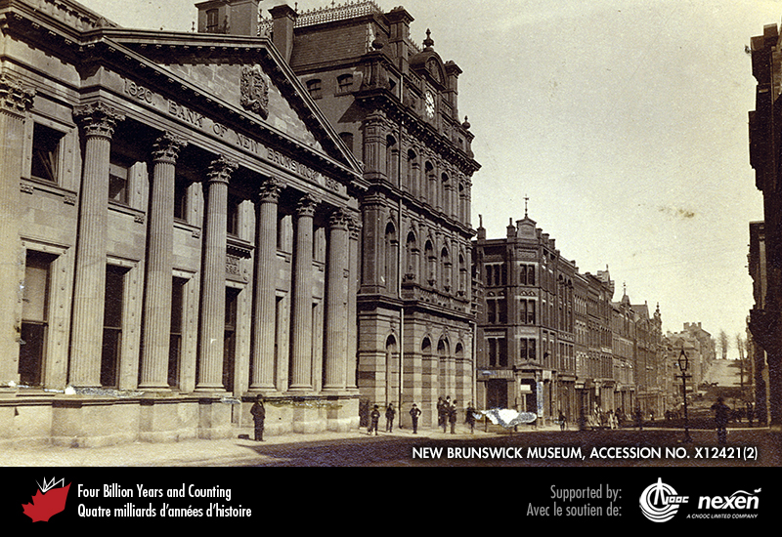
Notes:
View along Prince William Street, Saint John, New Brunswick, about 1900. The first structure on the left is the old Bank of New Brunswick, constructed of a white sandstone of unknown, but possibly Nova Scotian, origin. The white stone is more fitting to a classical style than darker New Brunswick sources offered. Next to the Bank is the old Post Office Building, its street front exhibiting darker sandstone from the Dorchester area of New Brunswick. Farther down the street, the buildings are predominantly of brick with sandstone trim. COURTESY OF THE NEW BRUNSWICK MUSEUM, ACCESSION NO. X12421(2)
_______________________________
All photographic and graphic images (henceforth referred to as images) posted on this site are copyright of the persons and/or institutions indicated in the caption directly associated with each image. The copyright holders have agreed that you may use their images for educational, non-commercial purposes only and provided that they are credited in each instance of use. For all other uses you must contact the copyright holder.

Slide 4
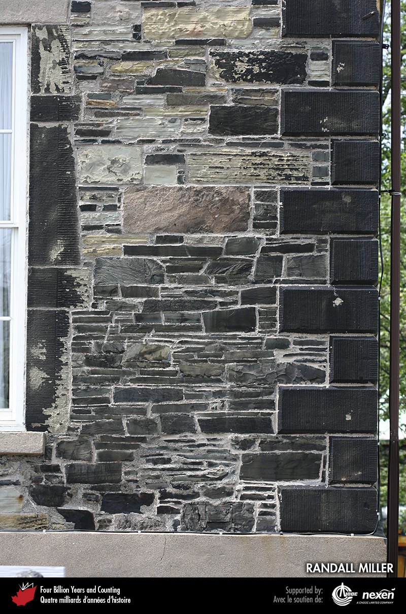
Notes:
The Saint John County Courthouse (1826–1829) on Sydney Street, Saint John, New Brunswick, predates the province’s domestic dimension stone industry. The back wall, shown here, is a mixture of cheaper stones from a variety of sources, some local and some possibly retrieved from ballast. The nicely finished sandstone blocks to the right. Representing the edge of the side wall, are of unknown origin, but may have arrived in New Brunswick as ballast from England. RANDALL MILLER.
_______________________________
All photographic and graphic images (henceforth referred to as images) posted on this site are copyright of the persons and/or institutions indicated in the caption directly associated with each image. The copyright holders have agreed that you may use their images for educational, non-commercial purposes only and provided that they are credited in each instance of use. For all other uses you must contact the copyright holder.

Slide 5
Notes:
Detail of the Pugsley Building (1879) at the corner of Prince William and Princess streets in Saint John, New Brunswick. Red and grey sandstone blocks used in its construction are possibly of late Carboniferous age and from Marys Point, New Brunswick. RANDALL MILLER.
_______________________________
All photographic and graphic images (henceforth referred to as images) posted on this site are copyright of the persons and/or institutions indicated in the caption directly associated with each image. The copyright holders have agreed that you may use their images for educational, non-commercial purposes only and provided that they are credited in each instance of use. For all other uses you must contact the copyright holder.

Slide 6
Notes:
Carving in yellow sandstone by James McAvity of a head spitting coins. This “grotesque” appears on the Palatine Building (1877–1878) on Prince William Street, Saint John, New Brunswick. RANDALL MILLER.
_______________________________
All photographic and graphic images (henceforth referred to as images) posted on this site are copyright of the persons and/or institutions indicated in the caption directly associated with each image. The copyright holders have agreed that you may use their images for educational, non-commercial purposes only and provided that they are credited in each instance of use. For all other uses you must contact the copyright holder.

Slide 7
Notes:
The City Market (1876) in Saint John, New Brunswick, is the oldest continuously operating farmers’ market in Canada. It has decorative sandstone trim, but is largely made of locally manufactured brick. RANDALL MILLER.
_______________________________
All photographic and graphic images (henceforth referred to as images) posted on this site are copyright of the persons and/or institutions indicated in the caption directly associated with each image. The copyright holders have agreed that you may use their images for educational, non-commercial purposes only and provided that they are credited in each instance of use. For all other uses you must contact the copyright holder.

Slide 8
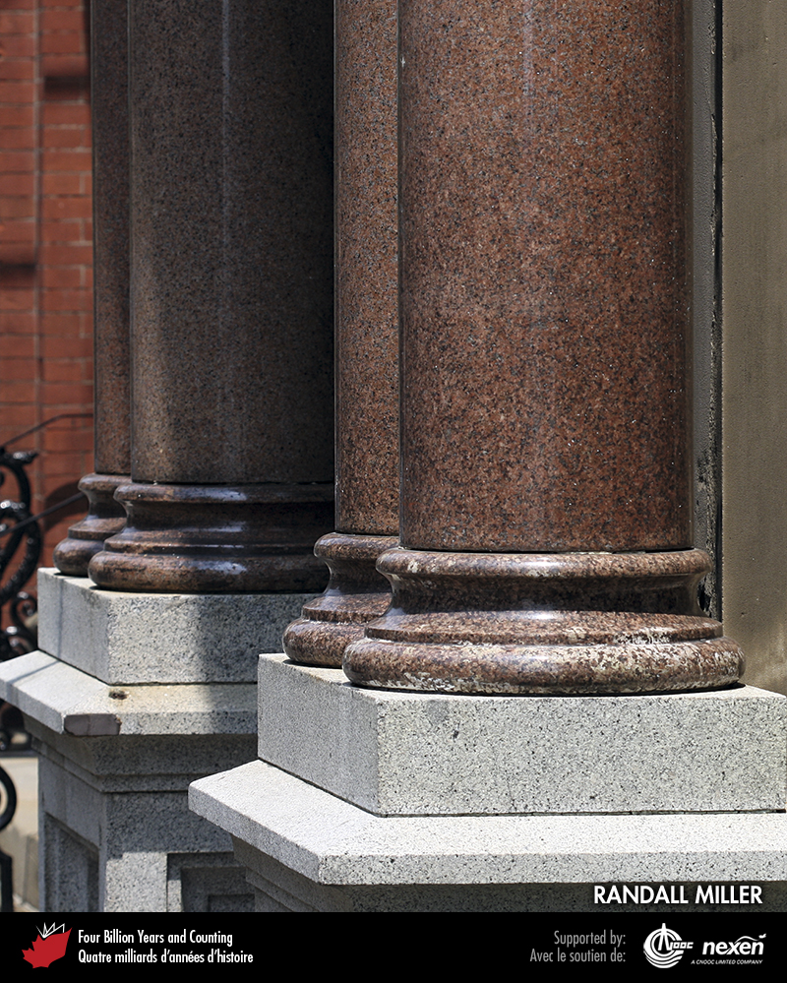
Notes:
Granite columns surround a doorway of the Palatine Building (1877–1878), Saint John, New Brunswick. Features carved in granite are still shiny and fresh, in contrast to sandstone carvings, which are losing their detail. The grey and red pillars shown here are of Silurian-Devonian age and were quarried near St. George, New Brunswick. RANDALL MILLER.
_______________________________
All photographic and graphic images (henceforth referred to as images) posted on this site are copyright of the persons and/or institutions indicated in the caption directly associated with each image. The copyright holders have agreed that you may use their images for educational, non-commercial purposes only and provided that they are credited in each instance of use. For all other uses you must contact the copyright holder.

Slide 9
Notes:
More substantial building materials such as stone are rare in the Prairies, so many of the original farmsteads were made of wattle and daub, basically sticks and soil. This farmstead, photographed in 1979, was near Mendham, Saskatchewan. ROB FENSOME.
_______________________________
All photographic and graphic images (henceforth referred to as images) posted on this site are copyright of the persons and/or institutions indicated in the caption directly associated with each image. The copyright holders have agreed that you may use their images for educational, non-commercial purposes only and provided that they are credited in each instance of use. For all other uses you must contact the copyright holder.

Slide 10
Notes:
Fieldstone barn at Indian Head, Saskatchewan, recently refurbished. The stones used in its construction are a variety of rock types from the Canadian Shield, transported to the Indian Head area by ice during the last glaciation. ROB FENSOME.
_______________________________
All photographic and graphic images (henceforth referred to as images) posted on this site are copyright of the persons and/or institutions indicated in the caption directly associated with each image. The copyright holders have agreed that you may use their images for educational, non-commercial purposes only and provided that they are credited in each instance of use. For all other uses you must contact the copyright holder.

Slide 11
Notes:
The University of Saskatchewan Observatory (1929) in Saskatoon is constructed from Ordovician dolostone, locally called greystone. Despite its uniformity, much of Saskatoon’s greystone is actually a fieldstone, as explained on page 284. ROB FENSOME.
_______________________________
All photographic and graphic images (henceforth referred to as images) posted on this site are copyright of the persons and/or institutions indicated in the caption directly associated with each image. The copyright holders have agreed that you may use their images for educational, non-commercial purposes only and provided that they are credited in each instance of use. For all other uses you must contact the copyright holder.

Slide 12
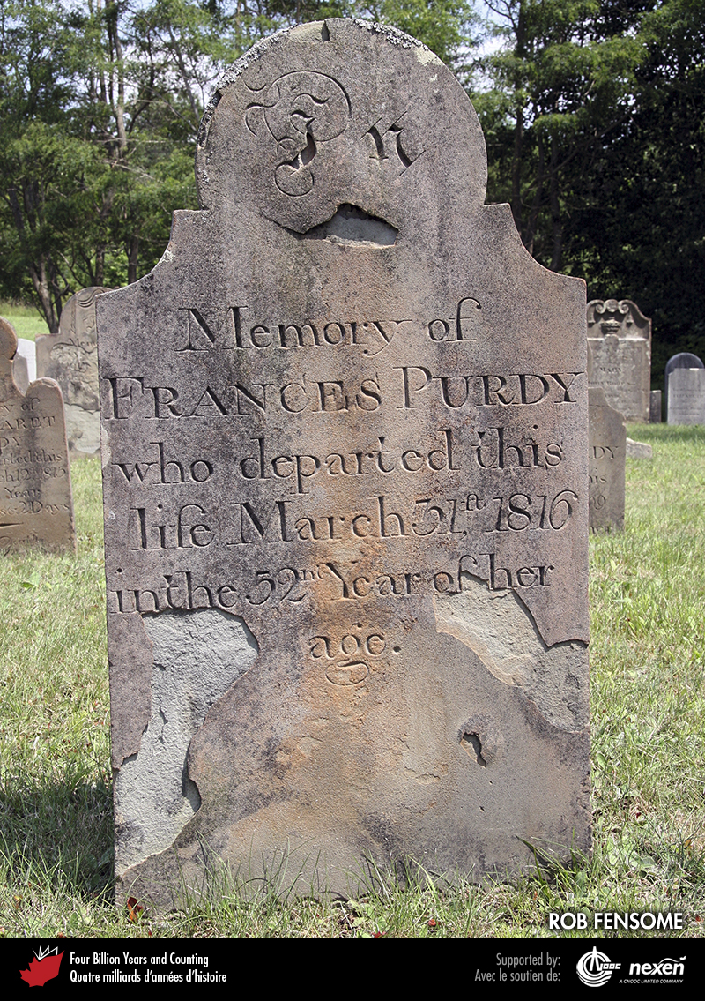
Notes:
Weathered sandstone gravestone, Clementsport, Nova Scotia. ROB FENSOME.
_______________________________
All photographic and graphic images (henceforth referred to as images) posted on this site are copyright of the persons and/or institutions indicated in the caption directly associated with each image. The copyright holders have agreed that you may use their images for educational, non-commercial purposes only and provided that they are credited in each instance of use. For all other uses you must contact the copyright holder.

Slide 13
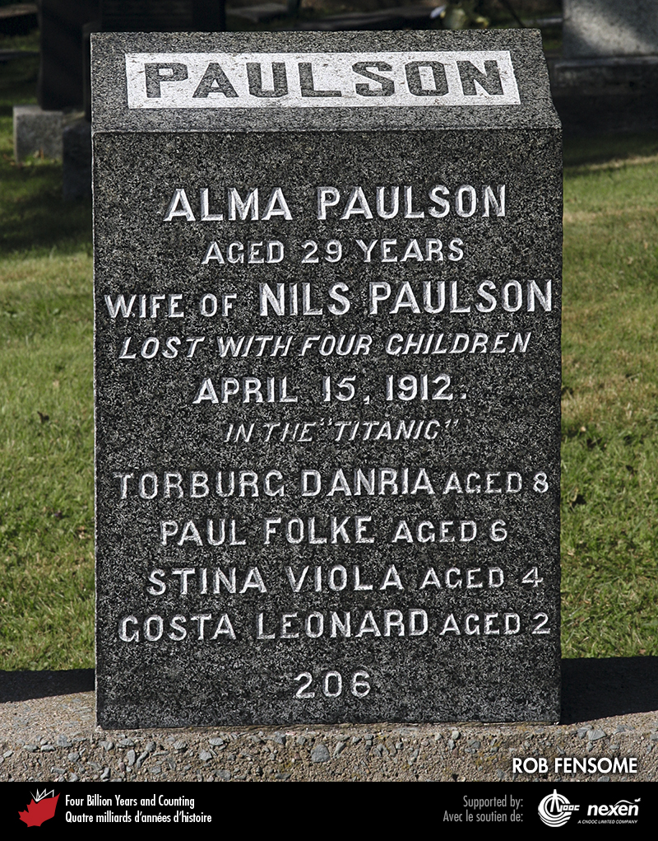
Notes:
A gravestone for victims of the sinking of the Titanic, Fairview Lawn Cemetery, Halifax, Nova Scotia. Although set up over a hundred years ago, this poignant marker of a family tragedy, made of hard gabbro, still looks fresh. ROB FENSOME.
_______________________________
All photographic and graphic images (henceforth referred to as images) posted on this site are copyright of the persons and/or institutions indicated in the caption directly associated with each image. The copyright holders have agreed that you may use their images for educational, non-commercial purposes only and provided that they are credited in each instance of use. For all other uses you must contact the copyright holder.

Slide 14
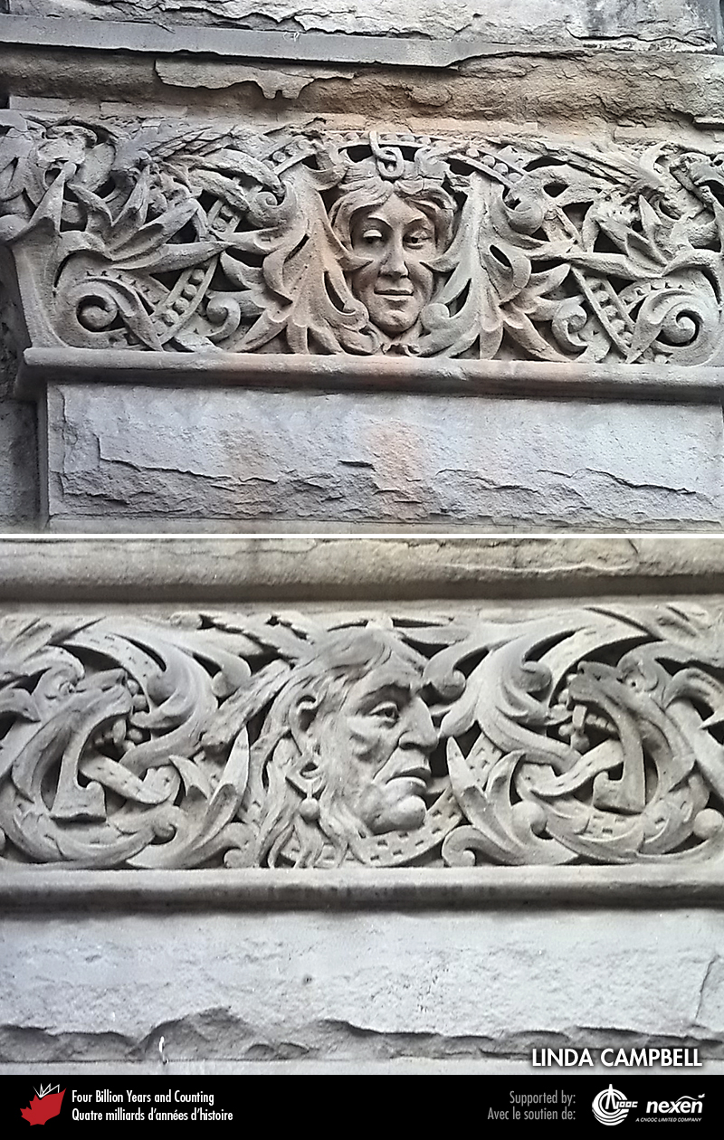
Notes:
Carved heads peek out from ornate fringes on the lower part of the Greenshields Building on Water Street in Vancouver, British Columbia. The stone for the carvings and surrounds is Gulf Islands or related sandstone, though the location of the quarry is unknown. LINDA CAMPBELL.
_______________________________
All photographic and graphic images (henceforth referred to as images) posted on this site are copyright of the persons and/or institutions indicated in the caption directly associated with each image. The copyright holders have agreed that you may use their images for educational, non-commercial purposes only and provided that they are credited in each instance of use. For all other uses you must contact the copyright holder.

Slide 15
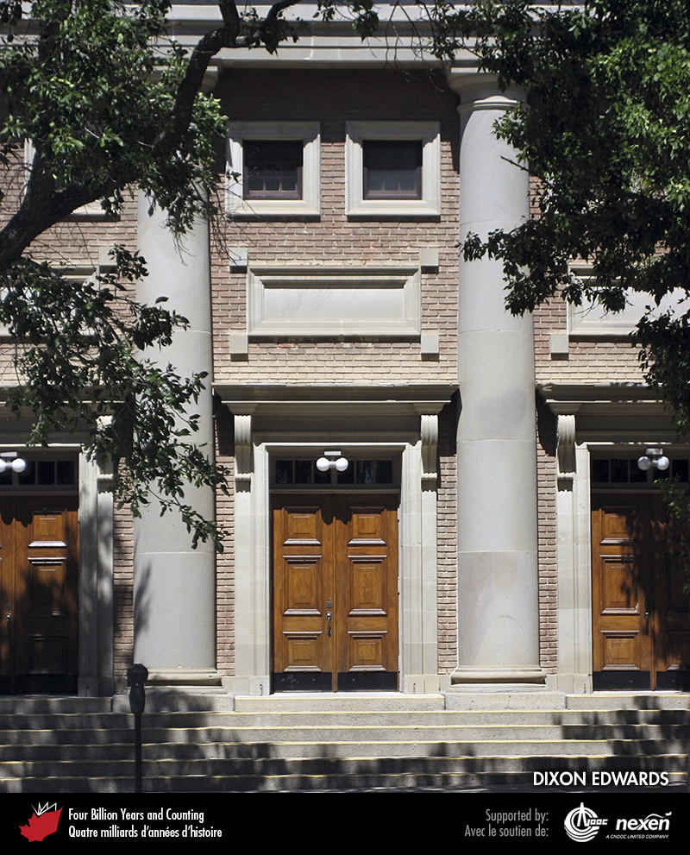
Notes:
Paleocene Paskapoo Sandstone was used for trim and columns, together with brick, in the construction of Southminster United Church (1913) in Lethbridge, Alberta. DIXON EDWARDS.
_______________________________
All photographic and graphic images (henceforth referred to as images) posted on this site are copyright of the persons and/or institutions indicated in the caption directly associated with each image. The copyright holders have agreed that you may use their images for educational, non-commercial purposes only and provided that they are credited in each instance of use. For all other uses you must contact the copyright holder.

Slide 16
Notes:
The Kamenka stone quarry in the Bow Valley, just outside Banff National Park of Canada, Alberta, produces hand-split Rundlestone, a Triassic clastic deposit used regionally as a building stone. DIXON EDWARDS.
_______________________________
All photographic and graphic images (henceforth referred to as images) posted on this site are copyright of the persons and/or institutions indicated in the caption directly associated with each image. The copyright holders have agreed that you may use their images for educational, non-commercial purposes only and provided that they are credited in each instance of use. For all other uses you must contact the copyright holder.

