Slide 1
CHAPTER 11 Part 1 of 3
All photographic and graphic images (henceforth referred to as images) posted on this site are copyright of the persons and/or institutions indicated in the caption directly associated with each image. The copyright holders have agreed that you may use their images for educational, non-commercial purposes only and provided that they are credited in each instance of use. For all other uses you must contact the copyright holder.

Slide 2
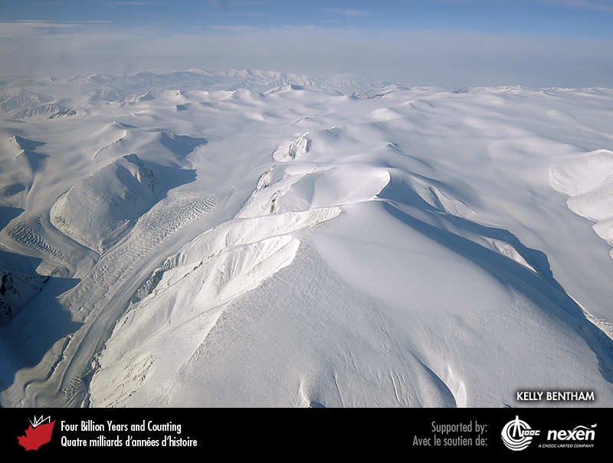
Notes:
Aerial view of Axel Heiberg Island, Nunavut, an icy scene reminiscent of what much larger areas of Canada would have looked like during the last glaciation. KELLY BENTHAM, FROM THE LORITA (LOMONOSOV RIDGE TEST OF APPURTENANCE) FIELD PROJECT, GEOLOGICAL SURVEY OF CANADA UNCLOS PROGRAM.
_______________________________
All photographic and graphic images (henceforth referred to as images) posted on this site are copyright of the persons and/or institutions indicated in the caption directly associated with each image. The copyright holders have agreed that you may use their images for educational, non-commercial purposes only and provided that they are credited in each instance of use. For all other uses you must contact the copyright holder.

Slide 3
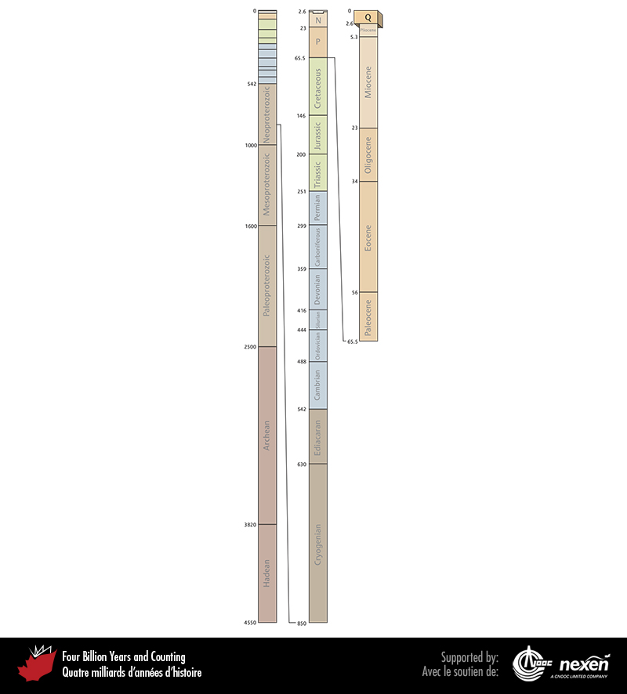
Notes:
Geological time scale, showing the interval covered in this chapter. Numbers indicate millions of years ago. P = Paleogene (Paleocene to Oligocene), N = Neogene (Miocene and Pliocene), and Q = Quaternary.
_______________________________
All photographic and graphic images (henceforth referred to as images) posted on this site are copyright of the persons and/or institutions indicated in the caption directly associated with each image. The copyright holders have agreed that you may use their images for educational, non-commercial purposes only and provided that they are credited in each instance of use. For all other uses you must contact the copyright holder.

Slide 4
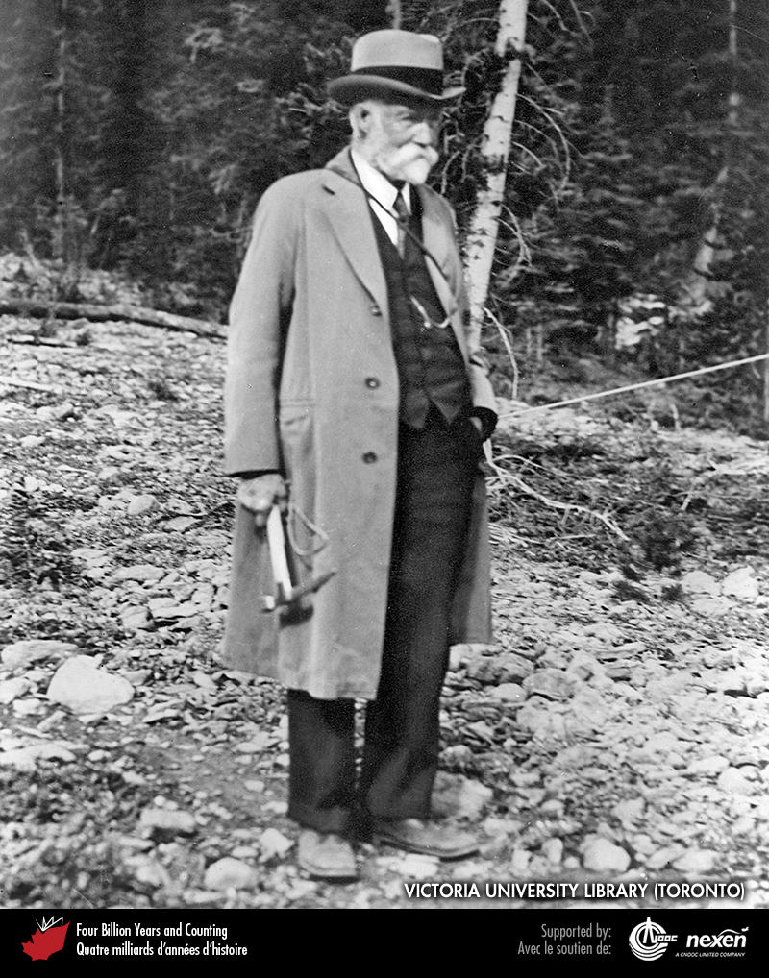
Notes:
Arthur Coleman—mountaineer, artist, and geologist—in his later years. COURTESY OF VICTORIA UNIVERSITY LIBRARY (TORONTO).
_______________________________
All photographic and graphic images (henceforth referred to as images) posted on this site are copyright of the persons and/or institutions indicated in the caption directly associated with each image. The copyright holders have agreed that you may use their images for educational, non-commercial purposes only and provided that they are credited in each instance of use. For all other uses you must contact the copyright holder.

Slide 5
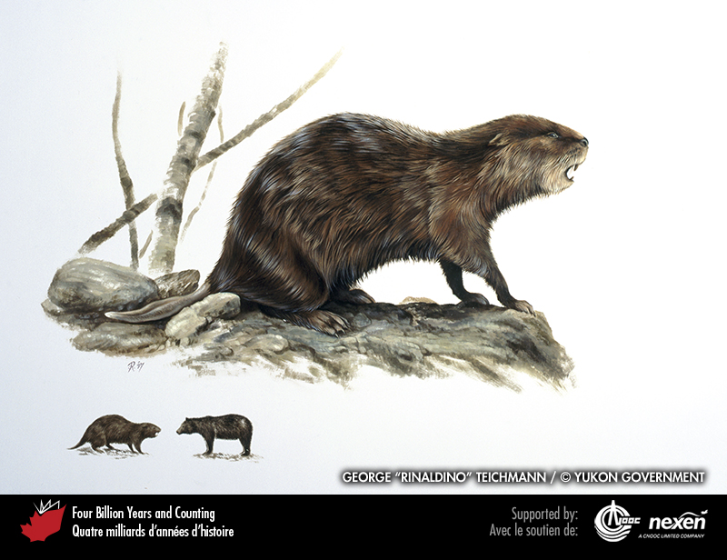
Notes:
Remains of giant beaver have been found in Quaternary sediments at various locations across Canada, including the Toronto area. For scale, the inset shows an imagined confrontation between a giant beaver, which could be up to 2.5 metres long, and a black bear. GIANT BEAVER, COPYRIGHT GOVERNMENT OF YUKON / ARTIST GEORGE “RINALDINO” TEICHMANN, 1997.
_______________________________
All photographic and graphic images (henceforth referred to as images) posted on this site are copyright of the persons and/or institutions indicated in the caption directly associated with each image. The copyright holders have agreed that you may use their images for educational, non-commercial purposes only and provided that they are credited in each instance of use. For all other uses you must contact the copyright holder.

Slide 6
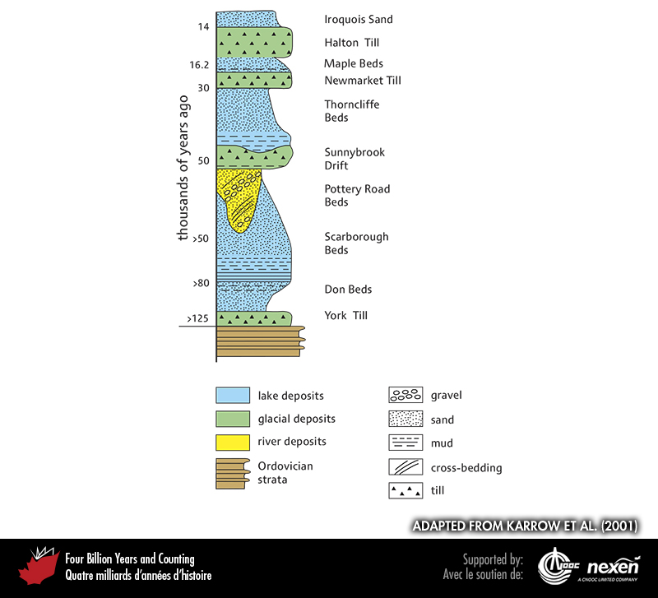
Notes:
Composite column of the succession of sediments at the Don Valley Brick Works and Scarborough Bluffs, near Toronto, Ontario, and their ages. ADAPTED FROM KARROW ET AL. (2001).
_______________________________
All photographic and graphic images (henceforth referred to as images) posted on this site are copyright of the persons and/or institutions indicated in the caption directly associated with each image. The copyright holders have agreed that you may use their images for educational, non-commercial purposes only and provided that they are credited in each instance of use. For all other uses you must contact the copyright holder.

Slide 7
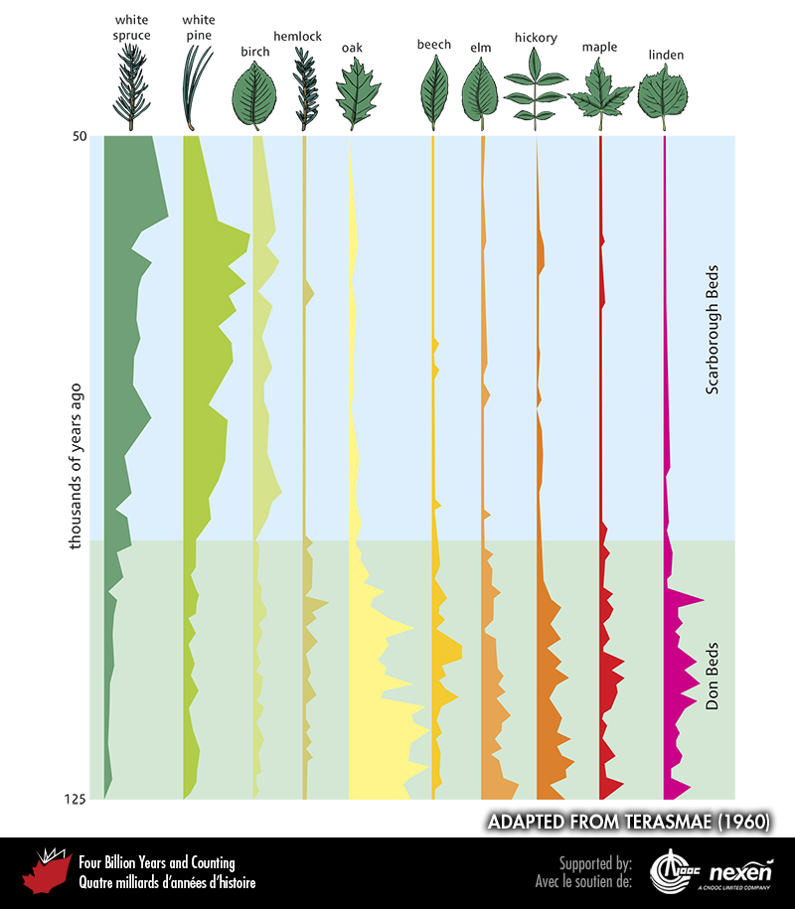
Notes:
Pollen assemblages recorded from the Don and Scarborough beds, largely reflecting changing climatic conditions. The coloured graphs represent the proportions of particular trees in the pollen assemblage, the broader the coloured band the greater the proportion. The dominant pollen in the interglacial Don Beds are from deciduous trees (oak to linden on the right side of the figure) that flourished during the last interglaciation, whereas the relative abundance of conifer pollen (spruce and pine) in the Scarborough Beds reflects a cooler climate as the last glaciation began to gain momentum. ADAPTED FROM TERASMAE (1960).
_______________________________
All photographic and graphic images (henceforth referred to as images) posted on this site are copyright of the persons and/or institutions indicated in the caption directly associated with each image. The copyright holders have agreed that you may use their images for educational, non-commercial purposes only and provided that they are credited in each instance of use. For all other uses you must contact the copyright holder.

Slide 8
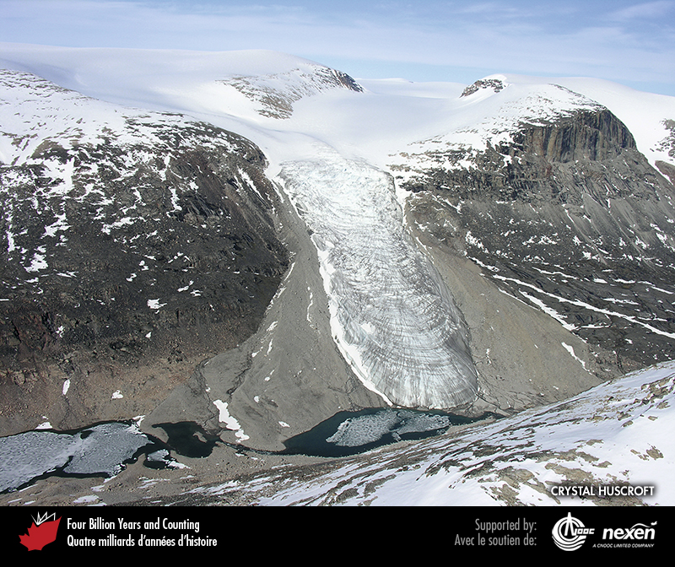
Notes:
Crevasses can have concentric and radial patterns, as on this tumbling glacier on Baffin Island, Nunavut. CRYSTAL HUSCROFT.
_______________________________
All photographic and graphic images (henceforth referred to as images) posted on this site are copyright of the persons and/or institutions indicated in the caption directly associated with each image. The copyright holders have agreed that you may use their images for educational, non-commercial purposes only and provided that they are credited in each instance of use. For all other uses you must contact the copyright holder.

Slide 9
Notes:
Glacial grooves and striations on a rock surface near Clam Harbour Beach, Nova Scotia. The rock surface was scratched and grooved by stones and grit frozen into the bed of the glacier. The grooves show various orientations, evidence for changes in the direction of glacier flow. ROB FENSOME.
_______________________________
All photographic and graphic images (henceforth referred to as images) posted on this site are copyright of the persons and/or institutions indicated in the caption directly associated with each image. The copyright holders have agreed that you may use their images for educational, non-commercial purposes only and provided that they are credited in each instance of use. For all other uses you must contact the copyright holder.

Slide 10
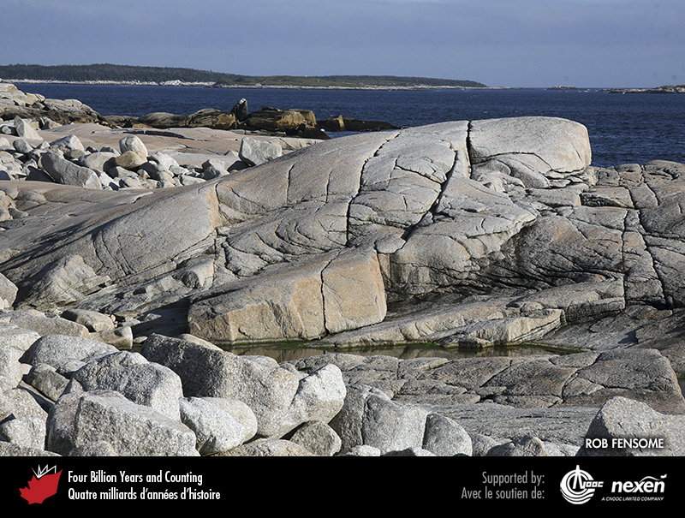
Notes:
A characteristic feature of a formerly glaciated rocky landscape is a roche moutonnee, a glacially smoothed rocky prominence with a gentler slope on the up-ice side and a steeper slope on the down-ice side. This example, at Prospect, Nova Scotia, occurs in Devonian granite of the South Mountain Batholith. ROB FENSOME.
_______________________________
All photographic and graphic images (henceforth referred to as images) posted on this site are copyright of the persons and/or institutions indicated in the caption directly associated with each image. The copyright holders have agreed that you may use their images for educational, non-commercial purposes only and provided that they are credited in each instance of use. For all other uses you must contact the copyright holder.

Slide 11
Notes:
The glacial origin of the valley containing Ten Mile Pond in Gros Morne National Park of Canada, Newfoundland, is evident from its U-shaped cross-section. MICHAEL BURZYNSKI.
_______________________________
All photographic and graphic images (henceforth referred to as images) posted on this site are copyright of the persons and/or institutions indicated in the caption directly associated with each image. The copyright holders have agreed that you may use their images for educational, non-commercial purposes only and provided that they are credited in each instance of use. For all other uses you must contact the copyright holder.

Slide 12
Notes:
Mount Assiniboine, on the Alberta-British Columbia border, is a Matterhorn-like peak eroded on all sides by glaciers. JOHN SCURLOCK.
_______________________________
All photographic and graphic images (henceforth referred to as images) posted on this site are copyright of the persons and/or institutions indicated in the caption directly associated with each image. The copyright holders have agreed that you may use their images for educational, non-commercial purposes only and provided that they are credited in each instance of use. For all other uses you must contact the copyright holder.

Slide 13
Notes:
A sediment-laden glacier resting on early Permian sandstone, northwestern Ellesmere Island, Nunavut. BENOIT BEAUCHAMP.
_______________________________
All photographic and graphic images (henceforth referred to as images) posted on this site are copyright of the persons and/or institutions indicated in the caption directly associated with each image. The copyright holders have agreed that you may use their images for educational, non-commercial purposes only and provided that they are credited in each instance of use. For all other uses you must contact the copyright holder.

Slide 14
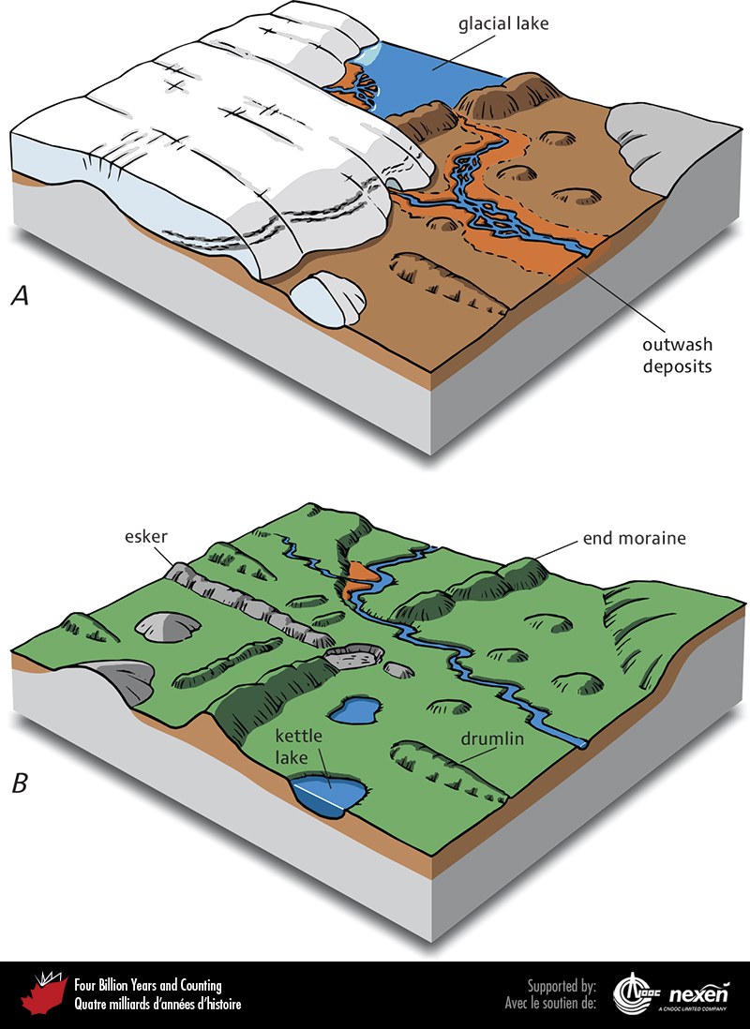
Notes:
Features produced by glacial deposition or glacier-related water-lain deposits. A shows a landscape still partly glaciated; B shows the same landscape after deglaciation.
_______________________________
All photographic and graphic images (henceforth referred to as images) posted on this site are copyright of the persons and/or institutions indicated in the caption directly associated with each image. The copyright holders have agreed that you may use their images for educational, non-commercial purposes only and provided that they are credited in each instance of use. For all other uses you must contact the copyright holder.

Slide 15
Notes:
Till deposited during the last glaciation in the Chibougamau area of Quebec. The orientation of elongated boulders and pebbles provides evidence of the flow direction of the last ice to cover the area; in this case it was to the southwest. GILBERT PRICHONNET.
_______________________________
All photographic and graphic images (henceforth referred to as images) posted on this site are copyright of the persons and/or institutions indicated in the caption directly associated with each image. The copyright holders have agreed that you may use their images for educational, non-commercial purposes only and provided that they are credited in each instance of use. For all other uses you must contact the copyright holder.

