Slide 1
CHAPTER 10 Part 1 of 3
All photographic and graphic images (henceforth referred to as images) posted on this site are copyright of the persons and/or institutions indicated in the caption directly associated with each image. The copyright holders have agreed that you may use their images for educational, non-commercial purposes only and provided that they are credited in each instance of use. For all other uses you must contact the copyright holder.

Slide 2
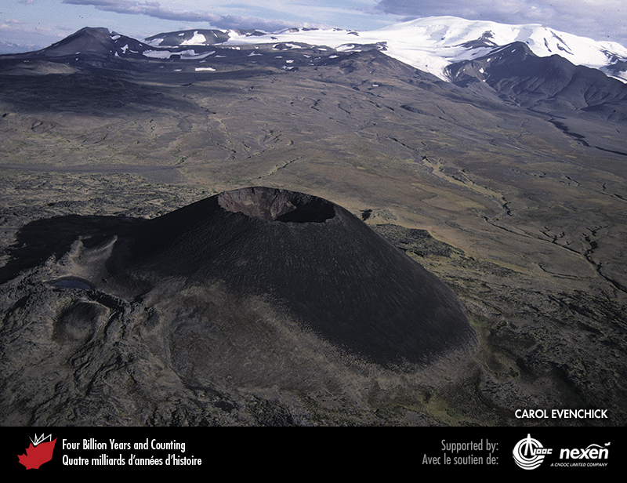
Notes:
Volcanoes have been active in the western Cordillera throughout the Cenozoic. Eve Cone is a 150-metre-high cinder cone on the northern flank of Mount Edziza, one of three large shield volcanoes in the Stikine Volcanic Belt of northern British Columbia. Eve Cone was active around the year 700 CE. CAROL EVENCHICK.
_______________________________
All photographic and graphic images (henceforth referred to as images) posted on this site are copyright of the persons and/or institutions indicated in the caption directly associated with each image. The copyright holders have agreed that you may use their images for educational, non-commercial purposes only and provided that they are credited in each instance of use. For all other uses you must contact the copyright holder.

Slide 3
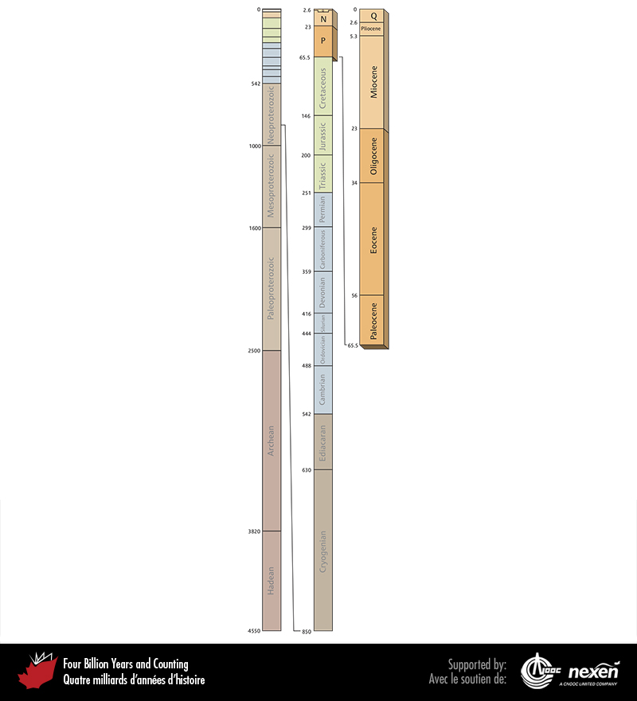
Notes:
Geological time scale, showing the interval covered in this chapter. Numbers indicate millions of years ago. P = Paleogene, N = Neogene, Q = Quaternary.
_______________________________
All photographic and graphic images (henceforth referred to as images) posted on this site are copyright of the persons and/or institutions indicated in the caption directly associated with each image. The copyright holders have agreed that you may use their images for educational, non-commercial purposes only and provided that they are credited in each instance of use. For all other uses you must contact the copyright holder.

Slide 4
Notes:
Aerial view of Eureka on Ellesmere Island, Nunavut, which was one of a network of weather and radar stations set up by Canada and the United States in 1946. KELLY BENTHAM.
_______________________________
All photographic and graphic images (henceforth referred to as images) posted on this site are copyright of the persons and/or institutions indicated in the caption directly associated with each image. The copyright holders have agreed that you may use their images for educational, non-commercial purposes only and provided that they are credited in each instance of use. For all other uses you must contact the copyright holder.

Slide 5
Notes:
Tree stump, probably of the dawn redwood, from the Eocene fossil forest on Axel Heiberg Island, Nunavut. JIM BASINGER.
_______________________________
All photographic and graphic images (henceforth referred to as images) posted on this site are copyright of the persons and/or institutions indicated in the caption directly associated with each image. The copyright holders have agreed that you may use their images for educational, non-commercial purposes only and provided that they are credited in each instance of use. For all other uses you must contact the copyright holder.

Slide 6
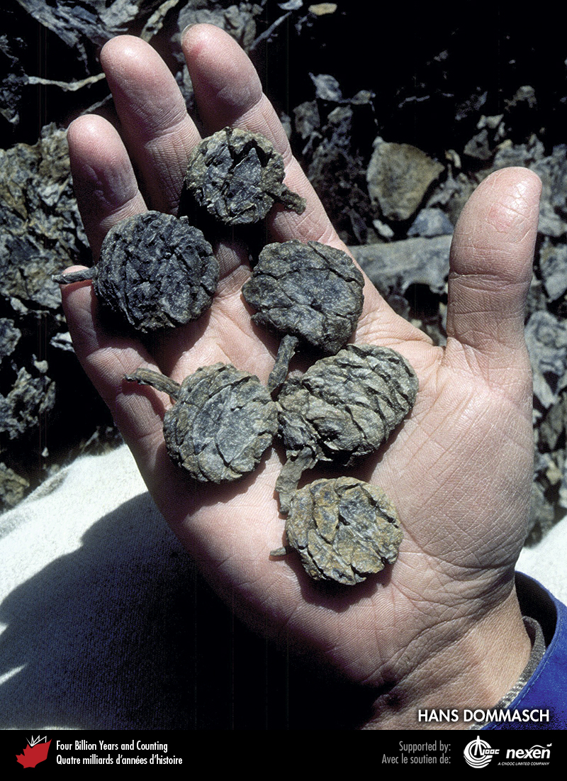
Notes:
Dawn redwood cones from the Eocene fossil forest on Axel Heiberg Island, Nunavut. HANS DOMMASCH.
_______________________________
All photographic and graphic images (henceforth referred to as images) posted on this site are copyright of the persons and/or institutions indicated in the caption directly associated with each image. The copyright holders have agreed that you may use their images for educational, non-commercial purposes only and provided that they are credited in each instance of use. For all other uses you must contact the copyright holder.

Slide 7
Notes:
Dawn redwood foliage from the Eocene fossil forest on Axel Heiberg Island, Nunavut. JIM BASINGER.
_______________________________
All photographic and graphic images (henceforth referred to as images) posted on this site are copyright of the persons and/or institutions indicated in the caption directly associated with each image. The copyright holders have agreed that you may use their images for educational, non-commercial purposes only and provided that they are credited in each instance of use. For all other uses you must contact the copyright holder.

Slide 8
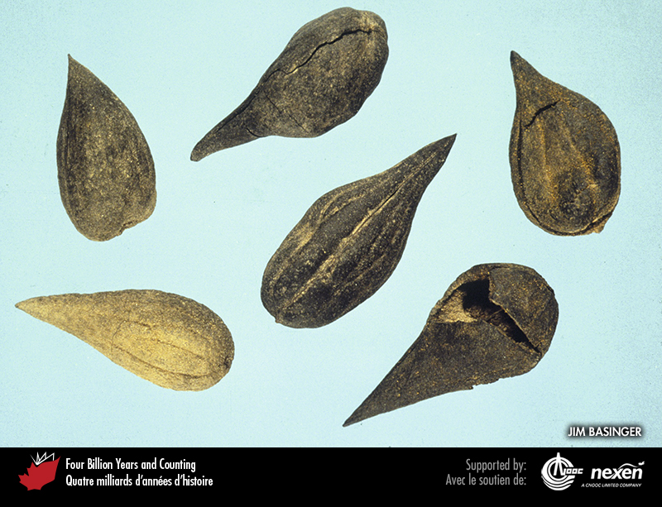
Notes:
Walnut seeds from the Eocene fossil forest on Axel Heiberg Island, Nunavut. JIM BASINGER.
_______________________________
All photographic and graphic images (henceforth referred to as images) posted on this site are copyright of the persons and/or institutions indicated in the caption directly associated with each image. The copyright holders have agreed that you may use their images for educational, non-commercial purposes only and provided that they are credited in each instance of use. For all other uses you must contact the copyright holder.

Slide 9
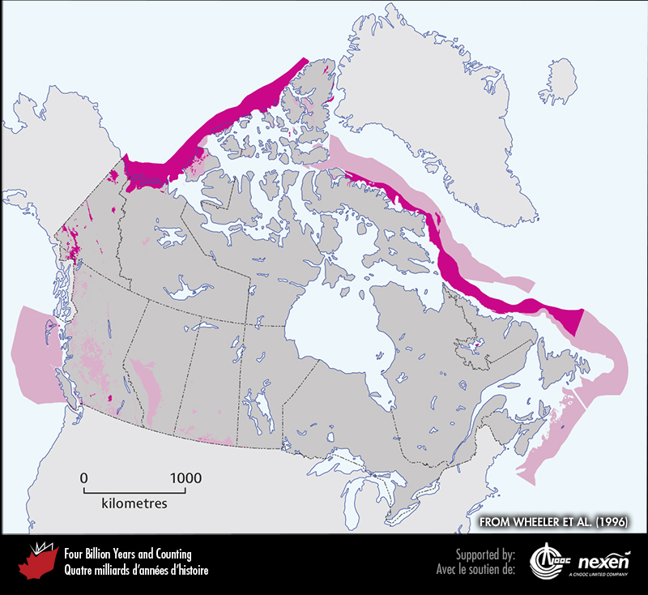
Notes:
General extent of Cenozoic rocks at the surface (beneath glacial deposits), onshore and offshore. The lighter shaded areas denote either uncertainty or areas where rocks of the particular age have been confirmed but are intimately associated with rocks of other ages and the scale of the map doesn’t allow us to show them separately. ADAPTED FROM WHEELER ET AL. (1996).
_______________________________
All photographic and graphic images (henceforth referred to as images) posted on this site are copyright of the persons and/or institutions indicated in the caption directly associated with each image. The copyright holders have agreed that you may use their images for educational, non-commercial purposes only and provided that they are credited in each instance of use. For all other uses you must contact the copyright holder.

Slide 10
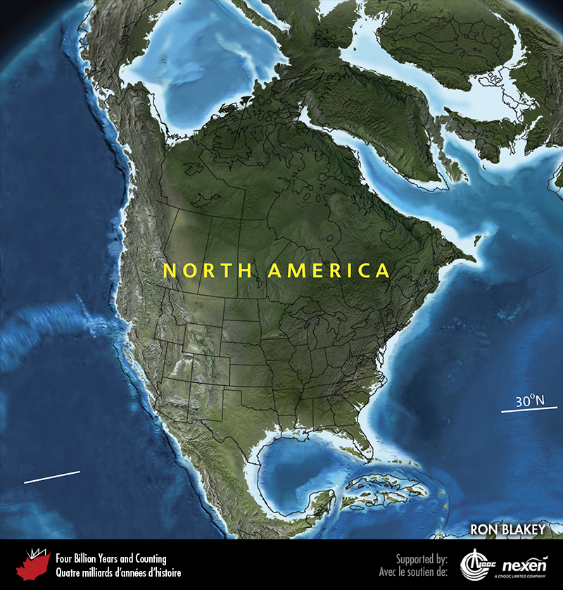
Notes:
Paleogeography of North America and adjacent regions in the Paleocene, 60 million years ago. Land is shown in brown, with shading showing topography. The lighter blue areas represent possible coastal or nearshore areas, darker blue represents deeper ocean waters, and black indicates trenches. Aspects of modern geography are shown for orientation.
_______________________________
All photographic and graphic images (henceforth referred to as images) posted on this site are copyright of the persons and/or institutions indicated in the caption directly associated with each image. The copyright holders have agreed that you may use their images for educational, non-commercial purposes only and provided that they are credited in each instance of use. For all other uses you must contact the copyright holder.

Slide 11
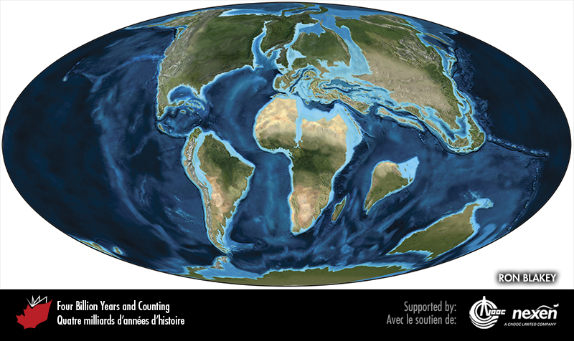
Notes:
Global paleogeography 60 million years ago, during the Paleocene. Colours as for previous figure.
_______________________________
All photographic and graphic images (henceforth referred to as images) posted on this site are copyright of the persons and/or institutions indicated in the caption directly associated with each image. The copyright holders have agreed that you may use their images for educational, non-commercial purposes only and provided that they are credited in each instance of use. For all other uses you must contact the copyright holder.

Slide 12
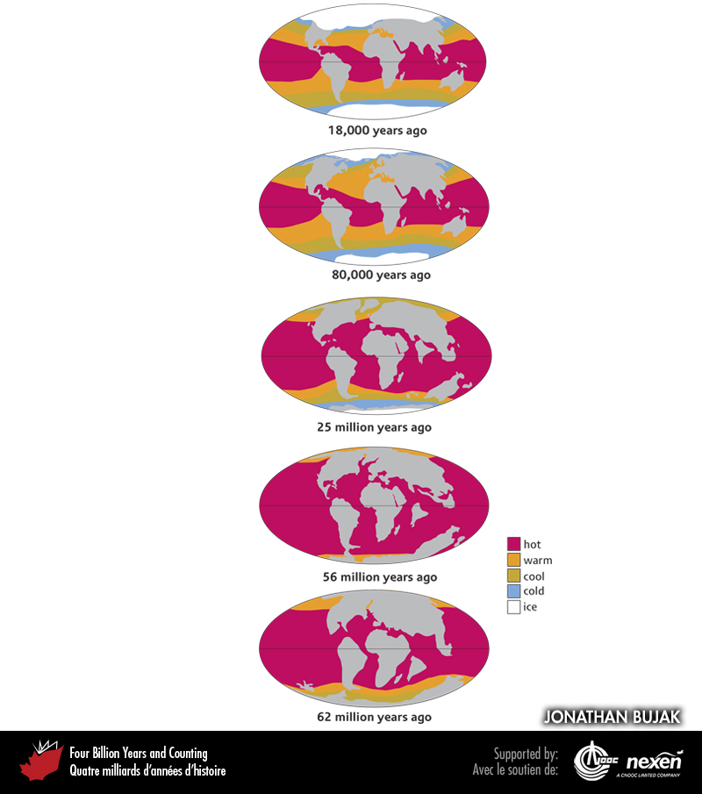
Notes:
Changing general ocean temperatures through the Cenozoic, showing the trend from a “greenhouse” world 62 million years ago and the Paleocene-Eocene Thermal Maximum 56 million years ago, to the “icehouse” world of today. JONATHAN BUJAK.
_______________________________
All photographic and graphic images (henceforth referred to as images) posted on this site are copyright of the persons and/or institutions indicated in the caption directly associated with each image. The copyright holders have agreed that you may use their images for educational, non-commercial purposes only and provided that they are credited in each instance of use. For all other uses you must contact the copyright holder.

Slide 13
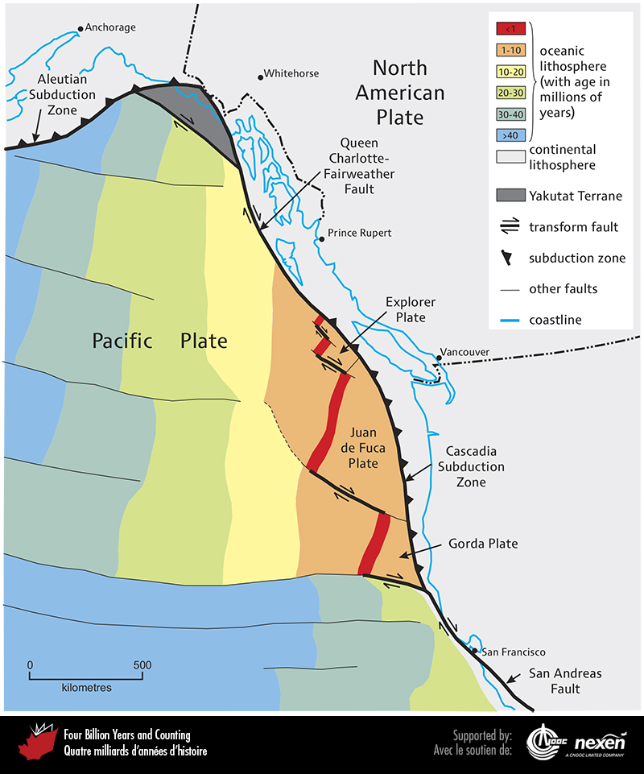
Notes:
Ages of oceanic lithosphere in the northeastern Pacific Ocean and the structures bounding the western margin of the North American Plate. Young oceanic lithosphere, coloured red, reflects the position of spreading ridges. ADAPTED FROM VARIOUS SOURCES.
_______________________________
All photographic and graphic images (henceforth referred to as images) posted on this site are copyright of the persons and/or institutions indicated in the caption directly associated with each image. The copyright holders have agreed that you may use their images for educational, non-commercial purposes only and provided that they are credited in each instance of use. For all other uses you must contact the copyright holder.

Slide 14
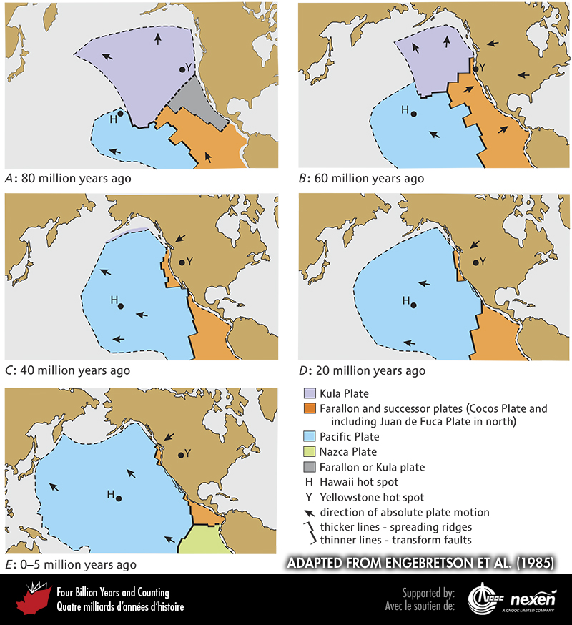
Notes:
Evolution of tectonic plates in the northeastern Pacific Ocean during the past 80 million years, based on a modern map. ADAPTED FROM ENGEBRETSON ET AL. (1985).
_______________________________
All photographic and graphic images (henceforth referred to as images) posted on this site are copyright of the persons and/or institutions indicated in the caption directly associated with each image. The copyright holders have agreed that you may use their images for educational, non-commercial purposes only and provided that they are credited in each instance of use. For all other uses you must contact the copyright holder.

Slide 15
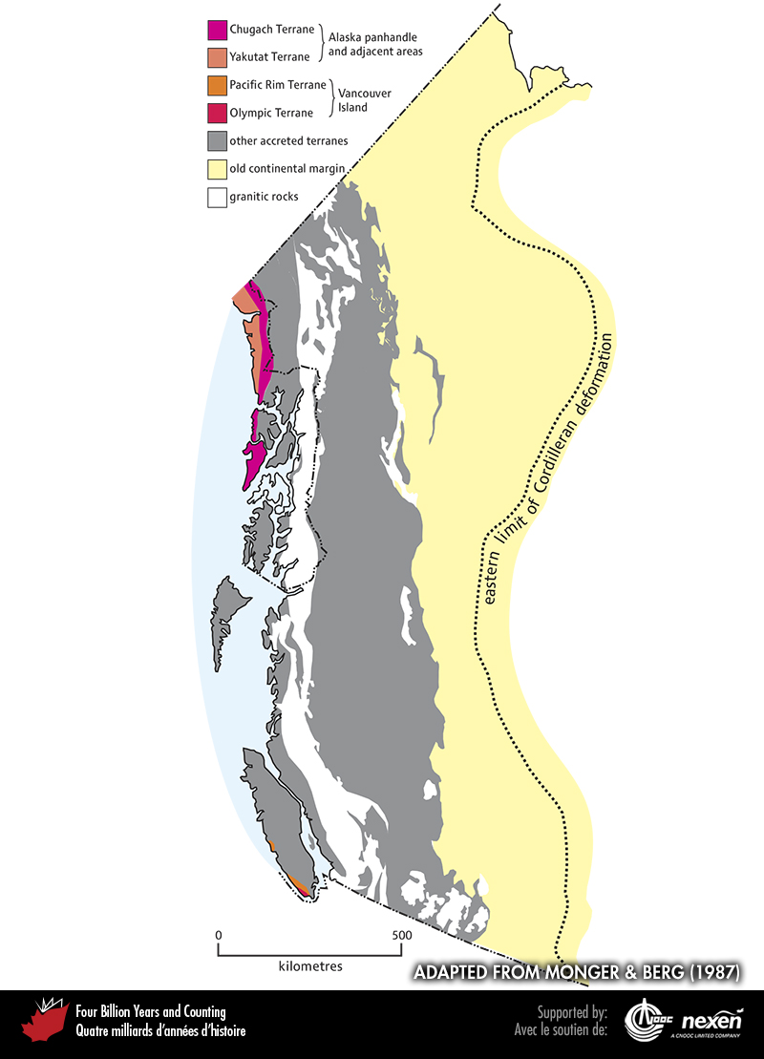
Notes:
The Canadian Cordillera and adjacent parts of southeastern Alaska showing the westernmost terranes, the latest additions to the continent. ADAPTED FROM MONGER AND BERG (1987), COURTESY OF THE US GEOLOGICAL SURVEY.
_______________________________
All photographic and graphic images (henceforth referred to as images) posted on this site are copyright of the persons and/or institutions indicated in the caption directly associated with each image. The copyright holders have agreed that you may use their images for educational, non-commercial purposes only and provided that they are credited in each instance of use. For all other uses you must contact the copyright holder.

Slide 16
Notes:
Pebbly mudstone of the Pacific Rim Terrane, at Chesterman Beach, Pacific Rim National Park Reserve of Canada, British Columbia. The Pacific Rim Terrane is composed of generally coarse clastic rocks and igneous rocks of Jurassic to Cretaceous age. JIM MONGER.
_______________________________
All photographic and graphic images (henceforth referred to as images) posted on this site are copyright of the persons and/or institutions indicated in the caption directly associated with each image. The copyright holders have agreed that you may use their images for educational, non-commercial purposes only and provided that they are credited in each instance of use. For all other uses you must contact the copyright holder.

