Slide 1
CHAPTER 9 Part 3 of 4
All photographic and graphic images (henceforth referred to as images) posted on this site are copyright of the persons and/or institutions indicated in the caption directly associated with each image. The copyright holders have agreed that you may use their images for educational, non-commercial purposes only and provided that they are credited in each instance of use. For all other uses you must contact the copyright holder.

Slide 2
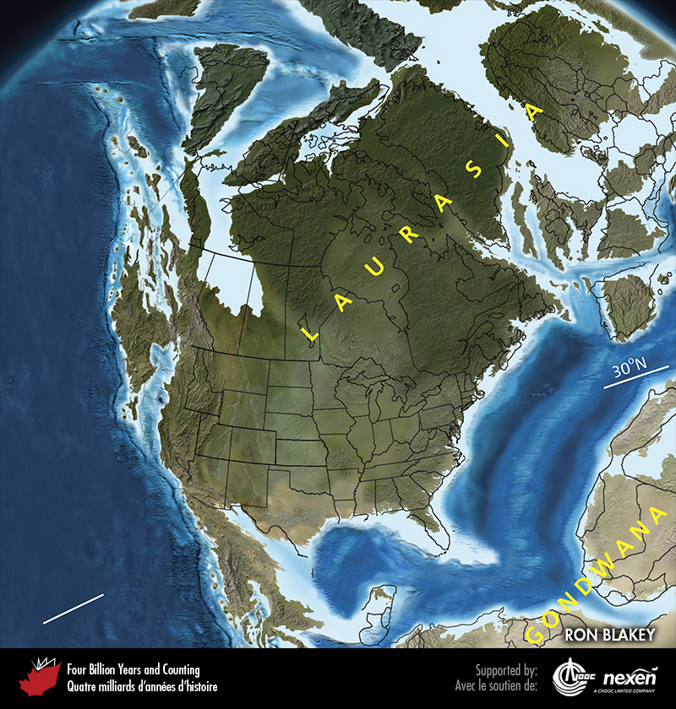
Notes:
Paleogeography of what was to become North America and adjacent regions in the Cretaceous, 130 million years ago. Land is shown in brown, with shading showing topography. The lighter blue areas represent possible coastal or nearshore areas, darker blue represents deeper ocean waters, and black indicates trenches. Aspects of modern geography are shown for orientation.
_______________________________
All photographic and graphic images (henceforth referred to as images) posted on this site are copyright of the persons and/or institutions indicated in the caption directly associated with each image. The copyright holders have agreed that you may use their images for educational, non-commercial purposes only and provided that they are credited in each instance of use. For all other uses you must contact the copyright holder.

Slide 3
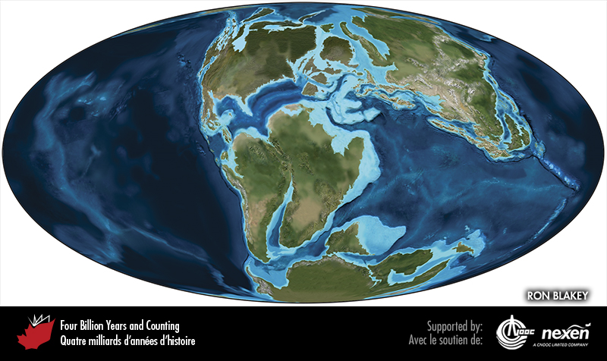
Notes:
Global paleogeography 130 million years ago, during the early Cretaceous. Colours as for previous figure.
_______________________________
All photographic and graphic images (henceforth referred to as images) posted on this site are copyright of the persons and/or institutions indicated in the caption directly associated with each image. The copyright holders have agreed that you may use their images for educational, non-commercial purposes only and provided that they are credited in each instance of use. For all other uses you must contact the copyright holder.

Slide 4
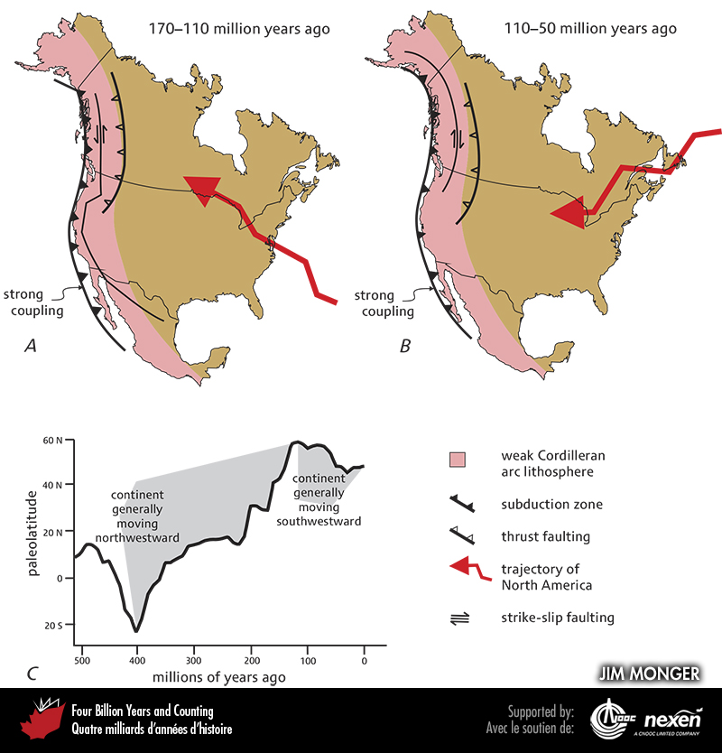
Notes:
Major structural features of the Cordillera and their relationship to the overall motion of tectonic plates. The fault symbols represent the general situation, not specific faults. The strong compressional force produced by the convergence of the North American Plate on the one side and the plates underlying the Pacific Ocean on the other causes the plates at the boundary to become stuck together (or strongly coupled). As a consequence, the strain was largely taken up by strike-slip faulting within the weak western edge of the North American Plate. From 170 to 110 million years ago, this strike-slip faulting was left lateral, reflecting northward movement of the continent relative to the subduction zone (A); from 110 million years ago to the present, faulting has been right-lateral, reflecting southward movement of the continent (B). C shows paleolatitudes determined from paleomagnetic studies of the continental interior, calculated using the 20- to 30-million year running averages for a point in northwestern Montana (48°N and 115°W).
_______________________________
All photographic and graphic images (henceforth referred to as images) posted on this site are copyright of the persons and/or institutions indicated in the caption directly associated with each image. The copyright holders have agreed that you may use their images for educational, non-commercial purposes only and provided that they are credited in each instance of use. For all other uses you must contact the copyright holder.

Slide 5
Notes:
A middle Cretaceous granitic pluton forms the Stawamus Chief (better known as “The Chief”), a rock climbers’ mecca, near Squamish, British Columbia. PAUL ADAM.
_______________________________
All photographic and graphic images (henceforth referred to as images) posted on this site are copyright of the persons and/or institutions indicated in the caption directly associated with each image. The copyright holders have agreed that you may use their images for educational, non-commercial purposes only and provided that they are credited in each instance of use. For all other uses you must contact the copyright holder.

Slide 6
Notes:
Cretaceous sandstone of the Georgia Basin, Tumbo Island, Gulf Islands, British Columbia. C. CHEADLE, COPYRIGHT PARKS CANADA.
_______________________________
All photographic and graphic images (henceforth referred to as images) posted on this site are copyright of the persons and/or institutions indicated in the caption directly associated with each image. The copyright holders have agreed that you may use their images for educational, non-commercial purposes only and provided that they are credited in each instance of use. For all other uses you must contact the copyright holder.

Slide 7
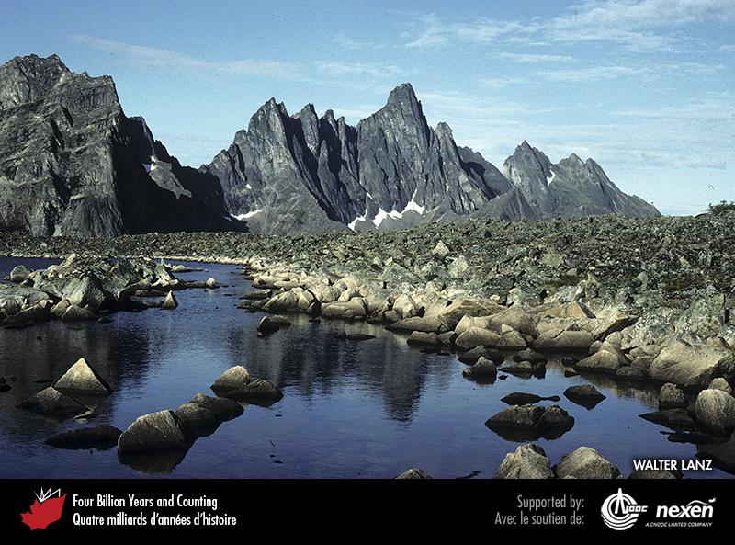
Notes:
The Tombstone Range, seen from Talus Lake, Yukon, has been eroded from the middle Cretaceous Tombstone Pluton. WALTER LANZ.
_______________________________
All photographic and graphic images (henceforth referred to as images) posted on this site are copyright of the persons and/or institutions indicated in the caption directly associated with each image. The copyright holders have agreed that you may use their images for educational, non-commercial purposes only and provided that they are credited in each instance of use. For all other uses you must contact the copyright holder.

Slide 8
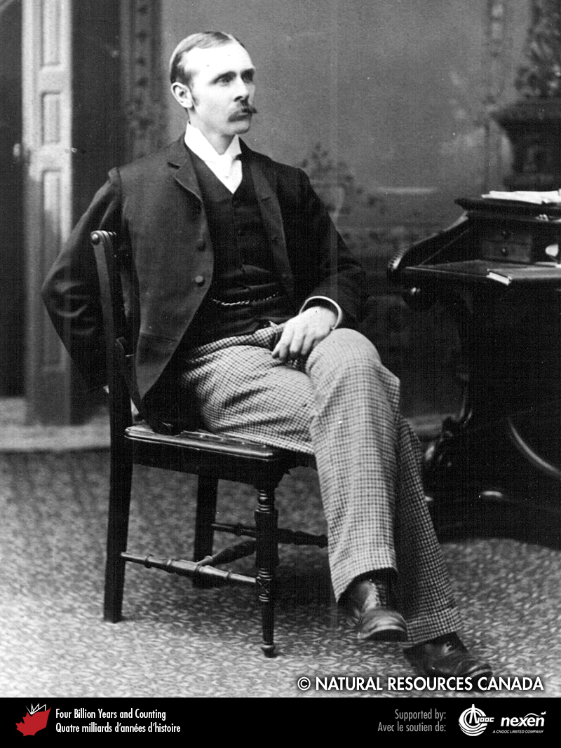
Notes:
Richard McConnell was the first person to recognize the thrustfaulted and folded structure of the Rocky Mountains. REPRODUCED WITH THE PERMISSION OF NATURAL RESOURCES CANADA 2013, COURTESY OF THE GEOLOGICAL SURVEY OF CANADA.
_______________________________
All photographic and graphic images (henceforth referred to as images) posted on this site are copyright of the persons and/or institutions indicated in the caption directly associated with each image. The copyright holders have agreed that you may use their images for educational, non-commercial purposes only and provided that they are credited in each instance of use. For all other uses you must contact the copyright holder.

Slide 9
Notes:
The progressive evolution from Jurassic to Paleocene (A to C) of the foreland basin in front of the advancing Rocky Mountains. ADAPTED FROM YORATH AND GADD (1995), REPRODUCED WITH PERMISSION OF THE AUTHORS, DUNDURN PRESS, AND NATURAL RESOURCES CANADA.
_______________________________
All photographic and graphic images (henceforth referred to as images) posted on this site are copyright of the persons and/or institutions indicated in the caption directly associated with each image. The copyright holders have agreed that you may use their images for educational, non-commercial purposes only and provided that they are credited in each instance of use. For all other uses you must contact the copyright holder.

Slide 10
Notes:
An aerial view along the Trans-Canada Highway near Exshaw, Alberta. To the left is Door Jamb Mountain and in the right centre Yamnuska (Mount Laurie). The surface trace of the McConnell Thrust is located at the break in the slope on both mountains. This fault places Cambrian carbonate over Cretaceous shale and sandstone (the vegetated areas). RON GARNETT / AIRSCAPES.CA.
_______________________________
All photographic and graphic images (henceforth referred to as images) posted on this site are copyright of the persons and/or institutions indicated in the caption directly associated with each image. The copyright holders have agreed that you may use their images for educational, non-commercial purposes only and provided that they are credited in each instance of use. For all other uses you must contact the copyright holder.

Slide 11
Notes:
Typical topography of the Rocky Mountain Front Ranges, seen in this view to the northwest from above the Trans- Canada Highway in the Sundance Canyon area, near Banff, Alberta. The landscape reflects the repetition of erosionresistant Paleozoic carbonate strata thrust over more-easily-eroded Mesozoic clastic rocks in the valleys. RAY PRICE.
______________________________
All photographic and graphic images (henceforth referred to as images) posted on this site are copyright of the persons and/or institutions indicated in the caption directly associated with each image. The copyright holders have agreed that you may use their images for educational, non-commercial purposes only and provided that they are credited in each instance of use. For all other uses you must contact the copyright holder.

Slide 12
Notes:
Tilted late Devonian carbonate strata of The Ancient Wall, a mountain in Jasper National Park of Canada, are highlighted by low sunlight. These rocks were moved eastward tens to hundreds of kilometres by thrust faulting during middle Cretaceous to Paleocene times. WALTER LANZ.
______________________________
All photographic and graphic images (henceforth referred to as images) posted on this site are copyright of the persons and/or institutions indicated in the caption directly associated with each image. The copyright holders have agreed that you may use their images for educational, non-commercial purposes only and provided that they are credited in each instance of use. For all other uses you must contact the copyright holder.

Slide 13
Notes:
Geologists examine tilted Jurassic shale and sandstone on the Trans-Canada Highway east of Banff, Alberta. Cascade Mountain in the background consists of folded Devonian and Carboniferous carbonate strata, which have been thrust over the Jurassic strata. JIM MONGER.
_______________________________
All photographic and graphic images (henceforth referred to as images) posted on this site are copyright of the persons and/or institutions indicated in the caption directly associated with each image. The copyright holders have agreed that you may use their images for educational, non-commercial purposes only and provided that they are credited in each instance of use. For all other uses you must contact the copyright holder.

Slide 14
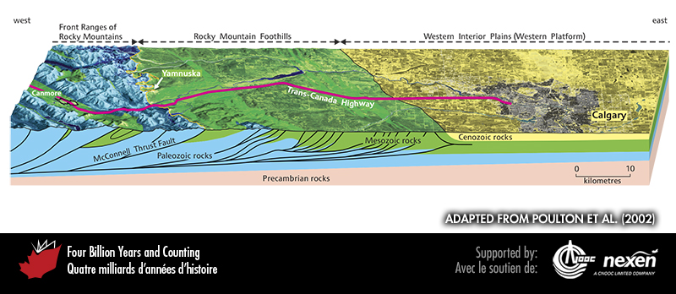
Notes:
The Rocky Mountain thrust-and-fold belt in southern Alberta, showing a generalized section through the Rocky Mountains and Western Interior Plains around and west of Calgary. The section shows the deformed edge of the former continental margin now underlying the Rocky Mountains, transitioning eastward to relatively undeformed rocks beneath the Plains. Paleozoic rocks (blue) thicken significantly westward; eastward they continue across the Plains beneath a cover of Mesozoic (green) and Cenozoic (yellow) strata. The mountains coincide generally with the area where the harder Paleozoic rocks reach the surface, a region bounded to the east by the McConnell Thrust Fault (orange line). The Foothills, between the Fault and Calgary, are underlain by deformed, but relatively easily eroded, Mesozoic strata. ADAPTED FROM POULTON ET AL. (2002).
_______________________________
All photographic and graphic images (henceforth referred to as images) posted on this site are copyright of the persons and/or institutions indicated in the caption directly associated with each image. The copyright holders have agreed that you may use their images for educational, non-commercial purposes only and provided that they are credited in each instance of use. For all other uses you must contact the copyright holder.

Slide 15
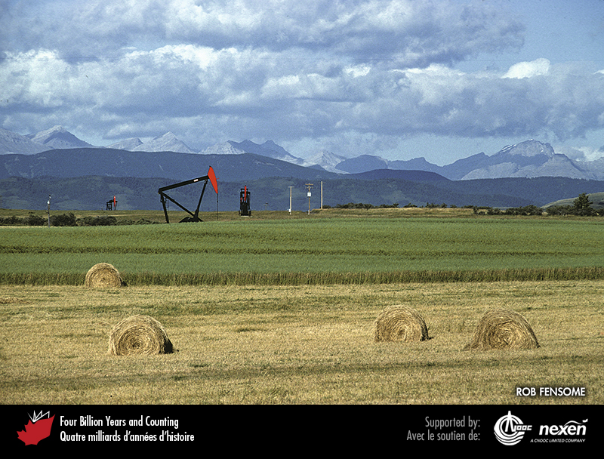
Notes:
South of Calgary, Alberta, plains and rolling foothills are underlain by less resistant, but still deformed, Mesozoic clastic sediments. On the horizon are distant peaks of the Front Ranges underlain by more resistant Paleozoic carbonates. Also evident are signs of two of Alberta’s major industries, petroleum and farming. ROB FENSOME.
_______________________________
All photographic and graphic images (henceforth referred to as images) posted on this site are copyright of the persons and/or institutions indicated in the caption directly associated with each image. The copyright holders have agreed that you may use their images for educational, non-commercial purposes only and provided that they are credited in each instance of use. For all other uses you must contact the copyright holder.

Slide 16
Notes:
The lighter-coloured sandstone in this roadcut at Pink Mountain, British Columbia, represents the channel deposits of a river that flowed in the Western Interior Basin sometime during the middle Cretaceous. DARREL LONG.
_______________________________
All photographic and graphic images (henceforth referred to as images) posted on this site are copyright of the persons and/or institutions indicated in the caption directly associated with each image. The copyright holders have agreed that you may use their images for educational, non-commercial purposes only and provided that they are credited in each instance of use. For all other uses you must contact the copyright holder.

