Slide 1
CHAPTER 9 Part 1 of 4
All photographic and graphic images (henceforth referred to as images) posted on this site are copyright of the persons and/or institutions indicated in the caption directly associated with each image. The copyright holders have agreed that you may use their images for educational, non-commercial purposes only and provided that they are credited in each instance of use. For all other uses you must contact the copyright holder.

Slide 2
Notes:
Although the prominent, resistant rocks of the Rockies are of Paleozoic age, it was Mesozoic tectonic forces that created the distinctive thrust faults and folds that are largely responsible for the modern grandeur of these mountains. This aerial view is of the “Big Bowl” on Mount Inflexible, Kananaskis Country, Alberta. MARILYN GARNETT / AIRSCAPES.CA.
_______________________________
All photographic and graphic images (henceforth referred to as images) posted on this site are copyright of the persons and/or institutions indicated in the caption directly associated with each image. The copyright holders have agreed that you may use their images for educational, non-commercial purposes only and provided that they are credited in each instance of use. For all other uses you must contact the copyright holder.

Slide 3
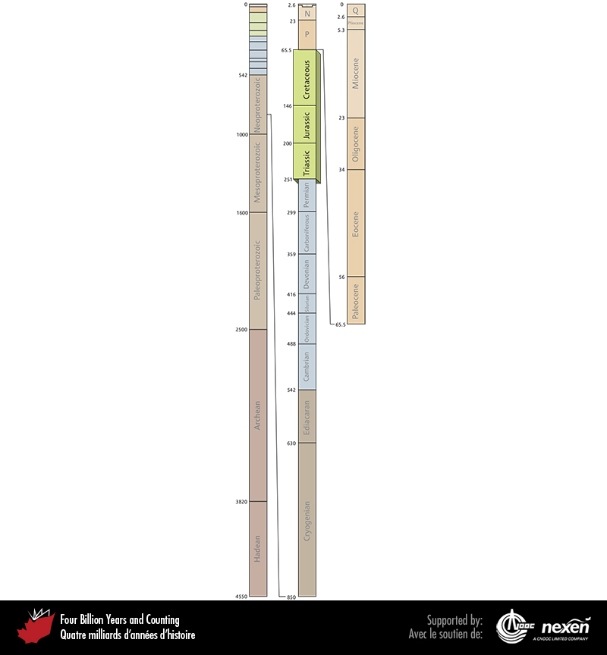
Notes:
Geologic time scale, showing the interval covered in this chapter. Numbers indicate millions of years ago. P = Paleogene (Paleocene to Oligocene), N = Neogene (Miocene and Pliocene), and Q = Quaternary.
_______________________________
All photographic and graphic images (henceforth referred to as images) posted on this site are copyright of the persons and/or institutions indicated in the caption directly associated with each image. The copyright holders have agreed that you may use their images for educational, non-commercial purposes only and provided that they are credited in each instance of use. For all other uses you must contact the copyright holder.

Slide 4
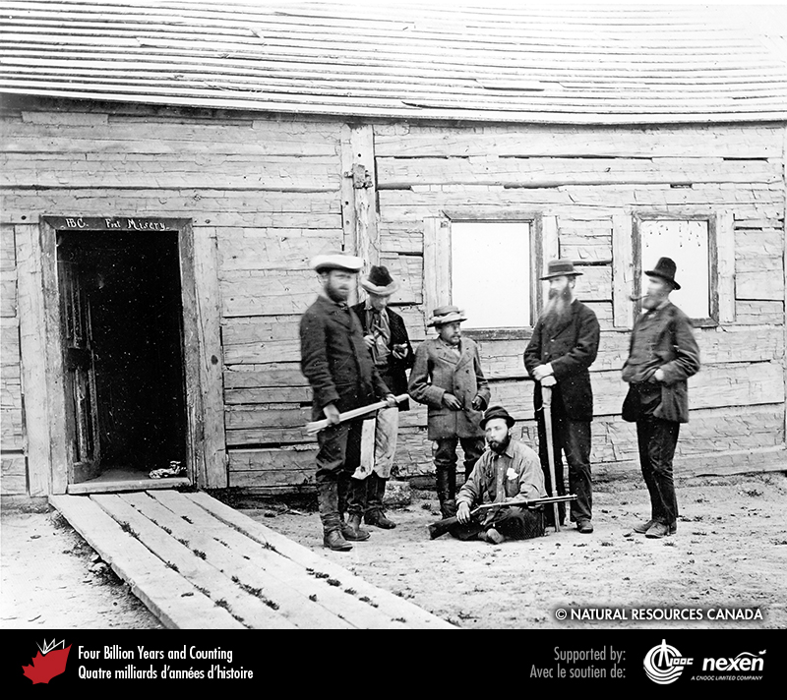
Notes:
George Mercer Dawson (third from the left) during his International Boundary Commission days. REPRODUCED WITH THE PERMISSION OF NATURAL RESOURCES CANADA 2013, COURTESY OF THE GEOLOGICAL SURVEY OF CANADA .
_______________________________
All photographic and graphic images (henceforth referred to as images) posted on this site are copyright of the persons and/or institutions indicated in the caption directly associated with each image. The copyright holders have agreed that you may use their images for educational, non-commercial purposes only and provided that they are credited in each instance of use. For all other uses you must contact the copyright holder.

Slide 5
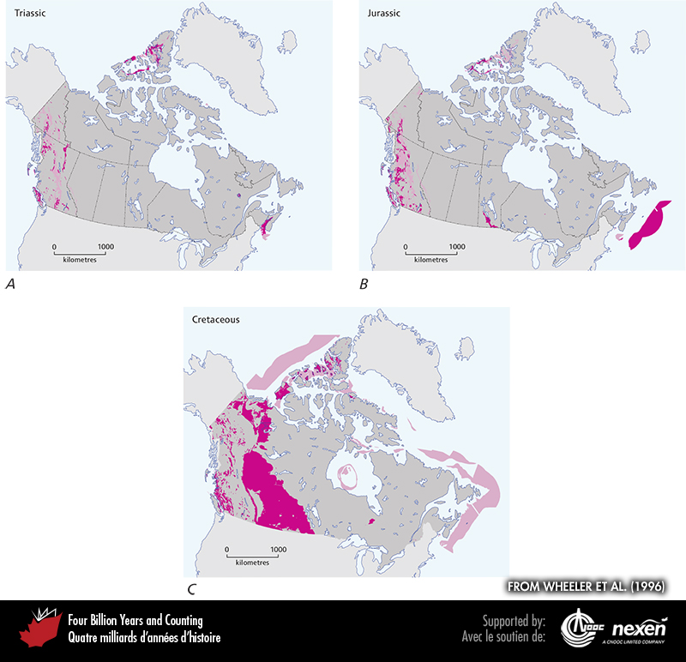
Notes:
General extent of Triassic (A), Jurassic (B), and Cretaceous (C) rocks at the surface (beneath glacial deposits), onshore and offshore. The lighter shaded areas denote either uncertainty or areas where rocks of the particular age have been confirmed but are intimately associated with rocks of other ages and the scale of the map doesn’t allow us to show them separately. ADAPTED FROM WHEELER ET AL. (1996).
_______________________________
All photographic and graphic images (henceforth referred to as images) posted on this site are copyright of the persons and/or institutions indicated in the caption directly associated with each image. The copyright holders have agreed that you may use their images for educational, non-commercial purposes only and provided that they are credited in each instance of use. For all other uses you must contact the copyright holder.

Slide 6
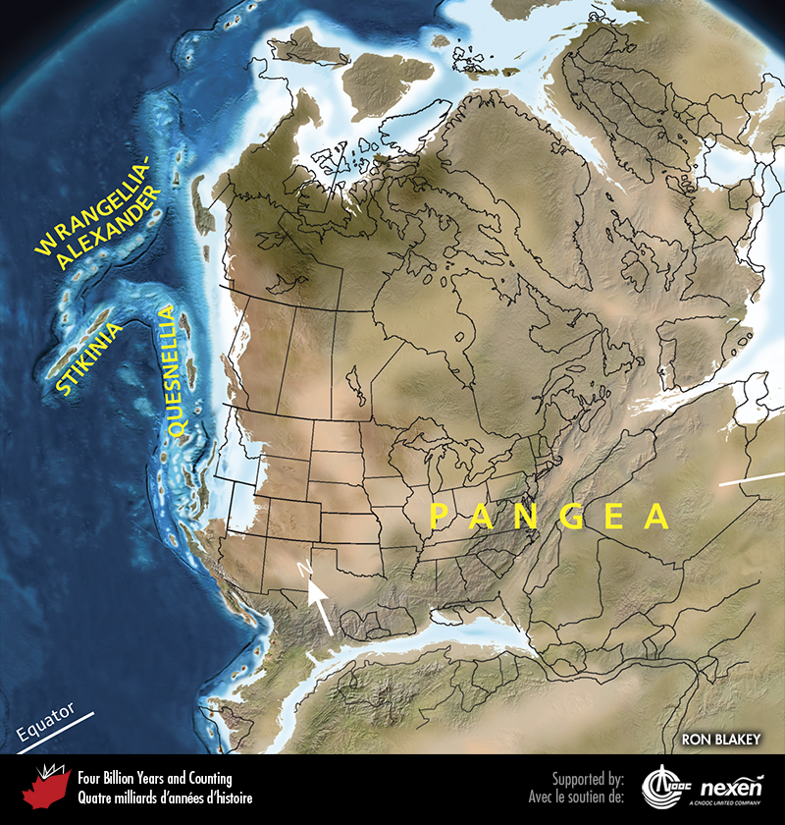
Notes:
Paleogeography of what was to become North America and adjacent regions in the Triassic, 245 million years ago. Land is shown in brown, with shading showing topography. The lighter blue areas represent possible coastal or nearshore areas, darker blue represents deeper ocean waters, and black indicates trenches. Aspects of modern geography are shown for orientation.
_______________________________
All photographic and graphic images (henceforth referred to as images) posted on this site are copyright of the persons and/or institutions indicated in the caption directly associated with each image. The copyright holders have agreed that you may use their images for educational, non-commercial purposes only and provided that they are credited in each instance of use. For all other uses you must contact the copyright holder.

Slide 7
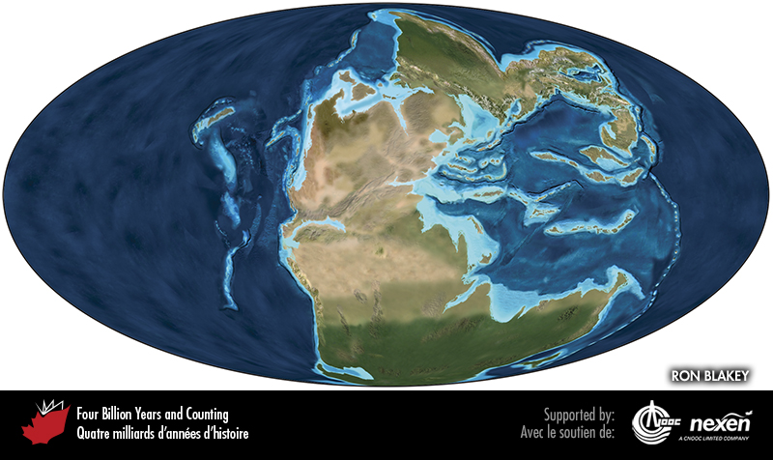
Notes:
Global paleogeography 245 million years ago, during the Triassic. Colours as for previous figure.
_______________________________
All photographic and graphic images (henceforth referred to as images) posted on this site are copyright of the persons and/or institutions indicated in the caption directly associated with each image. The copyright holders have agreed that you may use their images for educational, non-commercial purposes only and provided that they are credited in each instance of use. For all other uses you must contact the copyright holder.

Slide 8
Notes:
Triassic clastic rocks in the Kamenka stone quarry in the Bow Valley, just outside Banff National Park of Canada, Alberta. This quarry produces the commercial stone known as Rundlestone (Chapter 14). DIXON EDWARDS.
_______________________________
All photographic and graphic images (henceforth referred to as images) posted on this site are copyright of the persons and/or institutions indicated in the caption directly associated with each image. The copyright holders have agreed that you may use their images for educational, non-commercial purposes only and provided that they are credited in each instance of use. For all other uses you must contact the copyright holder.

Slide 9
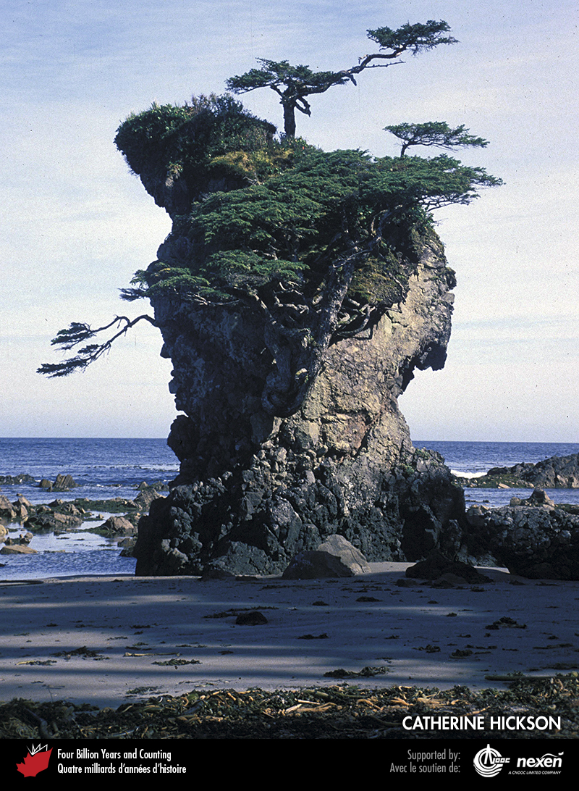
Notes:
The “Flower Pot”, at the northwest corner of Graham Island, Haida Gwaii, is composed of Wrangellian Triassic-Jurassic volcanic rocks. CATHERINE HICKSON.
_______________________________
All photographic and graphic images (henceforth referred to as images) posted on this site are copyright of the persons and/or institutions indicated in the caption directly associated with each image. The copyright holders have agreed that you may use their images for educational, non-commercial purposes only and provided that they are credited in each instance of use. For all other uses you must contact the copyright holder.

Slide 10
Notes:
Late Triassic volcanic breccia containing a basalt pillow in a road cut on the Trans-Canada Highway near the west end of Kamloops Lake, British Columbia. Such rocks are typical remnants of the magmatic arcs of Quesnellia. The breccias formed when volcanic material slid down the flank of a submarine volcano. JIM MONGER.
_______________________________
All photographic and graphic images (henceforth referred to as images) posted on this site are copyright of the persons and/or institutions indicated in the caption directly associated with each image. The copyright holders have agreed that you may use their images for educational, non-commercial purposes only and provided that they are credited in each instance of use. For all other uses you must contact the copyright holder.

Slide 11
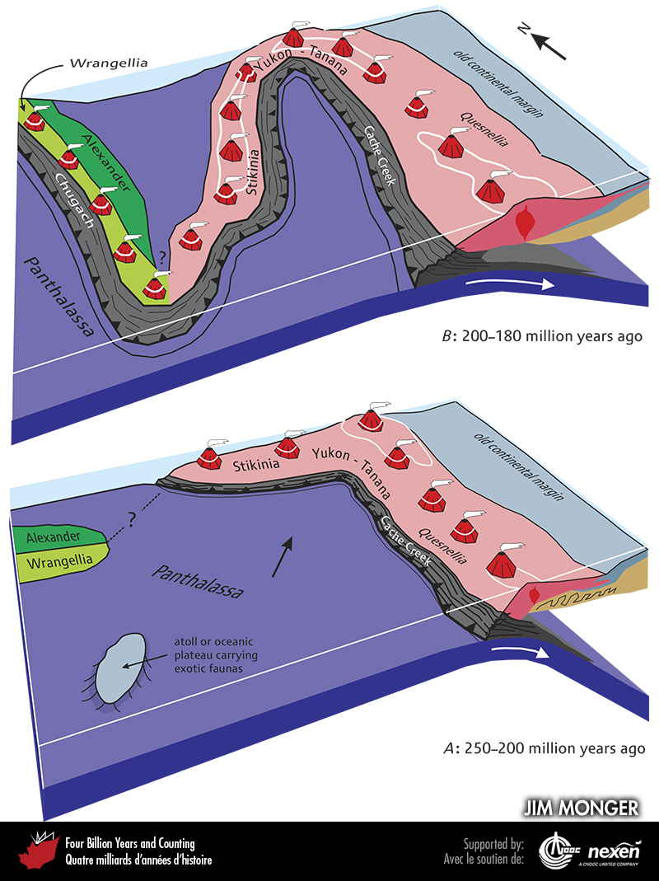
Notes:
The possible disposition of terranes on the Cordilleran margin during the Triassic (A) and early Jurassic (B), showing how the Cache Creek Terrane might have ended up sandwiched between Quesnellia and Stikinia. The Chugach Terrane is an accretionary wedge that accrued as oceanic crust of Panthalassa subducted beneath Wrangellia. The white lines represent sea level.
_______________________________
All photographic and graphic images (henceforth referred to as images) posted on this site are copyright of the persons and/or institutions indicated in the caption directly associated with each image. The copyright holders have agreed that you may use their images for educational, non-commercial purposes only and provided that they are credited in each instance of use. For all other uses you must contact the copyright holder.

Slide 12
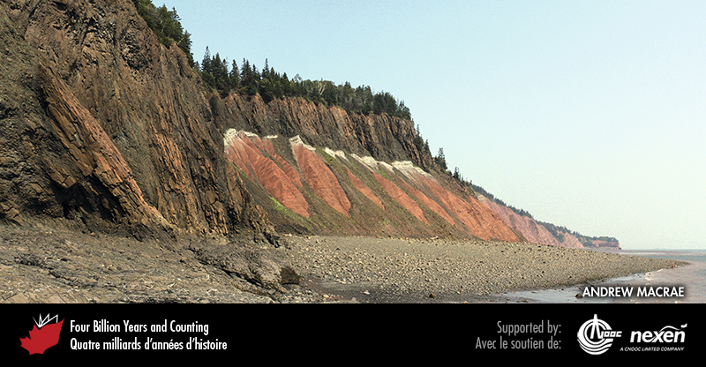
Notes:
At Five Islands Provincial Park, Nova Scotia, the cliffs to the right expose red lake and sand-flat deposits, white fluvial deposits and, at the top, North Mountain Basalt, all of late Triassic age. At left the basalt is now at beach level due to faulting. ANDREW MACRAE.
_______________________________
All photographic and graphic images (henceforth referred to as images) posted on this site are copyright of the persons and/or institutions indicated in the caption directly associated with each image. The copyright holders have agreed that you may use their images for educational, non-commercial purposes only and provided that they are credited in each instance of use. For all other uses you must contact the copyright holder.

Slide 13
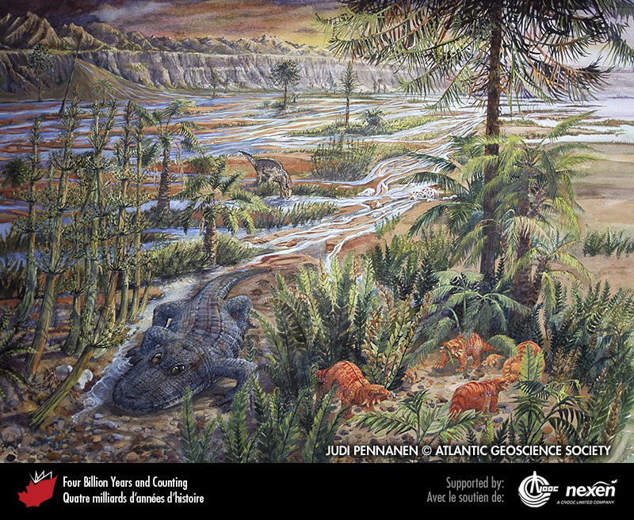
Notes:
Late Triassic scene in the Fundy Basin, about 220 million years ago. A family of the mammal-like reptile Hypsognathus browse among the ferns, hidden from the predatory crocodile-like amphibian Metoposaurus. In the background, a dinosaur like rauisuchid drinks from a channel in the braided-stream network. The animals in this scene are based on fossil finds around the Bay of Fundy in Nova Scotia. The plants, dominated by ferns, the horsetail Neocalamites (to the left of the Metoposaurus), and gymnosperm araucarian trees (such as the large tree shading the Hypsognathus family), are drawn from the general flora known from the time. PAINTING BY JUDI PENNANEN, COURTESY OF THE ATLANTIC GEOSCIENCE SOCIETY.
_______________________________
All photographic and graphic images (henceforth referred to as images) posted on this site are copyright of the persons and/or institutions indicated in the caption directly associated with each image. The copyright holders have agreed that you may use their images for educational, non-commercial purposes only and provided that they are credited in each instance of use. For all other uses you must contact the copyright holder.

Slide 14
Notes:
Wasson Bluff, near Parrsboro, Nova Scotia. The rocks are: dark grey-brown, latest Triassic North Mountain Basalt at the right; light lacustrine limestone, lower middle; red eolian sandstone, left; and brown paleotalus (“fossil” scree) composed of basalt boulders, upper centre. All the sedimentary rocks are probably of earliest Jurassic age. ROB FENSOME.
_______________________________
All photographic and graphic images (henceforth referred to as images) posted on this site are copyright of the persons and/or institutions indicated in the caption directly associated with each image. The copyright holders have agreed that you may use their images for educational, non-commercial purposes only and provided that they are credited in each instance of use. For all other uses you must contact the copyright holder.

Slide 15
Notes:
Side view of the skull of the tuatara-like reptile Clevosaurus, from early Jurassic deposits at Wasson Bluff, near Parrsboro, Nova Scotia. HEINZ WIELE, COURTESY OF THE ATLANTIC GEOSCIENCE SOCIETY; SPECIMEN COURTESY OF THE FUNDY GEOLOGICAL MUSEUM.
_______________________________
All photographic and graphic images (henceforth referred to as images) posted on this site are copyright of the persons and/or institutions indicated in the caption directly associated with each image. The copyright holders have agreed that you may use their images for educational, non-commercial purposes only and provided that they are credited in each instance of use. For all other uses you must contact the copyright holder.

Slide 16
Notes:
A lava tube and dyke in volcanic rocks that are equivalent to the latest Triassic North Mountain Basalt, Seven Days Work Cliff, Grand Manan Island, New Brunswick. GREGORY MCHONE.
_______________________________
All photographic and graphic images (henceforth referred to as images) posted on this site are copyright of the persons and/or institutions indicated in the caption directly associated with each image. The copyright holders have agreed that you may use their images for educational, non-commercial purposes only and provided that they are credited in each instance of use. For all other uses you must contact the copyright holder.

