Slide 1
BOX 3
All photographic and graphic images (henceforth referred to as images) posted on this site are copyright of the persons and/or institutions indicated in the caption directly associated with each image. The copyright holders have agreed that you may use their images for educational, non-commercial purposes only and provided that they are credited in each instance of use. For all other uses you must contact the copyright holder.

Slide 2
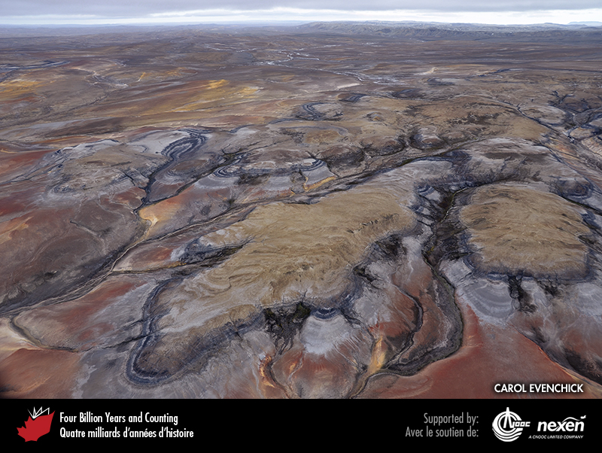
Notes:
These Cretaceous rocks on Ellef Ringnes Island, Nunavut, are so colourful and distinctive that it is easy to imagine how a geological map can be created from them. CAROL EVENCHICK.
_______________________________
All photographic and graphic images (henceforth referred to as images) posted on this site are copyright of the persons and/or institutions indicated in the caption directly associated with each image. The copyright holders have agreed that you may use their images for educational, non-commercial purposes only and provided that they are credited in each instance of use. For all other uses you must contact the copyright holder.

Slide 3
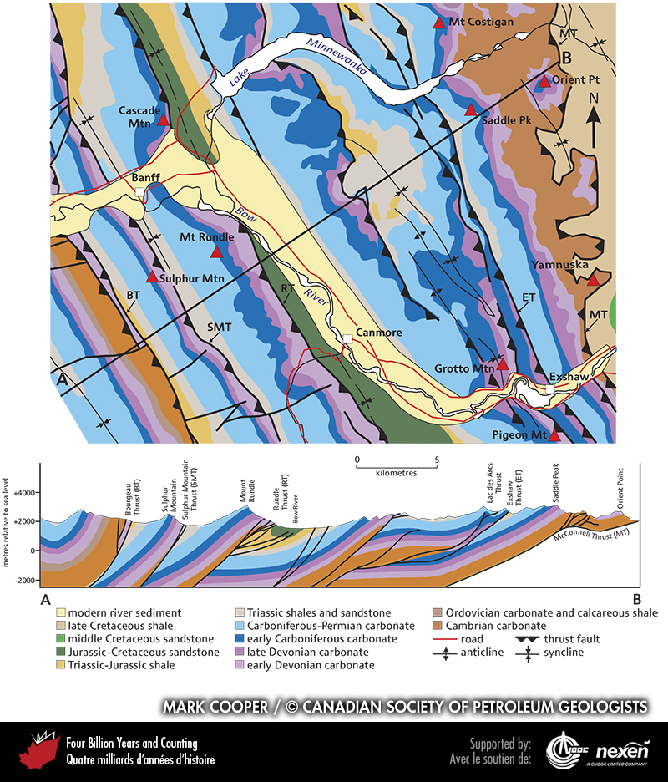
Notes:
Geological map of part of the Rocky Mountains, a thrust-and-fold belt in the Cordillera. Apart from the modern sediment deposited by the Bow River, the map shows the distribution of bedrock. It also shows symbols that represent faults, anticlines, and synclines. From such information, geologists can predict the structure beneath the surface as shown in the cross-section A–B below the map (the line of section is indicated on the map). To prove these predictions and provide additional information, core holes or remote sensing analyses are needed. ADAPTED FROM A MAP COMPILED BY MARK COOPER, USED WITH PERMISSION OF THE CANADIAN SOCIETY OF PETROLEUM GEOLOGISTS.
_______________________________
All photographic and graphic images (henceforth referred to as images) posted on this site are copyright of the persons and/or institutions indicated in the caption directly associated with each image. The copyright holders have agreed that you may use their images for educational, non-commercial purposes only and provided that they are credited in each instance of use. For all other uses you must contact the copyright holder.

Slide 4
Notes:
Boulder hopping, one of the skills developed by field geologists, in this case over the Current River in northern Ontario, near where Steepledge Lake empties into Ray Lake en-route to Lake Superior. GRAHAM WILSON.
_______________________________
All photographic and graphic images (henceforth referred to as images) posted on this site are copyright of the persons and/or institutions indicated in the caption directly associated with each image. The copyright holders have agreed that you may use their images for educational, non-commercial purposes only and provided that they are credited in each instance of use. For all other uses you must contact the copyright holder.

Slide 5
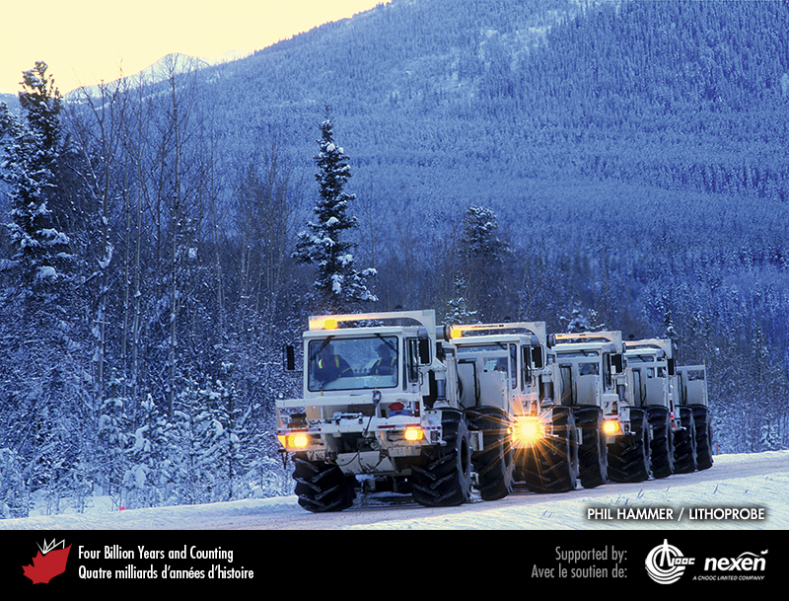
Notes:
The equipment used for shooting deep seismic lines for the LITHOPROBE Trans-Canada Transect included big trucks affectionately known as “dancing elephants”. These trucks generate seismic energy that penetrates deep into the crust. PHIL HAMMER, LITHOPROBE.
_______________________________
All photographic and graphic images (henceforth referred to as images) posted on this site are copyright of the persons and/or institutions indicated in the caption directly associated with each image. The copyright holders have agreed that you may use their images for educational, non-commercial purposes only and provided that they are credited in each instance of use. For all other uses you must contact the copyright holder.

Slide 6
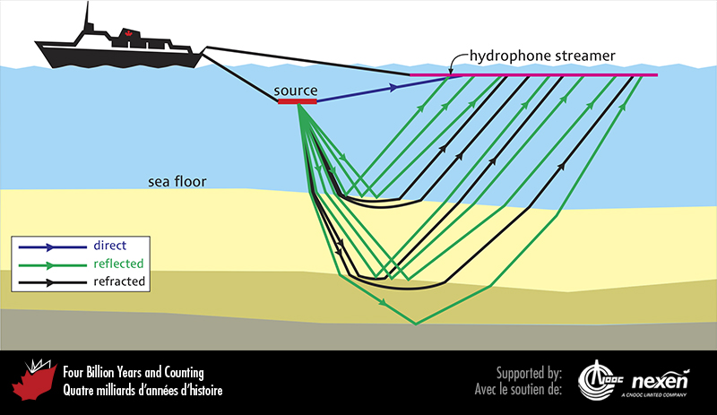
Notes:
Seismic analyses involve the generation of seismic waves, in this case setting off vibrations at sea, which are reflected or refracted back to the surface. The returning waves are recorded by a hydrophone streamer (or geophones on land). Digital processing of the seismic records produces seismic sections as shown in the figure on the next page.
_______________________________
All photographic and graphic images (henceforth referred to as images) posted on this site are copyright of the persons and/or institutions indicated in the caption directly associated with each image. The copyright holders have agreed that you may use their images for educational, non-commercial purposes only and provided that they are credited in each instance of use. For all other uses you must contact the copyright holder.

Slide 7
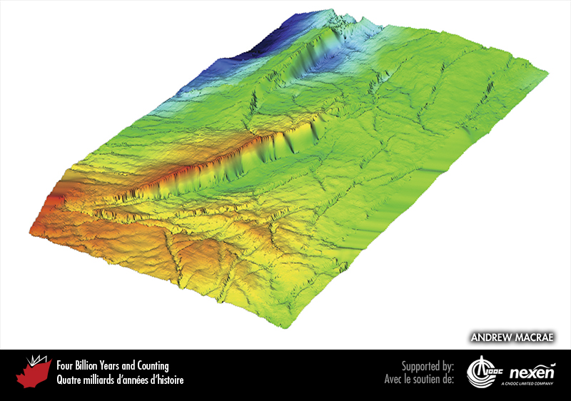
Notes:
Three-dimensional seismic surveys and sophisticated computer processing can reveal ancient surfaces such as this one, about one kilometre beneath sea level near Sable Island, off Nova Scotia. It shows the top of the late Cretaceous chalk, revealed in digitally enhanced colours: shallower areas are shown in red and yellow, deeper areas in green and blue. The unevenness of the surface is in part due to faulting (shown by the cliff-like features) and gentle folding. The area represented is 12 kilometres long by 7.5 kilometres wide. ANDREW MACRAE. _______________________________
All photographic and graphic images (henceforth referred to as images) posted on this site are copyright of the persons and/or institutions indicated in the caption directly associated with each image. The copyright holders have agreed that you may use their images for educational, non-commercial purposes only and provided that they are credited in each instance of use. For all other uses you must contact the copyright holder.

Slide 8
Notes:
Ground-penetrating radar survey, Kluane Lake, Yukon. JOHN CLAGUE.
_______________________________
All photographic and graphic images (henceforth referred to as images) posted on this site are copyright of the persons and/or institutions indicated in the caption directly associated with each image. The copyright holders have agreed that you may use their images for educational, non-commercial purposes only and provided that they are credited in each instance of use. For all other uses you must contact the copyright holder.

Slide 9
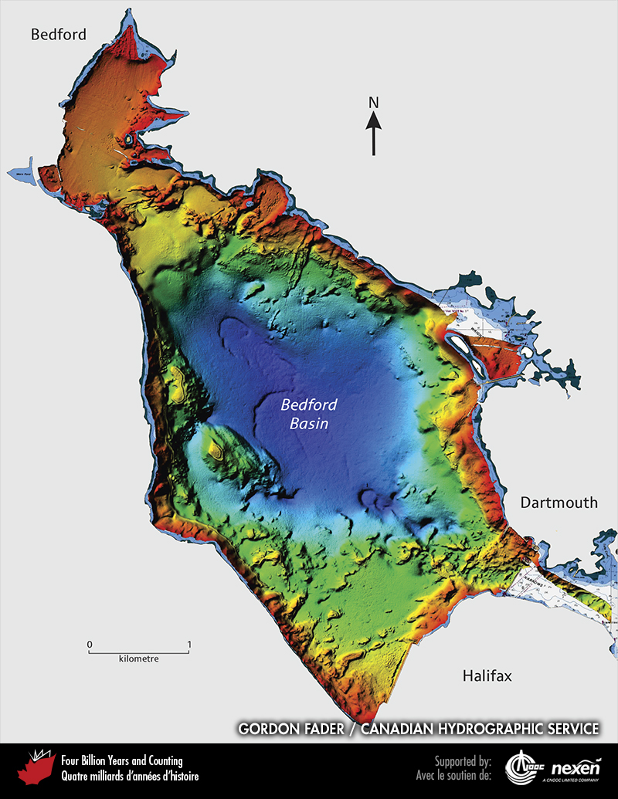
Notes:
Multibeam image of the Bedford Basin at the head of Halifax Harbour, Nova Scotia. Water depths range from shallow (red and orange) to deep (blue). Maximum depth is 61 metres. Such images show many features of the seabed, including former now-submerged shorelines, bedrock outcrops, deep-water methane gas escape trenches, and anchor marks. COURTESY OF GORDON FADER AND THE CANADIAN HYDROGRAPHIC SERVICE.
_______________________________
All photographic and graphic images (henceforth referred to as images) posted on this site are copyright of the persons and/or institutions indicated in the caption directly associated with each image. The copyright holders have agreed that you may use their images for educational, non-commercial purposes only and provided that they are credited in each instance of use. For all other uses you must contact the copyright holder.

