Slide 1
CHAPTER 1 Part 1 of 3
All photographic and graphic images (henceforth referred to as images) posted on this site are copyright of the persons and/or institutions indicated in the caption directly associated with each image. The copyright holders have agreed that you may use their images for educational, non-commercial purposes only and provided that they are credited in each instance of use. For all other uses you must contact the copyright holder.

Slide 2
Notes:
This view, from Skihist Provincial Park, British Columbia, shows the Thompson River flowing through a precipitous canyon before joining the Fraser River at Lytton. The scene shows how the rock cycle can have an impact on everyday life. WALTER LANZ
_______________________________
All photographic and graphic images (henceforth referred to as images) posted on this site are copyright of the persons and/or institutions indicated in the caption directly associated with each image. The copyright holders have agreed that you may use their images for educational, non-commercial purposes only and provided that they are credited in each instance of use. For all other uses you must contact the copyright holder.

Slide 3
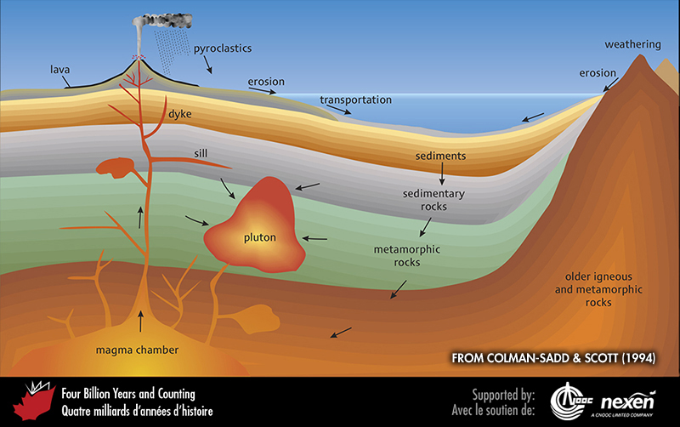
Notes:
The rock cycle: an eternal process of recycling rocks through erosion, deposition, subsidence, melting, cooling, uplift, and other processes. Igneous rocks started out as molten material that solidified either at the surface as volcanic (extrusive) rocks or below the surface as intrusive rocks in structures such as plutons and dykes. Erosion of igneous and other rocks produces sediments that may become sedimentary rocks. The effects of heat and pressure on all pre-existing rocks may change (metamorphose) them to metamorphic rocks and might eventually melt them to produce molten magma—and the cycle starts again. From Colman-Sadd and Scott (1994). Used with permission of the authors, THE GEOLOGICAL ASSOCIATION OF CANADA, AND THE Geological Survey of Newfoundland and Labrador.
_______________________________
All photographic and graphic images (henceforth referred to as images) posted on this site are copyright of the persons and/or institutions indicated in the caption directly associated with each image. The copyright holders have agreed that you may use their images for educational, non-commercial purposes only and provided that they are credited in each instance of use. For all other uses you must contact the copyright holder.

Slide 4
Notes:
A view of the Niagara River’s Horseshoe Falls from the Canadian side. The boulders to the left at the base of the falls testify to the erosive power of the River as it plummets over the precipice. KEITH VAUGHAN.
_______________________________
All photographic and graphic images (henceforth referred to as images) posted on this site are copyright of the persons and/or institutions indicated in the caption directly associated with each image. The copyright holders have agreed that you may use their images for educational, non-commercial purposes only and provided that they are credited in each instance of use. For all other uses you must contact the copyright holder.

Slide 5
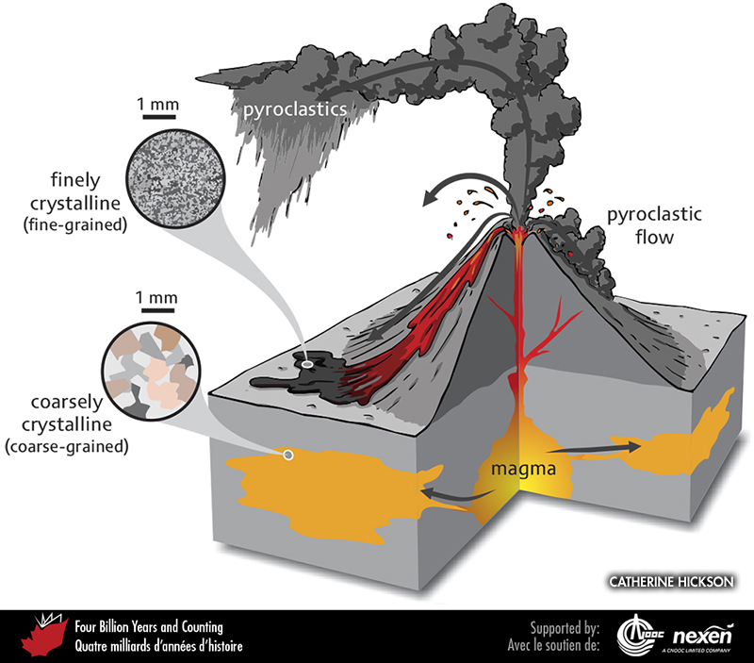
Notes:
A volcano, partly cut away, to show how magma reaches the surface and how it is then distributed as lava and pyroclastics.
______________________________
All photographic and graphic images (henceforth referred to as images) posted on this site are copyright of the persons and/or institutions indicated in the caption directly associated with each image. The copyright holders have agreed that you may use their images for educational, non-commercial purposes only and provided that they are credited in each instance of use. For all other uses you must contact the copyright holder.

Slide 6
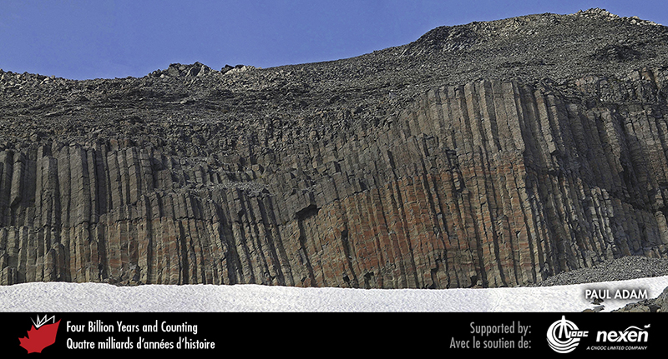
Notes:
Columnar basalt near Mount Garibaldi, British Columbia. Mount Garibaldi is one of the volcanoes of the Cascade Range, which extends from southwestern British Columbia to northern California. PAUL ADAM.
_______________________________
All photographic and graphic images (henceforth referred to as images) posted on this site are copyright of the persons and/or institutions indicated in the caption directly associated with each image. The copyright holders have agreed that you may use their images for educational, non-commercial purposes only and provided that they are credited in each instance of use. For all other uses you must contact the copyright holder.

Slide 7
Notes:
A boulder of 200-million-year-old basalt from Newport Landing, Nova Scotia. When molten, the lava gave off bubbles of gas, leaving vesicles once the rock had solidified, and these were later filled by crystals (white) precipitated from mineral-rich water percolating through the rock. ROB FENSOME.
_______________________________
All photographic and graphic images (henceforth referred to as images) posted on this site are copyright of the persons and/or institutions indicated in the caption directly associated with each image. The copyright holders have agreed that you may use their images for educational, non-commercial purposes only and provided that they are credited in each instance of use. For all other uses you must contact the copyright holder.

Slide 8
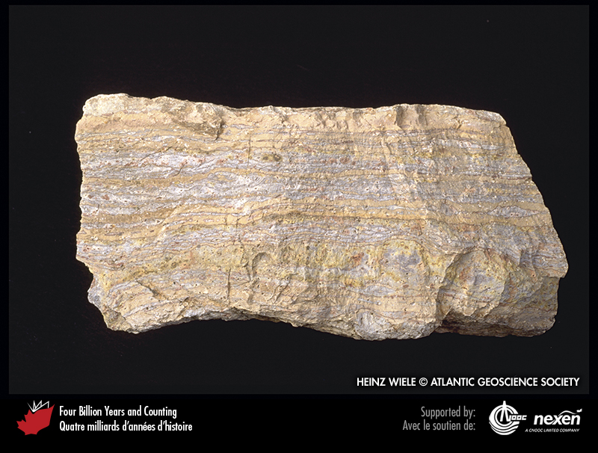
Notes:
A block of rhyolite from Campbellton, New Brunswick. As the original lava cooled and set about 410 million years ago, bands of different composition were stretched out into layers, like multicoloured toffee. HEINZ WIELE, courtesy of the Atlantic Geoscience Society.
_______________________________
All photographic and graphic images (henceforth referred to as images) posted on this site are copyright of the persons and/or institutions indicated in the caption directly associated with each image. The copyright holders have agreed that you may use their images for educational, non-commercial purposes only and provided that they are credited in each instance of use. For all other uses you must contact the copyright holder.

Slide 9
Notes:
Pillow lava from near the Lillooet Glacier, southwestern British Columbia. JOHN CLAGUE.
_______________________________
All photographic and graphic images (henceforth referred to as images) posted on this site are copyright of the persons and/or institutions indicated in the caption directly associated with each image. The copyright holders have agreed that you may use their images for educational, non-commercial purposes only and provided that they are credited in each instance of use. For all other uses you must contact the copyright holder.

Slide 10
Notes:
This polished specimen of granite from southern New Brunswick is part of a monument to Quebec historian François-Xavier Garneau near the House of Assembly in Québec City. ROB FENSOME.
______________________________
All photographic and graphic images (henceforth referred to as images) posted on this site are copyright of the persons and/or institutions indicated in the caption directly associated with each image. The copyright holders have agreed that you may use their images for educational, non-commercial purposes only and provided that they are credited in each instance of use. For all other uses you must contact the copyright holder.

Slide 11
Notes:
Gabbro, about 420 million years old and probably from New Brunswick, was used for gravestones of Titanic victims in Fairview Lawn Cemetery, Halifax, Nova Scotia. ROB FENSOME.
_______________________________
All photographic and graphic images (henceforth referred to as images) posted on this site are copyright of the persons and/or institutions indicated in the caption directly associated with each image. The copyright holders have agreed that you may use their images for educational, non-commercial purposes only and provided that they are credited in each instance of use. For all other uses you must contact the copyright holder.

Slide 12
Notes:
Remnant of what was originally a block of sedimentary rock enclosed by granite of the South Mountain Batholith, a large intrusion dating from 375 million years ago. Such inclusions of surrounding rock within an igneous intrusion are known as xenoliths, and many are visible in the granite around Peggys Cove Lighthouse, Nova Scotia. ROB FENSOME.
______________________________
All photographic and graphic images (henceforth referred to as images) posted on this site are copyright of the persons and/or institutions indicated in the caption directly associated with each image. The copyright holders have agreed that you may use their images for educational, non-commercial purposes only and provided that they are credited in each instance of use. For all other uses you must contact the copyright holder.

Slide 13
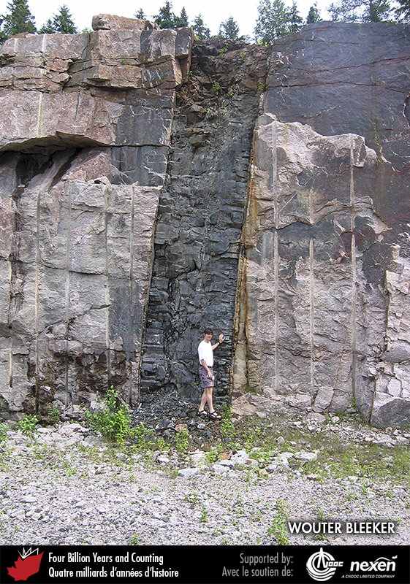
Notes:
This 590-million-year-old dyke near Powassen, Ontario, cuts through older, lighter-coloured rock. WOUTER BLEEKER.
_______________________________
All photographic and graphic images (henceforth referred to as images) posted on this site are copyright of the persons and/or institutions indicated in the caption directly associated with each image. The copyright holders have agreed that you may use their images for educational, non-commercial purposes only and provided that they are credited in each instance of use. For all other uses you must contact the copyright holder.

Slide 14
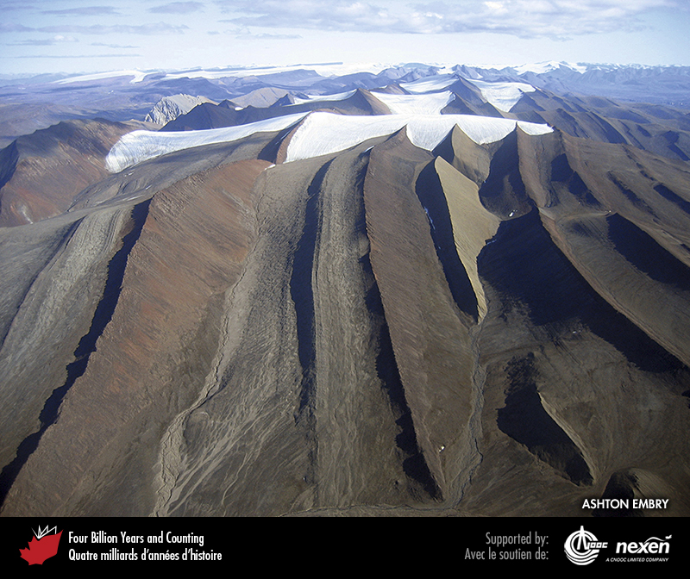
Notes:
Aerial view of resistant, mafic sills, about 120 million years old, within more easily eroded, dark-grey marine shales, over 200 million years old, in the Blue Mountains, northwest Ellesmere Island, Nunavut. ASHTON EMBRY.
_______________________________
All photographic and graphic images (henceforth referred to as images) posted on this site are copyright of the persons and/or institutions indicated in the caption directly associated with each image. The copyright holders have agreed that you may use their images for educational, non-commercial purposes only and provided that they are credited in each instance of use. For all other uses you must contact the copyright holder.

Slide 15
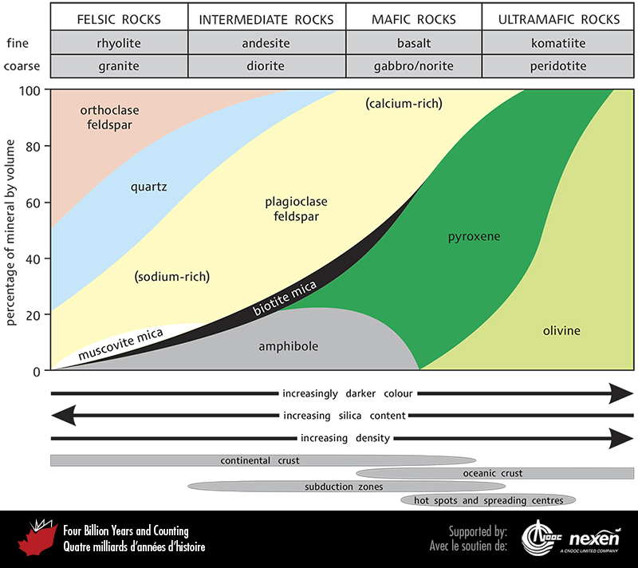
Notes:
Different igneous rock types have different mineral compositions, different physical properties such as grain size and colour, and different distributions. Explanations for the features represented by the four bars at the base of the diagram are provided in Box 2 and Chapter 2. Adapted from various sources with input fRom BARRIE CLARKE.
______________________________
All photographic and graphic images (henceforth referred to as images) posted on this site are copyright of the persons and/or institutions indicated in the caption directly associated with each image. The copyright holders have agreed that you may use their images for educational, non-commercial purposes only and provided that they are credited in each instance of use. For all other uses you must contact the copyright holder.

Slide 16
Notes:
Tree roots disrupt a resistant sandstone ledge, thus contributing to its weathering and erosion, near Chutes-de-la-Chaudière, Charny, Quebec. ROB FENSOME.
_______________________________
All photographic and graphic images (henceforth referred to as images) posted on this site are copyright of the persons and/or institutions indicated in the caption directly associated with each image. The copyright holders have agreed that you may use their images for educational, non-commercial purposes only and provided that they are credited in each instance of use. For all other uses you must contact the copyright holder.

