Slide 1
BOX 6
All photographic and graphic images (henceforth referred to as images) posted on this site are copyright of the persons and/or institutions indicated in the caption directly associated with each image. The copyright holders have agreed that you may use their images for educational, non-commercial purposes only and provided that they are credited in each instance of use. For all other uses you must contact the copyright holder.

Slide 2
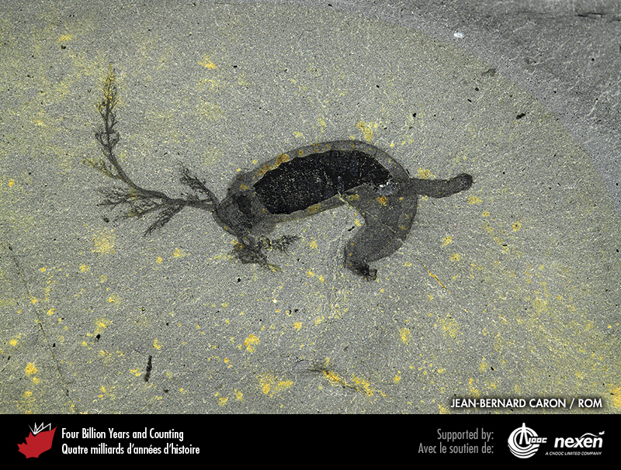
Notes:
Herpetogaster, a recently described animal from the Burgess Shale. JEAN-BERNARD CARON, COPYRIGHT ROYAL ONTARIO MUSEUM.
_______________________________
All photographic and graphic images (henceforth referred to as images) posted on this site are copyright of the persons and/or institutions indicated in the caption directly associated with each image. The copyright holders have agreed that you may use their images for educational, non-commercial purposes only and provided that they are credited in each instance of use. For all other uses you must contact the copyright holder.

Slide 3
Notes:
Reconstruction of Herpetogaster, swimming among a colony of sponges. COPYRIGHT ROYAL ONTARIO MUSEUM.
_______________________________
All photographic and graphic images (henceforth referred to as images) posted on this site are copyright of the persons and/or institutions indicated in the caption directly associated with each image. The copyright holders have agreed that you may use their images for educational, non-commercial purposes only and provided that they are credited in each instance of use. For all other uses you must contact the copyright holder.

Slide 4
Notes:
A claw of Anomalocaris from the Burgess Shale. JEAN-BERNARD CARON, COPYRIGHT ROYAL ONTARIO MUSEUM.
_______________________________
All photographic and graphic images (henceforth referred to as images) posted on this site are copyright of the persons and/or institutions indicated in the caption directly associated with each image. The copyright holders have agreed that you may use their images for educational, non-commercial purposes only and provided that they are credited in each instance of use. For all other uses you must contact the copyright holder.

Slide 5
Notes:
The mouthpart of an anomalocarid from the Burgess Shale. JEAN-BERNARD CARON, COPYRIGHT ROYAL ONTARIO MUSEUM.
_______________________________
All photographic and graphic images (henceforth referred to as images) posted on this site are copyright of the persons and/or institutions indicated in the caption directly associated with each image. The copyright holders have agreed that you may use their images for educational, non-commercial purposes only and provided that they are credited in each instance of use. For all other uses you must contact the copyright holder.

Slide 6
Notes:
Anomalocaris specimen from the Burgess Shale. JEAN-BERNARD CARON, COPYRIGHT ROYAL ONTARIO MUSEUM.
_______________________________
All photographic and graphic images (henceforth referred to as images) posted on this site are copyright of the persons and/or institutions indicated in the caption directly associated with each image. The copyright holders have agreed that you may use their images for educational, non-commercial purposes only and provided that they are credited in each instance of use. For all other uses you must contact the copyright holder.

Slide 7
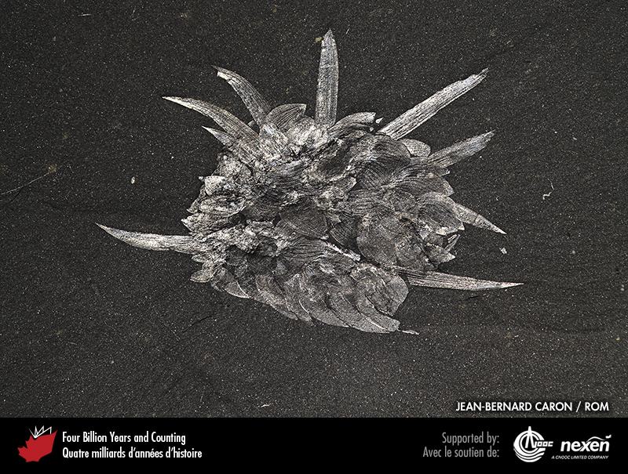
Notes:
Wiwaxia specimen from the Burgess Shale. JEAN-BERNARD CARON, COPYRIGHT ROYAL ONTARIO MUSEUM.
_______________________________
All photographic and graphic images (henceforth referred to as images) posted on this site are copyright of the persons and/or institutions indicated in the caption directly associated with each image. The copyright holders have agreed that you may use their images for educational, non-commercial purposes only and provided that they are credited in each instance of use. For all other uses you must contact the copyright holder.

Slide 8
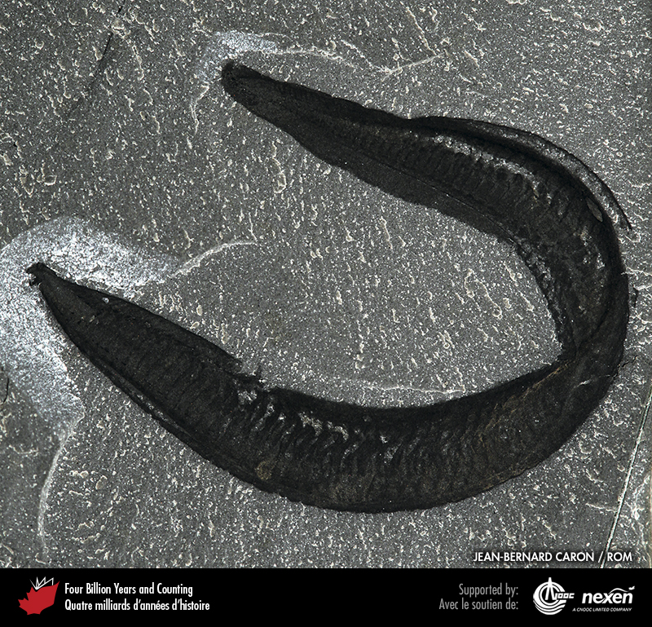
Notes:
Pikaia specimen from the Burgess Shale. JEAN-BERNARD CARON, COPYRIGHT ROYAL ONTARIO MUSEUM.
_______________________________
All photographic and graphic images (henceforth referred to as images) posted on this site are copyright of the persons and/or institutions indicated in the caption directly associated with each image. The copyright holders have agreed that you may use their images for educational, non-commercial purposes only and provided that they are credited in each instance of use. For all other uses you must contact the copyright holder.

Slide 9
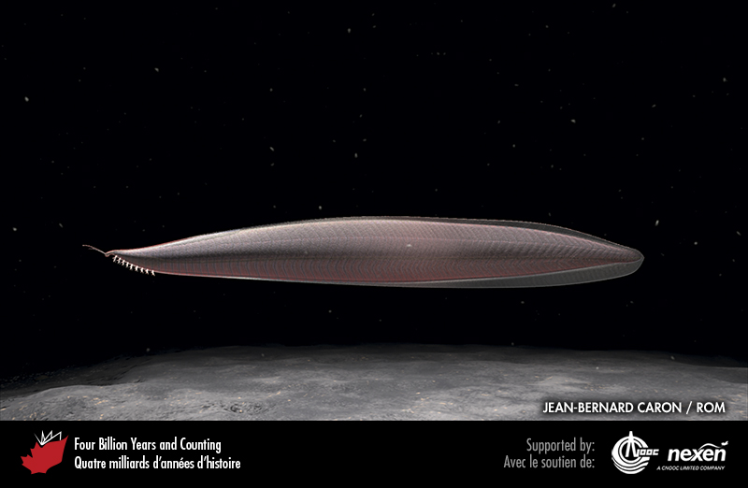
Notes:
Reconstruction of Pikaia. COPYRIGHT ROYAL ONTARIO MUSEUM.
_______________________________
All photographic and graphic images (henceforth referred to as images) posted on this site are copyright of the persons and/or institutions indicated in the caption directly associated with each image. The copyright holders have agreed that you may use their images for educational, non-commercial purposes only and provided that they are credited in each instance of use. For all other uses you must contact the copyright holder.

Slide 10
Notes:
Reconstruction of the Burgess Shale community, with the Cathedral Escarpment in the background. Included in this view are groups of tubular sponges, a spiny Wiwaxia on the sea bed, and a cruising Anomalocaris. COPYRIGHT ROYAL ONTARIO MUSEUM.
_______________________________
All photographic and graphic images (henceforth referred to as images) posted on this site are copyright of the persons and/or institutions indicated in the caption directly associated with each image. The copyright holders have agreed that you may use their images for educational, non-commercial purposes only and provided that they are credited in each instance of use. For all other uses you must contact the copyright holder.

