Slide 1
CHAPTER 18
All photographic and graphic images (henceforth referred to as images) posted on this site are copyright of the persons and/or institutions indicated in the caption directly associated with each image. The copyright holders have agreed that you may use their images for educational, non-commercial purposes only and provided that they are credited in each instance of use. For all other uses you must contact the copyright holder.

Slide 2
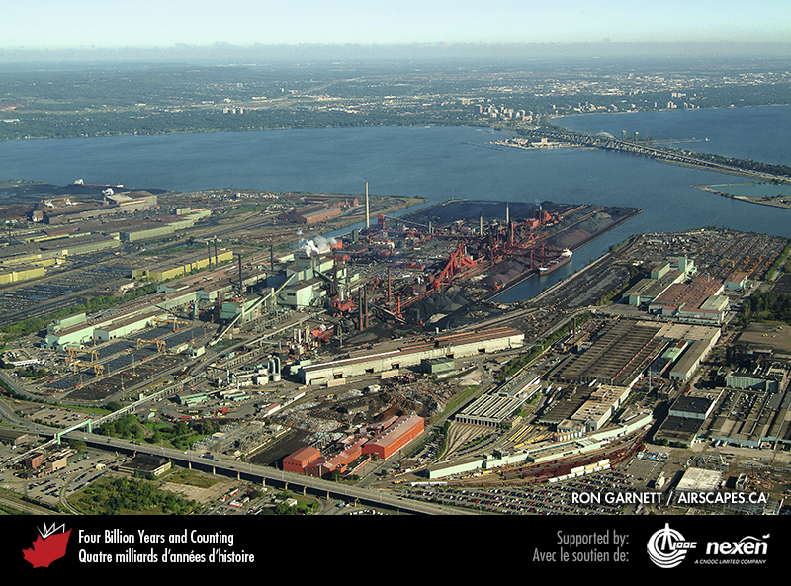
Notes:
The port of Hamilton on Lake Ontario, in Canada’s industrial heartland. Industry and related activities are an engine behind Canada’s economy and wealth, although they can result in environmental challenges. RON GARNETT / AIRSCAPES.CA.
_______________________________
All photographic and graphic images (henceforth referred to as images) posted on this site are copyright of the persons and/or institutions indicated in the caption directly associated with each image. The copyright holders have agreed that you may use their images for educational, non-commercial purposes only and provided that they are credited in each instance of use. For all other uses you must contact the copyright holder.

Slide 3
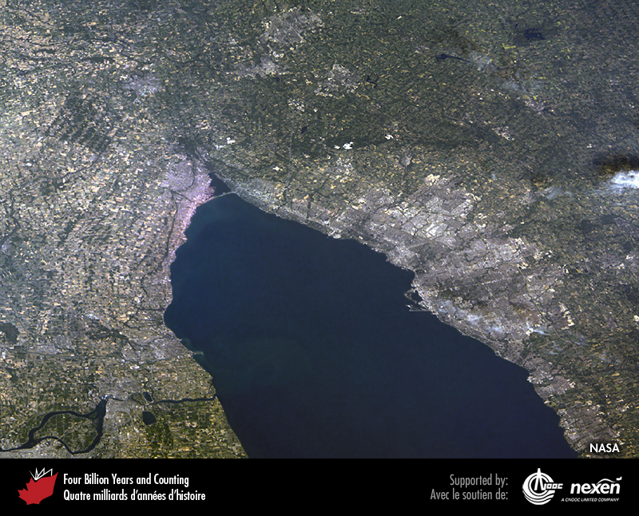
Notes:
Satellite image of Canada’s “Golden Horseshoe” around the western end of Lake Ontario (north is to the top right), from the Niagara River and the American border (bottom left) around to Oshawa (bottom right). About one third of Canada’s people live in this region, which includes Canada’s largest city, Toronto. Such extensive urban development leads to great environmental stress. THE NATIONAL AERONAUTICS AND SPACE ADMINISTRATION (NASA).
_______________________________
All photographic and graphic images (henceforth referred to as images) posted on this site are copyright of the persons and/or institutions indicated in the caption directly associated with each image. The copyright holders have agreed that you may use their images for educational, non-commercial purposes only and provided that they are credited in each instance of use. For all other uses you must contact the copyright holder.

Slide 4
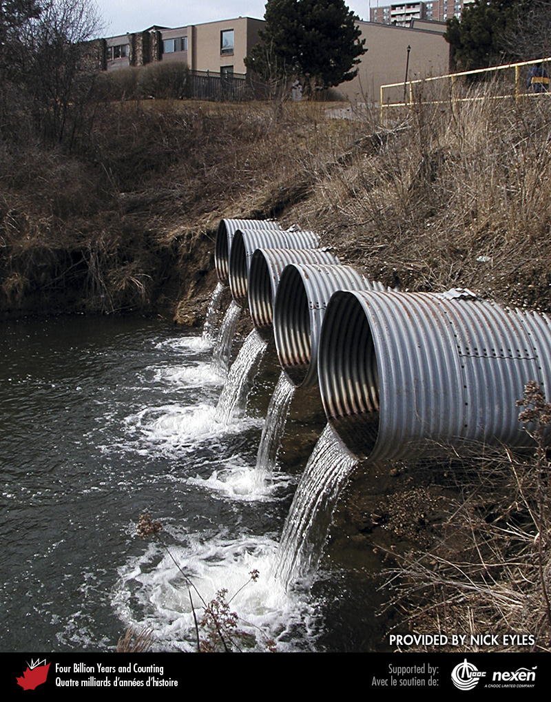
Notes:
Enhanced stormwater runoff from hardened watersheds in Toronto, Ontario, led to the extensive use of pipes and culverts to reduce erosion. However, these structures create insurmountable obstacles for fish. PROVIDED BY NICK EYLES.
_______________________________
All photographic and graphic images (henceforth referred to as images) posted on this site are copyright of the persons and/or institutions indicated in the caption directly associated with each image. The copyright holders have agreed that you may use their images for educational, non-commercial purposes only and provided that they are credited in each instance of use. For all other uses you must contact the copyright holder.

Slide 5
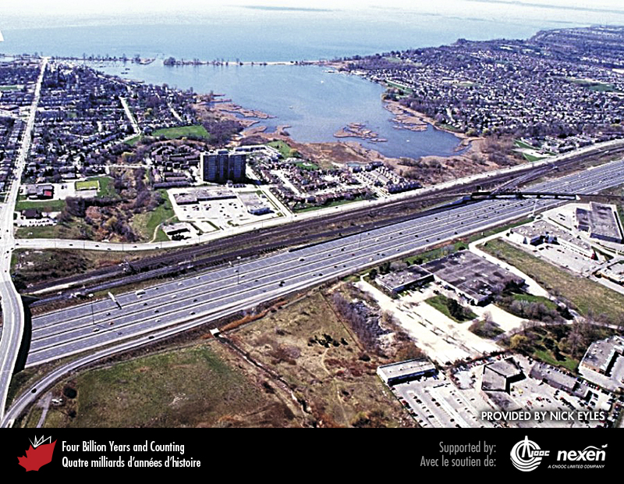
Notes:
Frenchman’s Bay in east Toronto, Ontario, is a lagoon that has experienced extensive loss of wetland and fish habitat due to stormwater runoff. The lagoon receives several thousand tonnes of road salt every winter from Highway 401 (foreground) and the surrounding urban catchment. PROVIDED BY NICK EYLES.
_______________________________
All photographic and graphic images (henceforth referred to as images) posted on this site are copyright of the persons and/or institutions indicated in the caption directly associated with each image. The copyright holders have agreed that you may use their images for educational, non-commercial purposes only and provided that they are credited in each instance of use. For all other uses you must contact the copyright holder.

Slide 6
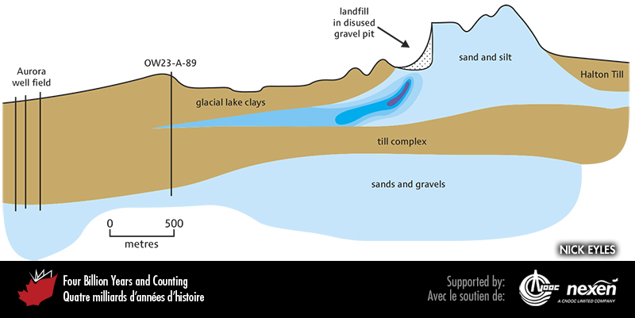
Notes:
Cross-section through a landfill at Aurora, Ontario, within the Oak Ridges Moraine. Historically, landfills such as this one involved the dumping of waste into an open gravel pit, where it was eventually covered and left. Rainwater and snowmelt pick up contaminants as they flow through the waste, creating a plume of contaminated groundwater that continues to seep slowly, sometimes toward wells. Interceptor wells can be drilled to pump up water from the plume, slowing down the advance.
_______________________________
All photographic and graphic images (henceforth referred to as images) posted on this site are copyright of the persons and/or institutions indicated in the caption directly associated with each image. The copyright holders have agreed that you may use their images for educational, non-commercial purposes only and provided that they are credited in each instance of use. For all other uses you must contact the copyright holder.

Slide 7
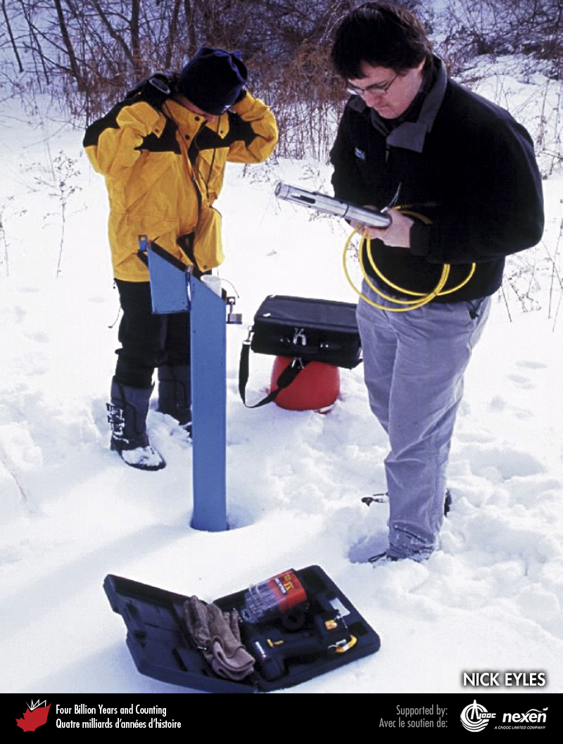
Notes:
Fieldwork at a monitoring well that tracks contaminants in groundwater. PROVIDED BY NICK EYLES.
_______________________________
All photographic and graphic images (henceforth referred to as images) posted on this site are copyright of the persons and/or institutions indicated in the caption directly associated with each image. The copyright holders have agreed that you may use their images for educational, non-commercial purposes only and provided that they are credited in each instance of use. For all other uses you must contact the copyright holder.

Slide 8
Notes:
Reclaimed land at the Cardinal River Mine, north of Cadomin, Alberta. Waste rock removed from the area prior to coal mining has been spread in the foreground as a rough surface and then re-seeded. GODFREY NOWLAN.
_______________________________
All photographic and graphic images (henceforth referred to as images) posted on this site are copyright of the persons and/or institutions indicated in the caption directly associated with each image. The copyright holders have agreed that you may use their images for educational, non-commercial purposes only and provided that they are credited in each instance of use. For all other uses you must contact the copyright holder.

Slide 9
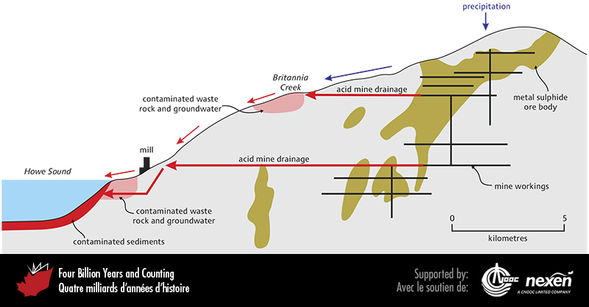
Notes:
The Britannia Mine, near Squamish in British Columbia, was active from 1902 to 1974, and at one time was the largest copper mine in the British Empire. Some 44 million tonnes of mine tailings were dumped directly into the sea, and the disused mine was a major source of acidic mine drainage containing dissolved metals that flowed into Howe Sound. This source of contamination had a significant impact on the marine biota until a major cleanup was conducted prior to the Vancouver Winter Olympics in 2010.
_______________________________
All photographic and graphic images (henceforth referred to as images) posted on this site are copyright of the persons and/or institutions indicated in the caption directly associated with each image. The copyright holders have agreed that you may use their images for educational, non-commercial purposes only and provided that they are credited in each instance of use. For all other uses you must contact the copyright holder.

Slide 10
Notes:
Oxidized gold-mine tailings at the historic Second Relief Mine near Salmo, British Columbia. MIKE PARSONS.
_______________________________
All photographic and graphic images (henceforth referred to as images) posted on this site are copyright of the persons and/or institutions indicated in the caption directly associated with each image. The copyright holders have agreed that you may use their images for educational, non-commercial purposes only and provided that they are credited in each instance of use. For all other uses you must contact the copyright holder.

Slide 11
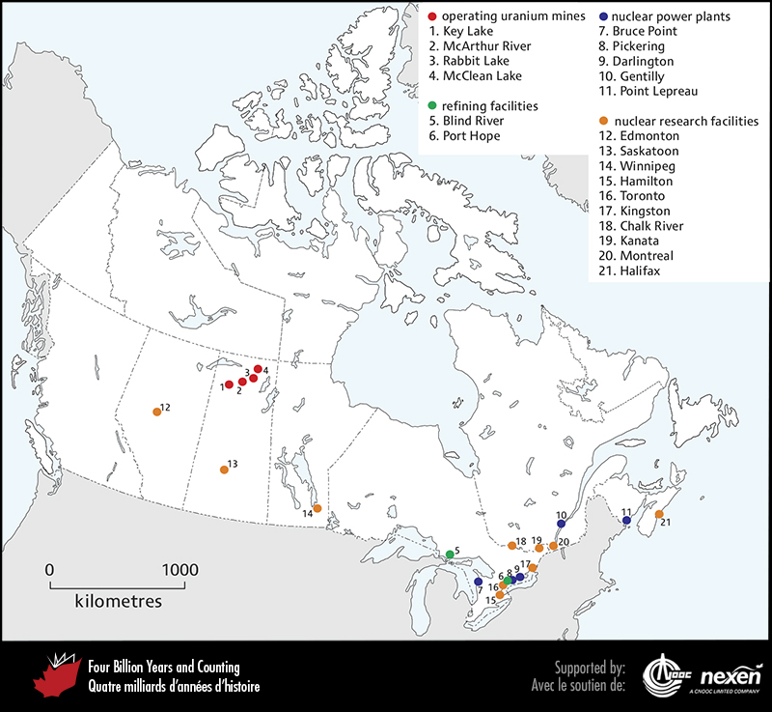
Notes:
Nuclear-related localities in Canada. ADAPTED FROM VARIOUS SOURCES.
_______________________________
All photographic and graphic images (henceforth referred to as images) posted on this site are copyright of the persons and/or institutions indicated in the caption directly associated with each image. The copyright holders have agreed that you may use their images for educational, non-commercial purposes only and provided that they are credited in each instance of use. For all other uses you must contact the copyright holder.

Slide 12
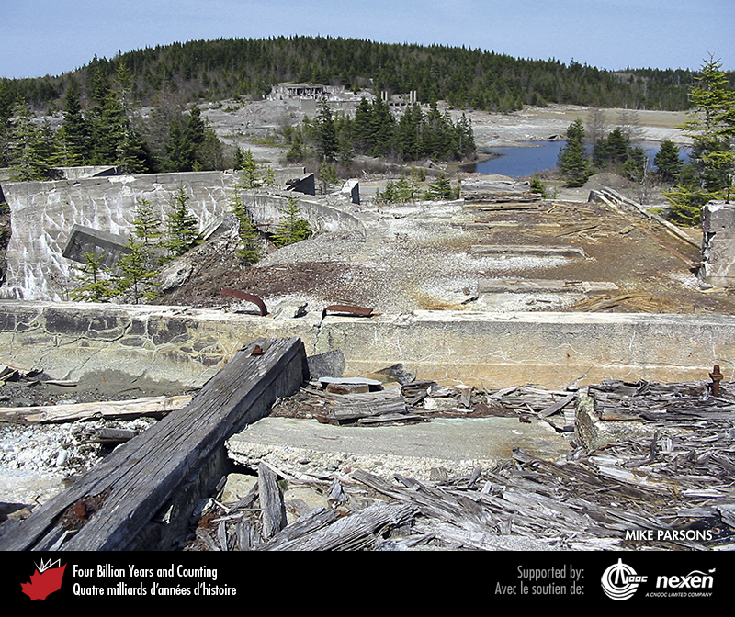
Notes:
Abandoned buildings, Stirling Mine, Nova Scotia. MIKE PARSONS.
_______________________________
All photographic and graphic images (henceforth referred to as images) posted on this site are copyright of the persons and/or institutions indicated in the caption directly associated with each image. The copyright holders have agreed that you may use their images for educational, non-commercial purposes only and provided that they are credited in each instance of use. For all other uses you must contact the copyright holder.

Slide 13
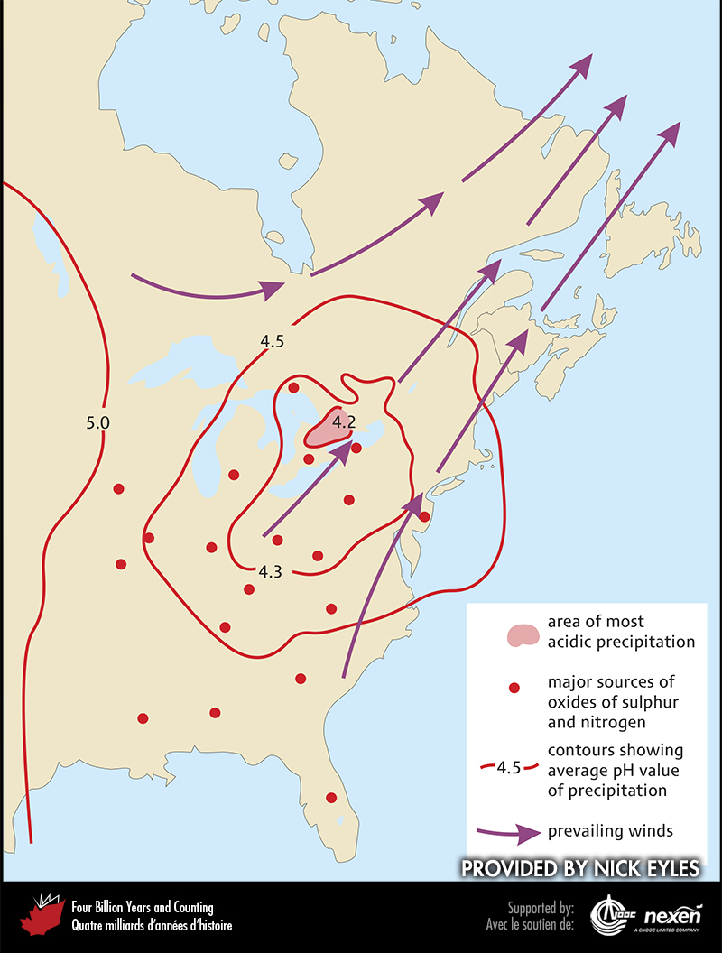
Notes:
The distribution of acid rain in eastern North America and the impact of prevailing winds.
_______________________________
All photographic and graphic images (henceforth referred to as images) posted on this site are copyright of the persons and/or institutions indicated in the caption directly associated with each image. The copyright holders have agreed that you may use their images for educational, non-commercial purposes only and provided that they are credited in each instance of use. For all other uses you must contact the copyright holder.

Slide 14
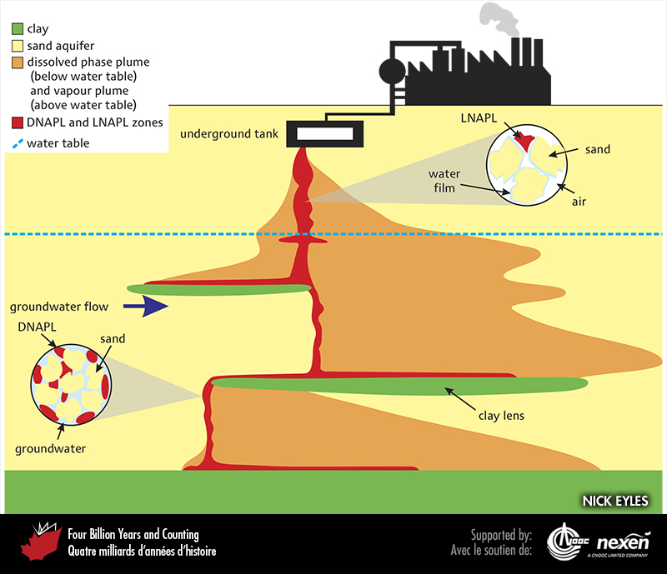
Notes:
Contrasting subsurface migration of light non-aqueous phase liquids (LNAPLs) and dense non-aqueous phase liquids (DNAPL s). Being dense, the latter move down below the water table and are much more difficult to clean up.
_______________________________
All photographic and graphic images (henceforth referred to as images) posted on this site are copyright of the persons and/or institutions indicated in the caption directly associated with each image. The copyright holders have agreed that you may use their images for educational, non-commercial purposes only and provided that they are credited in each instance of use. For all other uses you must contact the copyright holder.

