Slide 1
CHAPTER 1 Part 3 of 3
All photographic and graphic images (henceforth referred to as images) posted on this site are copyright of the persons and/or institutions indicated in the caption directly associated with each image. The copyright holders have agreed that you may use their images for educational, non-commercial purposes only and provided that they are credited in each instance of use. For all other uses you must contact the copyright holder.

Slide 2
Notes:
Low cliffs of peat, Escuminac Point, New Brunswick. ROB FENSOME.
_______________________________
All photographic and graphic images (henceforth referred to as images) posted on this site are copyright of the persons and/or institutions indicated in the caption directly associated with each image. The copyright holders have agreed that you may use their images for educational, non-commercial purposes only and provided that they are credited in each instance of use. For all other uses you must contact the copyright holder.

Slide 3
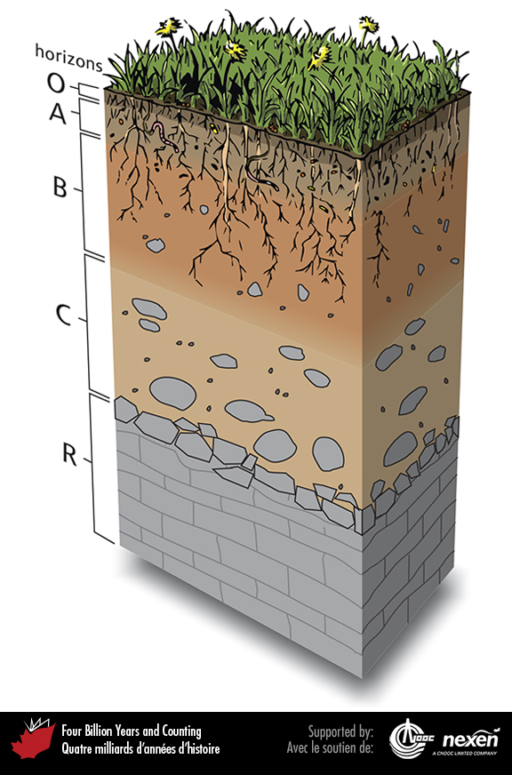
Notes:
A soil profile. At the top is the O horizon, consisting of not-yet decomposed organic matter, mainly plant litter. The A horizon is the topsoil, generally darker than horizons lower down because it still contains much organic matter. The B horizon is known as the subsoil and consists mainly of minerals and clay; it also includes many plant roots and organisms that churn the soil. The C horizon is made up mainly of chunks of rock and smaller rock particles. The R horizon is the bedrock on which the soil forms; the nature of the bedrock influences the chemical characteristics of the soil. Adapted from various sources.
_______________________________
All photographic and graphic images (henceforth referred to as images) posted on this site are copyright of the persons and/or institutions indicated in the caption directly associated with each image. The copyright holders have agreed that you may use their images for educational, non-commercial purposes only and provided that they are credited in each instance of use. For all other uses you must contact the copyright holder.

Slide 4
Notes:
An ancient calcareous paleosol, known as calcrete, near St. Martins, New Brunswick. MARTIN GIBLING.
_______________________________
All photographic and graphic images (henceforth referred to as images) posted on this site are copyright of the persons and/or institutions indicated in the caption directly associated with each image. The copyright holders have agreed that you may use their images for educational, non-commercial purposes only and provided that they are credited in each instance of use. For all other uses you must contact the copyright holder.

Slide 5
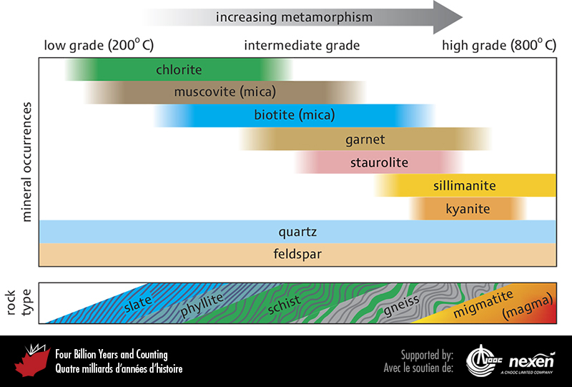
Notes:
Minerals and rocks that form at increasing grades of metamorphism. Laboratory studies show that different minerals form under different conditions of pressure and temperature. The bottom row shows the succession of rock types formed as metamorphism progresses, assuming that the original rock was a mudstone. Adapted from various sources.
_______________________________
All photographic and graphic images (henceforth referred to as images) posted on this site are copyright of the persons and/or institutions indicated in the caption directly associated with each image. The copyright holders have agreed that you may use their images for educational, non-commercial purposes only and provided that they are credited in each instance of use. For all other uses you must contact the copyright holder.

Slide 6
Notes:
Cleavage in this 480-million-year-old slate from Blue Rocks, Nova Scotia, is vertical and more or less perpendicular to the original sedimentary bedding (the light and dark grey banding). Because sedimentary layers are still discernible, this slate is considered a low-grade metamorphic rock. MARTIN GIBLING.
_______________________________
All photographic and graphic images (henceforth referred to as images) posted on this site are copyright of the persons and/or institutions indicated in the caption directly associated with each image. The copyright holders have agreed that you may use their images for educational, non-commercial purposes only and provided that they are credited in each instance of use. For all other uses you must contact the copyright holder.

Slide 7
Notes:
This roadside block near Pont Rouge, Quebec, illustrates the banded nature of gneiss. ROB FENSOME.
_______________________________
All photographic and graphic images (henceforth referred to as images) posted on this site are copyright of the persons and/or institutions indicated in the caption directly associated with each image. The copyright holders have agreed that you may use their images for educational, non-commercial purposes only and provided that they are credited in each instance of use. For all other uses you must contact the copyright holder.

Slide 8
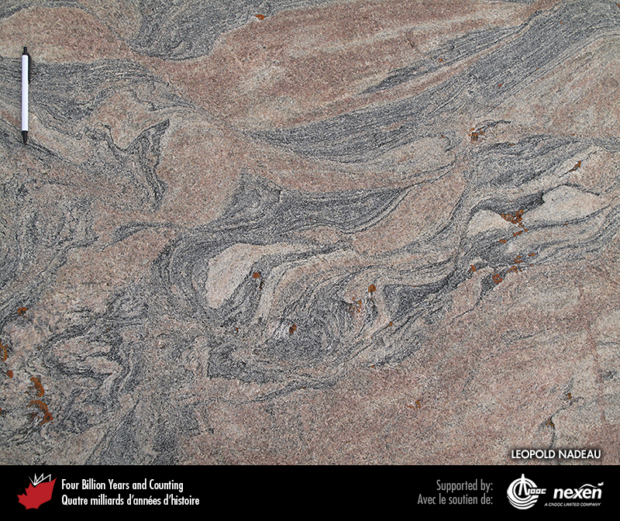
Notes:
Migmatite formed deep in the crust by the partial melting of grey gneiss and later injection of pink granitic melt. The grey gneiss formed about 3,000 million years ago, and the granitic melt was injected about 400 million years later. This beautiful rock is exposed on mainland Nunavut. LEOPOLD NADEAU.
_______________________________
All photographic and graphic images (henceforth referred to as images) posted on this site are copyright of the persons and/or institutions indicated in the caption directly associated with each image. The copyright holders have agreed that you may use their images for educational, non-commercial purposes only and provided that they are credited in each instance of use. For all other uses you must contact the copyright holder.

Slide 9
Notes:
Colourful marble consisting largely of orange calcite and a green pyroxene from a quarry near Bancroft, Ontario. The rock was metamorphosed from limestone about 1,100 million years ago. GRAHAM WILSON.
_______________________________
All photographic and graphic images (henceforth referred to as images) posted on this site are copyright of the persons and/or institutions indicated in the caption directly associated with each image. The copyright holders have agreed that you may use their images for educational, non-commercial purposes only and provided that they are credited in each instance of use. For all other uses you must contact the copyright holder.

Slide 10
Notes:
At Clarke Head, near Parrsboro, Nova Scotia, orange and translucent white gypsum veins have been injected into older (about 350 million-year-old) mudstone. ROB FENSOME.
_______________________________
All photographic and graphic images (henceforth referred to as images) posted on this site are copyright of the persons and/or institutions indicated in the caption directly associated with each image. The copyright holders have agreed that you may use their images for educational, non-commercial purposes only and provided that they are credited in each instance of use. For all other uses you must contact the copyright holder.

Slide 11
Notes:
Tight folds in 150-million-year-old sedimentary rocks in the Skeena Mountains, British Columbia. MARGO MCMECHAN.
_______________________________
All photographic and graphic images (henceforth referred to as images) posted on this site are copyright of the persons and/or institutions indicated in the caption directly associated with each image. The copyright holders have agreed that you may use their images for educational, non-commercial purposes only and provided that they are credited in each instance of use. For all other uses you must contact the copyright holder.

Slide 12
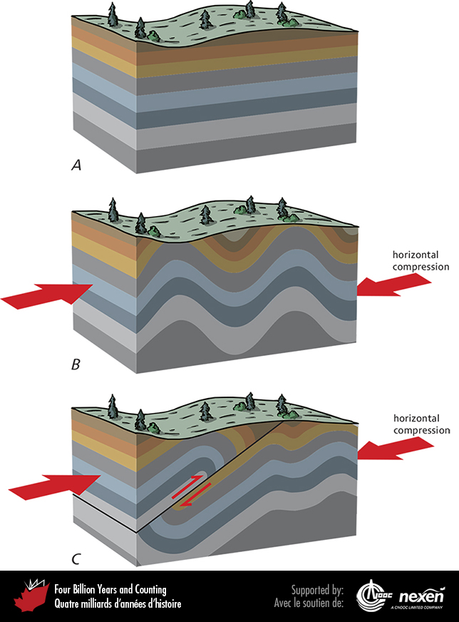
Notes:
A. Sedimentary strata before deformation. B. The same rocks after horizontal compression rumples them into folds, forming anticlines and synclines. C. Continuing pressure may form thrust faults (low-angle reverse faults—see also the next figure) that push layers of rock on top of other layers.
_______________________________
All photographic and graphic images (henceforth referred to as images) posted on this site are copyright of the persons and/or institutions indicated in the caption directly associated with each image. The copyright holders have agreed that you may use their images for educational, non-commercial purposes only and provided that they are credited in each instance of use. For all other uses you must contact the copyright holder.

Slide 13
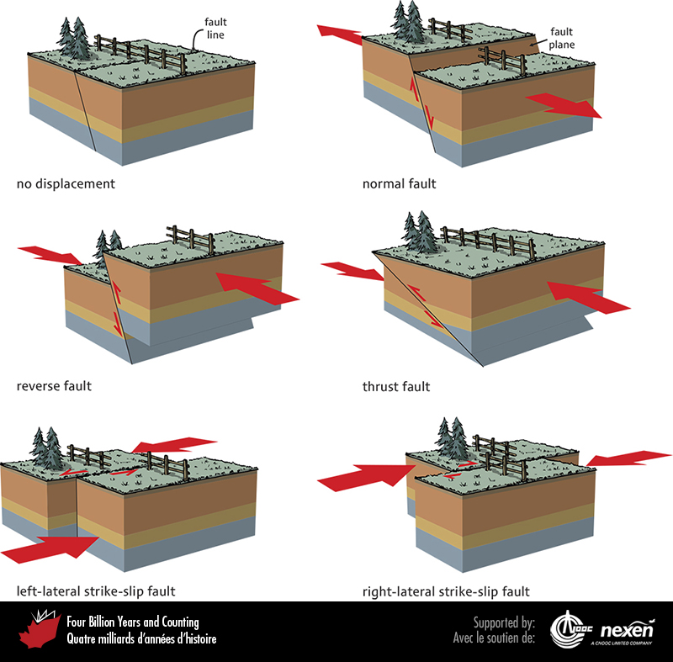
Notes:
Different kinds of faults. Check the location of the fence to see which way fault blocks are moving.
_______________________________
All photographic and graphic images (henceforth referred to as images) posted on this site are copyright of the persons and/or institutions indicated in the caption directly associated with each image. The copyright holders have agreed that you may use their images for educational, non-commercial purposes only and provided that they are credited in each instance of use. For all other uses you must contact the copyright holder.

Slide 14
Notes:
Rectangular arrangement of joints in sedimentary rocks on Ellef Ringnes Island, Nunavut. CAROL EVENCHICK.
_______________________________
All photographic and graphic images (henceforth referred to as images) posted on this site are copyright of the persons and/or institutions indicated in the caption directly associated with each image. The copyright holders have agreed that you may use their images for educational, non-commercial purposes only and provided that they are credited in each instance of use. For all other uses you must contact the copyright holder.

Slide 15
Notes:
Normal faults in sedimentary rocks, Prince Patrick Island, Northwest Territories. CHRISTOPHER HARRISON.
_______________________________
All photographic and graphic images (henceforth referred to as images) posted on this site are copyright of the persons and/or institutions indicated in the caption directly associated with each image. The copyright holders have agreed that you may use their images for educational, non-commercial purposes only and provided that they are credited in each instance of use. For all other uses you must contact the copyright holder.

Slide 16
Notes:
In this cliff near Parrsboro, Nova Scotia, the steeply tilted grey rocks at far right are about 350 million years old and have been thrust up relative to younger (around 200-million-year-old) grey volcanic and reddish sedimentary rocks to the left. The older and younger strata are separated by light-green, finely crushed material produced by grinding as the fault moved the two sets of rocks past each other. ROB FENSOME.
_______________________________
All photographic and graphic images (henceforth referred to as images) posted on this site are copyright of the persons and/or institutions indicated in the caption directly associated with each image. The copyright holders have agreed that you may use their images for educational, non-commercial purposes only and provided that they are credited in each instance of use. For all other uses you must contact the copyright holder.

Slide 17
Notes:
Ice-smoothed surface showing folds in dark amphibolite and pink gneiss on the west side of Franklin Island, Georgian Bay, Ontario. Such metamorphic rocks form in the crust beneath mountain ranges, perhaps as deep as 40 kilometres. That these rocks are now exposed at the surface implies that the mountains have eroded away and the crust in the region has been uplifted. CHRISTOPHER HARRISON.
_______________________________
All photographic and graphic images (henceforth referred to as images) posted on this site are copyright of the persons and/or institutions indicated in the caption directly associated with each image. The copyright holders have agreed that you may use their images for educational, non-commercial purposes only and provided that they are credited in each instance of use. For all other uses you must contact the copyright holder.

Slide 18
Notes:
This view of the Wernecke Mountains in Yukon reveals an unconformity between older, steeply tilted, brown sedimentary rocks below and younger, gently tilted, light-coloured carbonates above. The brown rocks were deposited before 1,710 million years ago in the Wernecke Basin (Chapter 6). R. T. BELL, REPRODUCED WITH THE PERMISSION OF NATURAL RESOURCES CANADA 2013, COURTESY OF THE GEOLOGICAL SURVEY OF CANADA.
_______________________________
All photographic and graphic images (henceforth referred to as images) posted on this site are copyright of the persons and/or institutions indicated in the caption directly associated with each image. The copyright holders have agreed that you may use their images for educational, non-commercial purposes only and provided that they are credited in each instance of use. For all other uses you must contact the copyright holder.

Slide 19
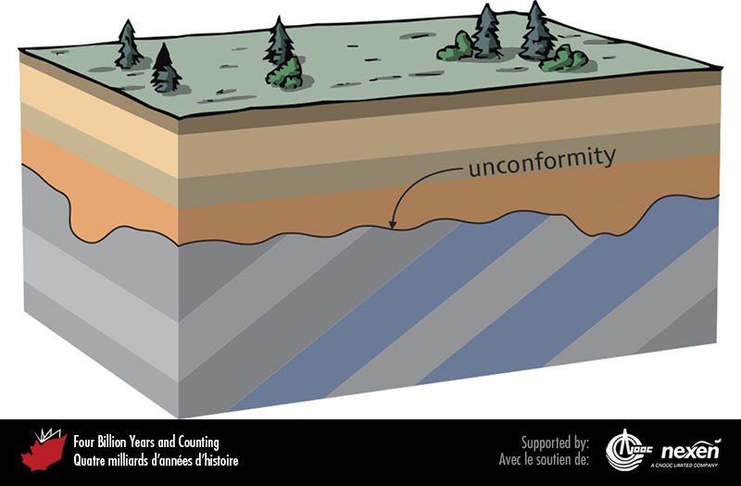
Notes:
An unconformity (irregular line) separates a lower suite of tilted strata from an upper suite of horizontal strata. Unconformities represent ancient erosion surfaces, commonly subaerial, and preserve relics of former landscapes such as channels.
_______________________________
All photographic and graphic images (henceforth referred to as images) posted on this site are copyright of the persons and/or institutions indicated in the caption directly associated with each image. The copyright holders have agreed that you may use their images for educational, non-commercial purposes only and provided that they are credited in each instance of use. For all other uses you must contact the copyright holder.

