Slide 1
CHAPTER 9 Part 2 of 4
All photographic and graphic images (henceforth referred to as images) posted on this site are copyright of the persons and/or institutions indicated in the caption directly associated with each image. The copyright holders have agreed that you may use their images for educational, non-commercial purposes only and provided that they are credited in each instance of use. For all other uses you must contact the copyright holder.

Slide 2
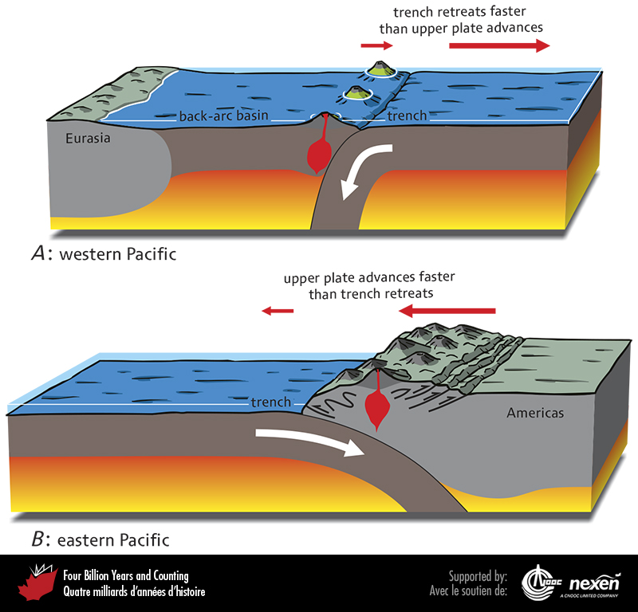
Notes:
Comparison between aspects of plate convergence in the modern western Pacific Ocean (A) and the present-day eastern Pacific Ocean (B).
_______________________________
All photographic and graphic images (henceforth referred to as images) posted on this site are copyright of the persons and/or institutions indicated in the caption directly associated with each image. The copyright holders have agreed that you may use their images for educational, non-commercial purposes only and provided that they are credited in each instance of use. For all other uses you must contact the copyright holder.

Slide 3
Notes:
Early Jurassic rocks from the Bighorn Creek area, southwestern Alberta. Thin, light-coloured volcanic ash layers are interbedded with brown-weathering shales. These ash beds record the approach of Quesnellian magmatic arcs to the old continental margin. RUSSELL HALL.
_______________________________
All photographic and graphic images (henceforth referred to as images) posted on this site are copyright of the persons and/or institutions indicated in the caption directly associated with each image. The copyright holders have agreed that you may use their images for educational, non-commercial purposes only and provided that they are credited in each instance of use. For all other uses you must contact the copyright holder.

Slide 4
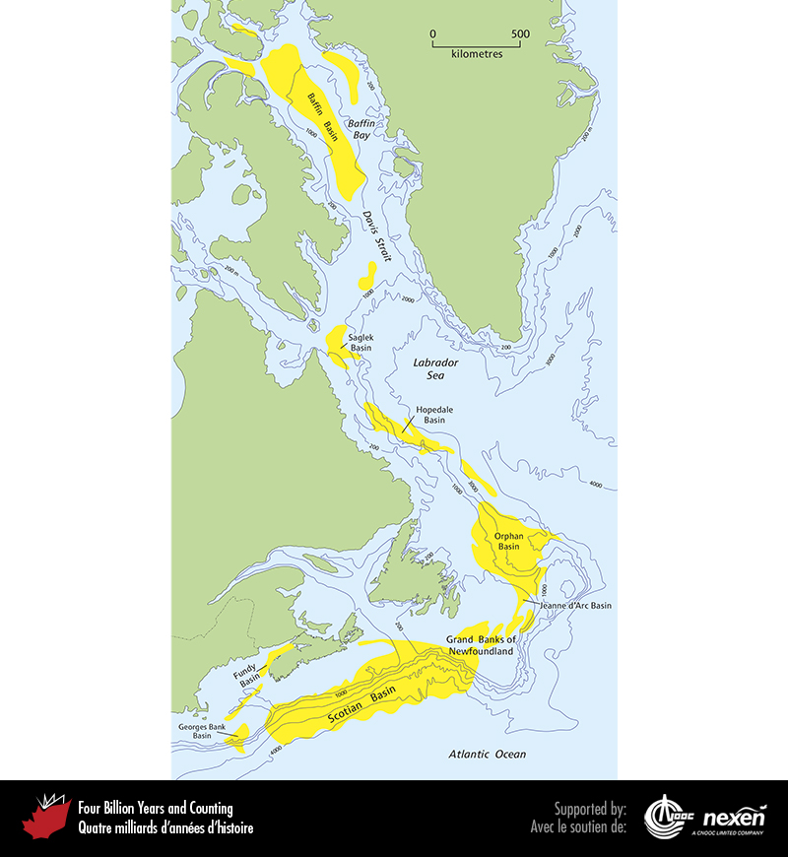
Notes:
Mesozoic-Cenozoic sedimentary basins of offshore eastern Canada. Depths are in metres. ADAPTED FROM VARIOUS SOURCES.
_______________________________
All photographic and graphic images (henceforth referred to as images) posted on this site are copyright of the persons and/or institutions indicated in the caption directly associated with each image. The copyright holders have agreed that you may use their images for educational, non-commercial purposes only and provided that they are credited in each instance of use. For all other uses you must contact the copyright holder.

Slide 5
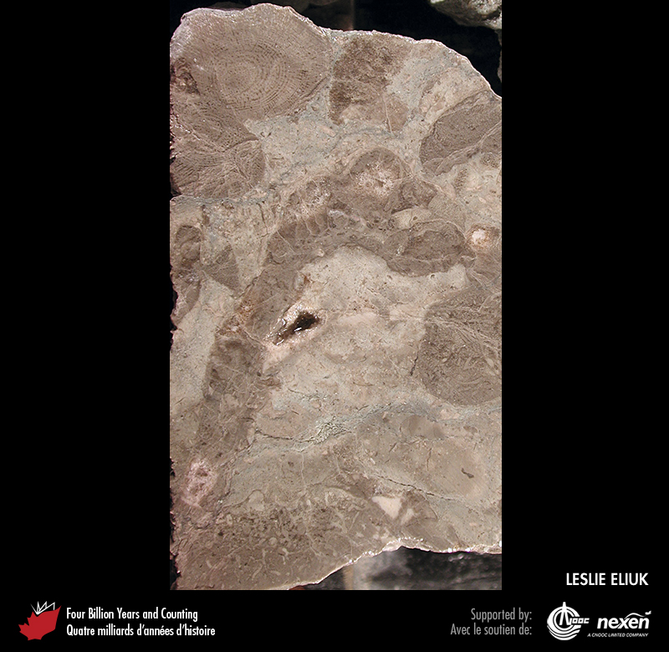
Notes:
Fossil sponges in a drill core of Jurassic carbonate reef rocks from the Demascota G-32 well in the Scotian Basin off Nova Scotia. LESLIE ELIUK.
_______________________________
All photographic and graphic images (henceforth referred to as images) posted on this site are copyright of the persons and/or institutions indicated in the caption directly associated with each image. The copyright holders have agreed that you may use their images for educational, non-commercial purposes only and provided that they are credited in each instance of use. For all other uses you must contact the copyright holder.

Slide 6
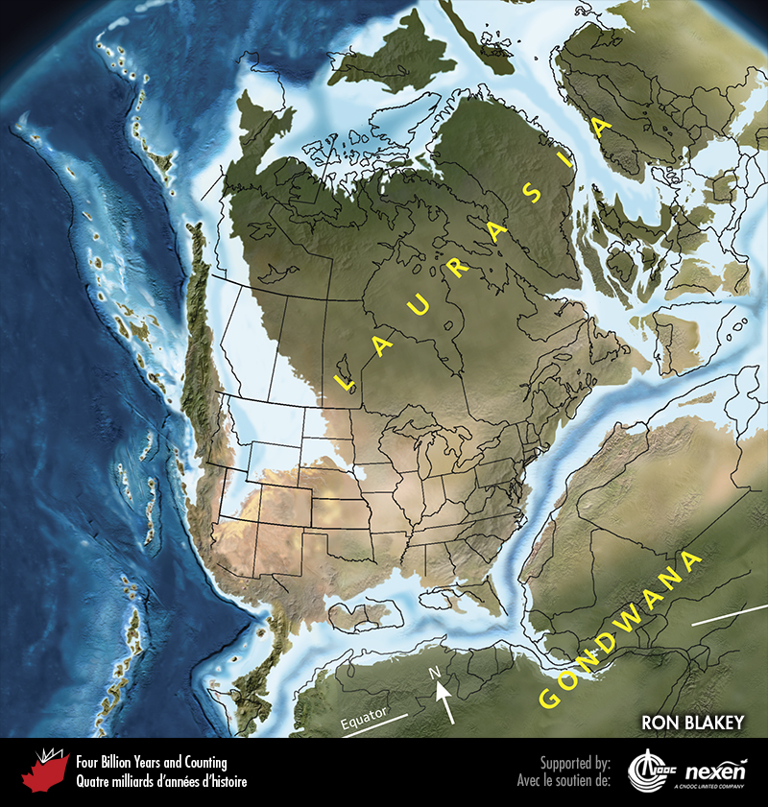
Notes:
Paleogeography of what was to become North America and adjacent regions in the Jurassic, 170 million years ago. Land is shown in brown, with shading showing topography. The lighter blue areas represent possible coastal or nearshore areas, darker blue represents deeper ocean waters, and black indicates trenches. Aspects of modern geography are shown for orientation.
_______________________________
All photographic and graphic images (henceforth referred to as images) posted on this site are copyright of the persons and/or institutions indicated in the caption directly associated with each image. The copyright holders have agreed that you may use their images for educational, non-commercial purposes only and provided that they are credited in each instance of use. For all other uses you must contact the copyright holder.

Slide 7
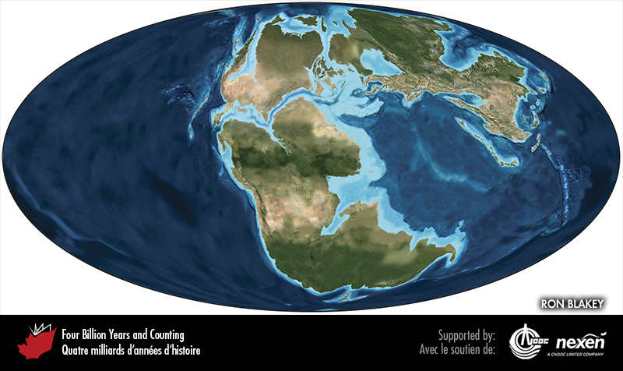
Notes:
Global paleogeography 170 million years ago, during the middle Jurassic. Colours as for previous figure.
_______________________________
All photographic and graphic images (henceforth referred to as images) posted on this site are copyright of the persons and/or institutions indicated in the caption directly associated with each image. The copyright holders have agreed that you may use their images for educational, non-commercial purposes only and provided that they are credited in each instance of use. For all other uses you must contact the copyright holder.

Slide 8
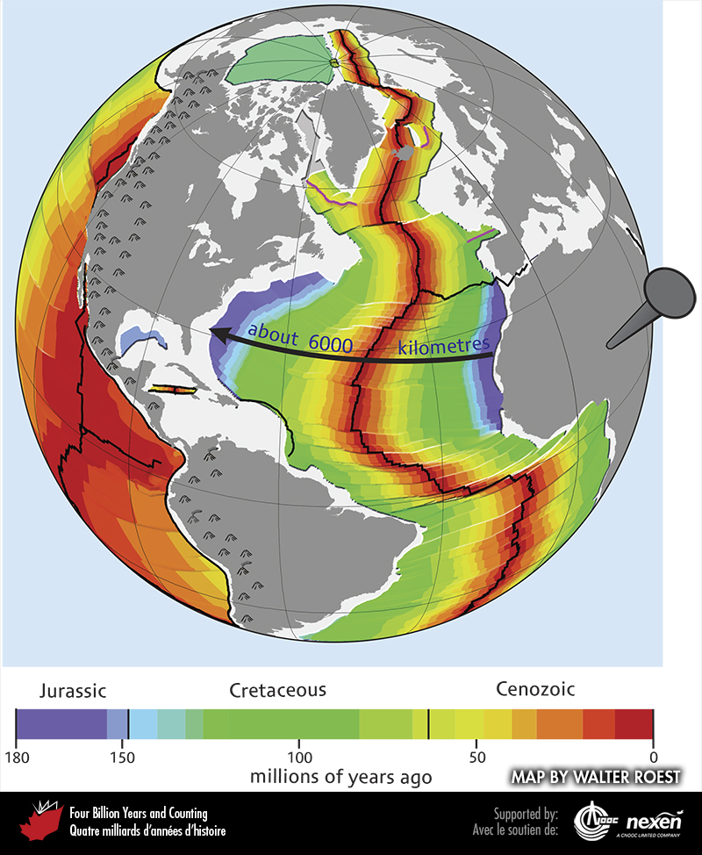
Notes:
The Atlantic Ocean and bordering continents showing how, over the past 180 million years, this ocean has grown to be over 6,000 kilometres across. The darker grey areas represent modern land, the lighter grey areas represent submerged continental margins underlain by continental crust, and the coloured areas represent oceanic crust of various ages, as indicated in the legend. The black lines represent, in part, plate boundaries. ADAPTED IN PART FROM A GRAPHIC BY WALTER ROEST.
_______________________________
All photographic and graphic images (henceforth referred to as images) posted on this site are copyright of the persons and/or institutions indicated in the caption directly associated with each image. The copyright holders have agreed that you may use their images for educational, non-commercial purposes only and provided that they are credited in each instance of use. For all other uses you must contact the copyright holder.

Slide 9
Notes:
Late Jurassic deltaic sedimentary rocks of the Bowser Basin, southeast of Taft Creek, Skeena Mountains, British Columbia. These rocks were folded during the Cordilleran collisions of the Cretaceous. MARGOT MCMECHAN.
_______________________________
All photographic and graphic images (henceforth referred to as images) posted on this site are copyright of the persons and/or institutions indicated in the caption directly associated with each image. The copyright holders have agreed that you may use their images for educational, non-commercial purposes only and provided that they are credited in each instance of use. For all other uses you must contact the copyright holder.

Slide 10
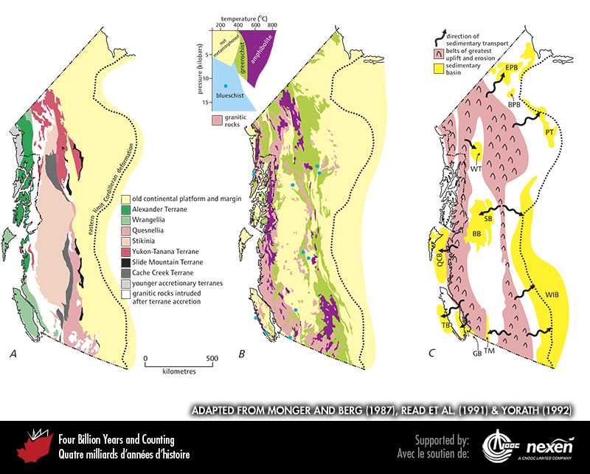
Notes:
The effects of Mesozoic and early Cenozoic collisions in the Canadian Cordillera and the adjoining part of southeastern Alaska. A. The distribution of terranes in the Canadian Cordillera (see Chapter 8). B. The distribution and nature (see inset graph) of Mesozoic metamorphic rocks and granitic intrusive igneous rocks produced by Mesozoic collisions, showing their grouping mainly in two largely separate belts. The eastern belt underlies the Columbia, Omineca, and Cassiar mountains of the eastern Cordillera, and the western belt underlies the Coast Mountains. Note how the eastern belt corresponds to the boundary between the inner terranes (including Quesnellia, Stikinia, and Yukon-Tanana) with the old continental margin, and the western belt to the boundary between the inner terranes and the outer terranes (Wrangellia and Alexander). Yellow shading on map represents areas of non-metamorphosed to weakly metamorphosed rocks. C. Location of areas of long-term uplift and long-term subsidence: the uplift coincides with areas of metamorphism in B, where once deeply buried rocks are now at the surface; and the subsidence is recorded by sedimentary basins. The sedimentary basins include: Bonnet Plume Basin (BPB), Bowser Basin (BB), Eagle Plains Basin (EP B), Georgia Basin (GB), Peel Trough (PT ), Queen Charlotte Basin (QCB), Sustut Basin (SB), Tofino Basin (TB), Tyaughton-Methow Basin (TM), Western Interior Basin (WIB), and Whitehorse Trough (WT). A IS ADAPTED FROM MONGER AND BERG (1987), COURTESY OF THE US GEOLOGICAL SURVEY; B IS FROM READ ET AL. (1991); C IS ADAPTED FROM YORATH (1992).
_______________________________
All photographic and graphic images (henceforth referred to as images) posted on this site are copyright of the persons and/or institutions indicated in the caption directly associated with each image. The copyright holders have agreed that you may use their images for educational, non-commercial purposes only and provided that they are credited in each instance of use. For all other uses you must contact the copyright holder.

Slide 11
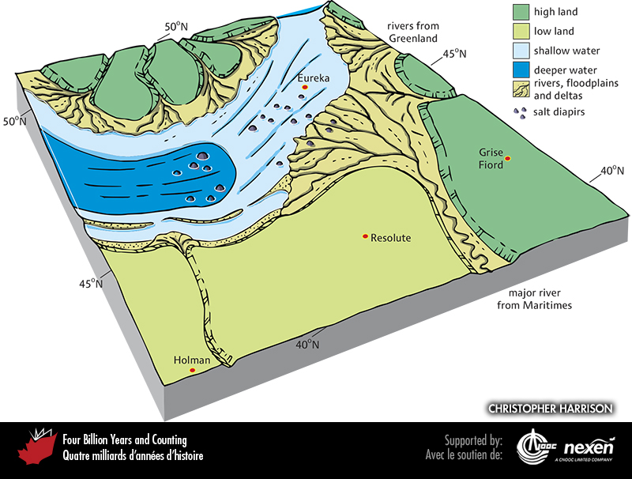
Notes:
Paleogeography of what was to become the Canadian Arctic in the middle late Triassic to early Jurassic, 215 to 195 million years ago. The approximate locations of Holman, Resolute, Grise Fiord, and Eureka are included to provide a guide for orientation, as well as paleolatitudes. The main feature was the Sverdrup Basin, now dominated by clastic deposition, especially from large deltas.
_______________________________
All photographic and graphic images (henceforth referred to as images) posted on this site are copyright of the persons and/or institutions indicated in the caption directly associated with each image. The copyright holders have agreed that you may use their images for educational, non-commercial purposes only and provided that they are credited in each instance of use. For all other uses you must contact the copyright holder.

Slide 12
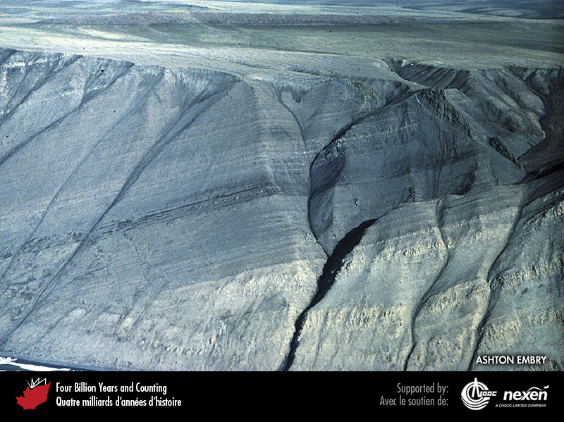
Notes:
Sea cliffs west of Smith Creek, northwest Ellesmere Island, Nunavut, expose early Triassic light-coloured sandstone and siltstone of shallow marine origin, overlain by dark mudstone of deeper marine origin. ASHTON EMBRY.
_______________________________
All photographic and graphic images (henceforth referred to as images) posted on this site are copyright of the persons and/or institutions indicated in the caption directly associated with each image. The copyright holders have agreed that you may use their images for educational, non-commercial purposes only and provided that they are credited in each instance of use. For all other uses you must contact the copyright holder.

Slide 13
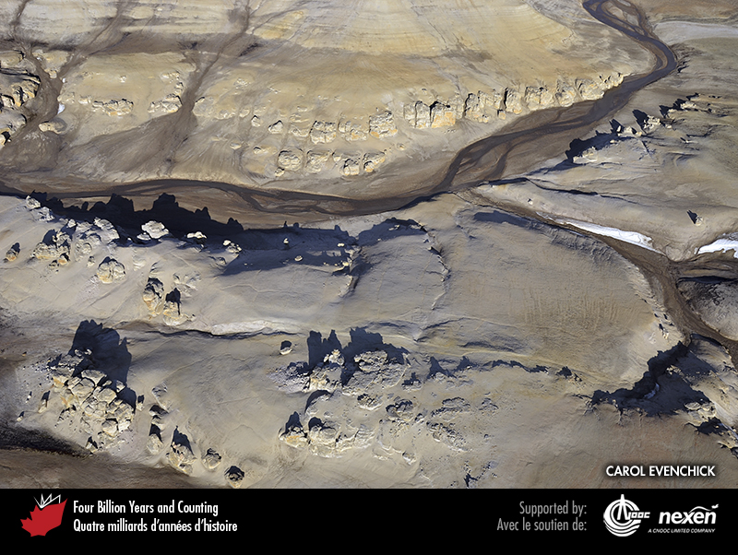
Notes:
Aerial view of cliffs and hoodoos developed in early Cretaceous deltaic sandstone, Ellef Ringnes Island, Nunavut. CAROL EVENCHICK.
_______________________________
All photographic and graphic images (henceforth referred to as images) posted on this site are copyright of the persons and/or institutions indicated in the caption directly associated with each image. The copyright holders have agreed that you may use their images for educational, non-commercial purposes only and provided that they are credited in each instance of use. For all other uses you must contact the copyright holder.

Slide 14
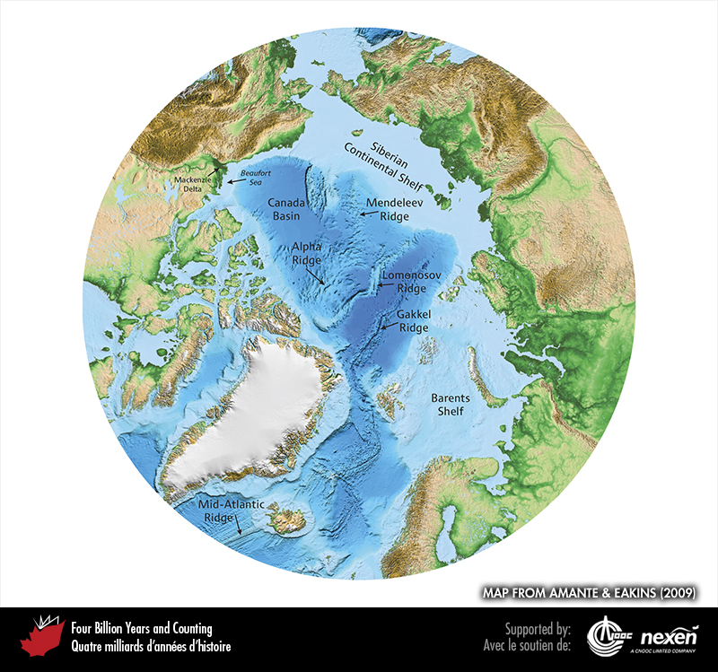
Notes:
Modern bathymetry of the Arctic Ocean and topography of its borderlands. MAP FROM AMANTE AND EAKINS (2009).
_______________________________
All photographic and graphic images (henceforth referred to as images) posted on this site are copyright of the persons and/or institutions indicated in the caption directly associated with each image. The copyright holders have agreed that you may use their images for educational, non-commercial purposes only and provided that they are credited in each instance of use. For all other uses you must contact the copyright holder.

Slide 15
Notes:
Tilted brown Cretaceous lava flows and pyroclastic rocks overlie lighter-coloured Cretaceous sediments, Kanguk Peninsula, Axel Heiberg Island, Nunavut. ANDREW MACRAE.
_______________________________
All photographic and graphic images (henceforth referred to as images) posted on this site are copyright of the persons and/or institutions indicated in the caption directly associated with each image. The copyright holders have agreed that you may use their images for educational, non-commercial purposes only and provided that they are credited in each instance of use. For all other uses you must contact the copyright holder.

