Slide 1
CHAPTER 10 Part 2 of 3
All photographic and graphic images (henceforth referred to as images) posted on this site are copyright of the persons and/or institutions indicated in the caption directly associated with each image. The copyright holders have agreed that you may use their images for educational, non-commercial purposes only and provided that they are credited in each instance of use. For all other uses you must contact the copyright holder.

Slide 2
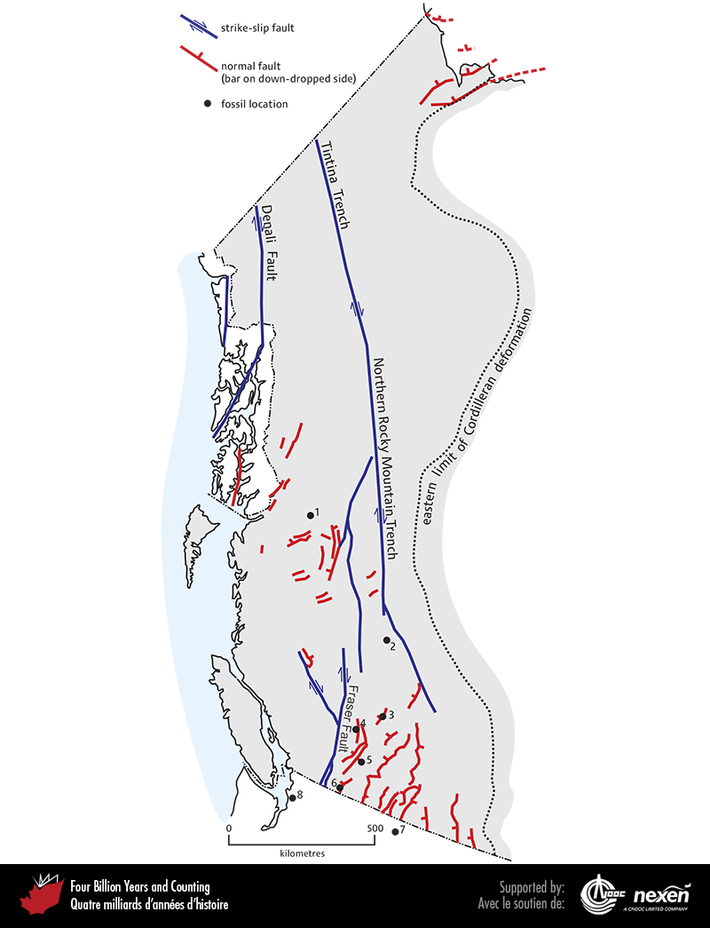
Notes:
Locations of the major strike-slip faults and prominent normal faults active in the Cordillera during the Cenozoic. The numbered locations show fossil sites: Driftwood Canyon (1), Horsefly (2), Chu Chua (3), McAbee (4), Quilchena (5), Princeton (6), Republic (7), and Chuckanut (8). The last two localities are in the United States.
_______________________________
All photographic and graphic images (henceforth referred to as images) posted on this site are copyright of the persons and/or institutions indicated in the caption directly associated with each image. The copyright holders have agreed that you may use their images for educational, non-commercial purposes only and provided that they are credited in each instance of use. For all other uses you must contact the copyright holder.

Slide 3
Notes:
The Okanagan Valley Fault southeast of Okanagan Falls, British Columbia. Bluffs above the lake at left consist of Jurassic to early Cenozoic gneiss. The surface that gently slopes away from the top of the bluffs marks the fault plane. Above this normal fault are weakly metamorphosed Paleozoic to Cenozoic rocks. JIM MONGER.
_______________________________
All photographic and graphic images (henceforth referred to as images) posted on this site are copyright of the persons and/or institutions indicated in the caption directly associated with each image. The copyright holders have agreed that you may use their images for educational, non-commercial purposes only and provided that they are credited in each instance of use. For all other uses you must contact the copyright holder.

Slide 4
Notes:
In this exposure at Three Valley Gap, southwest of Revelstoke, British Columbia, the darker, dog-bone-shaped body is a boudin, which was originally part of a mafic intrusion but has been metamorphosed to amphibolite. This boudin formed during the Eocene at the same time as brittle normal faulting in the upper crust. RAY PRICE.
_______________________________
All photographic and graphic images (henceforth referred to as images) posted on this site are copyright of the persons and/or institutions indicated in the caption directly associated with each image. The copyright holders have agreed that you may use their images for educational, non-commercial purposes only and provided that they are credited in each instance of use. For all other uses you must contact the copyright holder.

Slide 5
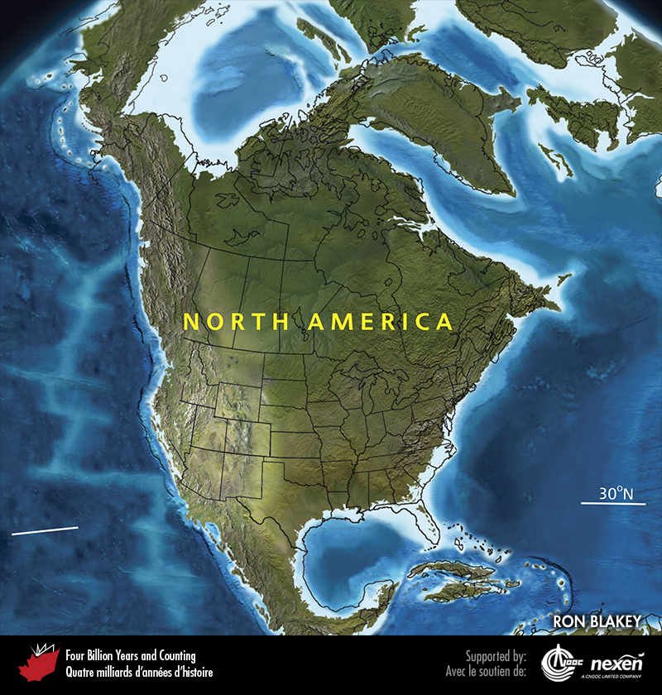
Notes:
Paleogeography of North America and adjacent regions in the late Eocene, 35 million years ago. Land is shown in brown, with shading showing topography. The lighter blue areas represent possible coastal or nearshore areas, darker blue represents deeper ocean waters, and black indicates trenches. Aspects of modern geography are shown for orientation.
_______________________________
All photographic and graphic images (henceforth referred to as images) posted on this site are copyright of the persons and/or institutions indicated in the caption directly associated with each image. The copyright holders have agreed that you may use their images for educational, non-commercial purposes only and provided that they are credited in each instance of use. For all other uses you must contact the copyright holder.

Slide 6
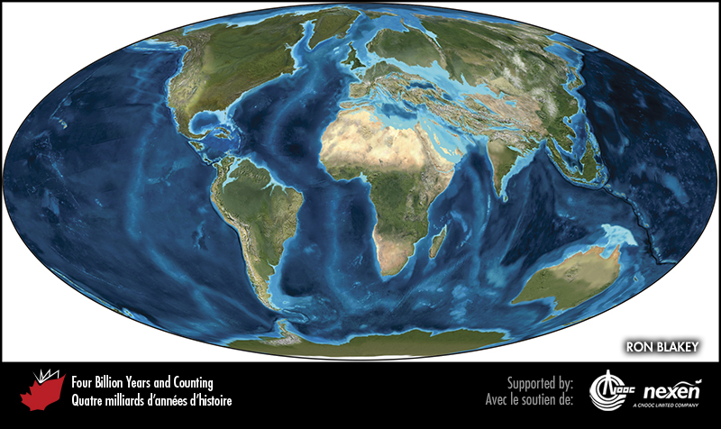
Notes:
Global paleogeography 35 million years ago, during the late Eocene. Colours as for previous figure.
_______________________________
All photographic and graphic images (henceforth referred to as images) posted on this site are copyright of the persons and/or institutions indicated in the caption directly associated with each image. The copyright holders have agreed that you may use their images for educational, non-commercial purposes only and provided that they are credited in each instance of use. For all other uses you must contact the copyright holder.

Slide 7
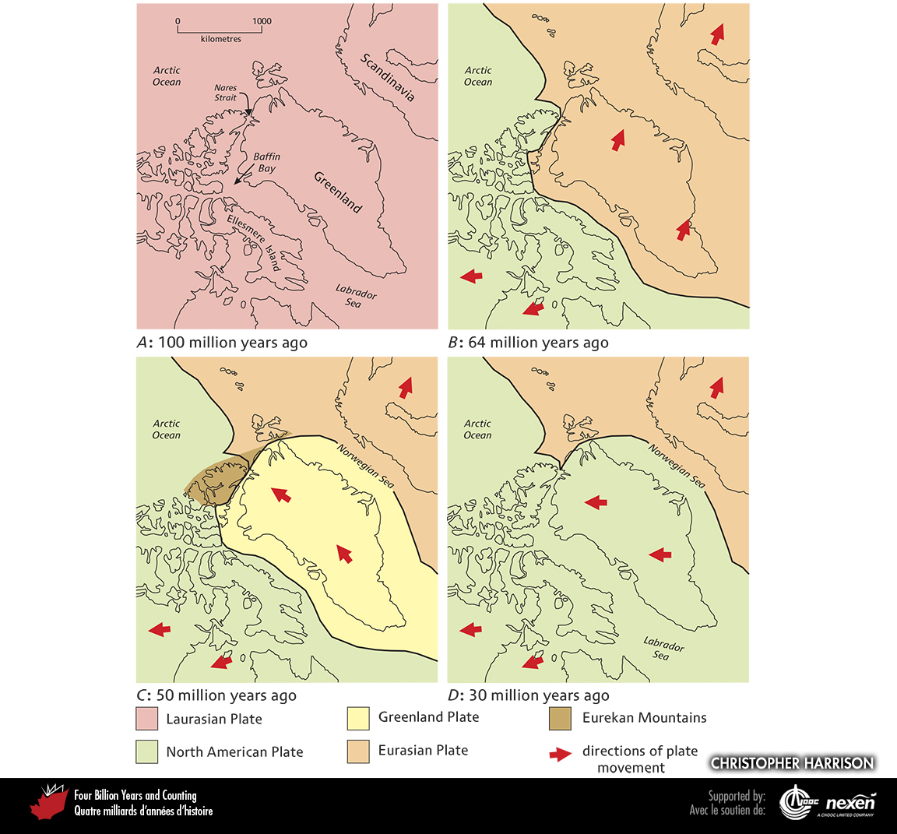
Notes:
The changing plate-tectonic relationships of Laurasia, Greenland, North America, and Eurasia for middle Cretaceous (A), early Paleocene (B), early Eocene (C), and Oligocene and later times (D). The modern shoreline is shown for orientation, and Eocene plate positions are shown on all figures for simplicity. ADAPTED FROM VARIOUS SOURCES.
_______________________________
All photographic and graphic images (henceforth referred to as images) posted on this site are copyright of the persons and/or institutions indicated in the caption directly associated with each image. The copyright holders have agreed that you may use their images for educational, non-commercial purposes only and provided that they are credited in each instance of use. For all other uses you must contact the copyright holder.

Slide 8
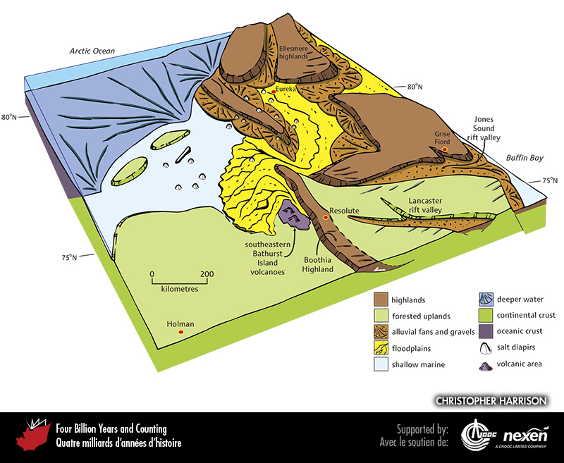
Notes:
Paleogeography of what was to become the Canadian Arctic in the late Paleocene to Eocene, 62 to 35 million years ago. The approximate location of Holman, Resolute, Grise Fiord, and Eureka are included to provide a guide for orientation, as well as paleolatitudes.
_______________________________
All photographic and graphic images (henceforth referred to as images) posted on this site are copyright of the persons and/or institutions indicated in the caption directly associated with each image. The copyright holders have agreed that you may use their images for educational, non-commercial purposes only and provided that they are credited in each instance of use. For all other uses you must contact the copyright holder.

Slide 9
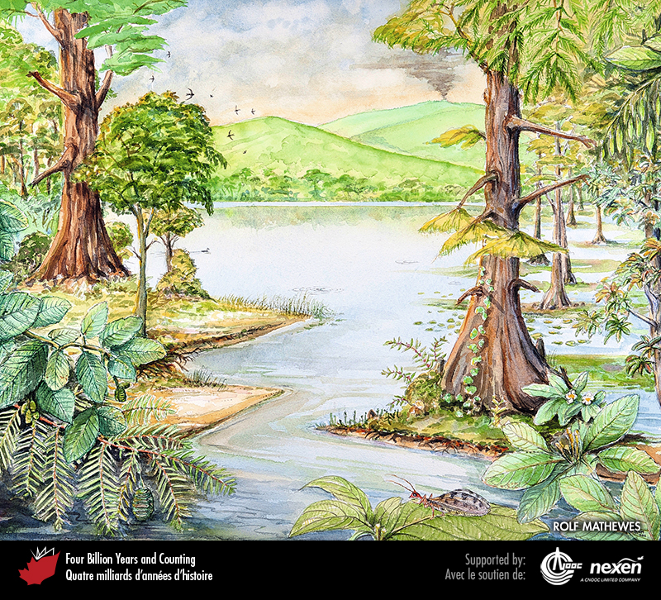
Notes:
An early Eocene summer lakeside scene based on fossils, about 50 million years old, found near Quilchena, British Columbia. On the right is a large swamp cypress tree with flowering “water willow” (Decodon) shoots at its left base. Leaves of tea-family plants can be seen at far and lower right, with a fruiting branch of ash at upper right. The shallow waters around the cypress support floating mats of algae, the fern Azolla, and leaves of water lily. At left, an alder branch with cones hangs over a fertile shoot of dawn redwood. The small blade-leafed plants at the middle water’s edge, although not true grasses, may be early relatives of that group or other grass-like plants. Animal fossils at Quilchena include insects, which likely provided food for the swallow-like swifts (upper left), fossils of which have been found recently. ARTWORK COPYRIGHT ROLF MATHEWES.
_______________________________
All photographic and graphic images (henceforth referred to as images) posted on this site are copyright of the persons and/or institutions indicated in the caption directly associated with each image. The copyright holders have agreed that you may use their images for educational, non-commercial purposes only and provided that they are credited in each instance of use. For all other uses you must contact the copyright holder.

Slide 10
Notes:
Wing of a lacewing insect found in the Eocene lake deposits at Quilchena, British Columbia. ROLF MATHEWES
_______________________________
All photographic and graphic images (henceforth referred to as images) posted on this site are copyright of the persons and/or institutions indicated in the caption directly associated with each image. The copyright holders have agreed that you may use their images for educational, non-commercial purposes only and provided that they are credited in each instance of use. For all other uses you must contact the copyright holder.

Slide 11
Notes:
Dawn redwood foliage at left and a cypress branch crossing the bottom-right of the image. These fossils were found in the Eocene lake deposits at Quilchena, British Columbia. RON LONG.
_______________________________
All photographic and graphic images (henceforth referred to as images) posted on this site are copyright of the persons and/or institutions indicated in the caption directly associated with each image. The copyright holders have agreed that you may use their images for educational, non-commercial purposes only and provided that they are credited in each instance of use. For all other uses you must contact the copyright holder.

Slide 12
Notes:
Flower calyx Florissantia quichenensis found in the Eocene lake deposits at Quilchena, British Columbia. ROLF MATHEWES.
_______________________________
All photographic and graphic images (henceforth referred to as images) posted on this site are copyright of the persons and/or institutions indicated in the caption directly associated with each image. The copyright holders have agreed that you may use their images for educational, non-commercial purposes only and provided that they are credited in each instance of use. For all other uses you must contact the copyright holder.

Slide 13
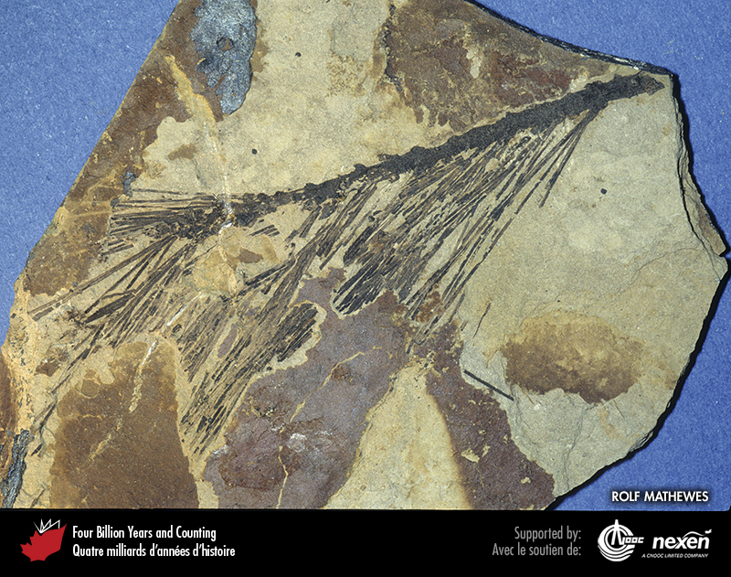
Notes:
Pine branch with needles found in the Eocene lake deposits at Quilchena, British Columbia. ROLF MATHEWES.
_______________________________
All photographic and graphic images (henceforth referred to as images) posted on this site are copyright of the persons and/or institutions indicated in the caption directly associated with each image. The copyright holders have agreed that you may use their images for educational, non-commercial purposes only and provided that they are credited in each instance of use. For all other uses you must contact the copyright holder.

Slide 14
Notes:
Flight feather found in the Eocene lake deposits at Quilchena, British Columbia. ROLF MATHEWES.
_______________________________
All photographic and graphic images (henceforth referred to as images) posted on this site are copyright of the persons and/or institutions indicated in the caption directly associated with each image. The copyright holders have agreed that you may use their images for educational, non-commercial purposes only and provided that they are credited in each instance of use. For all other uses you must contact the copyright holder.

Slide 15
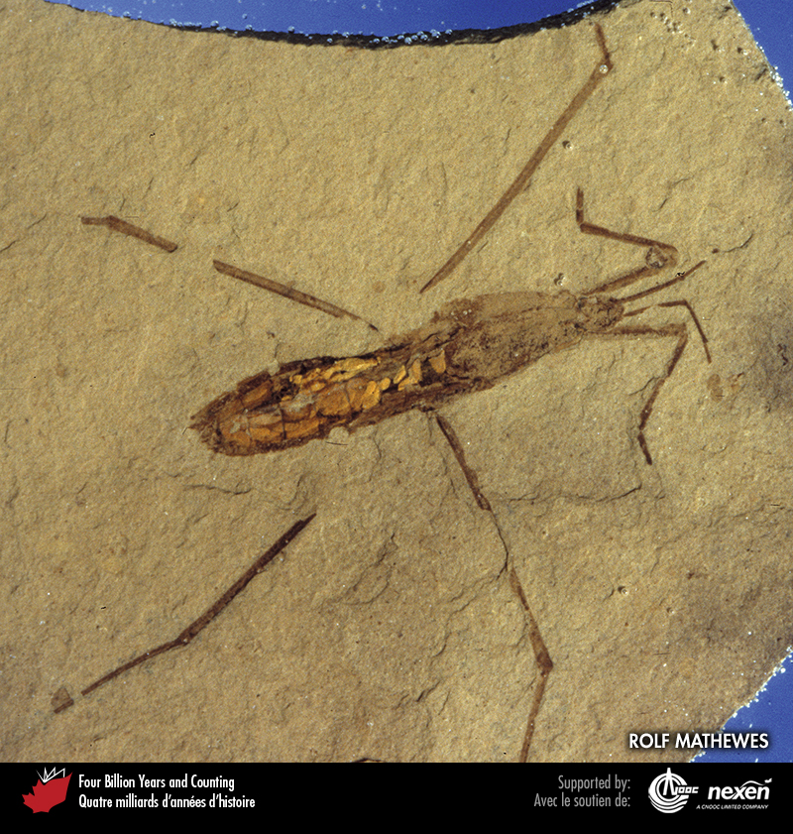
Notes:
A waterstrider found in the Eocene lake deposits at Quilchena. ROLF MATHEWES.
_______________________________
All photographic and graphic images (henceforth referred to as images) posted on this site are copyright of the persons and/or institutions indicated in the caption directly associated with each image. The copyright holders have agreed that you may use their images for educational, non-commercial purposes only and provided that they are credited in each instance of use. For all other uses you must contact the copyright holder.

Slide 16
Notes:
Flat-lying Paleocene basalt flows resting on brown volcanic breccia, on the coast of Baffin Island, northwest of Cape Dyer. BARRIE CLARKE.
_______________________________
All photographic and graphic images (henceforth referred to as images) posted on this site are copyright of the persons and/or institutions indicated in the caption directly associated with each image. The copyright holders have agreed that you may use their images for educational, non-commercial purposes only and provided that they are credited in each instance of use. For all other uses you must contact the copyright holder.

