Slide 1
BOX 1 Part 1 of 2
All photographic and graphic images (henceforth referred to as images) posted on this site are copyright of the persons and/or institutions indicated in the caption directly associated with each image. The copyright holders have agreed that you may use their images for educational, non-commercial purposes only and provided that they are credited in each instance of use. For all other uses you must contact the copyright holder.

Slide 2
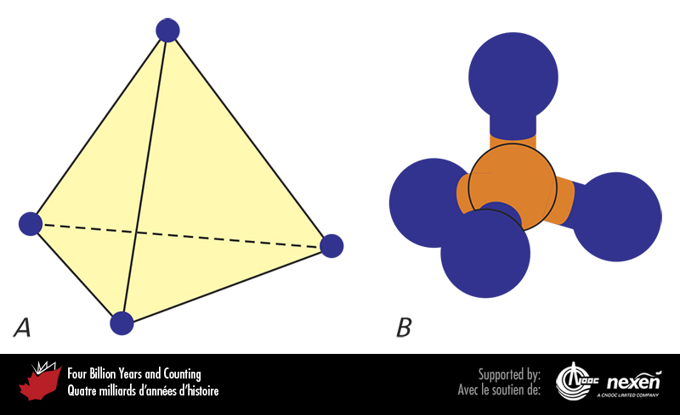
Notes:
Silicates are based on a tetrahedral molecular arrangement. A shows the basic shape of a tetrahedron. In silicates, a silicon atom sits in the middle surrounded by four oxygen atoms, representing the four corners, as shown in B.
_______________________________
All photographic and graphic images (henceforth referred to as images) posted on this site are copyright of the persons and/or institutions indicated in the caption directly associated with each image. The copyright holders have agreed that you may use their images for educational, non-commercial purposes only and provided that they are credited in each instance of use. For all other uses you must contact the copyright holder.

Slide 3
Notes:
Native copper, Cape d’Or, Nova Scotia. HEINZ WIELE, COURTESY OF THE ATLANTIC GEOSCIENCE SOCIETY; SPECIMEN COURTESY OF THE NOVA SCOTIA MUSEUM.
_______________________________
All photographic and graphic images (henceforth referred to as images) posted on this site are copyright of the persons and/or institutions indicated in the caption directly associated with each image. The copyright holders have agreed that you may use their images for educational, non-commercial purposes only and provided that they are credited in each instance of use. For all other uses you must contact the copyright holder.

Slide 4
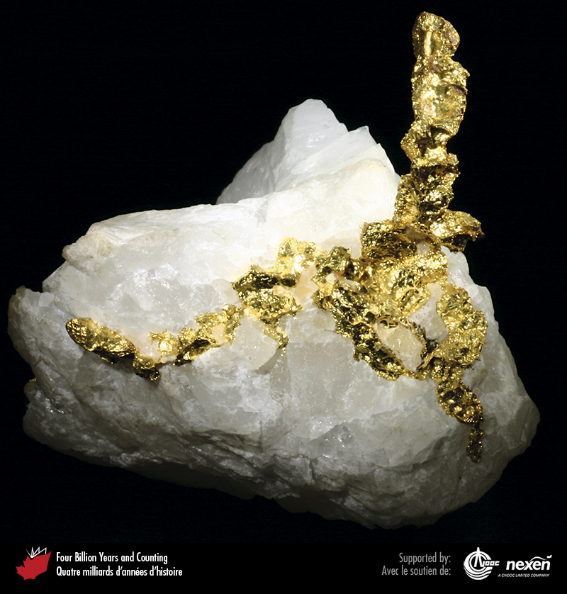
Notes:
Native gold from Timmins, Ontario.
_______________________________
All photographic and graphic images (henceforth referred to as images) posted on this site are copyright of the persons and/or institutions indicated in the caption directly associated with each image. The copyright holders have agreed that you may use their images for educational, non-commercial purposes only and provided that they are credited in each instance of use. For all other uses you must contact the copyright holder.

Slide 5
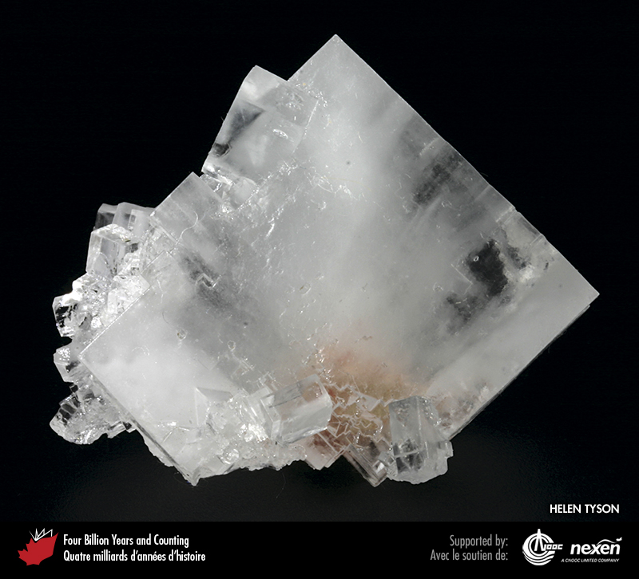
Notes:
Halite from a potash mine at Rocanville, Saskatchewan. HELEN TYSON, FROM THE COLLECTION OF ROD AND HELEN TYSON.
_______________________________
All photographic and graphic images (henceforth referred to as images) posted on this site are copyright of the persons and/or institutions indicated in the caption directly associated with each image. The copyright holders have agreed that you may use their images for educational, non-commercial purposes only and provided that they are credited in each instance of use. For all other uses you must contact the copyright holder.

Slide 6
Notes:
Quartz crystals, Salmon River Gold District, Nova Scotia. HEINZ WIELE, COURTESY OF THE ATLANTIC GEOSCIENCE SOCIETY; SPECIMEN COURTESY OF THE NOVA SCOTIA MUSEUM.
_______________________________
All photographic and graphic images (henceforth referred to as images) posted on this site are copyright of the persons and/or institutions indicated in the caption directly associated with each image. The copyright holders have agreed that you may use their images for educational, non-commercial purposes only and provided that they are credited in each instance of use. For all other uses you must contact the copyright holder.

Slide 7
Notes:
Smoky quartz from Nova Scotia. HEINZ WIELE, COURTESY OF THE ATLANTIC GEOSCIENCE SOCIETY; SPECIMEN COURTESY OF THE FUNDY GEOLOGICAL MUSEUM.
_______________________________
All photographic and graphic images (henceforth referred to as images) posted on this site are copyright of the persons and/or institutions indicated in the caption directly associated with each image. The copyright holders have agreed that you may use their images for educational, non-commercial purposes only and provided that they are credited in each instance of use. For all other uses you must contact the copyright holder.

Slide 8
Notes:
Amethyst from Thunder Bay, Ontario. HELEN TYSON, FROM THE COLLECTION OF ROD AND HELEN TYSON.
_______________________________
All photographic and graphic images (henceforth referred to as images) posted on this site are copyright of the persons and/or institutions indicated in the caption directly associated with each image. The copyright holders have agreed that you may use their images for educational, non-commercial purposes only and provided that they are credited in each instance of use. For all other uses you must contact the copyright holder.

Slide 9
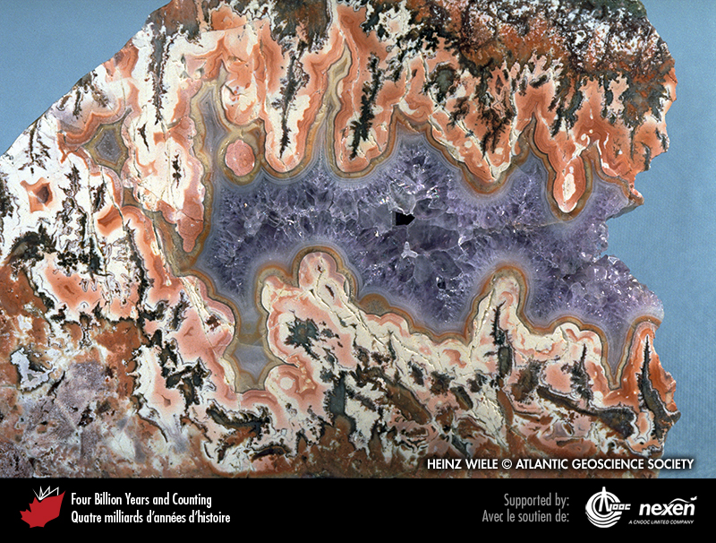
Notes:
Multicoloured agate surrounds a core of purple amethyst in this example from around the Bay of Fundy in Nova Scotia. HEINZ WIELE, COURTESY OF THE ATLANTIC GEOSCIENCE SOCIET Y; SPECIMEN COURTESY OF THE FUNDY GEOLO GICAL MUSEUM.
_______________________________
All photographic and graphic images (henceforth referred to as images) posted on this site are copyright of the persons and/or institutions indicated in the caption directly associated with each image. The copyright holders have agreed that you may use their images for educational, non-commercial purposes only and provided that they are credited in each instance of use. For all other uses you must contact the copyright holder.

Slide 10
Notes:
Garnet from the Jeffrey Mine, Quebec. HELEN TYSON, FROM THE COLLECTION OF ROD AND HELEN TYSON.
_______________________________
All photographic and graphic images (henceforth referred to as images) posted on this site are copyright of the persons and/or institutions indicated in the caption directly associated with each image. The copyright holders have agreed that you may use their images for educational, non-commercial purposes only and provided that they are credited in each instance of use. For all other uses you must contact the copyright holder.

Slide 11
Notes:
Crystals of biotite (black) and apatite (green) southwest of Bancroft, Ontario. GRAHAM WILSON.
_______________________________
All photographic and graphic images (henceforth referred to as images) posted on this site are copyright of the persons and/or institutions indicated in the caption directly associated with each image. The copyright holders have agreed that you may use their images for educational, non-commercial purposes only and provided that they are credited in each instance of use. For all other uses you must contact the copyright holder.

Slide 12
Notes:
Hornblende, the common rock-forming variety of amphibole, from Bear Lake, west of Bancroft, Ontario. HELEN TYSON, FROM THE COLLECTION OF ROD AND HELEN TYSON.
_______________________________
All photographic and graphic images (henceforth referred to as images) posted on this site are copyright of the persons and/or institutions indicated in the caption directly associated with each image. The copyright holders have agreed that you may use their images for educational, non-commercial purposes only and provided that they are credited in each instance of use. For all other uses you must contact the copyright holder.

