Slide 1
BOX 10 Part 1 of 1
All photographic and graphic images (henceforth referred to as images) posted on this site are copyright of the persons and/or institutions indicated in the caption directly associated with each image. The copyright holders have agreed that you may use their images for educational, non-commercial purposes only and provided that they are credited in each instance of use. For all other uses you must contact the copyright holder.

Slide 2
Notes:
This downstream view of the St. Lawrence River reveals why the Cap Diamant, or Québec, promontory is so strategically important. The promontory consists of resistant rocks of the most northwesterly of the thrust sheets of the Appalachian Orogen. The highlands in the far distance are underlain by rocks of the Grenville Orogen of the Canadian Shield. Most of the lowlands in this view were covered some 12,000 years ago by the Champlain Sea. ROB FENSOME.
_______________________________
All photographic and graphic images (henceforth referred to as images) posted on this site are copyright of the persons and/or institutions indicated in the caption directly associated with each image. The copyright holders have agreed that you may use their images for educational, non-commercial purposes only and provided that they are credited in each instance of use. For all other uses you must contact the copyright holder.

Slide 3
Notes:
Flat-lying late Ordovician limestone, belonging to the St. Lawrence Platform sequence, unconformably overlies hard crystalline Grenvillian gneiss at Montmorency Falls, Beauport, Quebec. A gap of about 550 million years is represented by the unconformity. ROB FENSOME.
_______________________________
All photographic and graphic images (henceforth referred to as images) posted on this site are copyright of the persons and/or institutions indicated in the caption directly associated with each image. The copyright holders have agreed that you may use their images for educational, non-commercial purposes only and provided that they are credited in each instance of use. For all other uses you must contact the copyright holder.

Slide 4
Notes:
This wall along Sous-le-Capin in old Québec City sits on tilted Ordovician calcareous mudstone deposited in the deep waters of the Iapetus Ocean. Ordovician and older rocks were thrust-faulted and folded during the Taconic Orogeny, an event within the Appalachian Orogen. ROB FENSOME.
_______________________________
All photographic and graphic images (henceforth referred to as images) posted on this site are copyright of the persons and/or institutions indicated in the caption directly associated with each image. The copyright holders have agreed that you may use their images for educational, non-commercial purposes only and provided that they are credited in each instance of use. For all other uses you must contact the copyright holder.

Slide 5
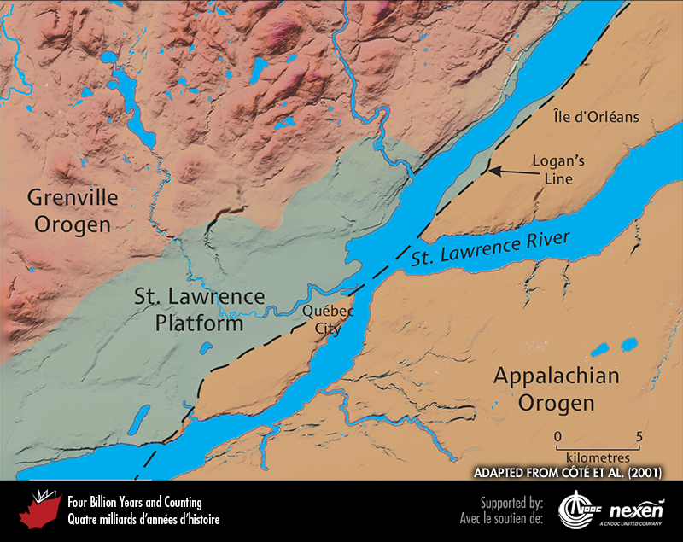
Notes:
Québec City’s geological setting at the crossroads of the Canadian Shield (pink), the St. Lawrence Platform (green), and the Appalachian Orogen (brown). ADAPTED FROM CÔTÉ ET AL. (2001).
_______________________________
All photographic and graphic images (henceforth referred to as images) posted on this site are copyright of the persons and/or institutions indicated in the caption directly associated with each image. The copyright holders have agreed that you may use their images for educational, non-commercial purposes only and provided that they are credited in each instance of use. For all other uses you must contact the copyright holder.

Slide 6
Notes:
Detail of the Maison Cureux (1729 reconstruction of a 1709 building) on rue Saint-Louis, near its intersection with rue d’Auteuil. This is a rare example of a house built of Ordovician Cap Diamant Blackstone. ROB FENSOME.
_______________________________
All photographic and graphic images (henceforth referred to as images) posted on this site are copyright of the persons and/or institutions indicated in the caption directly associated with each image. The copyright holders have agreed that you may use their images for educational, non-commercial purposes only and provided that they are credited in each instance of use. For all other uses you must contact the copyright holder.

Slide 7
Notes:
The main building stone in Place Royale is Ordovician Beauport Limestone. ROB FENSOME.
_______________________________
All photographic and graphic images (henceforth referred to as images) posted on this site are copyright of the persons and/or institutions indicated in the caption directly associated with each image. The copyright holders have agreed that you may use their images for educational, non-commercial purposes only and provided that they are credited in each instance of use. For all other uses you must contact the copyright holder.

Slide 8
Notes:
Detail of the city wall in Montmorency Park. The wall is composed of Ordovician Ange- Gardien (yellowish) and Cambrian Sillery-Cap Rouge (greenish to brownish) sandstones. ROB FENSOME.
_______________________________
All photographic and graphic images (henceforth referred to as images) posted on this site are copyright of the persons and/or institutions indicated in the caption directly associated with each image. The copyright holders have agreed that you may use their images for educational, non-commercial purposes only and provided that they are credited in each instance of use. For all other uses you must contact the copyright holder.

Slide 9
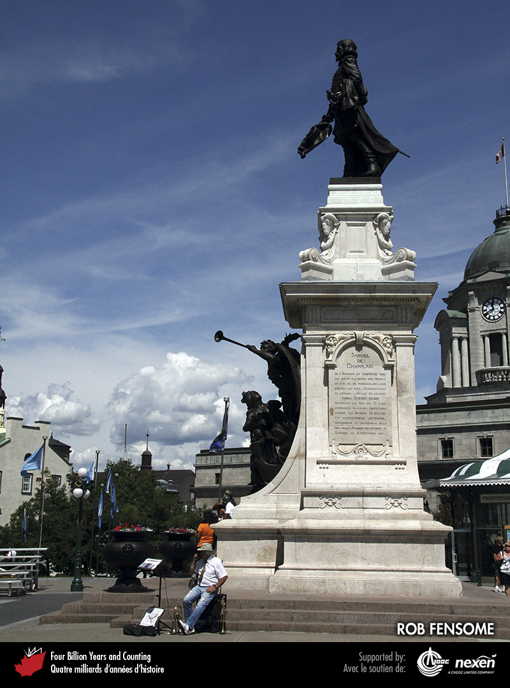
Notes:
The Champlain Monument (1898) on terrasse Dufferin. The creamy white limestone of the pedestal is from Château-Landon in France. The steps at the base are Vosges granite, also from France. ROB FENSOME.
_______________________________
All photographic and graphic images (henceforth referred to as images) posted on this site are copyright of the persons and/or institutions indicated in the caption directly associated with each image. The copyright holders have agreed that you may use their images for educational, non-commercial purposes only and provided that they are credited in each instance of use. For all other uses you must contact the copyright holder.

Slide 10
Notes:
Facades of two houses along the rue des Remparts. The house to the left is constructed of Ordovician Saint-Marc-des-Carrières Limestone, the house to the right of greenish Cambrian Sillery Sandstone. ROB FENSOME.
_______________________________
All photographic and graphic images (henceforth referred to as images) posted on this site are copyright of the persons and/or institutions indicated in the caption directly associated with each image. The copyright holders have agreed that you may use their images for educational, non-commercial purposes only and provided that they are credited in each instance of use. For all other uses you must contact the copyright holder.

Slide 11
Notes:
Maison Parent (1761), located at the corner of rue Sous-le-Fort and rue Saint-Pierre, is built of a variety of local rocks, many from a former building on the site that was destroyed during the British siege of the city in 1759. The rocks include reddish to brownish calcareous Ange-Gardien Sandstone (its colour due to iron oxide grain coatings), Beauport Limestone, Sillery Sandstone, Rivière-à-Pierre Granite, and Cap Diamant Blackstone. The trim around doors and windows is the Pointe-aux-Trembles Limestone. ROB FENSOME.
_______________________________
All photographic and graphic images (henceforth referred to as images) posted on this site are copyright of the persons and/or institutions indicated in the caption directly associated with each image. The copyright holders have agreed that you may use their images for educational, non-commercial purposes only and provided that they are credited in each instance of use. For all other uses you must contact the copyright holder.

Slide 12
Notes:
A cliff of precarious-looking Ordovician calcareous mudstone along a lane in Québec City illustrates the potential danger of rockfalls in the city. ROB FENSOME.
_______________________________
All photographic and graphic images (henceforth referred to as images) posted on this site are copyright of the persons and/or institutions indicated in the caption directly associated with each image. The copyright holders have agreed that you may use their images for educational, non-commercial purposes only and provided that they are credited in each instance of use. For all other uses you must contact the copyright holder.

Slide 13
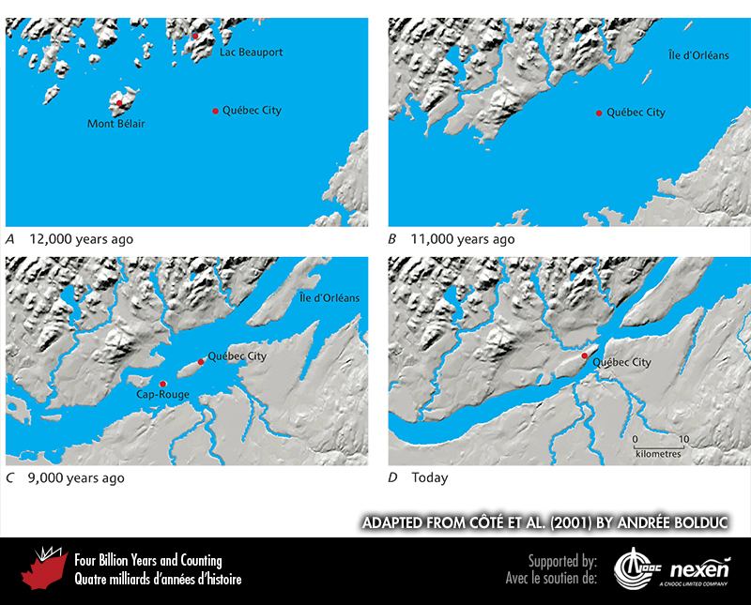
Notes:
After the glaciers retreated, the lithosphere took a while to rebound isostatically from their weight, resulting in depressions below sea level. One such depression was the area now occupied by the St. Lawrence Valley, which was flooded by the Champlain Sea. The maximum extent of the Sea’s inundation is shown in A and the early stages of its retreat in B. By 9,000 years ago (C) the Cap Diamant promontory was an island in a broad St. Lawrence Estuary. Over the past 9,000 years, sea levels have continued to recede to today (D). ADAPTED FROM CÔTÉ ET AL. (2001) BY ANDRÉE BOLDUC.
_______________________________
All photographic and graphic images (henceforth referred to as images) posted on this site are copyright of the persons and/or institutions indicated in the caption directly associated with each image. The copyright holders have agreed that you may use their images for educational, non-commercial purposes only and provided that they are credited in each instance of use. For all other uses you must contact the copyright holder.

