Slide 1
CHAPTER 20 Part 1 of 3
All photographic and graphic images (henceforth referred to as images) posted on this site are copyright of the persons and/or institutions indicated in the caption directly associated with each image. The copyright holders have agreed that you may use their images for educational, non-commercial purposes only and provided that they are credited in each instance of use. For all other uses you must contact the copyright holder.

Slide 2
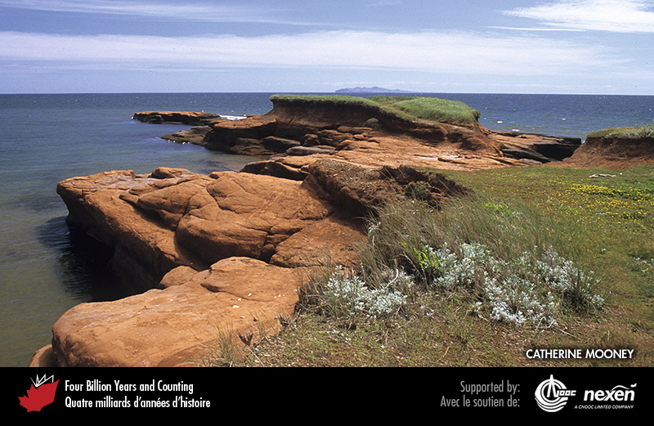
Notes:
Coastal exposure of sandstones on the Magdalen Islands, Quebec. These Permian redbeds were deposited in the interior of the supercontinent Pangea. CATHERINE MOONEY.
_______________________________
All photographic and graphic images (henceforth referred to as images) posted on this site are copyright of the persons and/or institutions indicated in the caption directly associated with each image. The copyright holders have agreed that you may use their images for educational, non-commercial purposes only and provided that they are credited in each instance of use. For all other uses you must contact the copyright holder.

Slide 3
Notes:
Weathered Archean komatiite, about 2,700 million years old, from the Rae Craton on Baffin Island, Nunavut. The pattern may reflect columnar jointing. MIKE YOUNG.
_______________________________
All photographic and graphic images (henceforth referred to as images) posted on this site are copyright of the persons and/or institutions indicated in the caption directly associated with each image. The copyright holders have agreed that you may use their images for educational, non-commercial purposes only and provided that they are credited in each instance of use. For all other uses you must contact the copyright holder.

Slide 4
Notes:
These well-preserved Paleoproterozoic pillow lavas on central Baffin Island, Nunavut, are 1,970 million years old and likely formed in the Manikewan Ocean prior to the Trans-Hudson Orogeny. The white areas between pillows (not the cross-cutting white veins) represent carbonate that was precipitated in crevices between pillows. DAVID CORRIGAN.
_______________________________
All photographic and graphic images (henceforth referred to as images) posted on this site are copyright of the persons and/or institutions indicated in the caption directly associated with each image. The copyright holders have agreed that you may use their images for educational, non-commercial purposes only and provided that they are credited in each instance of use. For all other uses you must contact the copyright holder.

Slide 5
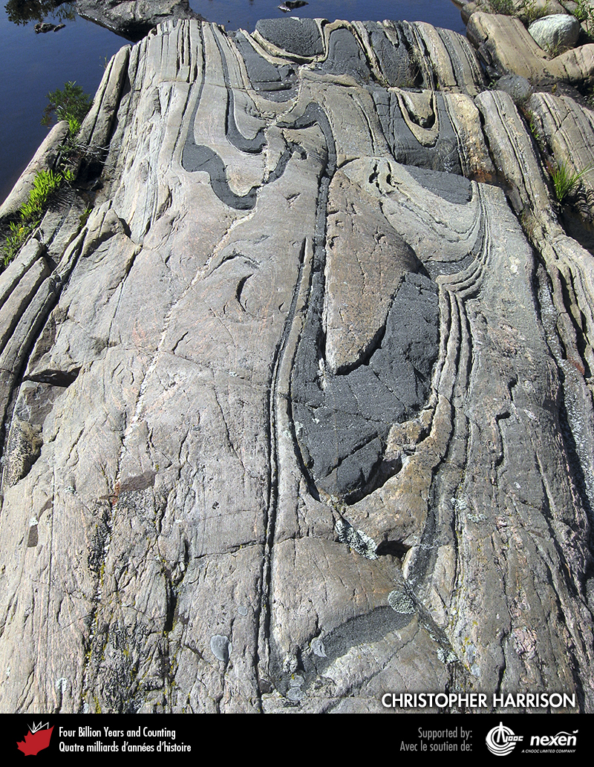
Notes:
Gneiss and metamorphosed mafic dykes exposed on Franklin Island, off Georgian Bay’s east shore. These rocks were deformed at great depth beneath the Grenvillian Mountains over 1,000 million years ago. They reveal what parts of the continental crust might be like today at depths of a few tens of kilometres below the surface. CHRISTOPHER HARRISON.
_______________________________
All photographic and graphic images (henceforth referred to as images) posted on this site are copyright of the persons and/or institutions indicated in the caption directly associated with each image. The copyright holders have agreed that you may use their images for educational, non-commercial purposes only and provided that they are credited in each instance of use. For all other uses you must contact the copyright holder.

Slide 6
Notes:
The strata in the upper left half of this photo, taken from Lake Louise ski hill, Alberta, are Cambrian sandstones. Unconformably beneath these are less well-exposed Neoproterozoic deep-sea deposits of the Windermere Seaway. The grey rocks at centre and immediately beneath the well-bedded Cambrian strata represent a submarine canyon and can be seen to thin toward the distance. BILL ARNOTT.
_______________________________
All photographic and graphic images (henceforth referred to as images) posted on this site are copyright of the persons and/or institutions indicated in the caption directly associated with each image. The copyright holders have agreed that you may use their images for educational, non-commercial purposes only and provided that they are credited in each instance of use. For all other uses you must contact the copyright holder.

Slide 7
Notes:
Aerial view of early Cambrian sandstones and overlying Carboniferous redbeds east of Hare Fiord on Ellesmere Island, Nunavut. These strata have been intruded by a Cretaceous mafic dyke (the dark band running obliquely down the cliff). CHRISTOPHER HARRISON.
_______________________________
All photographic and graphic images (henceforth referred to as images) posted on this site are copyright of the persons and/or institutions indicated in the caption directly associated with each image. The copyright holders have agreed that you may use their images for educational, non-commercial purposes only and provided that they are credited in each instance of use. For all other uses you must contact the copyright holder.

Slide 8
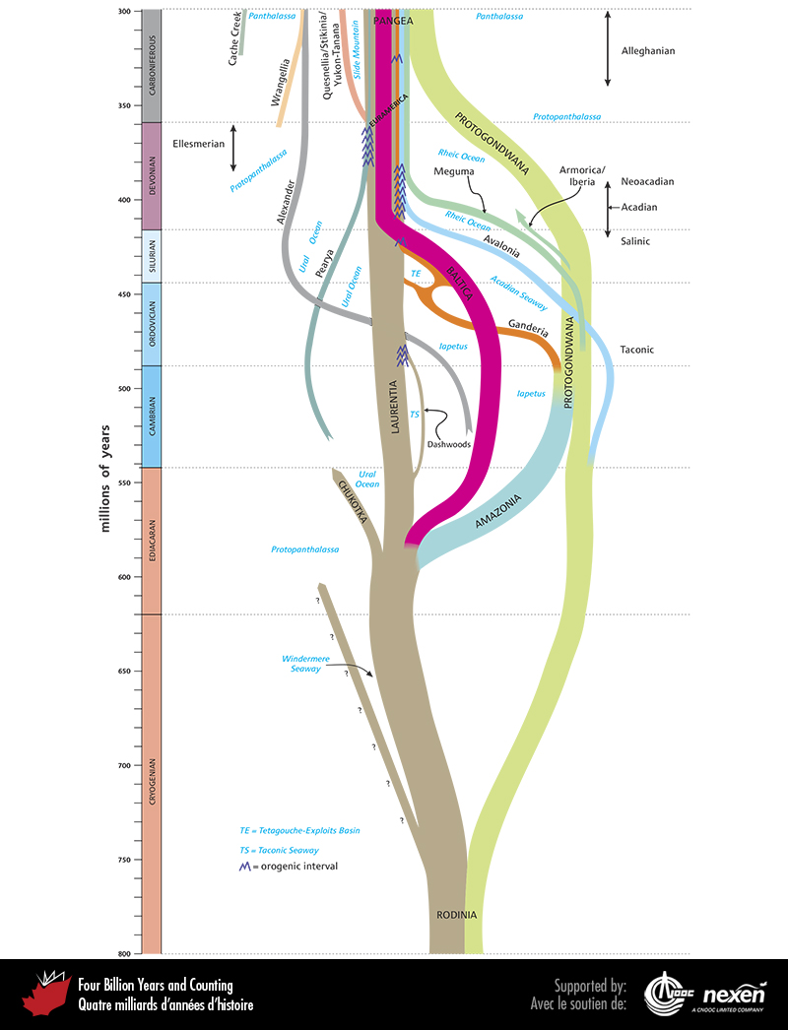
Notes:
Impressionistic representation of the evolution of continents, oceans, terranes (including microcontinents), orogenies (indicated at right and left), and other major geological features over the interval from 800 to about 300 million years ago. Oceans and seas are in blue lettering; otherwise colours are mainly for clarity and aesthetics. The main focus is on events that relate to the evolution of Canada. It is impossible to accurately represent all events that have occurred during this interval in two dimensions, but this figure provides a sense of how events are related through time and across Canada.
_______________________________
All photographic and graphic images (henceforth referred to as images) posted on this site are copyright of the persons and/or institutions indicated in the caption directly associated with each image. The copyright holders have agreed that you may use their images for educational, non-commercial purposes only and provided that they are credited in each instance of use. For all other uses you must contact the copyright holder.

Slide 9
Notes:
Flat-lying Ordovician limestone beds near the Alexandra Bridge in Ottawa, Ontario. ROB FENSOME.
______________________________
All photographic and graphic images (henceforth referred to as images) posted on this site are copyright of the persons and/or institutions indicated in the caption directly associated with each image. The copyright holders have agreed that you may use their images for educational, non-commercial purposes only and provided that they are credited in each instance of use. For all other uses you must contact the copyright holder.

Slide 10
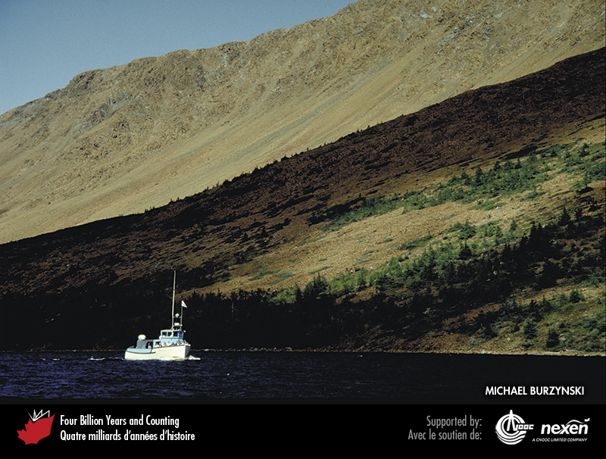
Notes:
The brown rocks on these slopes near Trout River Pond, Gros Morne National Park of Canada, Newfoundland, are part of the Bay of Islands ophiolite, which was thrust up from the mantle during the Taconic Orogeny, about 480 million years ago. MICHAEL BURZYNSKI.
_______________________________
All photographic and graphic images (henceforth referred to as images) posted on this site are copyright of the persons and/or institutions indicated in the caption directly associated with each image. The copyright holders have agreed that you may use their images for educational, non-commercial purposes only and provided that they are credited in each instance of use. For all other uses you must contact the copyright holder.

Slide 11
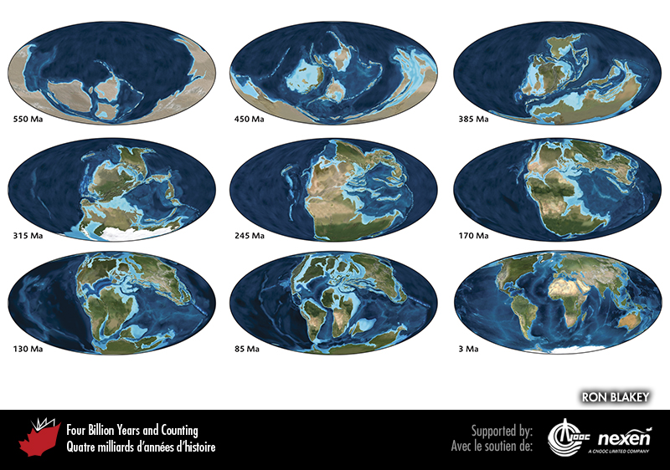
Notes:
Global paleogeographic reconstructions for selected times from the late Neoproterozoic to almost the present day. Ma = millions of years ago. RON BLAKEY.
_______________________________
All photographic and graphic images (henceforth referred to as images) posted on this site are copyright of the persons and/or institutions indicated in the caption directly associated with each image. The copyright holders have agreed that you may use their images for educational, non-commercial purposes only and provided that they are credited in each instance of use. For all other uses you must contact the copyright holder.

Slide 12
Notes:
Unconformity between Silurian and Carboniferous rocks at Quinn Point, Jacquet River, New Brunswick. The Silurian rocks were tilted during the Acadian Orogeny about 420 to 390 million years ago. ROB FENSOME.
_______________________________
All photographic and graphic images (henceforth referred to as images) posted on this site are copyright of the persons and/or institutions indicated in the caption directly associated with each image. The copyright holders have agreed that you may use their images for educational, non-commercial purposes only and provided that they are credited in each instance of use. For all other uses you must contact the copyright holder.

Slide 13
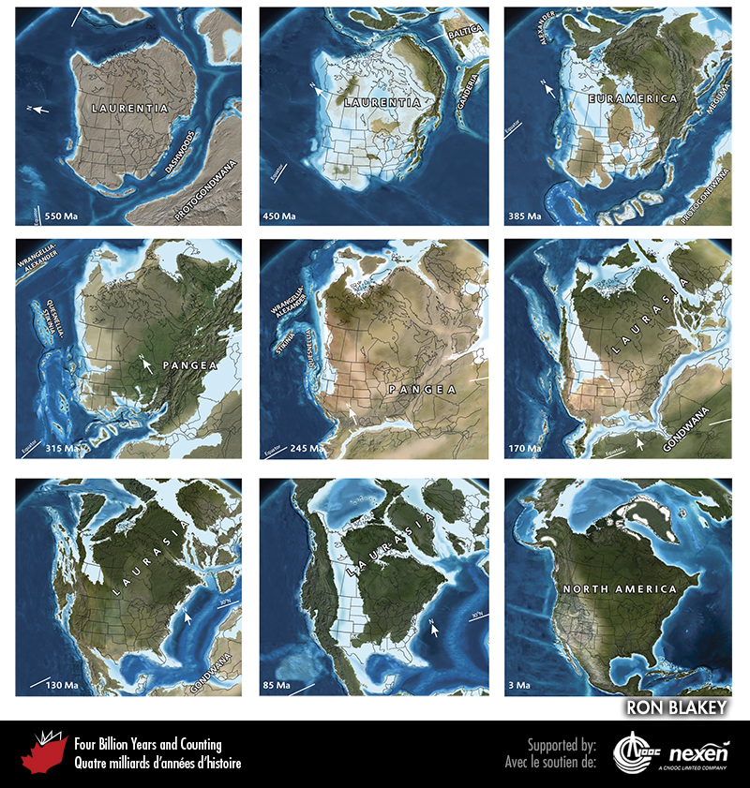
Notes:
Paleogeographic reconstructions of what was to become North America for selected times (ages in millions of years at top left of each map) from the late Neoproterozoic to almost the present time. Ma = millions of years ago. RON BLAKEY.
_______________________________
All photographic and graphic images (henceforth referred to as images) posted on this site are copyright of the persons and/or institutions indicated in the caption directly associated with each image. The copyright holders have agreed that you may use their images for educational, non-commercial purposes only and provided that they are credited in each instance of use. For all other uses you must contact the copyright holder.

Slide 14
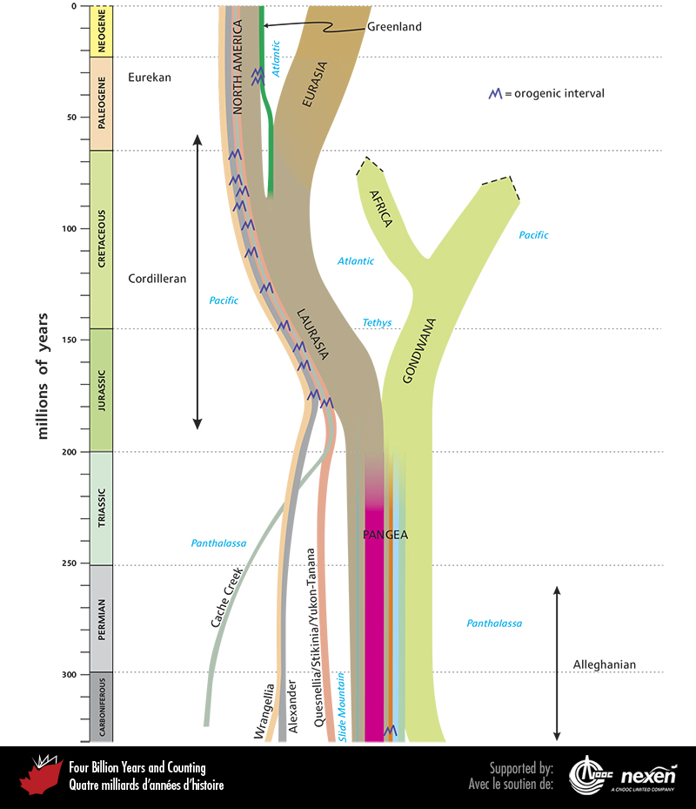
Notes:
Impressionistic representation of the evolution of continents, oceans, terranes (including microcontinents), orogenies (indicated at right and left), and other major geological features over the interval from 330 million years ago to the present. Oceans and seas are in blue lettering; otherwise colours are mainly for clarity and aesthetics. The main focus is on events that relate to the evolution of Canada. It is impossible to accurately represent all events that have occurred during this interval in two dimensions, but this figure provides a sense of how events are related through time and across Canada.
_______________________________
All photographic and graphic images (henceforth referred to as images) posted on this site are copyright of the persons and/or institutions indicated in the caption directly associated with each image. The copyright holders have agreed that you may use their images for educational, non-commercial purposes only and provided that they are credited in each instance of use. For all other uses you must contact the copyright holder.

Slide 15
Notes:
Folded early Cretaceous sandstone with interbeds of coal at the Cardinal River Mine, north of Cadomin, Alberta. These folds are evidence of the deformation that produced the thrust-and-fold belt of the Canadian Rocky Mountains during later Cretaceous to Paleocene time. The horizontal lines are the old pit roads. GODFREY NOWLAN.
_______________________________
All photographic and graphic images (henceforth referred to as images) posted on this site are copyright of the persons and/or institutions indicated in the caption directly associated with each image. The copyright holders have agreed that you may use their images for educational, non-commercial purposes only and provided that they are credited in each instance of use. For all other uses you must contact the copyright holder.

