Slide 1
BOX 8
All photographic and graphic images (henceforth referred to as images) posted on this site are copyright of the persons and/or institutions indicated in the caption directly associated with each image. The copyright holders have agreed that you may use their images for educational, non-commercial purposes only and provided that they are credited in each instance of use. For all other uses you must contact the copyright holder.

Slide 2
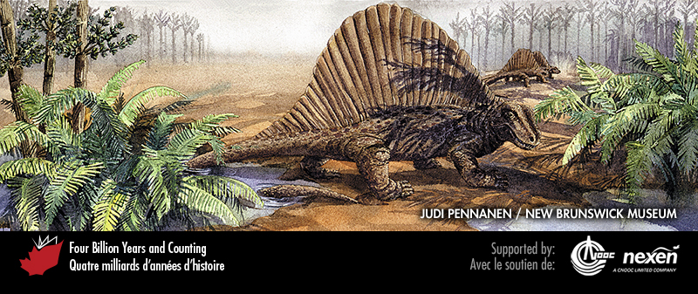
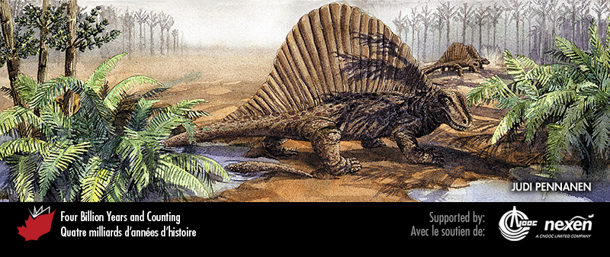
Notes:
A Permian scene from Prince Edward Island, showing a group of Bathygnathus (possibly equivalent to the more famous Dimetrodon, or at least a close cousin) prowling among cycads, with copses of small horsetail trees in the background. PAINTING BY JUDI PENNANEN, COURTESY OF THE NEW BRUNSWICK MUSEUM.
_______________________________
All photographic and graphic images (henceforth referred to as images) posted on this site are copyright of the persons and/or institutions indicated in the caption directly associated with each image. The copyright holders have agreed that you may use their images for educational, non-commercial purposes only and provided that they are credited in each instance of use. For all other uses you must contact the copyright holder.

Slide 3
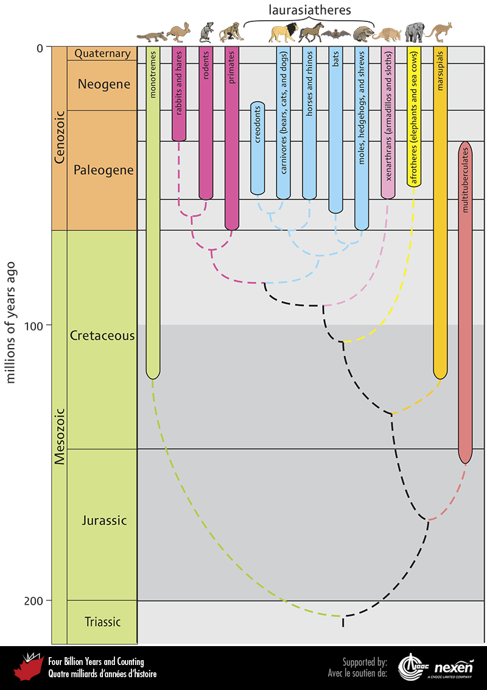
Notes:
Evolutionary relationships and the timing of first appearances and ranges of the main groups of mammals. Probable inter-relationships are shown by the dashed lines.
_______________________________
All photographic and graphic images (henceforth referred to as images) posted on this site are copyright of the persons and/or institutions indicated in the caption directly associated with each image. The copyright holders have agreed that you may use their images for educational, non-commercial purposes only and provided that they are credited in each instance of use. For all other uses you must contact the copyright holder.

Slide 4
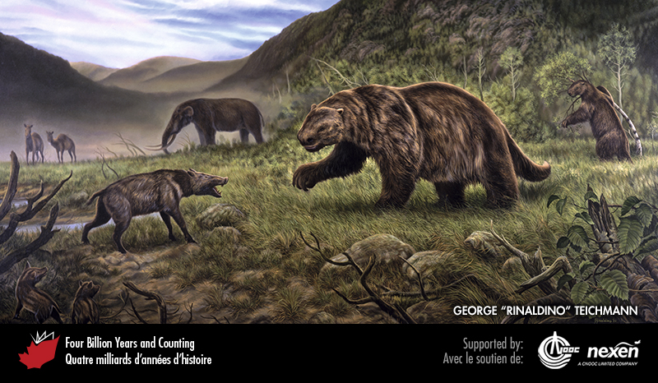
Notes:
Scene from Beringia during the last interglaciation (Chapter 11) depicting a faceoff between a peccary (a laurasiathere, with Eurasian ancestry) and giant ground sloth (a xenarthran, with South American ancestry). In the background is a mammoth (an afrothere, with African antecedants) and two camels (laurasiatheres). BERINGIA INTERGLACIAL PERIOD, COPYRIGHT GOVERNMENT OF YUKON / ARTIST GEORGE “RINALDINO” TEICHMANN 2001.
_______________________________
All photographic and graphic images (henceforth referred to as images) posted on this site are copyright of the persons and/or institutions indicated in the caption directly associated with each image. The copyright holders have agreed that you may use their images for educational, non-commercial purposes only and provided that they are credited in each instance of use. For all other uses you must contact the copyright holder.

