Slide 1
BOX 2
All photographic and graphic images (henceforth referred to as images) posted on this site are copyright of the persons and/or institutions indicated in the caption directly associated with each image. The copyright holders have agreed that you may use their images for educational, non-commercial purposes only and provided that they are credited in each instance of use. For all other uses you must contact the copyright holder.

Slide 2
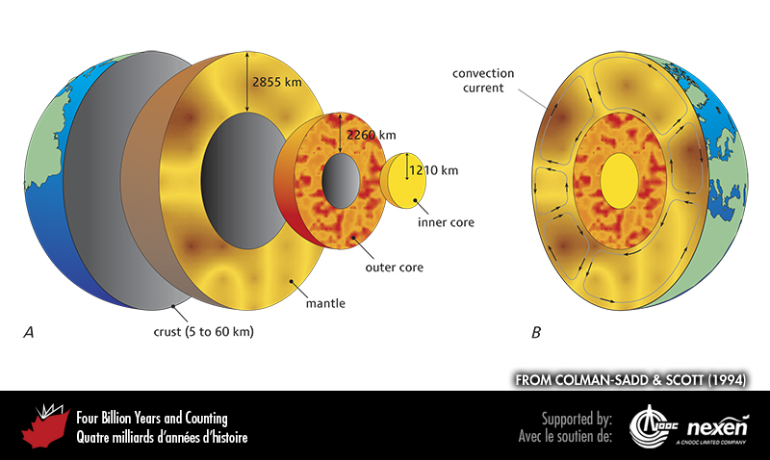
Notes:
Structure of the Earth. A shows approximate radius measurements of the different layers from crust to inner core. B shows the possible distribution of convection currents within the mantle. FROM COLMAN-SADD AND SCOTT (1994); USED WITH PERMISSION OF THE AUTHORS, THE GEOLOGICAL ASSOCIATION OF CANADA, AND THE GEOLOGICAL SURVEY OF NEWFOUNDLAND AND LABRADOR.
_______________________________
All photographic and graphic images (henceforth referred to as images) posted on this site are copyright of the persons and/or institutions indicated in the caption directly associated with each image. The copyright holders have agreed that you may use their images for educational, non-commercial purposes only and provided that they are credited in each instance of use. For all other uses you must contact the copyright holder.

Slide 3
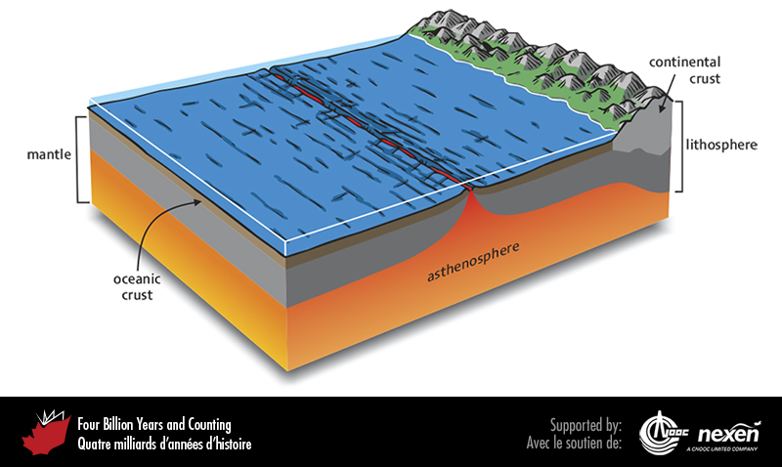
Notes:
Structure of the outer layers of the Earth in terms of both rock composition (crust versus mantle) and rock strength (lithosphere versus asthenosphere). The latter relationship is the most important when considering plate tectonics (Chapter 2) because the outer, stiff lithosphere, consisting of rigid crust and outermost mantle, forms plates that float on the more plastic asthenosphere.
_______________________________
All photographic and graphic images (henceforth referred to as images) posted on this site are copyright of the persons and/or institutions indicated in the caption directly associated with each image. The copyright holders have agreed that you may use their images for educational, non-commercial purposes only and provided that they are credited in each instance of use. For all other uses you must contact the copyright holder.

