Slide 1
CHAPTER 6 Part 2 of 2
All photographic and graphic images (henceforth referred to as images) posted on this site are copyright of the persons and/or institutions indicated in the caption directly associated with each image. The copyright holders have agreed that you may use their images for educational, non-commercial purposes only and provided that they are credited in each instance of use. For all other uses you must contact the copyright holder.

Slide 2
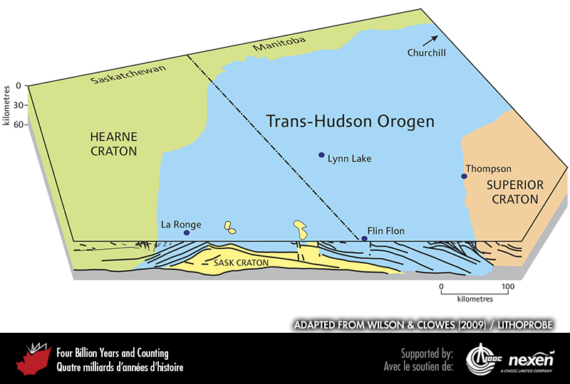
Notes:
Block diagram showing how the Sask Craton is caught between the western Superior and Hearne margins and accounts for the greater width of the Trans-Hudson Orogen in parts of northern Saskatchewan and Manitoba. ADAPTED FROM WILSON AND CLOWES (2009), COURTESY OF LITHOPROBE.
_______________________________
All photographic and graphic images (henceforth referred to as images) posted on this site are copyright of the persons and/or institutions indicated in the caption directly associated with each image. The copyright holders have agreed that you may use their images for educational, non-commercial purposes only and provided that they are credited in each instance of use. For all other uses you must contact the copyright holder.

Slide 3
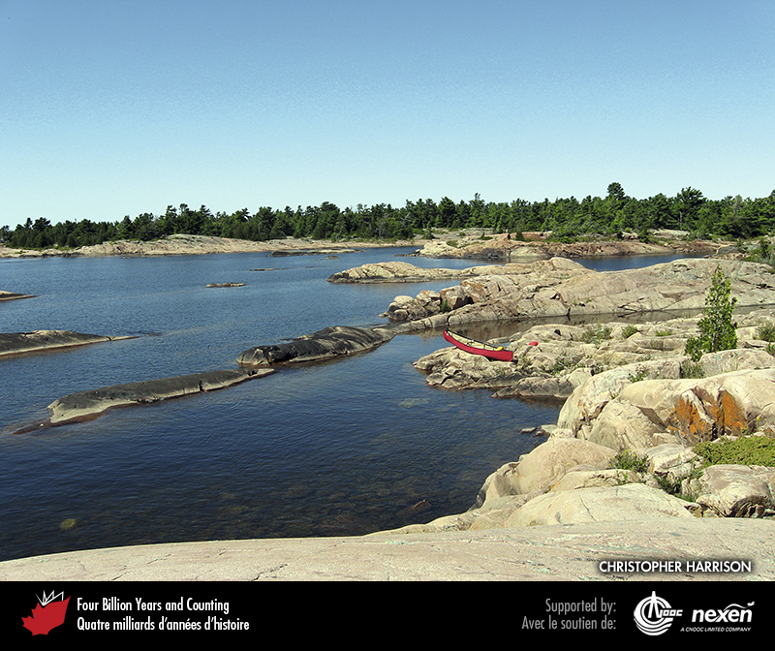
Notes:
Ice-sculpted, 1,650-million-year-old granite and gneiss on the south side of Philip Edward Island, Georgian Bay. These rocks formed in magmatic arcs of the Grenville Orogen on the southeastern side of Nuna. CHRISTOPHER HARRISON.
_______________________________
All photographic and graphic images (henceforth referred to as images) posted on this site are copyright of the persons and/or institutions indicated in the caption directly associated with each image. The copyright holders have agreed that you may use their images for educational, non-commercial purposes only and provided that they are credited in each instance of use. For all other uses you must contact the copyright holder.

Slide 4
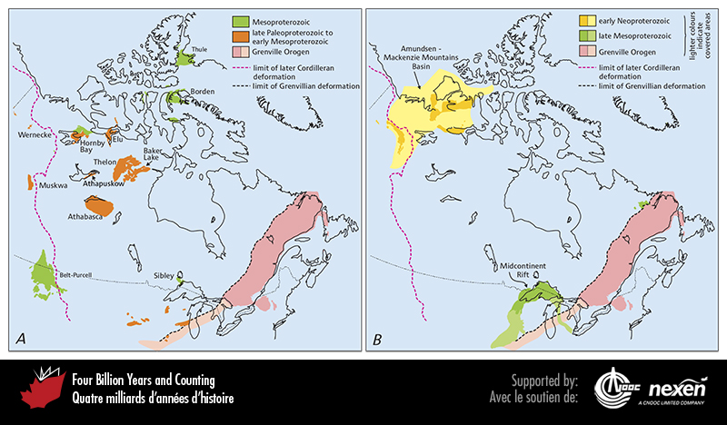
Notes:
Map showing the Grenville Orogen and the continental-interior basins that existed in what was to become part of North America during the intervals from 1,800 to 1,300 million years ago (A) and 1,300 to 750 million years ago (B). ADAPTED FROM VARIOUS SOURCES.
_______________________________
All photographic and graphic images (henceforth referred to as images) posted on this site are copyright of the persons and/or institutions indicated in the caption directly associated with each image. The copyright holders have agreed that you may use their images for educational, non-commercial purposes only and provided that they are credited in each instance of use. For all other uses you must contact the copyright holder.

Slide 5
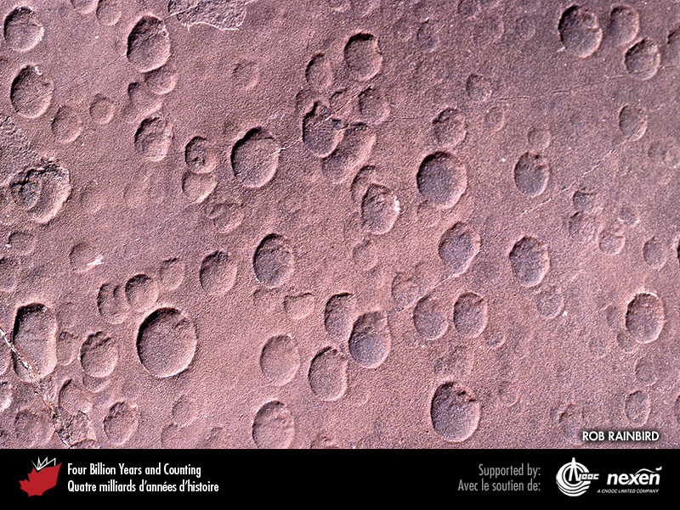
Notes:
Paleoproterozoic raindrop prints in redbeds of the Baker Lake Basin, Nunavut. ROB RAINBIRD.
_______________________________
All photographic and graphic images (henceforth referred to as images) posted on this site are copyright of the persons and/or institutions indicated in the caption directly associated with each image. The copyright holders have agreed that you may use their images for educational, non-commercial purposes only and provided that they are credited in each instance of use. For all other uses you must contact the copyright holder.

Slide 6
Notes:
Mesoproterozoic red argillite viewed from the Carthew-Alderson Trail, Waterton Lakes National Park of Canada, Alberta. W. LYNCH, COPYRIGHT PARKS CANADA.
_______________________________
All photographic and graphic images (henceforth referred to as images) posted on this site are copyright of the persons and/or institutions indicated in the caption directly associated with each image. The copyright holders have agreed that you may use their images for educational, non-commercial purposes only and provided that they are credited in each instance of use. For all other uses you must contact the copyright holder.

Slide 7
Notes:
Red Rock Canyon in Waterton Lakes National Park of Canada is aptly named for the red argillite (1,500 million years old), which was formed from iron-rich sediments deposited on ancient tidal mudflats. JOHN WILLIAM WEBB.
_______________________________
All photographic and graphic images (henceforth referred to as images) posted on this site are copyright of the persons and/or institutions indicated in the caption directly associated with each image. The copyright holders have agreed that you may use their images for educational, non-commercial purposes only and provided that they are credited in each instance of use. For all other uses you must contact the copyright holder.

Slide 8
Notes:
View north along the eastern flank of Adams Sound, south of the community of Arctic Bay on Baffin Island, Nunavut. Here, Mesoproterozoic lava flows (the steep face in the middle part of the cliff ) unconformably overlie Paleoproterozoic gneisses (the gentler slopes near the base of the cliff ). The red rocks near the top of the cliff are Mesoproterozoic marine sandstones of the Borden Basin. DARREL LONG.
_______________________________
All photographic and graphic images (henceforth referred to as images) posted on this site are copyright of the persons and/or institutions indicated in the caption directly associated with each image. The copyright holders have agreed that you may use their images for educational, non-commercial purposes only and provided that they are credited in each instance of use. For all other uses you must contact the copyright holder.

Slide 9
Notes:
The Coppermine Basalts, here exposed near Kugluktuk, Nunavut, were extruded 1,240 million years ago above a hot spot centred on Victoria Island. They are associated with the Mackenzie Dyke Swarm (Chapter 1). The Coppermine Basalts, named for the native copper they contain, consist of about 150 individual lava flows, each 10 to 25 metres thick. HANS WIELENS.
_______________________________
All photographic and graphic images (henceforth referred to as images) posted on this site are copyright of the persons and/or institutions indicated in the caption directly associated with each image. The copyright holders have agreed that you may use their images for educational, non-commercial purposes only and provided that they are credited in each instance of use. For all other uses you must contact the copyright holder.

Slide 10
Notes:
Mount Lister is an 850-metre-high bald massif on the north side of Tikkoatokak Bay, west of Nain, Labrador. It is underlain by massive pale grey anorthosite of the Nain region, intruded between 1,360 and 1,290 million years ago. BRUCE RYAN.
_______________________________
All photographic and graphic images (henceforth referred to as images) posted on this site are copyright of the persons and/or institutions indicated in the caption directly associated with each image. The copyright holders have agreed that you may use their images for educational, non-commercial purposes only and provided that they are credited in each instance of use. For all other uses you must contact the copyright holder.

Slide 11
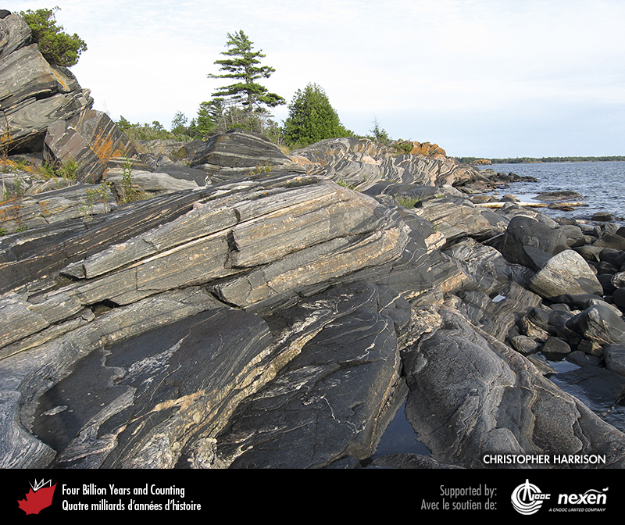
Notes:
These rocks on the western side of Franklin Island in Georgian Bay, Ontario, originated between 1,680 and 1,400 million years ago and were metamorphosed and deformed to folded gneiss during the Grenvillian Orogeny about 1,000 million years ago. CHRISTOPHER HARRISON.
_______________________________
All photographic and graphic images (henceforth referred to as images) posted on this site are copyright of the persons and/or institutions indicated in the caption directly associated with each image. The copyright holders have agreed that you may use their images for educational, non-commercial purposes only and provided that they are credited in each instance of use. For all other uses you must contact the copyright holder.

Slide 12
Notes:
Layering in this rock from Parry Sound, Ontario, is not sedimentary but was produced by intense heating and compression of many igneous intrusions deep within the crust during the Grenvillian Orogeny. DAVID CORRIGAN.
_______________________________
All photographic and graphic images (henceforth referred to as images) posted on this site are copyright of the persons and/or institutions indicated in the caption directly associated with each image. The copyright holders have agreed that you may use their images for educational, non-commercial purposes only and provided that they are credited in each instance of use. For all other uses you must contact the copyright holder.

Slide 13
Notes:
Neoproterozoic sandstones and shales of the Amundsen-Mackenzie Mountains Basin in the Backbone Ranges, Mackenzie Mountains, Northwest Territories. HENDRICK FALCK.
_______________________________
All photographic and graphic images (henceforth referred to as images) posted on this site are copyright of the persons and/or institutions indicated in the caption directly associated with each image. The copyright holders have agreed that you may use their images for educational, non-commercial purposes only and provided that they are credited in each instance of use. For all other uses you must contact the copyright holder.

Slide 14
Notes:
Redbeds at the base of this road cut on the Trans-Canada Highway, just east of Nipigon, Ontario, were deposited in the small Sibley Basin 1,550 to 1,400 million years ago. Above the redbeds is a mafic sill, intruded about 1,100 million years ago during formation of the Midcontinent Rift. GRAHAM WILSON.
_______________________________
All photographic and graphic images (henceforth referred to as images) posted on this site are copyright of the persons and/or institutions indicated in the caption directly associated with each image. The copyright holders have agreed that you may use their images for educational, non-commercial purposes only and provided that they are credited in each instance of use. For all other uses you must contact the copyright holder.

Slide 15
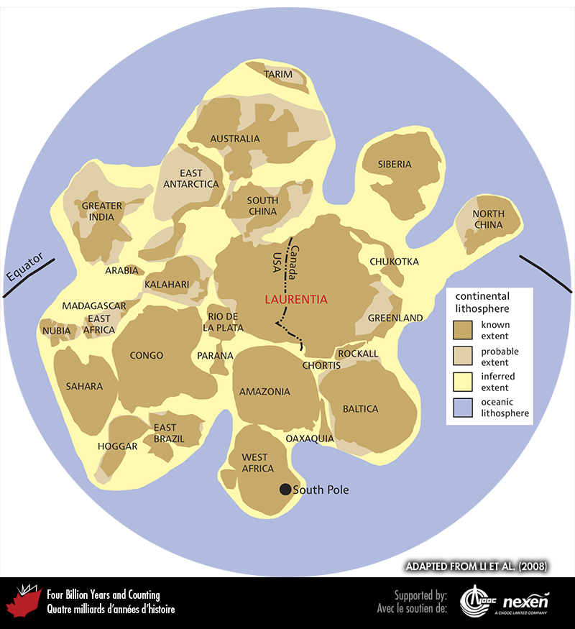
Notes:
Map of the Rodinia showing the possible distribution within that supercontinent of later continental elements. ADAPTED FROM LI E T AL. (2008).
_______________________________
All photographic and graphic images (henceforth referred to as images) posted on this site are copyright of the persons and/or institutions indicated in the caption directly associated with each image. The copyright holders have agreed that you may use their images for educational, non-commercial purposes only and provided that they are credited in each instance of use. For all other uses you must contact the copyright holder.

Slide 16
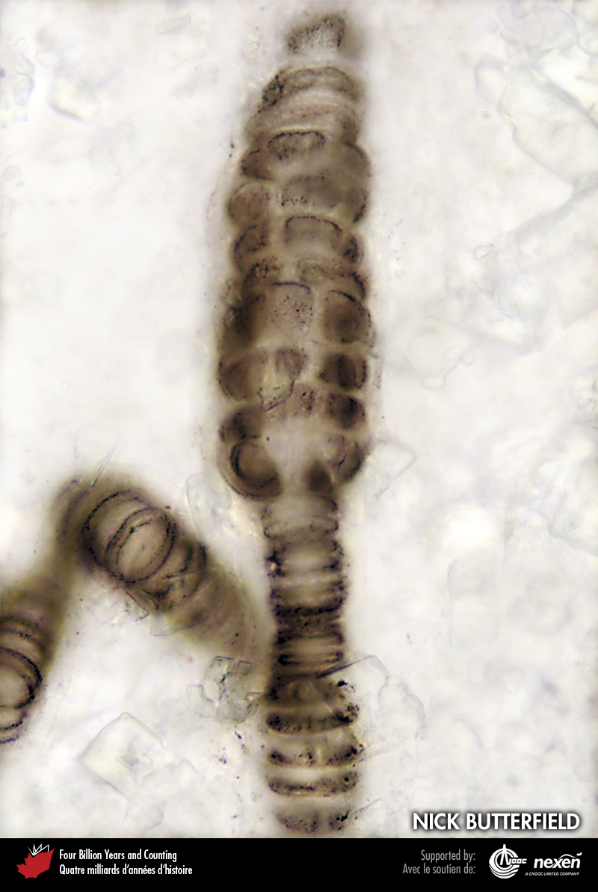
Notes:
Bangiomorpha pubescens, a red alga from Mesoproterozoic (1,200-million-year-old) rocks on Somerset Island, Nunavut. The specimen is just under 0.2 millimetres long. NICK BUTTERFIELD.
_______________________________
All photographic and graphic images (henceforth referred to as images) posted on this site are copyright of the persons and/or institutions indicated in the caption directly associated with each image. The copyright holders have agreed that you may use their images for educational, non-commercial purposes only and provided that they are credited in each instance of use. For all other uses you must contact the copyright holder.

Slide 17
Notes:
The microfossil Characodictyon, composed of calcium phosphate, from Yukon’s Mount Slipper in the Amundsen-Mackenzie Mountains Basin. PHOEBE COHEN.
_______________________________
All photographic and graphic images (henceforth referred to as images) posted on this site are copyright of the persons and/or institutions indicated in the caption directly associated with each image. The copyright holders have agreed that you may use their images for educational, non-commercial purposes only and provided that they are credited in each instance of use. For all other uses you must contact the copyright holder.

