Slide 1
CHAPTER 5 Part 2 of 2
All photographic and graphic images (henceforth referred to as images) posted on this site are copyright of the persons and/or institutions indicated in the caption directly associated with each image. The copyright holders have agreed that you may use their images for educational, non-commercial purposes only and provided that they are credited in each instance of use. For all other uses you must contact the copyright holder.

Slide 2
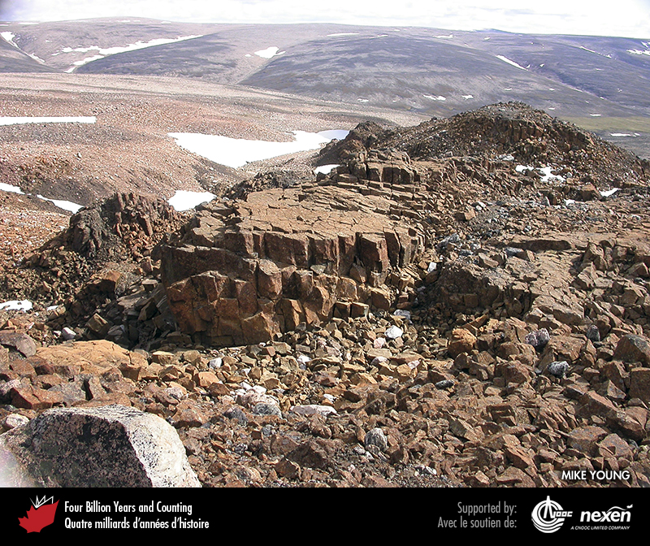
Notes:
Komatiite, dated to around 2,700 million years old, showing columnar jointing. These rocks are from the Rae Craton on northern Baffin Island, Nunavut. MIKE YOUNG.
_______________________________
All photographic and graphic images (henceforth referred to as images) posted on this site are copyright of the persons and/or institutions indicated in the caption directly associated with each image. The copyright holders have agreed that you may use their images for educational, non-commercial purposes only and provided that they are credited in each instance of use. For all other uses you must contact the copyright holder.

Slide 3
Notes:
Archean conglomerate from the James Bay region of northern Quebec. The conglomerate was originally a fluvial deposit that formed in a greenstone belt within the Superior Craton. It is about 2,700 million years old. JEAN GOUTIER.
______________________________
All photographic and graphic images (henceforth referred to as images) posted on this site are copyright of the persons and/or institutions indicated in the caption directly associated with each image. The copyright holders have agreed that you may use their images for educational, non-commercial purposes only and provided that they are credited in each instance of use. For all other uses you must contact the copyright holder.

Slide 4
Notes:
Folded Archean felsic gneisses (3,300 to 3,100 million years old) and mafic dykes (metamorphosed to amphibolite) of the North Atlantic Craton in the Hopedale area of Labrador. Mafic dykes, originally intruded typically as tabular sheets, bend and as here may break into smaller segments if the host rock is later deformed under high temperature and pressure. BRUCE RYAN.
_______________________________
All photographic and graphic images (henceforth referred to as images) posted on this site are copyright of the persons and/or institutions indicated in the caption directly associated with each image. The copyright holders have agreed that you may use their images for educational, non-commercial purposes only and provided that they are credited in each instance of use. For all other uses you must contact the copyright holder.

Slide 5
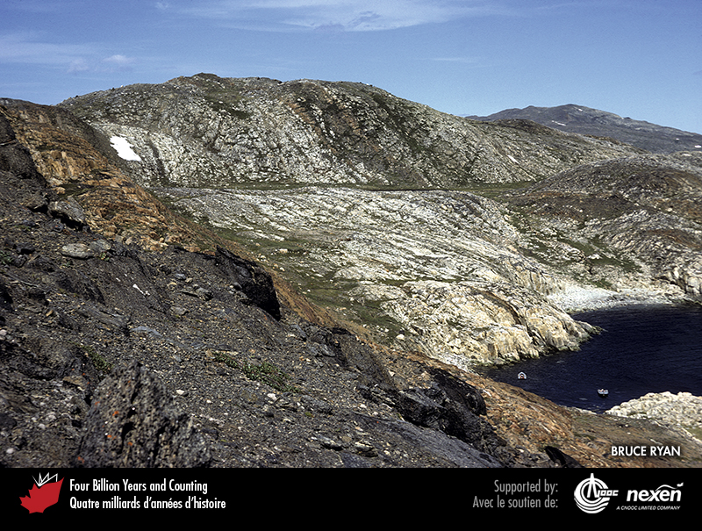
Notes:
This view of the North Atlantic Craton on Shuldham Island in Saglek Fiord captures the major elements of the geology of the Nain area of Labrador. All rocks are gneisses; the white-weathering exposures to the right and at centre are derived from granitic rocks, the brown-weathering exposures originated from sedimentary rocks, and the black-weathering exposures to the left are metamorphosed mafic volcanic rocks. BRUCE RYAN.
_______________________________
All photographic and graphic images (henceforth referred to as images) posted on this site are copyright of the persons and/or institutions indicated in the caption directly associated with each image. The copyright holders have agreed that you may use their images for educational, non-commercial purposes only and provided that they are credited in each instance of use. For all other uses you must contact the copyright holder.

Slide 6
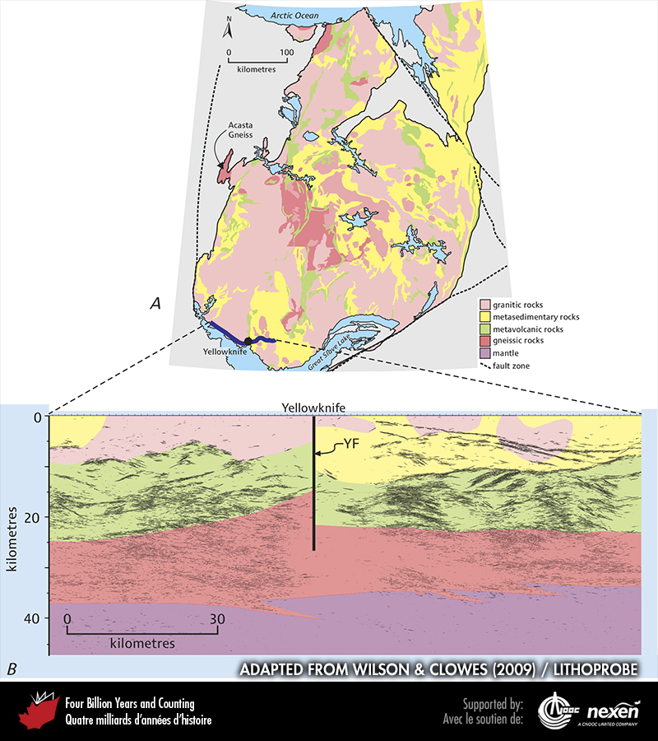
Notes:
A is a simplified geological map of the Slave Craton (coloured areas). B is a section across part of the southernmost Slave Craton showing basic geology interpreted from a LITHOPRO BE seismic section (blue line in A). YF indicates the Yellowknife Fault, a strike-slip fault in which the block to the right has moved toward the reader and the block to the left has moved away. ADAPTED FROM WILSON AND CLOWES (2009), COURTESY OF LITHOPROBE.
_______________________________
All photographic and graphic images (henceforth referred to as images) posted on this site are copyright of the persons and/or institutions indicated in the caption directly associated with each image. The copyright holders have agreed that you may use their images for educational, non-commercial purposes only and provided that they are credited in each instance of use. For all other uses you must contact the copyright holder.

Slide 7
Notes:
Archean pillow lava (top) deposited on cross-bedded sandstone (below), Slave Craton, Yellowknife, Northwest Territories. RAY PRICE.
_______________________________
All photographic and graphic images (henceforth referred to as images) posted on this site are copyright of the persons and/or institutions indicated in the caption directly associated with each image. The copyright holders have agreed that you may use their images for educational, non-commercial purposes only and provided that they are credited in each instance of use. For all other uses you must contact the copyright holder.

Slide 8
Notes:
Granite dykes intruding amphibolite within the Superior Craton near Lake Minto, Quebec. JOHN PERCIVAL.
_______________________________
All photographic and graphic images (henceforth referred to as images) posted on this site are copyright of the persons and/or institutions indicated in the caption directly associated with each image. The copyright holders have agreed that you may use their images for educational, non-commercial purposes only and provided that they are credited in each instance of use. For all other uses you must contact the copyright holder.

Slide 9
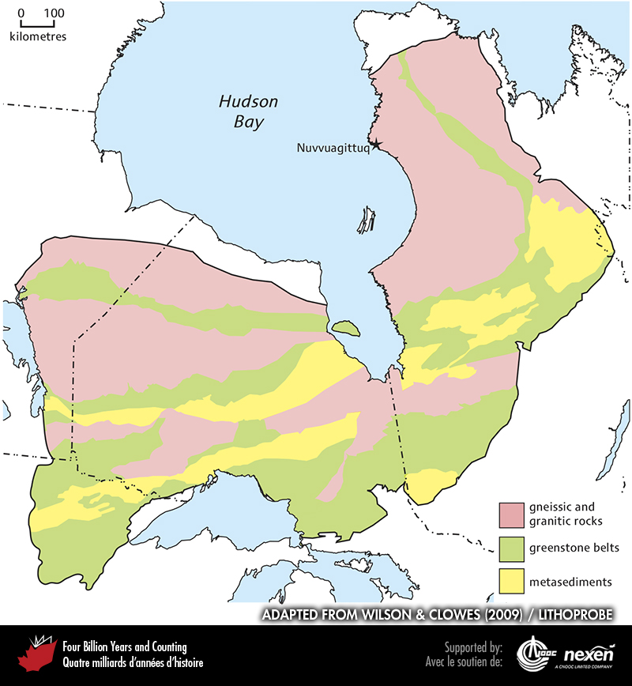
Notes:
Simplified geological map of the Superior Craton. ADAPTED FROM WILSON AND CLOWES (2009), COURTESY OF LITHOPROBE.
_______________________________
All photographic and graphic images (henceforth referred to as images) posted on this site are copyright of the persons and/or institutions indicated in the caption directly associated with each image. The copyright holders have agreed that you may use their images for educational, non-commercial purposes only and provided that they are credited in each instance of use. For all other uses you must contact the copyright holder.

Slide 10
Notes:
Modern stromatolites at Shark Bay, Western Australia. ANDREW KNOLL.
_______________________________
All photographic and graphic images (henceforth referred to as images) posted on this site are copyright of the persons and/or institutions indicated in the caption directly associated with each image. The copyright holders have agreed that you may use their images for educational, non-commercial purposes only and provided that they are credited in each instance of use. For all other uses you must contact the copyright holder.

Slide 11
Notes:
These large ovoid stromatolites in the western part of the Superior Craton, at Steep Rock Lake, Ontario, are 2,800 million years old. Note the hammer at bottom right-centre for scale. JOHN PERCIVAL.
_______________________________
All photographic and graphic images (henceforth referred to as images) posted on this site are copyright of the persons and/or institutions indicated in the caption directly associated with each image. The copyright holders have agreed that you may use their images for educational, non-commercial purposes only and provided that they are credited in each instance of use. For all other uses you must contact the copyright holder.

Slide 12
Notes:
Archean banded iron formation, about 2,700 million years old, from the Sherman Mine, Temagami, Ontario. This example consists of red jasper interbedded with grey magnetite. BRIAN PRATT.
_______________________________
All photographic and graphic images (henceforth referred to as images) posted on this site are copyright of the persons and/or institutions indicated in the caption directly associated with each image. The copyright holders have agreed that you may use their images for educational, non-commercial purposes only and provided that they are credited in each instance of use. For all other uses you must contact the copyright holder.

