Slide 1
CHAPTER 10 Part 3 of 3
All photographic and graphic images (henceforth referred to as images) posted on this site are copyright of the persons and/or institutions indicated in the caption directly associated with each image. The copyright holders have agreed that you may use their images for educational, non-commercial purposes only and provided that they are credited in each instance of use. For all other uses you must contact the copyright holder.

Slide 2
Notes:
A comparison of middle Cenozoic (left) and modern (right) river drainage basins of northern parts of North America. For much of the Cenozoic two small river systems drained into the Arctic Ocean, and most of the interior was drained by the vast Bell River System. Today, the Mackenzie River basin covers a large area of northwestern Canada. Note too how the river basins of Alaska and Yukon have changed (see pages 210–211). In the map at left, 1 = ancestral Porcupine River Basin, 2 = ancestral Peel River basin, 3 = ancestral Yukon River basin.
_______________________________
All photographic and graphic images (henceforth referred to as images) posted on this site are copyright of the persons and/or institutions indicated in the caption directly associated with each image. The copyright holders have agreed that you may use their images for educational, non-commercial purposes only and provided that they are credited in each instance of use. For all other uses you must contact the copyright holder.

Slide 3
Notes:
Tertiary conglomerate, originally fluvial gravels, Cypress Hills, southwestern Saskatchewan. FLOYD WIST.
_______________________________
All photographic and graphic images (henceforth referred to as images) posted on this site are copyright of the persons and/or institutions indicated in the caption directly associated with each image. The copyright holders have agreed that you may use their images for educational, non-commercial purposes only and provided that they are credited in each instance of use. For all other uses you must contact the copyright holder.

Slide 4
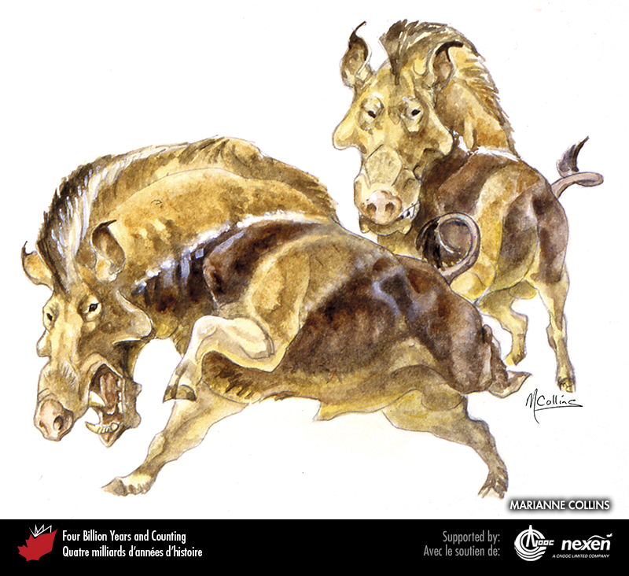
Notes:
An angry-looking pair of entelodonts, pig-like animals whose remains have been found in Eocene to Miocene deposits of the Prairies. ART BY AND COPYRIGHT OF MARIANNE COLLINS, USED WITH THE ARTIST'S PERMISSION.
_______________________________
All photographic and graphic images (henceforth referred to as images) posted on this site are copyright of the persons and/or institutions indicated in the caption directly associated with each image. The copyright holders have agreed that you may use their images for educational, non-commercial purposes only and provided that they are credited in each instance of use. For all other uses you must contact the copyright holder.

Slide 5
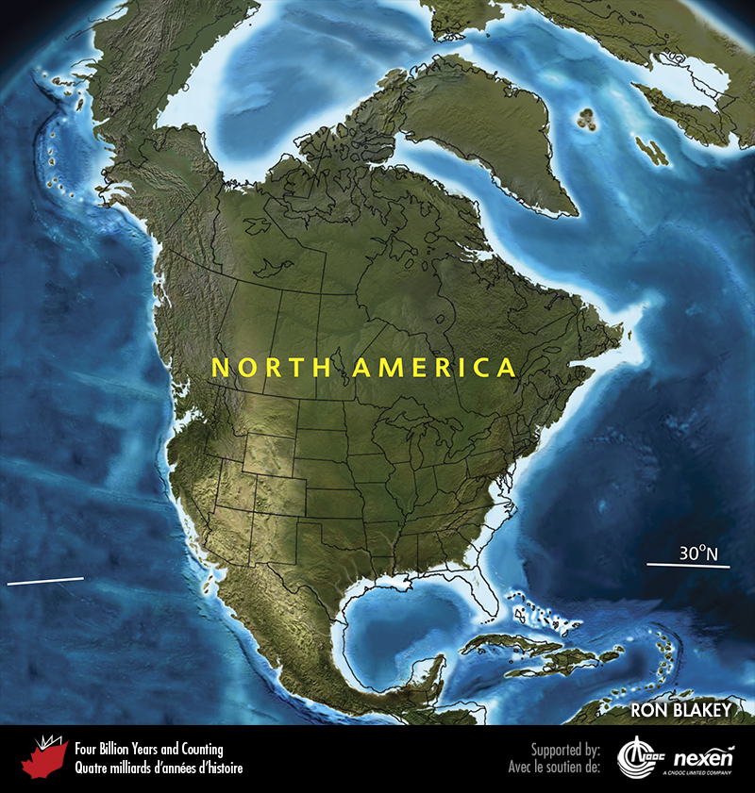
Notes:
Paleogeography of North America and adjacent regions in the Miocene, 15 million years ago. Land is shown in brown, with shading showing topography. The lighter blue areas represent possible coastal or nearshore areas, darker blue represents deeper ocean waters, and black indicates trenches. Aspects of modern geography are shown for orientation.
_______________________________
All photographic and graphic images (henceforth referred to as images) posted on this site are copyright of the persons and/or institutions indicated in the caption directly associated with each image. The copyright holders have agreed that you may use their images for educational, non-commercial purposes only and provided that they are credited in each instance of use. For all other uses you must contact the copyright holder.

Slide 6
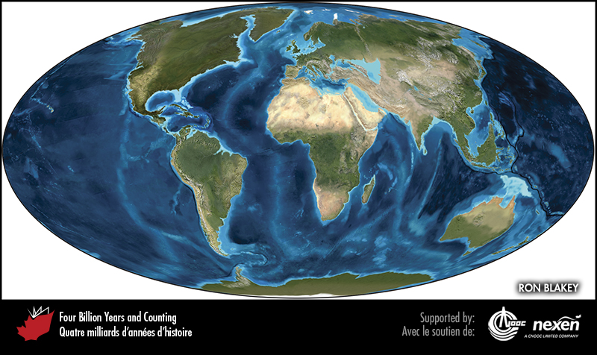
Notes:
Global paleogeography 15 million years ago, during the Miocene. Colours as for previous figure.
_______________________________
All photographic and graphic images (henceforth referred to as images) posted on this site are copyright of the persons and/or institutions indicated in the caption directly associated with each image. The copyright holders have agreed that you may use their images for educational, non-commercial purposes only and provided that they are credited in each instance of use. For all other uses you must contact the copyright holder.

Slide 7
Notes:
Mount Garibaldi, a stratovolcano of the Cascade Magmatic Arc northeast of Squamish, British Columbia, was last active about 13,000 years ago. This view is from the northwest. PAUL ADAM.
_______________________________
All photographic and graphic images (henceforth referred to as images) posted on this site are copyright of the persons and/or institutions indicated in the caption directly associated with each image. The copyright holders have agreed that you may use their images for educational, non-commercial purposes only and provided that they are credited in each instance of use. For all other uses you must contact the copyright holder.

Slide 8
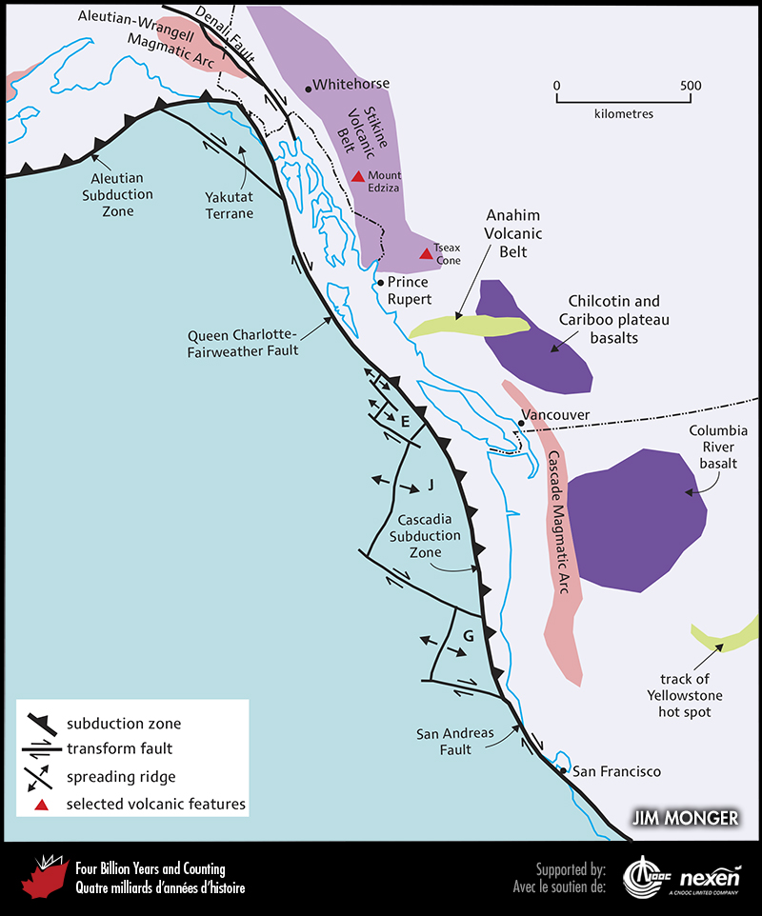
Notes:
The location of active volcanic areas in western North America and the distribution of plates and plate boundaries associated with the continent’s western margin and the northeastern Pacific Ocean. The Columbia River basalts form a huge area of volcanics in the northwestern United States akin to the Chilcotin and Cariboo basalts of British Columbia. E = Explorer Plate, J = Juan de Fuca Plate, G = Gorda Plate.
_______________________________
All photographic and graphic images (henceforth referred to as images) posted on this site are copyright of the persons and/or institutions indicated in the caption directly associated with each image. The copyright holders have agreed that you may use their images for educational, non-commercial purposes only and provided that they are credited in each instance of use. For all other uses you must contact the copyright holder.

Slide 9
Notes:
Close-up of the base of a lava flow over till at Mushbowl Hill, Wells Gray Provincial Park, British Columbia. The volcanic rocks at Wells Gray are possibly related to the Anahim Volcanic Belt. DALE GREGORY.
_______________________________
All photographic and graphic images (henceforth referred to as images) posted on this site are copyright of the persons and/or institutions indicated in the caption directly associated with each image. The copyright holders have agreed that you may use their images for educational, non-commercial purposes only and provided that they are credited in each instance of use. For all other uses you must contact the copyright holder.

Slide 10
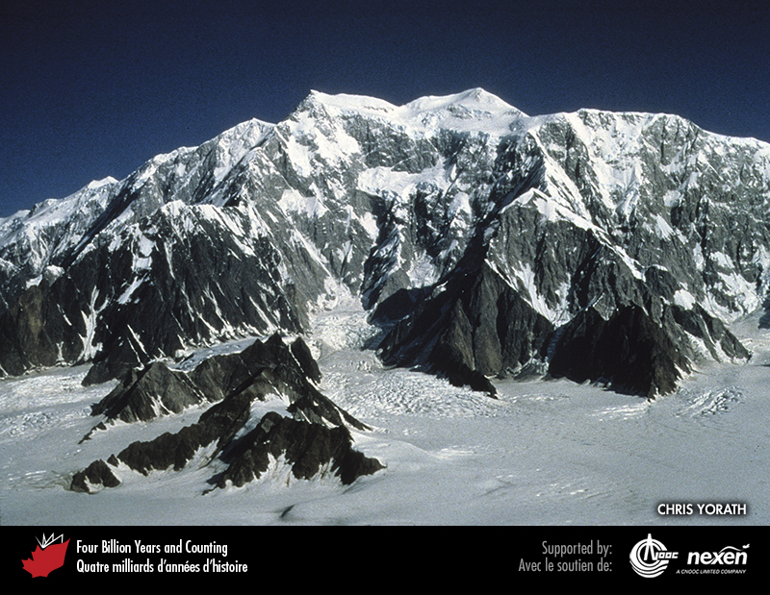
Notes:
At 5,951 metres, Mount Logan in the St. Elias Mountains of Yukon is the highest peak in Canada. Mount Logan consists mainly of Jurassic and Cretaceous granitic rocks. The lower southwestern slopes are underlain by early to late Cretaceous sedimentary strata of the Chugach Terrane. A fault, clearly visible here as the abrupt change from grey to dark brown, separates the granitic rocks from the sedimentary strata. CHRIS YORATH.
_______________________________
All photographic and graphic images (henceforth referred to as images) posted on this site are copyright of the persons and/or institutions indicated in the caption directly associated with each image. The copyright holders have agreed that you may use their images for educational, non-commercial purposes only and provided that they are credited in each instance of use. For all other uses you must contact the copyright holder.

Slide 11
Notes:
Mount Waddington, formed of late Cretaceous gneiss, is the highest peak in the predominantly granitic Coast Mountains. JOHN SCURLOCK.
_______________________________
All photographic and graphic images (henceforth referred to as images) posted on this site are copyright of the persons and/or institutions indicated in the caption directly associated with each image. The copyright holders have agreed that you may use their images for educational, non-commercial purposes only and provided that they are credited in each instance of use. For all other uses you must contact the copyright holder.

Slide 12
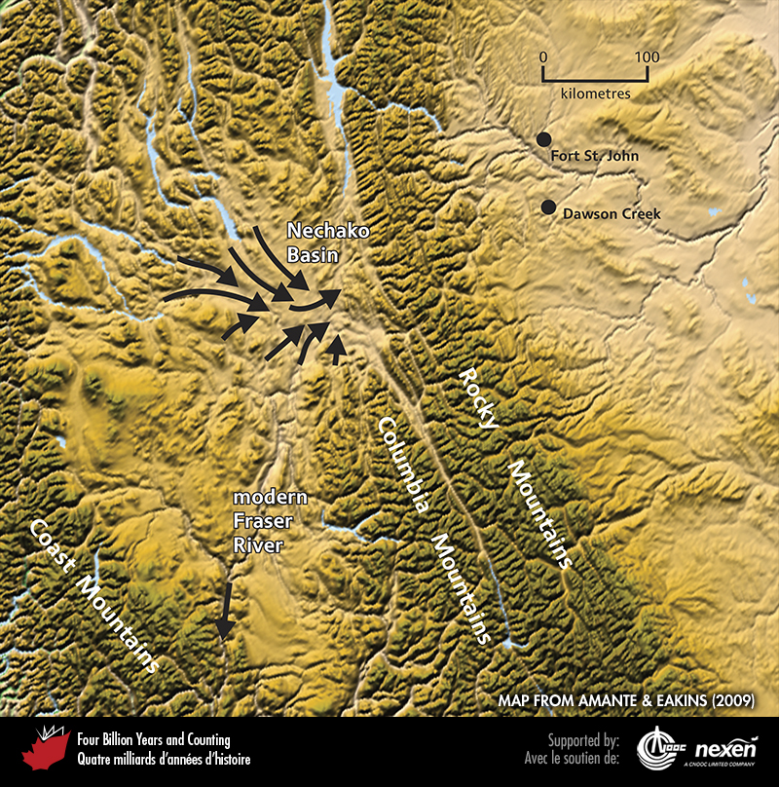
Notes:
Physiography of the central Canadian Cordillera showing how valleys (arrows) lead into the Nechako Basin at angles that suggest the original flow of the headwaters of the Fraser River was to the east. The geologically recent rise of the Rocky Mountains blocked the route and flow was diverted southwestward down the modern Fraser River. BASE MAP FROM AMANTE AND EAKINS (2009).
_______________________________
All photographic and graphic images (henceforth referred to as images) posted on this site are copyright of the persons and/or institutions indicated in the caption directly associated with each image. The copyright holders have agreed that you may use their images for educational, non-commercial purposes only and provided that they are credited in each instance of use. For all other uses you must contact the copyright holder.

Slide 13
Notes:
The modern Fraser River near Big Bar Creek, British Columbia, flows in a deep inner Holocene valley incised into a broader pre-glacial valley. Terraces mark former levels of the valley floor. The Fraser River now flows south and southwest to the Pacific, but during the Miocene and Pliocene it flowed northward, then eastward. JOHN CLAGUE.
_______________________________
All photographic and graphic images (henceforth referred to as images) posted on this site are copyright of the persons and/or institutions indicated in the caption directly associated with each image. The copyright holders have agreed that you may use their images for educational, non-commercial purposes only and provided that they are credited in each instance of use. For all other uses you must contact the copyright holder.

Slide 14
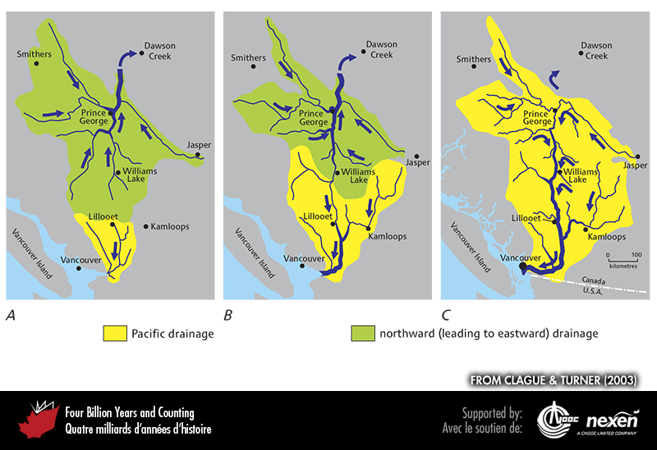
Notes:
The evolution of the Fraser watershed in British Columbia. A shows the situation prior to the Ice Age, when the Fraser was a small coastal river. B shows an expanded Fraser system as the river worked its headwaters inland and the watershed captured the upper reaches of other streams. C shows the modern drainage. ADAPTED FROM A GRAPHIC BY RICHARD FRANKLIN FOR CLAGUE AND TURNER (2003), USED WITH PERMISSION FROM TRICOUNI PRESS.
______________________________
All photographic and graphic images (henceforth referred to as images) posted on this site are copyright of the persons and/or institutions indicated in the caption directly associated with each image. The copyright holders have agreed that you may use their images for educational, non-commercial purposes only and provided that they are credited in each instance of use. For all other uses you must contact the copyright holder.

Slide 15
Notes:
Reconstruction of Puijila darwini swimming. This creature was a “walking seal”, intermediate between terrestrial mammals and pinnipeds. PAINTING BY ALEX TIRABASSO, COPYRIGHT CANADIAN MUSEUM OF NATURE.
_______________________________
All photographic and graphic images (henceforth referred to as images) posted on this site are copyright of the persons and/or institutions indicated in the caption directly associated with each image. The copyright holders have agreed that you may use their images for educational, non-commercial purposes only and provided that they are credited in each instance of use. For all other uses you must contact the copyright holder.

Slide 16
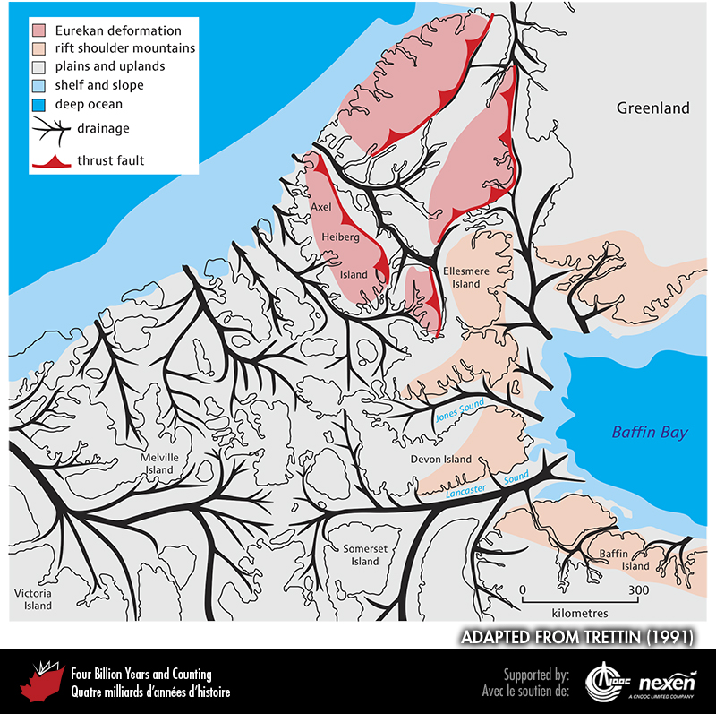
Notes:
Late Cenozoic paleogeography of the region that was to become the Arctic Islands, showing the courses of major rivers. The valleys of these rivers were broadened and deepened by glaciers over the past 3 million years, so that when the ice receded after the latest glacial advance, the valleys became sea channels and the higher areas between them became the modern islands. Also shown is the distribution of rift-shoulder mountains flanking Baffin Bay and the mountains produced by the Eurekan Orogeny. ADAPTED FROM TRETTIN (1991), REPRODUCED WITH THE PERMISSION OF NATURAL RESOURCES CANADA, COURTESY OF THE GEOLOGICAL SURVEY OF CANADA.
_______________________________
All photographic and graphic images (henceforth referred to as images) posted on this site are copyright of the persons and/or institutions indicated in the caption directly associated with each image. The copyright holders have agreed that you may use their images for educational, non-commercial purposes only and provided that they are credited in each instance of use. For all other uses you must contact the copyright holder.

Slide 17
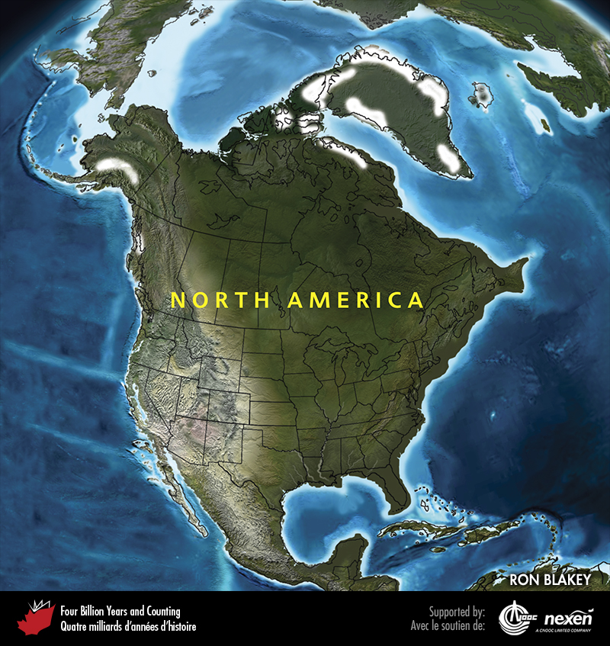
Notes:
Paleogeography of North America and adjacent regions in the Pliocene, 3 million years ago. Land is shown in brown, with shading showing topography. The lighter blue areas represent possible coastal or nearshore areas, darker blue represents deeper ocean waters, and black indicates trenches. Aspects of modern geography are shown for orientation.
_______________________________
All photographic and graphic images (henceforth referred to as images) posted on this site are copyright of the persons and/or institutions indicated in the caption directly associated with each image. The copyright holders have agreed that you may use their images for educational, non-commercial purposes only and provided that they are credited in each instance of use. For all other uses you must contact the copyright holder.

Slide 18
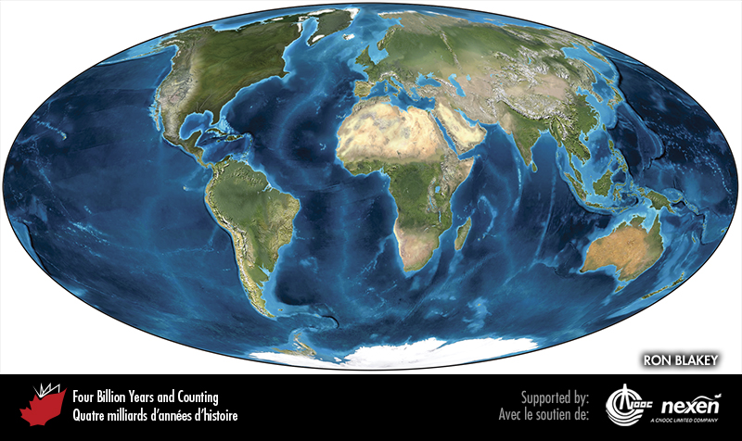
Notes:
Global paleogeography of the Pliocene, 3 million years ago. Colours as for previous figure.
_______________________________
All photographic and graphic images (henceforth referred to as images) posted on this site are copyright of the persons and/or institutions indicated in the caption directly associated with each image. The copyright holders have agreed that you may use their images for educational, non-commercial purposes only and provided that they are credited in each instance of use. For all other uses you must contact the copyright holder.

Slide 19
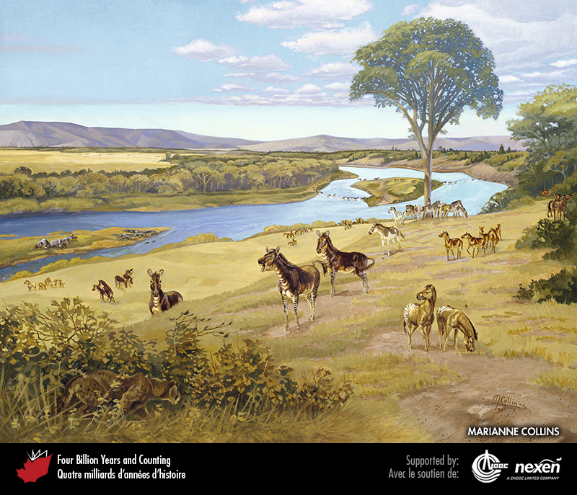
Notes:
A view reminiscent of the Wood Mountain area of Saskatchewan during the Miocene. The foreground is dominated by Merychippus, a three-toed horse, while a group of Merycodus, an extinct pronghorn, look on in the middle distance at right. Painting copyright Marianne Collins, artist. ART BY AND COPYRIGHT OF MARIANNE COLLINS, USED WITH THE ARTIST'S PERMISSION.
_______________________________
All photographic and graphic images (henceforth referred to as images) posted on this site are copyright of the persons and/or institutions indicated in the caption directly associated with each image. The copyright holders have agreed that you may use their images for educational, non-commercial purposes only and provided that they are credited in each instance of use. For all other uses you must contact the copyright holder.

