Slide 1
CHAPTER 7 Part 3 of 4
All photographic and graphic images (henceforth referred to as images) posted on this site are copyright of the persons and/or institutions indicated in the caption directly associated with each image. The copyright holders have agreed that you may use their images for educational, non-commercial purposes only and provided that they are credited in each instance of use. For all other uses you must contact the copyright holder.

Slide 2
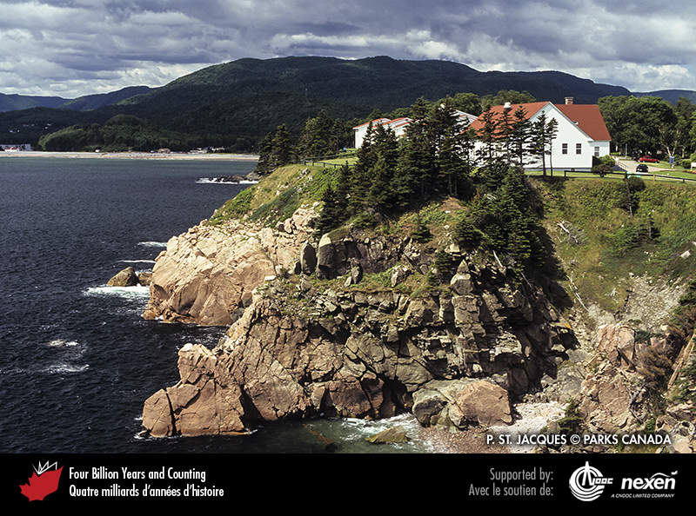
Notes:
Ediacaran diorite intruded by late Cambrian granite at Middle Head, Cape Breton Highlands National Park of Canada, Nova Scotia. These rocks were part of Ganderia. P. ST. JACQUES, COPYRIGHT PARKS CANADA.
_______________________________
All photographic and graphic images (henceforth referred to as images) posted on this site are copyright of the persons and/or institutions indicated in the caption directly associated with each image. The copyright holders have agreed that you may use their images for educational, non-commercial purposes only and provided that they are credited in each instance of use. For all other uses you must contact the copyright holder.

Slide 3
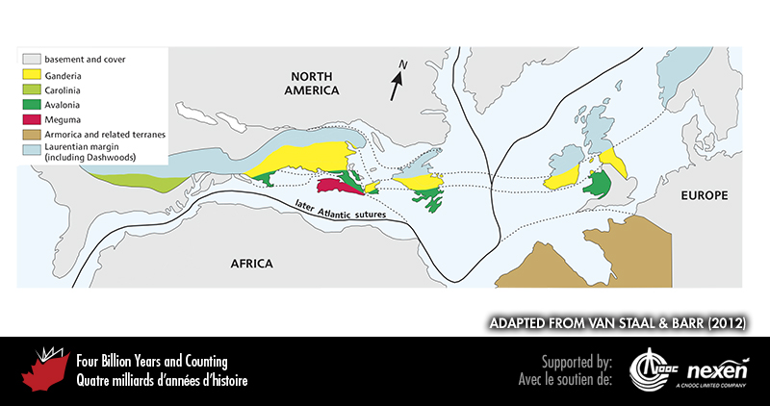
Notes:
Geological collage of terranes as distributed today in North Atlantic borderlands, but with later oceanic lithosphere removed to better represent their relationships in the late Paleozoic. This distribution has been complicated by latest- and post-Paleozoic tectonic activity, such as movement along strike-slip faults, so the match in not perfect. And we do not have a full understanding of the extension of the terranes beneath the cover of young rocks. ADAPTED FROM VAN STAAL AND BARR (2012).
_______________________________
All photographic and graphic images (henceforth referred to as images) posted on this site are copyright of the persons and/or institutions indicated in the caption directly associated with each image. The copyright holders have agreed that you may use their images for educational, non-commercial purposes only and provided that they are credited in each instance of use. For all other uses you must contact the copyright holder.

Slide 4
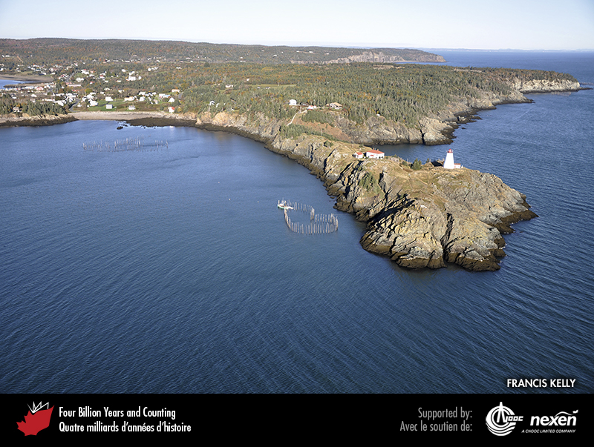
Notes:
Neoproterozoic marine sedimentary rocks of Ganderia, exposed at Swallowtail Head, Grand Manan Island, New Brunswick. FRANCIS KELLY, COURTESY OF FISHERIES AND OCEANS CANADA.
_______________________________
All photographic and graphic images (henceforth referred to as images) posted on this site are copyright of the persons and/or institutions indicated in the caption directly associated with each image. The copyright holders have agreed that you may use their images for educational, non-commercial purposes only and provided that they are credited in each instance of use. For all other uses you must contact the copyright holder.

Slide 5
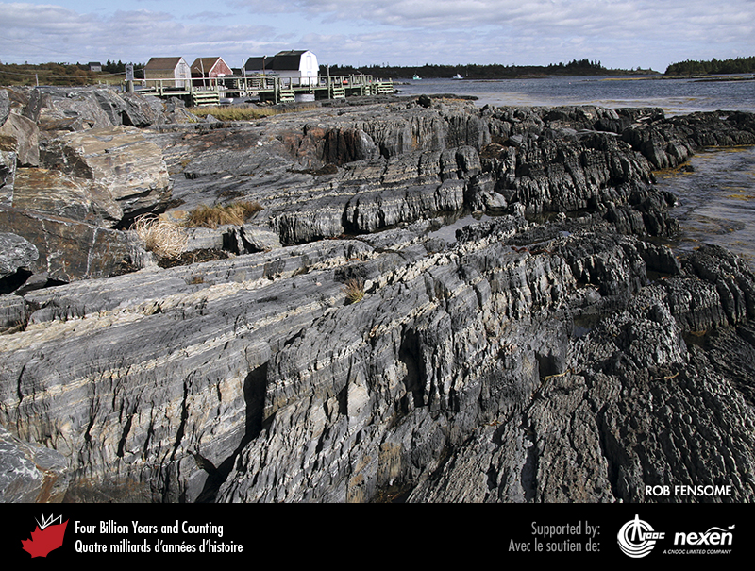
Notes:
Early Ordovician metasedimentary rocks of the Meguma Terrane at Blue Rocks, near Lunenburg, Nova Scotia. The original bedding is reflected in the lighter and darker bands. These rocks were tilted and metamorphosed during the Neoacadian Orogeny (Chapter 8). ROB FENSOME.
_______________________________
All photographic and graphic images (henceforth referred to as images) posted on this site are copyright of the persons and/or institutions indicated in the caption directly associated with each image. The copyright holders have agreed that you may use their images for educational, non-commercial purposes only and provided that they are credited in each instance of use. For all other uses you must contact the copyright holder.

Slide 6
Notes:
The dark band seen in this aerial view of Brock River, Tuktut Nogait National Park of Canada, Northwest Territories, is a mafic sill associated with the 720-million-year-old Franklin Dyke Swarm. The sill cuts through later Neoproterozoic sediments of the Amundsen-Mackenzie Mountains Basin. HANS WIELENS.
_______________________________
All photographic and graphic images (henceforth referred to as images) posted on this site are copyright of the persons and/or institutions indicated in the caption directly associated with each image. The copyright holders have agreed that you may use their images for educational, non-commercial purposes only and provided that they are credited in each instance of use. For all other uses you must contact the copyright holder.

Slide 7
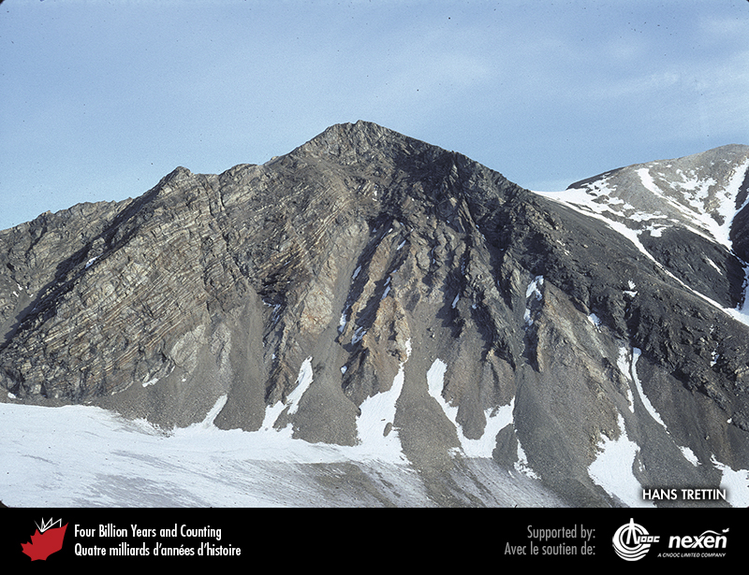
Notes:
Rocks northeast of Ayles Fiord at the northern tip of Ellesmere Island, Nunavut, record the geological history of Pearya, a continental fragment that drifted within the Ural Ocean during Cambrian and Ordovician times. This outcrop shows an anticline, with latest Neoproterozoic or Cambrian schist and quartzite overlying Mesoproterozoic gneiss. HANS TRETTIN.
_______________________________
All photographic and graphic images (henceforth referred to as images) posted on this site are copyright of the persons and/or institutions indicated in the caption directly associated with each image. The copyright holders have agreed that you may use their images for educational, non-commercial purposes only and provided that they are credited in each instance of use. For all other uses you must contact the copyright holder.

Slide 8
Notes:
Section from north to south through the Neoproterozoic to Ordovician rocks of Ellesmere Island, reconstructed to show how they would have appeared at the end of the Ordovician. Notice that older rocks were deposited in less extensive, fault-bounded rift basins and younger rocks are distributed more broadly over a passive margin, with strata thickening oceanward. This pattern is similar to that along the early Paleozoic Cordilleran margin and the Atlantic margin off eastern Canada today.
_______________________________
All photographic and graphic images (henceforth referred to as images) posted on this site are copyright of the persons and/or institutions indicated in the caption directly associated with each image. The copyright holders have agreed that you may use their images for educational, non-commercial purposes only and provided that they are credited in each instance of use. For all other uses you must contact the copyright holder.

Slide 9
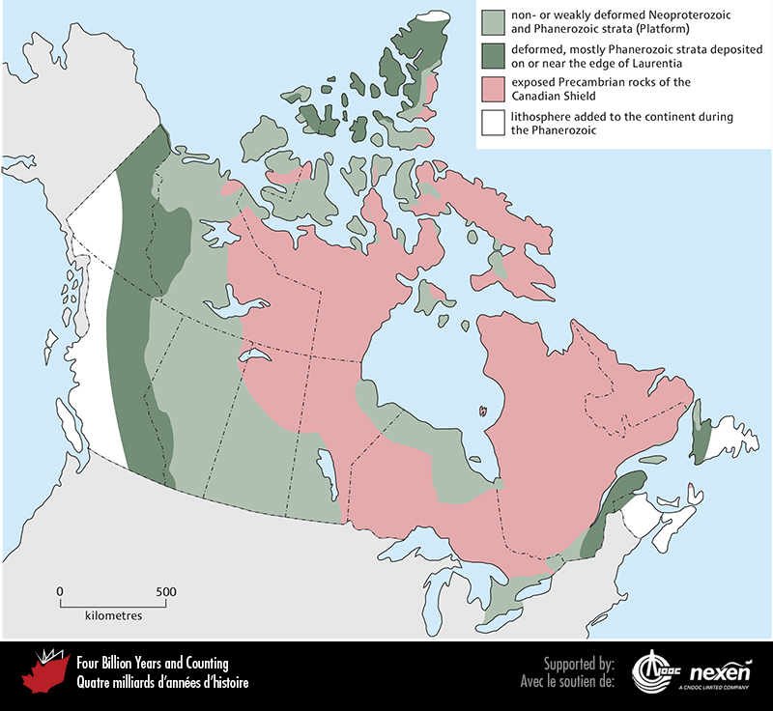
Notes:
The modern geological structure of Canada in part reflects early Paleozoic geography, with a large part of the former continent of Laurentia central to the story. The white areas to the far west, far east, and at the tip of Ellesmere Island in the far north are the only parts of Canada not underlain by the former continent. These areas are largely composed of terranes that have accreted during the past 550 million years, crumpling the edges of the former Laurentian continent in the process, as shown by the dark green areas. Light green represents areas of relatively undeformed strata formed during the past 550 million years. Pink represents the Canadian Shield, the exposed core of Laurentia, which was once also covered by a blanket of Phanerozoic sediment. ADAPTED FROM VARIOUS SOURCES.
_______________________________
All photographic and graphic images (henceforth referred to as images) posted on this site are copyright of the persons and/or institutions indicated in the caption directly associated with each image. The copyright holders have agreed that you may use their images for educational, non-commercial purposes only and provided that they are credited in each instance of use. For all other uses you must contact the copyright holder.

Slide 10
Notes:
Ordovician strata overlying crystalline rocks of the Grenville Orogen, Trenton, Ontario. PIERRE JUTRAS.
_______________________________
All photographic and graphic images (henceforth referred to as images) posted on this site are copyright of the persons and/or institutions indicated in the caption directly associated with each image. The copyright holders have agreed that you may use their images for educational, non-commercial purposes only and provided that they are credited in each instance of use. For all other uses you must contact the copyright holder.

Slide 11
Notes:
Cambrian carbonates form the precipitous cliffs of Castle Mountain in Alberta. The snowclad, more thinly bedded sequence on the lower slopes is mainly composed of Cambrian quartz-rich sandstone. RON GARNETT / AIRSCAPES.CA.
_______________________________
All photographic and graphic images (henceforth referred to as images) posted on this site are copyright of the persons and/or institutions indicated in the caption directly associated with each image. The copyright holders have agreed that you may use their images for educational, non-commercial purposes only and provided that they are credited in each instance of use. For all other uses you must contact the copyright holder.

Slide 12
Notes:
This aerial view, 40 kilometres southeast of Mount Field, British Columbia, shows black and rusty-weathering Cambrian calcareous shale abutting Cambrian carbonate of the Cathedral Escarpment. Fault movements more than 500 million years ago created the escarpment and, in places, caused the edge of the paleonorthern continental shelf of Laurentia to collapse in huge underwater landslides. BRIAN PRATT.
_______________________________
All photographic and graphic images (henceforth referred to as images) posted on this site are copyright of the persons and/or institutions indicated in the caption directly associated with each image. The copyright holders have agreed that you may use their images for educational, non-commercial purposes only and provided that they are credited in each instance of use. For all other uses you must contact the copyright holder.

