Slide 1
CHAPTER 14 Part 3 of 3
All photographic and graphic images (henceforth referred to as images) posted on this site are copyright of the persons and/or institutions indicated in the caption directly associated with each image. The copyright holders have agreed that you may use their images for educational, non-commercial purposes only and provided that they are credited in each instance of use. For all other uses you must contact the copyright holder.

Slide 2
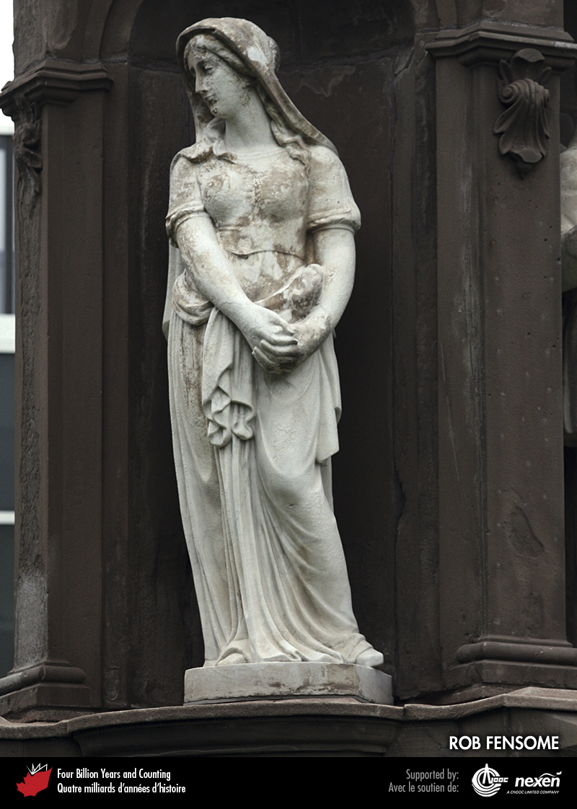
Notes:
Detail of the Canadian Volunteers Monument (1870) in Toronto, Ontario, commemorating volunteers who perished in the Fenian Raids of 1866. This statue is one of several on the monument that were carved from Italian Carrara Marble. It has passed the test of time better than the motif in the next photo. ROB FENSOME.
_______________________________
All photographic and graphic images (henceforth referred to as images) posted on this site are copyright of the persons and/or institutions indicated in the caption directly associated with each image. The copyright holders have agreed that you may use their images for educational, non-commercial purposes only and provided that they are credited in each instance of use. For all other uses you must contact the copyright holder.

Slide 3
Notes:
Detail of the Canadian Volunteers Monument (1870) in Toronto, Ontario, commemorating volunteers who perished in the Fenian Raids of 1866. This relief, carved from soft Nova Scotia sandstone, has weathered much more extensively than the statue in the previous photo. ROB FENSOME.
_______________________________
All photographic and graphic images (henceforth referred to as images) posted on this site are copyright of the persons and/or institutions indicated in the caption directly associated with each image. The copyright holders have agreed that you may use their images for educational, non-commercial purposes only and provided that they are credited in each instance of use. For all other uses you must contact the copyright holder.

Slide 4
Notes:
The Prince of Wales Martello Tower (1796–1797) in Halifax, Nova Scotia, was built of local Meguma “ironstone”. ROB FENSOME.
_______________________________
All photographic and graphic images (henceforth referred to as images) posted on this site are copyright of the persons and/or institutions indicated in the caption directly associated with each image. The copyright holders have agreed that you may use their images for educational, non-commercial purposes only and provided that they are credited in each instance of use. For all other uses you must contact the copyright holder.

Slide 5
Notes:
The local brick and Paskapoo Sandstone used to build Athabasca Hall (1906–1911) at the University of Alberta in Edmonton suffered significant weathering. The building was restored during the 1970s and now looks much as it did when it was first built. DIXON EDWARDS.
_______________________________
All photographic and graphic images (henceforth referred to as images) posted on this site are copyright of the persons and/or institutions indicated in the caption directly associated with each image. The copyright holders have agreed that you may use their images for educational, non-commercial purposes only and provided that they are credited in each instance of use. For all other uses you must contact the copyright holder.

Slide 6
Notes:
Gravel pit developed in an esker (Chapter 11), near McAdam, New Brunswick. ALLEN SEAMAN.
_______________________________
All photographic and graphic images (henceforth referred to as images) posted on this site are copyright of the persons and/or institutions indicated in the caption directly associated with each image. The copyright holders have agreed that you may use their images for educational, non-commercial purposes only and provided that they are credited in each instance of use. For all other uses you must contact the copyright holder.

Slide 7
Notes:
The Decarie Interchange in Montréal, Quebec, illustrates the demand for construction materials. REPRODUCED WITH THE PERMISSION OF NATURAL RESOURCES CANADA 2013, COURTESY OF THE GEOLOGICAL SURVEY OF CANADA.
_______________________________
All photographic and graphic images (henceforth referred to as images) posted on this site are copyright of the persons and/or institutions indicated in the caption directly associated with each image. The copyright holders have agreed that you may use their images for educational, non-commercial purposes only and provided that they are credited in each instance of use. For all other uses you must contact the copyright holder.

