Slide 1
CHAPTER 4 Part 1 of 2
All photographic and graphic images (henceforth referred to as images) posted on this site are copyright of the persons and/or institutions indicated in the caption directly associated with each image. The copyright holders have agreed that you may use their images for educational, non-commercial purposes only and provided that they are credited in each instance of use. For all other uses you must contact the copyright holder.

Slide 2
Notes:
Among fossil aficionados, Canada is famous for having many sites that have yielded striking specimens of global significance, including four UNESCO World Heritage Sites designated for their paleontological importance. One such site is Miguasha National Park in Quebec, famous for its Devonian fossil fish, such as Eusthenopteron shown here. JOHANNE KERR, COURTESY OF MIGUASHA NATIONAL PARK.
_______________________________
All photographic and graphic images (henceforth referred to as images) posted on this site are copyright of the persons and/or institutions indicated in the caption directly associated with each image. The copyright holders have agreed that you may use their images for educational, non-commercial purposes only and provided that they are credited in each instance of use. For all other uses you must contact the copyright holder.

Slide 3
Notes:
Skeleton of Albertosaurus libratus, found in Dinosaur Provincial Park, Alberta, and now at the Royal Tyrrell Museum of Palaeontology in Drumheller. ROYAL TYRRELL MUSEUM. _______________________________
All photographic and graphic images (henceforth referred to as images) posted on this site are copyright of the persons and/or institutions indicated in the caption directly associated with each image. The copyright holders have agreed that you may use their images for educational, non-commercial purposes only and provided that they are credited in each instance of use. For all other uses you must contact the copyright holder.

Slide 4
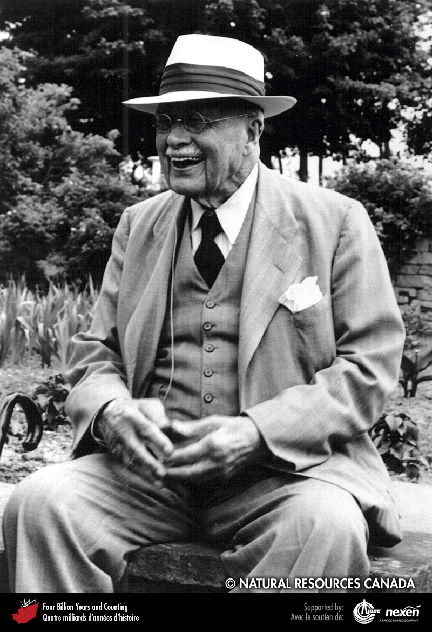
Notes:
Joseph Tyrrell in his later years. Reproduced with the permission of Natural Resources Canada 2013, courtesy of the Geological Survey of Canada.
_______________________________
All photographic and graphic images (henceforth referred to as images) posted on this site are copyright of the persons and/or institutions indicated in the caption directly associated with each image. The copyright holders have agreed that you may use their images for educational, non-commercial purposes only and provided that they are credited in each instance of use. For all other uses you must contact the copyright holder.

Slide 5
Notes:
In this Silurian rock from Arisaig, Nova Scotia, the shell material of a brachiopod (left) and several gastropods have been dissolved leaving gaps that are molds of the original shell. ANDREW MACRAE.
_______________________________
All photographic and graphic images (henceforth referred to as images) posted on this site are copyright of the persons and/or institutions indicated in the caption directly associated with each image. The copyright holders have agreed that you may use their images for educational, non-commercial purposes only and provided that they are credited in each instance of use. For all other uses you must contact the copyright holder.

Slide 6
Notes:
Fern foliage preserved as a carbonized film in late Carboniferous rocks of the Sydney area of Nova Scotia. HEINZ WIELE, COURTESY OF THE ATLANTIC GEOSCIENCE SOCIETY; SPECIMEN FROM THE NOVA SCOTIA MUSEUM.
_______________________________
All photographic and graphic images (henceforth referred to as images) posted on this site are copyright of the persons and/or institutions indicated in the caption directly associated with each image. The copyright holders have agreed that you may use their images for educational, non-commercial purposes only and provided that they are credited in each instance of use. For all other uses you must contact the copyright holder.

Slide 7
Notes:
A petrified late Carboniferous tree stump from Inverness, Nova Scotia. The tissue of the plant has been replaced by silica. MARTIN GIBLING.
_______________________________
All photographic and graphic images (henceforth referred to as images) posted on this site are copyright of the persons and/or institutions indicated in the caption directly associated with each image. The copyright holders have agreed that you may use their images for educational, non-commercial purposes only and provided that they are credited in each instance of use. For all other uses you must contact the copyright holder.

Slide 8
Notes:
Tetrapod footprints (Hylopus) from middle Carboniferous rocks near Parrsboro, Nova Scotia. This view is of the underside of the bed, so the footprints are raised rather than depressed. The many small raised bumps represent small pits in the original sediment, probably the impact marks of rain drops that fell about 320 million years ago. DAVID BROWN; SPECIMEN COURTESY OF ELDON GEORGE.
_______________________________
All photographic and graphic images (henceforth referred to as images) posted on this site are copyright of the persons and/or institutions indicated in the caption directly associated with each image. The copyright holders have agreed that you may use their images for educational, non-commercial purposes only and provided that they are credited in each instance of use. For all other uses you must contact the copyright holder.

Slide 9
Notes:
The branching feeding burrows in this organic-rich Ordovician mudstone from eastern Canada (location unknown) are known as Chondrites. The burrows typically branch at about 45 degrees and may show evidence of the organism (possibly a worm) probing the sediment and producing the small pits along the burrow walls. DARREL LONG.
_______________________________
All photographic and graphic images (henceforth referred to as images) posted on this site are copyright of the persons and/or institutions indicated in the caption directly associated with each image. The copyright holders have agreed that you may use their images for educational, non-commercial purposes only and provided that they are credited in each instance of use. For all other uses you must contact the copyright holder.

Slide 10
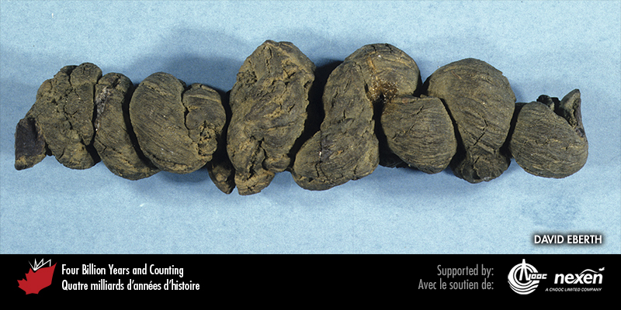
Notes:
Fossil dung or intestinal remains found in the late Cretaceous sediments of the Frenchman Valley in southern Saskatchewan. PROVIDED BY DAVID EBERTH. _______________________________
All photographic and graphic images (henceforth referred to as images) posted on this site are copyright of the persons and/or institutions indicated in the caption directly associated with each image. The copyright holders have agreed that you may use their images for educational, non-commercial purposes only and provided that they are credited in each instance of use. For all other uses you must contact the copyright holder.

Slide 11
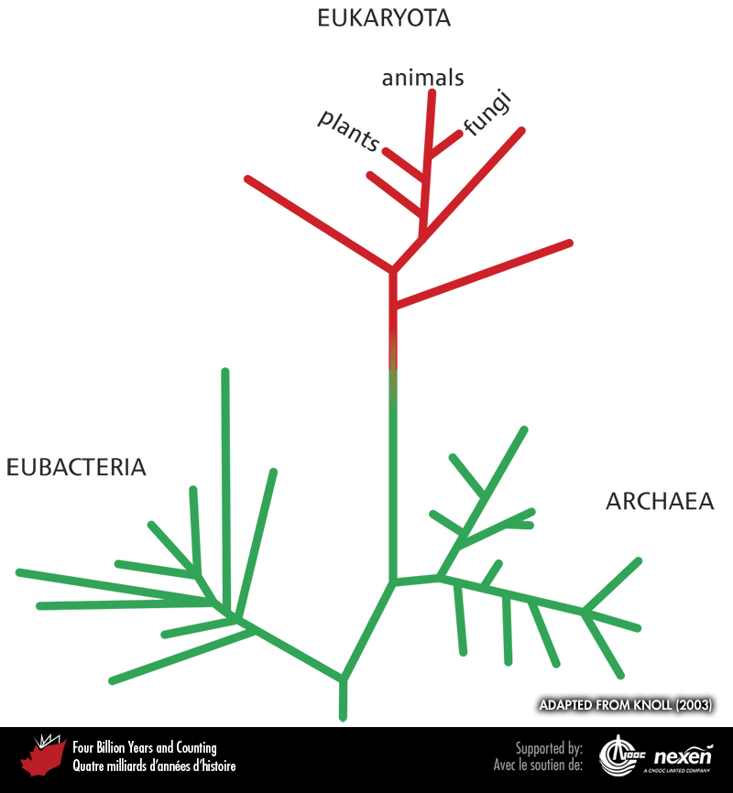
Notes:
Relationships between the three main branches of life on Earth: prokaryotic Eubacteria and Archaea (both shown by green lines), and the Eukaryota (shown by red lines). Line lengths indicate the degree of difference among gene sequences and do not directly represent time. However, striking parallels can be made between this pattern derived from molecular studies of modern organisms and the timing of first appearances of fossils of the same groups of organisms—a powerful confirmation of evolution. ADAPTED FROM KNOLL (2003). _______________________________
All photographic and graphic images (henceforth referred to as images) posted on this site are copyright of the persons and/or institutions indicated in the caption directly associated with each image. The copyright holders have agreed that you may use their images for educational, non-commercial purposes only and provided that they are credited in each instance of use. For all other uses you must contact the copyright holder.

Slide 12
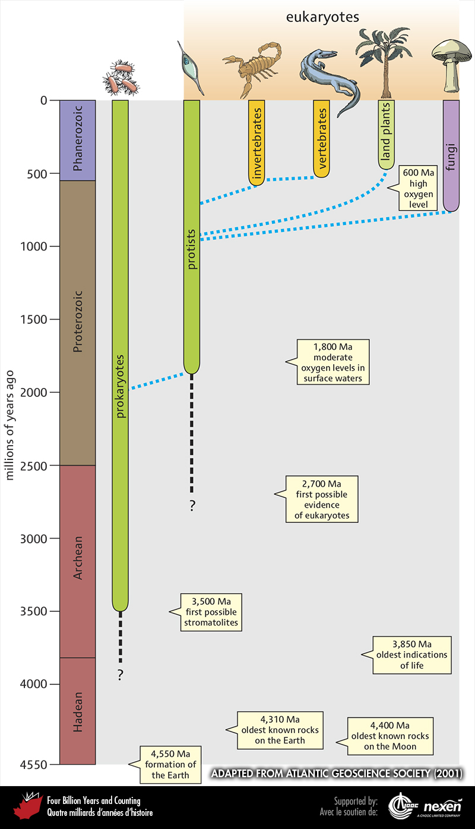
Notes:
The sequence of major events in the history of life on Earth and the timing of first appearances and ranges of the main groups of organisms. Probable interrelationships are shown by the dashed lines. ADAPTED FROM ATLANTIC GEOSCIENCE SOCIETY (2001).
_______________________________
All photographic and graphic images (henceforth referred to as images) posted on this site are copyright of the persons and/or institutions indicated in the caption directly associated with each image. The copyright holders have agreed that you may use their images for educational, non-commercial purposes only and provided that they are credited in each instance of use. For all other uses you must contact the copyright holder.

Slide 13
Notes:
A fossil radiolarian from offshore eastern Canada. Radiolaria are marine protists that have shells made of silica. They live among the plankton, and their skeletal remains cover huge areas of deep ocean floor. REPRODUCED WITH THE PERMISSION OF NATURAL RESOURCES CANADA 2013, COURTESY OF THE GEOLOGICAL SURVEY OF CANADA.
_______________________________
All photographic and graphic images (henceforth referred to as images) posted on this site are copyright of the persons and/or institutions indicated in the caption directly associated with each image. The copyright holders have agreed that you may use their images for educational, non-commercial purposes only and provided that they are credited in each instance of use. For all other uses you must contact the copyright holder.

Slide 14
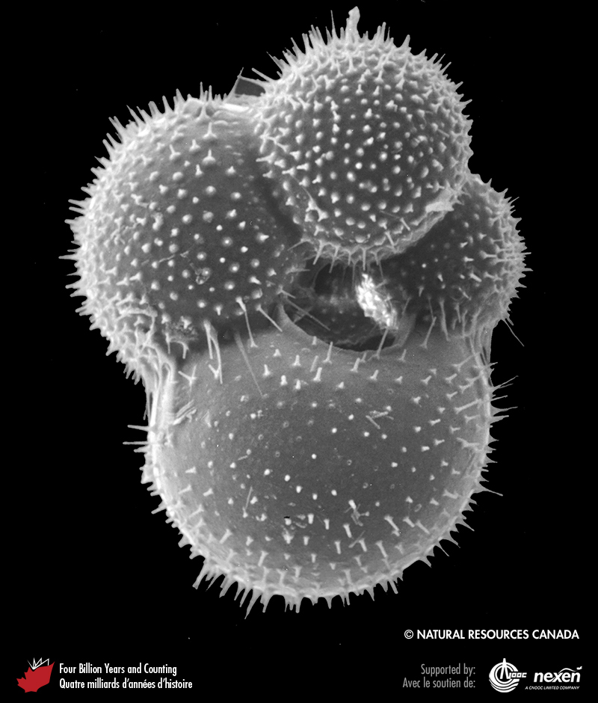
Notes:
Foraminifera are protists with shells commonly made of calcite. This fossil is from offshore eastern Canada. REPRODUCED WITH THE PERMISSION OF NATURAL RESOURCES CANADA 2013, COURTESY OF THE GEOLOGICAL SURVEY OF CANADA.
_______________________________
All photographic and graphic images (henceforth referred to as images) posted on this site are copyright of the persons and/or institutions indicated in the caption directly associated with each image. The copyright holders have agreed that you may use their images for educational, non-commercial purposes only and provided that they are credited in each instance of use. For all other uses you must contact the copyright holder.

Slide 15
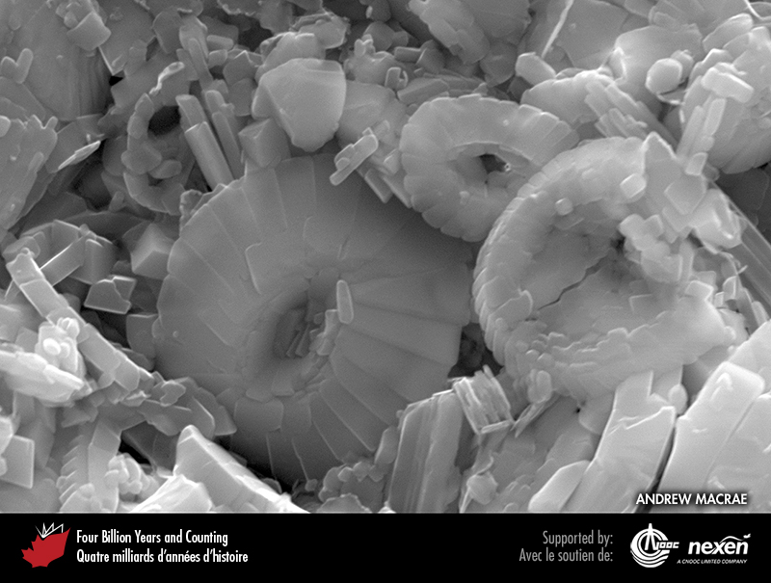
Notes:
Several disc-like coccoliths can be distinguished in this close-up of a piece of chalk from beneath the continental shelf off Nova Scotia (Chapter 9). The prominent coccolith at centre-left is about 6 microns (0.006 millimetres) across. ANDREW MACRAE AND THE SAINT MARY’S UNIVERSITY MICROANALYSIS UNIT.
_______________________________
All photographic and graphic images (henceforth referred to as images) posted on this site are copyright of the persons and/or institutions indicated in the caption directly associated with each image. The copyright holders have agreed that you may use their images for educational, non-commercial purposes only and provided that they are credited in each instance of use. For all other uses you must contact the copyright holder.

