Slide 1
BOX 5
All photographic and graphic images (henceforth referred to as images) posted on this site are copyright of the persons and/or institutions indicated in the caption directly associated with each image. The copyright holders have agreed that you may use their images for educational, non-commercial purposes only and provided that they are credited in each instance of use. For all other uses you must contact the copyright holder.

Slide 2
Notes:
The rugged St. Elias Mountains in southwestern Yukon, northern British Columbia, and southern Alaska contain North America’s highest peaks as well as spectacular icefields and valley glaciers. Here, Kaskawulsh Glacier scours the Paleozoic rocks of the valley walls. In the distance are mounts Logan and St. Elias. JOHN CLAGUE.
_______________________________
All photographic and graphic images (henceforth referred to as images) posted on this site are copyright of the persons and/or institutions indicated in the caption directly associated with each image. The copyright holders have agreed that you may use their images for educational, non-commercial purposes only and provided that they are credited in each instance of use. For all other uses you must contact the copyright holder.

Slide 3
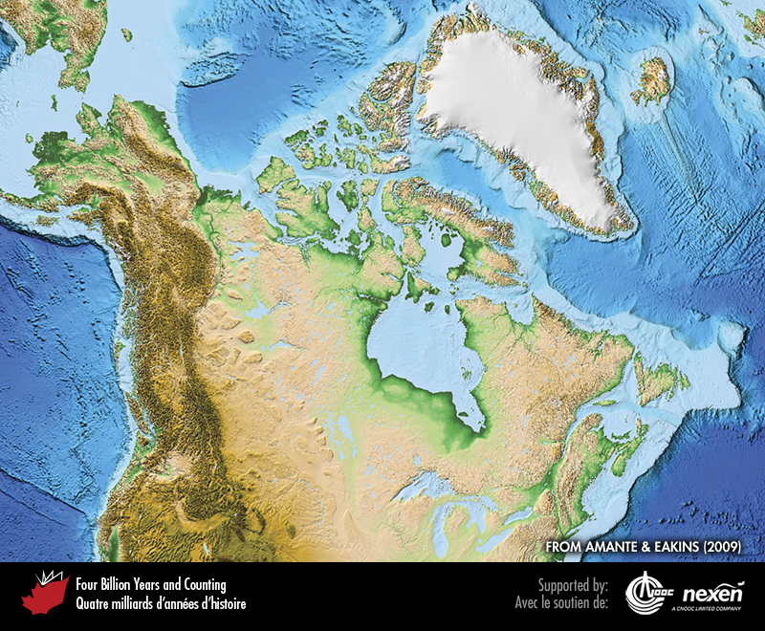
Notes:
Physiographic (topographic and bathymetric) map of Canada and surrounding lands and seas. To indicate increasing height, land is shaded from dark green through light green and light brown to dark brown; white represents ice. Note the distribution of highlands and lowlands. Shades of blue indicate water bodies, from light blue for shallow water to dark blue for deeper water. Note the generally sharp transition from continental shelves to ocean floor. FROM AMANTE AND EAKINS (2009).
_______________________________
All photographic and graphic images (henceforth referred to as images) posted on this site are copyright of the persons and/or institutions indicated in the caption directly associated with each image. The copyright holders have agreed that you may use their images for educational, non-commercial purposes only and provided that they are credited in each instance of use. For all other uses you must contact the copyright holder.

Slide 4
Notes:
Lake Louise, Banff National Park of Canada, Alberta, is a popular tourist destination in the southern Rocky Mountains. KEITH VAUGHAN.
_______________________________
All photographic and graphic images (henceforth referred to as images) posted on this site are copyright of the persons and/or institutions indicated in the caption directly associated with each image. The copyright holders have agreed that you may use their images for educational, non-commercial purposes only and provided that they are credited in each instance of use. For all other uses you must contact the copyright holder.

Slide 5
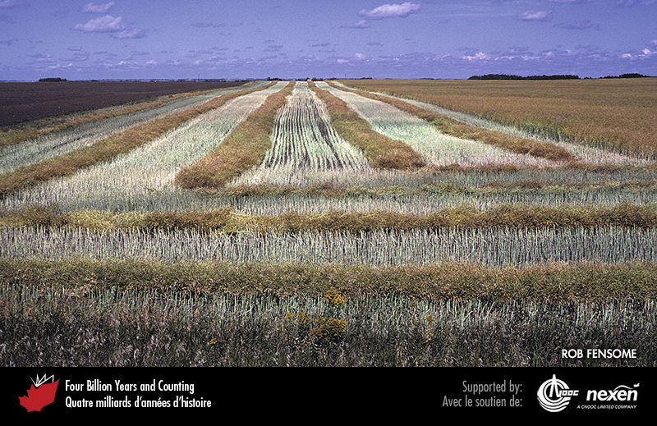
Notes:
A view of a flat Prairie landscape near Struan, Saskatchewan. ROB FENSOME.
_______________________________
All photographic and graphic images (henceforth referred to as images) posted on this site are copyright of the persons and/or institutions indicated in the caption directly associated with each image. The copyright holders have agreed that you may use their images for educational, non-commercial purposes only and provided that they are credited in each instance of use. For all other uses you must contact the copyright holder.

Slide 6
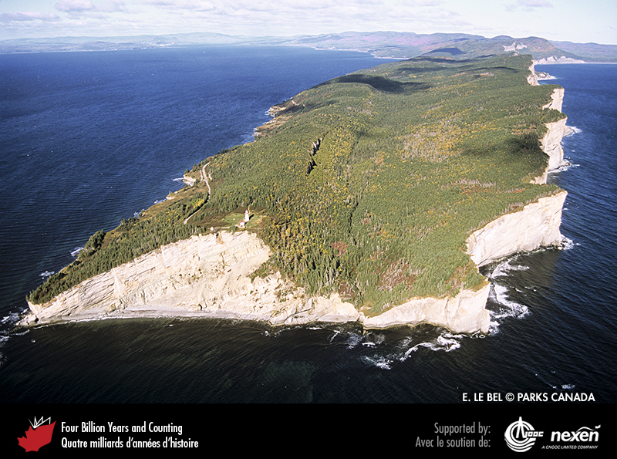
Notes:
The Appalachian Mountains reach the sea on the Gaspé Peninsula of Quebec, as seen here at Cap Gaspé, Forillon National Park of Canada. Lower than the Cordilleran mountains, the Appalachians are an older mountain system that has been worn down by weathering and erosion over a much longer time. E. LE BEL, COPYRIGHT PARKS CANADA . _______________________________
All photographic and graphic images (henceforth referred to as images) posted on this site are copyright of the persons and/or institutions indicated in the caption directly associated with each image. The copyright holders have agreed that you may use their images for educational, non-commercial purposes only and provided that they are credited in each instance of use. For all other uses you must contact the copyright holder.

Slide 7
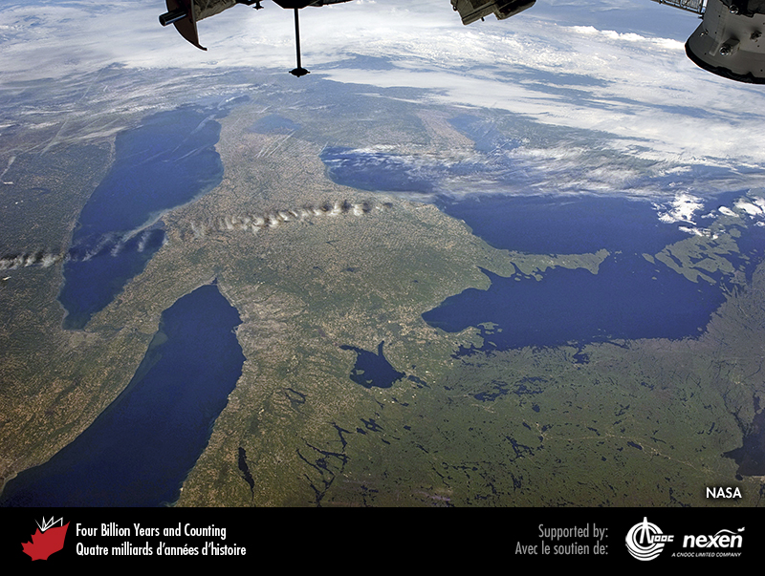
Notes:
Satellite view with north to the right, Lake Ontario at bottom left (bordered by Toronto to its top right), Lake Erie at top left, and Lake Huron to the right. Canada is to the right of lakes Ontario and Erie, and the United States is most of the area to the left of these lakes. Note the sediment plume entering Lake Ontario from the Niagara River (linking the eastern end of Lake Erie with western Lake Ontario), and the Bruce Peninsula, a peninsula in Lake Huron that owes its existence to the Niagara Escarpment and its Silurian cap rock (Chapter 1). Note also the distinctly different quality of the landscape and tone of green to the bottom right; this area is the infertile and sparsely populated Canadian Shield. COURTESY OF NASA. _______________________________
All photographic and graphic images (henceforth referred to as images) posted on this site are copyright of the persons and/or institutions indicated in the caption directly associated with each image. The copyright holders have agreed that you may use their images for educational, non-commercial purposes only and provided that they are credited in each instance of use. For all other uses you must contact the copyright holder.

Slide 8
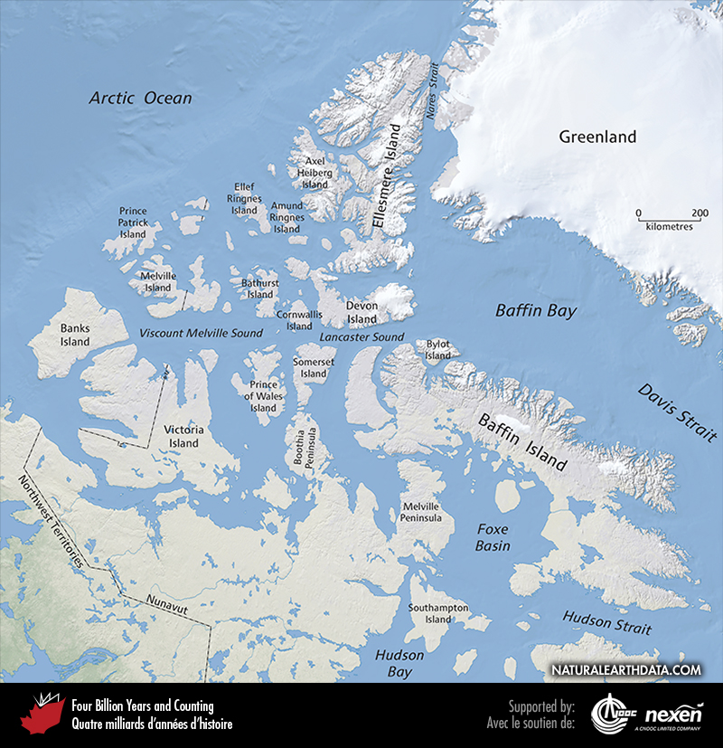
Notes:
A map of the Arctic Islands and surrounding lands and seas. Together, Viscount Melville Sound and Lancaster Sound are part of the famed Northwest Passage, and the islands to the north of these two seaways are collectively referred to as the Queen Elizabeth Islands. The lightest coloured areas are ice caps. ADAPTED FROM NATURAL EARTH (NATURALEARTHDATA.COM).
_______________________________
All photographic and graphic images (henceforth referred to as images) posted on this site are copyright of the persons and/or institutions indicated in the caption directly associated with each image. The copyright holders have agreed that you may use their images for educational, non-commercial purposes only and provided that they are credited in each instance of use. For all other uses you must contact the copyright holder.

Slide 9
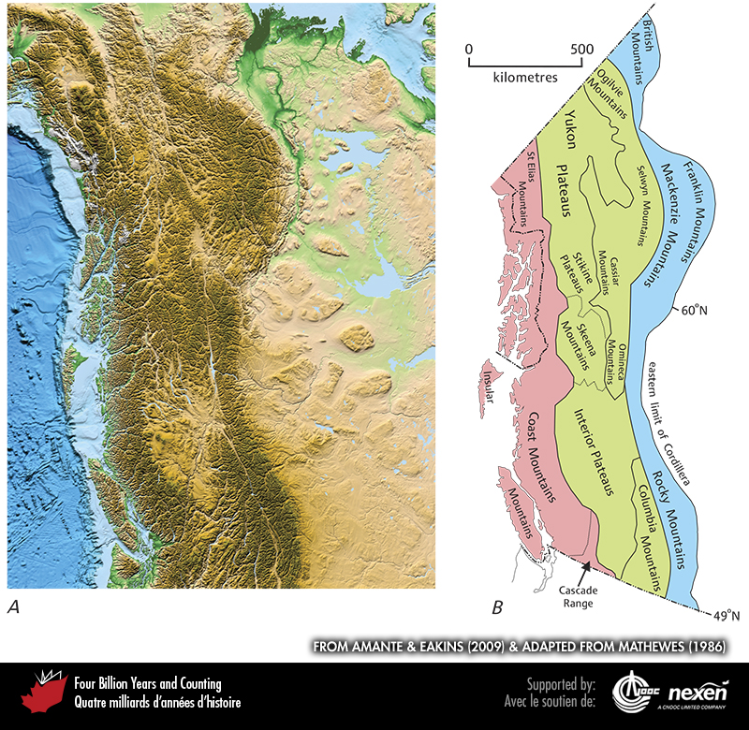
Notes:
A is a physiographic map of the Canadian Cordillera and adjacent areas, with shading as previously explained. B names the main physiographic regions of the Canadian Cordillera. The more westerly mountain ranges (pink), including the Coast Mountains, are separated from the more easterly ranges (blue), including the Rocky Mountains, by an interior belt (green) dominated by plateaus. A FROM AMANTE AND EAKINS (2009); B ADAPTED FROM MATHEWES (1986).
_______________________________
All photographic and graphic images (henceforth referred to as images) posted on this site are copyright of the persons and/or institutions indicated in the caption directly associated with each image. The copyright holders have agreed that you may use their images for educational, non-commercial purposes only and provided that they are credited in each instance of use. For all other uses you must contact the copyright holder.

Slide 10
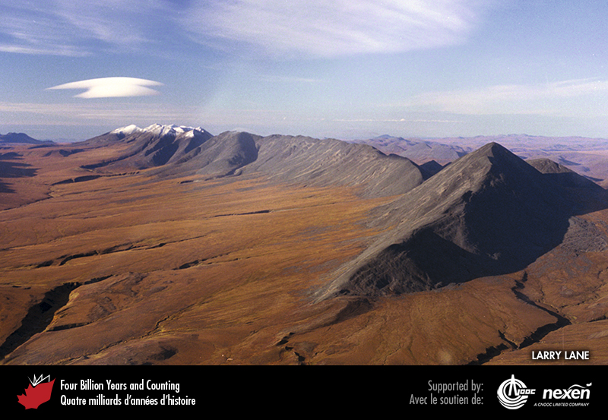
Notes:
The mountains of the Cordillera reach far inland, especially in the north, as here in the Mackenzie Mountains, Northwest Territories. In the right foreground is Mount Close. LARRY LANE.
_______________________________
All photographic and graphic images (henceforth referred to as images) posted on this site are copyright of the persons and/or institutions indicated in the caption directly associated with each image. The copyright holders have agreed that you may use their images for educational, non-commercial purposes only and provided that they are credited in each instance of use. For all other uses you must contact the copyright holder.

