Slide 1
CHAPTER 8 Part 3 of 4
All photographic and graphic images (henceforth referred to as images) posted on this site are copyright of the persons and/or institutions indicated in the caption directly associated with each image. The copyright holders have agreed that you may use their images for educational, non-commercial purposes only and provided that they are credited in each instance of use. For all other uses you must contact the copyright holder.

Slide 2
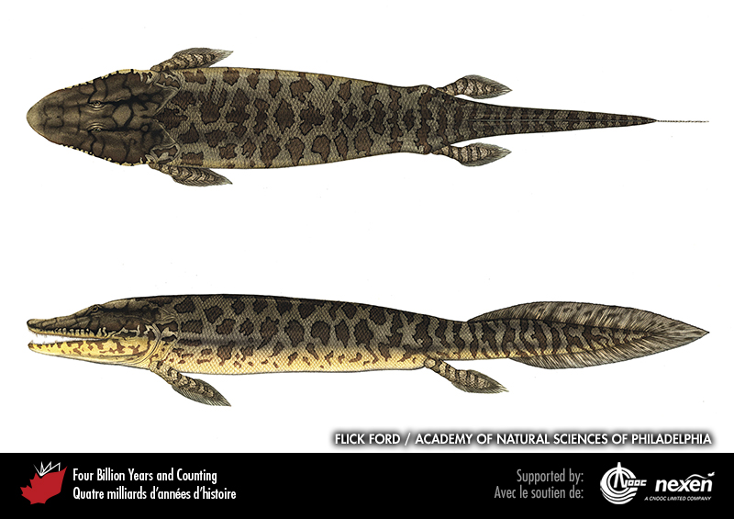
Notes:
Artist’s reconstruction of Tiktaalik roseae in top and side views. ARTWORK BY FLICK FORD, RECONSTRUCTION COURTESY OF THE ACADEMY OF NATURAL SCIENCES OF PHILADELPHIA.
_______________________________
All photographic and graphic images (henceforth referred to as images) posted on this site are copyright of the persons and/or institutions indicated in the caption directly associated with each image. The copyright holders have agreed that you may use their images for educational, non-commercial purposes only and provided that they are credited in each instance of use. For all other uses you must contact the copyright holder.

Slide 3
Notes:
Part of the skeleton of Tiktaalik roseae, showing its flexible neck. This animal fills the gap between fish and land animals. This landmark fossil was found in late Devonian rocks, about 375 million years old, from Ellesmere Island, Nunavut. TED DAESCHLER, ACADEMY OF NATURAL SCIENCES OF PHILADELPHIA (FOR IMAGE OF THE SPECIMEN).
_______________________________
All photographic and graphic images (henceforth referred to as images) posted on this site are copyright of the persons and/or institutions indicated in the caption directly associated with each image. The copyright holders have agreed that you may use their images for educational, non-commercial purposes only and provided that they are credited in each instance of use. For all other uses you must contact the copyright holder.

Slide 4
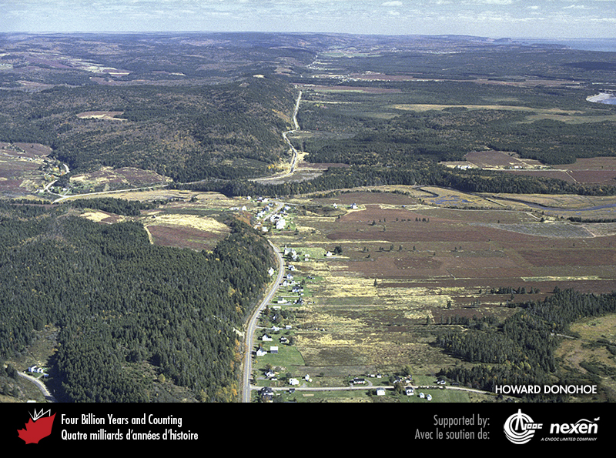
Notes:
Aerial view of a road following the surface trace of the Cobequid Fault near Port Greville, Nova Scotia. This fault is a component of the Cobequid-Chedabucto Fault System along which the Meguma microcontinent docked with the Avalonian margin of Euramerica during the Devonian and Carboniferous. HOWARD DONOHOE.
_______________________________
All photographic and graphic images (henceforth referred to as images) posted on this site are copyright of the persons and/or institutions indicated in the caption directly associated with each image. The copyright holders have agreed that you may use their images for educational, non-commercial purposes only and provided that they are credited in each instance of use. For all other uses you must contact the copyright holder.

Slide 5
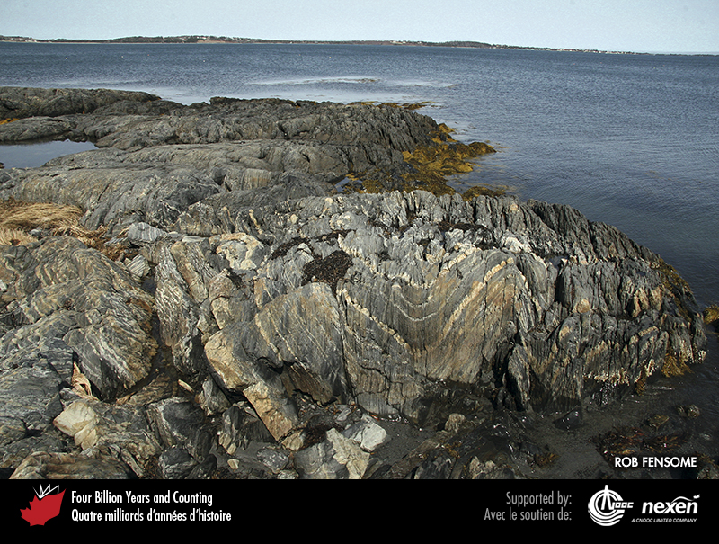
Notes:
Cambrian-Ordovician metasedimentary rocks of the Meguma Terrane at Feltzen South, near Lunenburg, Nova Scotia. The strata were folded and metamorphosed during the Neoacadian Orogeny. ROB FENSOME.
_______________________________
All photographic and graphic images (henceforth referred to as images) posted on this site are copyright of the persons and/or institutions indicated in the caption directly associated with each image. The copyright holders have agreed that you may use their images for educational, non-commercial purposes only and provided that they are credited in each instance of use. For all other uses you must contact the copyright holder.

Slide 6
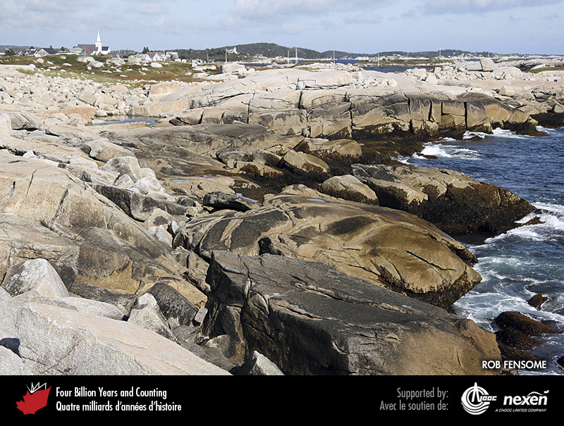
Notes:
The shoreline at Prospect, Nova Scotia, is underlain by, and littered with boulders of granite from the Devonian South Mountain Batholith. ROB FENSOME.
_______________________________
All photographic and graphic images (henceforth referred to as images) posted on this site are copyright of the persons and/or institutions indicated in the caption directly associated with each image. The copyright holders have agreed that you may use their images for educational, non-commercial purposes only and provided that they are credited in each instance of use. For all other uses you must contact the copyright holder.

Slide 7
Notes:
The west half of Cirrus Mountain (middle distance, viewed from the highway leading up to Sunwapta Pass in Alberta) exposes the classic threefold structure of the Front Ranges of the southern Rocky Mountains: lower cliffs of Devonian carbonate, middle slopes of Carboniferous shale, and upper cliffs of Carboniferous carbonate. CHRIS YORATH.
_______________________________
All photographic and graphic images (henceforth referred to as images) posted on this site are copyright of the persons and/or institutions indicated in the caption directly associated with each image. The copyright holders have agreed that you may use their images for educational, non-commercial purposes only and provided that they are credited in each instance of use. For all other uses you must contact the copyright holder.

Slide 8
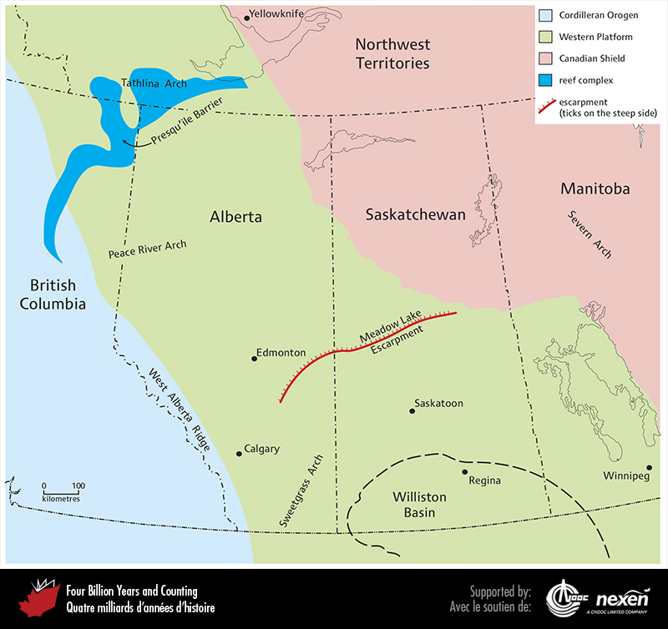
Notes:
Some important paleogeographic and tectonic features on the Western Platform and adjacent areas during the Silurian to Permian. The Canadian Shield and Cordilleran Orogen are shown for orientation, but these areas represent more recent geological developments and were not present during the late Paleozoic. ADAPTED FROM VARIOUS SOURCES.
_______________________________
All photographic and graphic images (henceforth referred to as images) posted on this site are copyright of the persons and/or institutions indicated in the caption directly associated with each image. The copyright holders have agreed that you may use their images for educational, non-commercial purposes only and provided that they are credited in each instance of use. For all other uses you must contact the copyright holder.

Slide 9
Notes:
Mountainside exposing two late Devonian reefs, Flathead Range, southwestern Alberta. BRIAN PRATT.
_______________________________
All photographic and graphic images (henceforth referred to as images) posted on this site are copyright of the persons and/or institutions indicated in the caption directly associated with each image. The copyright holders have agreed that you may use their images for educational, non-commercial purposes only and provided that they are credited in each instance of use. For all other uses you must contact the copyright holder.

Slide 10
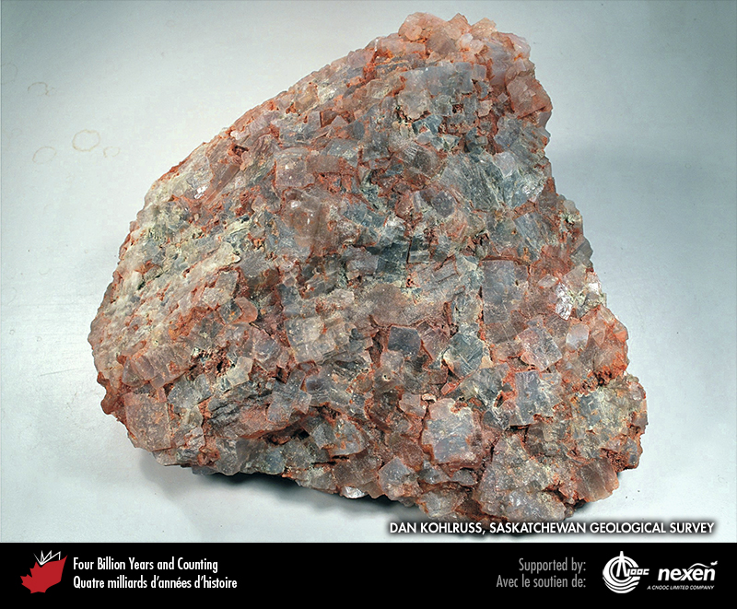
Notes:
Potash ore from Devonian subsurface deposits in Saskatchewan. The ore, an evaporite rock called sylvinite, consists of a mixture of halite, sylvite (potassium chloride), carnallite (a complex mineral that includes potassium, chlorine, and magnesium), and other minerals. Sylvite is the principal ore mineral and source of potash. The red colour reflects iron oxide staining. DAN KOHLRUSS, SASKATCHEWAN GEOLOGICAL SURVEY.
_______________________________
All photographic and graphic images (henceforth referred to as images) posted on this site are copyright of the persons and/or institutions indicated in the caption directly associated with each image. The copyright holders have agreed that you may use their images for educational, non-commercial purposes only and provided that they are credited in each instance of use. For all other uses you must contact the copyright holder.

Slide 11
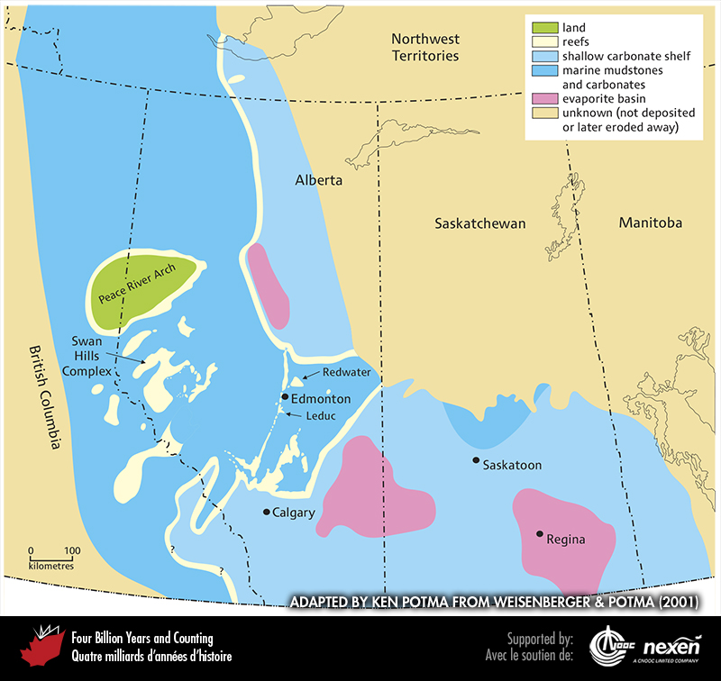
Notes:
Reefs and other important features on the Western Platform and adjacent areas during the late Devonian. The locations of the reefs now found in the Rocky Mountains Foothills and mountains are shown on this map in their probable original locations before Paleozoic rocks were thrust eastward during the Mesozoic (Chapter 9). ADAPTED BY KEN POTMA FROM WEISENBERGER AND POTMA (2001).
_______________________________
All photographic and graphic images (henceforth referred to as images) posted on this site are copyright of the persons and/or institutions indicated in the caption directly associated with each image. The copyright holders have agreed that you may use their images for educational, non-commercial purposes only and provided that they are credited in each instance of use. For all other uses you must contact the copyright holder.

Slide 12
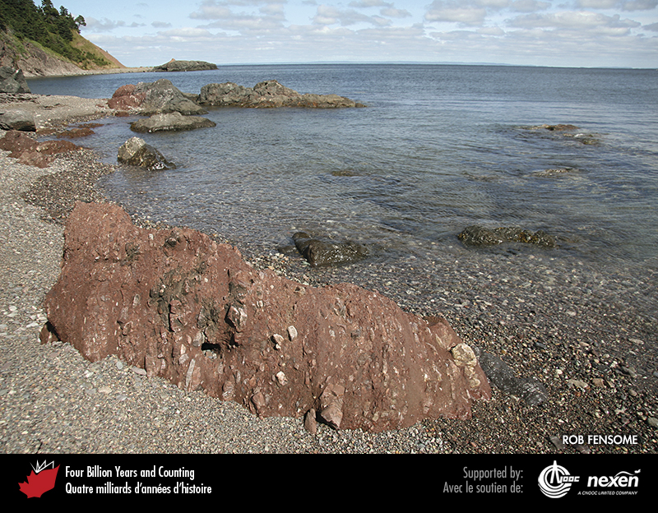
Notes:
Late Devonian conglomerate (red rocks in foreground and to the left) and mafic volcanics (grey rocks), Ballantynes Cove, Nova Scotia. ROB FENSOME.
_______________________________
All photographic and graphic images (henceforth referred to as images) posted on this site are copyright of the persons and/or institutions indicated in the caption directly associated with each image. The copyright holders have agreed that you may use their images for educational, non-commercial purposes only and provided that they are credited in each instance of use. For all other uses you must contact the copyright holder.

Slide 13
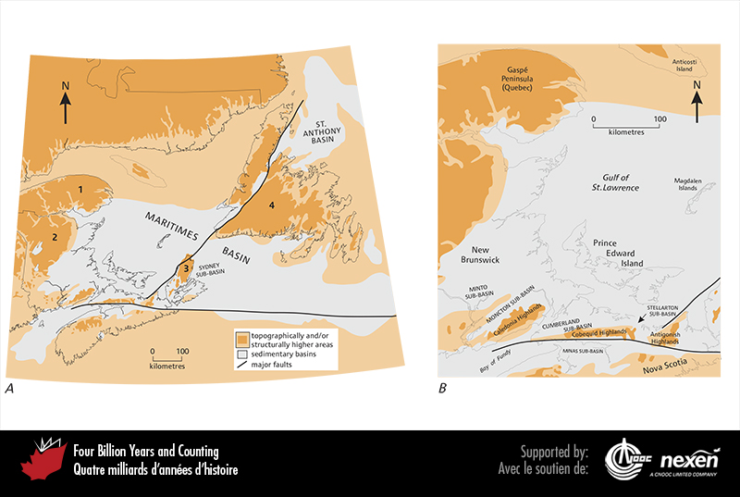
Notes:
A. The late Devonian to Permian sedimentary basins and sub-basins of Atlantic Canada and surrounding areas. The highlands include: 1, Gaspé Highlands; 2, Miramichi Highlands; 3, Cape Breton Highlands; and 4, Western Newfoundland Highlands. B. Detail of the western Gulf of St. Lawrence and surrounding areas. ADAPTED FROM VARIOUS SOURCES.
_______________________________
All photographic and graphic images (henceforth referred to as images) posted on this site are copyright of the persons and/or institutions indicated in the caption directly associated with each image. The copyright holders have agreed that you may use their images for educational, non-commercial purposes only and provided that they are credited in each instance of use. For all other uses you must contact the copyright holder.

Slide 14
Notes:
Gypsum cliffs along the St. Croix River, near Windsor, Nova Scotia. The gypsum was deposited in the early Carboniferous Windsor Sea. WAYNE GARLAND.
_______________________________
All photographic and graphic images (henceforth referred to as images) posted on this site are copyright of the persons and/or institutions indicated in the caption directly associated with each image. The copyright holders have agreed that you may use their images for educational, non-commercial purposes only and provided that they are credited in each instance of use. For all other uses you must contact the copyright holder.

Slide 15
Notes:
An early Carboniferous underwater lake scene. Three types of early ray-finned fish are shown: silvery purple Rhadinichthys swimming in a school toward the left; three larger, brownish-grey Elonichthys on the left; and a deep-bodied form akin to Eurynotus at right. In the background, coloured green, is the large lobe-finned fish Latvius. The colours are guesses, but the morphology is based on fossil finds from rocks at Albert Mines, New Brunswick. PAINTING BY JUDI PENNANEN, COURTESY OF THE NEW BRUNSWICK MUSEUM.
_______________________________
All photographic and graphic images (henceforth referred to as images) posted on this site are copyright of the persons and/or institutions indicated in the caption directly associated with each image. The copyright holders have agreed that you may use their images for educational, non-commercial purposes only and provided that they are credited in each instance of use. For all other uses you must contact the copyright holder.

Slide 16
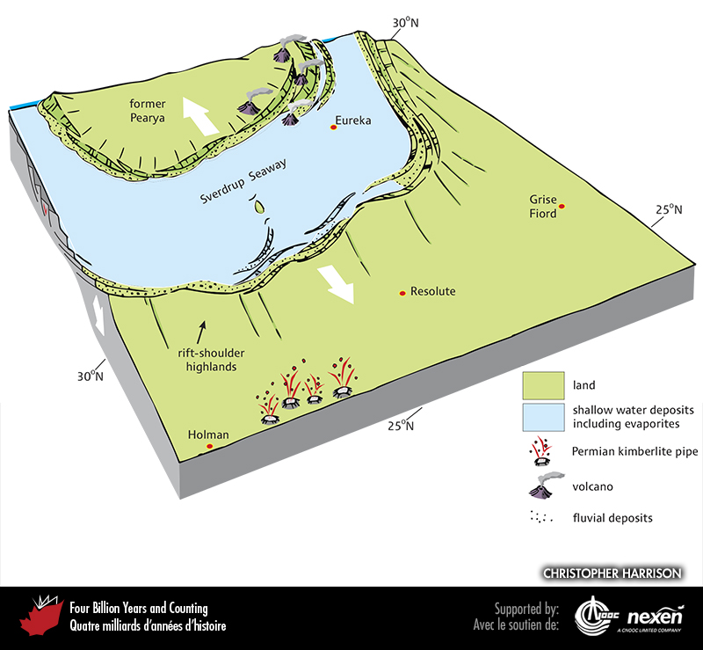
Notes:
Paleogeography of what was to become the Canadian Arctic in the middle Carboniferous to Permian, 325 to 285 million years ago. The approximate locations of Holman, Resolute, Grise Fiord, and Eureka are included to provide a guide for orientation, as well as paleolatitudes. The focus for the region, now approaching mid-latitudes, was the Sverdrup Seaway, a broad rift basin in which shallow-water deposits, including evaporites, accumulated. The arrows show the direction of crustal tension. Kimberlite pipes, the source of diamond deposits, are discussed in Chapter 12.
_______________________________
All photographic and graphic images (henceforth referred to as images) posted on this site are copyright of the persons and/or institutions indicated in the caption directly associated with each image. The copyright holders have agreed that you may use their images for educational, non-commercial purposes only and provided that they are credited in each instance of use. For all other uses you must contact the copyright holder.

Slide 17
Notes:
This cliff near Hare Fiord on Ellesmere Island, Nunavut, reveals changing Carboniferous environments. Redbeds near the base are sequentially overlain by evaporites (lighter bands in the lower part of the cliff ), shales (thick brown-grey sequence), and carbonates (light-grey sequence near the top). CHRISTOPHER HARRISON.
_______________________________
All photographic and graphic images (henceforth referred to as images) posted on this site are copyright of the persons and/or institutions indicated in the caption directly associated with each image. The copyright holders have agreed that you may use their images for educational, non-commercial purposes only and provided that they are credited in each instance of use. For all other uses you must contact the copyright holder.

