Slide 1
CHAPTER 3
All photographic and graphic images (henceforth referred to as images) posted on this site are copyright of the persons and/or institutions indicated in the caption directly associated with each image. The copyright holders have agreed that you may use their images for educational, non-commercial purposes only and provided that they are credited in each instance of use. For all other uses you must contact the copyright holder.

Slide 2
Notes:
The Principle of Superposition states that younger sediments are always deposited on top of older sediments. Thus, in this scene from the Big Muddy Badlands of southern Saskatchewan, layers (or beds) lower down on the slope are relatively older than the layers higher up. ROB FENSOME.
_______________________________
All photographic and graphic images (henceforth referred to as images) posted on this site are copyright of the persons and/or institutions indicated in the caption directly associated with each image. The copyright holders have agreed that you may use their images for educational, non-commercial purposes only and provided that they are credited in each instance of use. For all other uses you must contact the copyright holder.

Slide 3
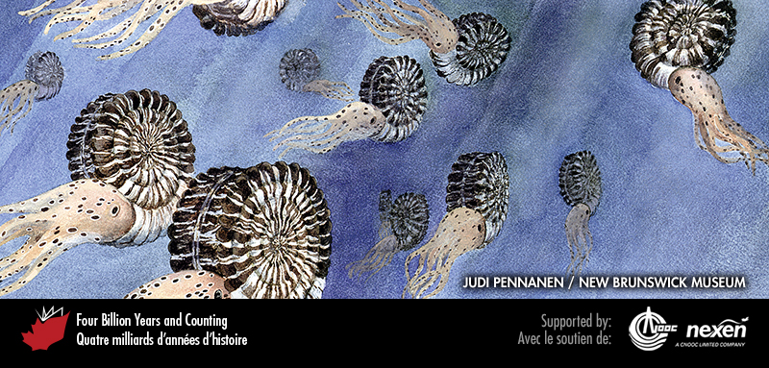
Notes:
Extinct mollusks known as ammonites (Chapter 4) were common in Jurassic and Cretaceous seas, and distinctive species evolved rapidly, making their fossil shells excellent tools for relative dating. Ammonite fossils were used extensively by the nineteenth-century pioneers of the geological time scale. PAINTING BY JUDI PENNANEN, COURTESY OF THE NEW BRUNSWICK MUSEUM.
_______________________________
All photographic and graphic images (henceforth referred to as images) posted on this site are copyright of the persons and/or institutions indicated in the caption directly associated with each image. The copyright holders have agreed that you may use their images for educational, non-commercial purposes only and provided that they are credited in each instance of use. For all other uses you must contact the copyright holder.

Slide 4
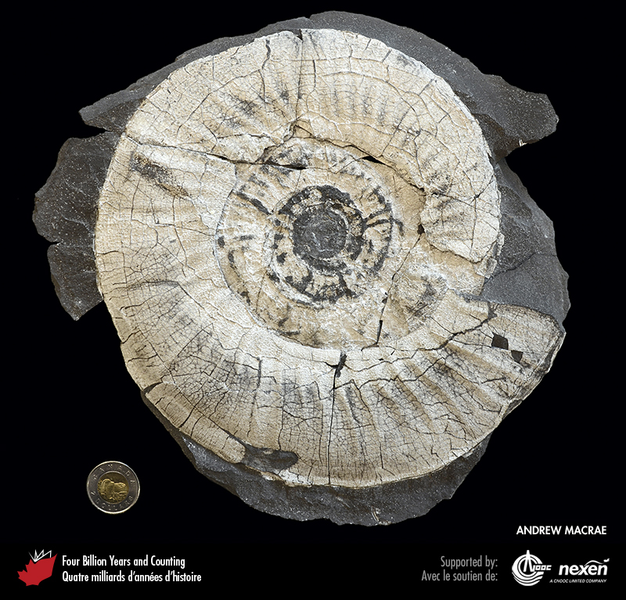
Notes:
The late Jurassic to early Cretaceous ammonite Pseudocraspedites, found north of Eureka, Ellesmere Island. Such large fossils, clearly visible to the naked eye, are rarely recovered in exploration wells, so geologists rely largely on microfossils for dating subsurface sections. ANDREW MACRAE.
_______________________________
All photographic and graphic images (henceforth referred to as images) posted on this site are copyright of the persons and/or institutions indicated in the caption directly associated with each image. The copyright holders have agreed that you may use their images for educational, non-commercial purposes only and provided that they are credited in each instance of use. For all other uses you must contact the copyright holder.

Slide 5
Notes:
The relative ages of adjacent intrusive rocks, such as these two dykes in Kejimkujik National Park of Canada Seaside, Nova Scotia, can be determined by cross-cutting relationships. That the large dyke trending from bottom left to upper right cuts through and offsets the small dyke running from top left to bottom right shows that the former is the younger of the two dykes. ROB FENSOME.
_______________________________
All photographic and graphic images (henceforth referred to as images) posted on this site are copyright of the persons and/or institutions indicated in the caption directly associated with each image. The copyright holders have agreed that you may use their images for educational, non-commercial purposes only and provided that they are credited in each instance of use. For all other uses you must contact the copyright holder.

Slide 6
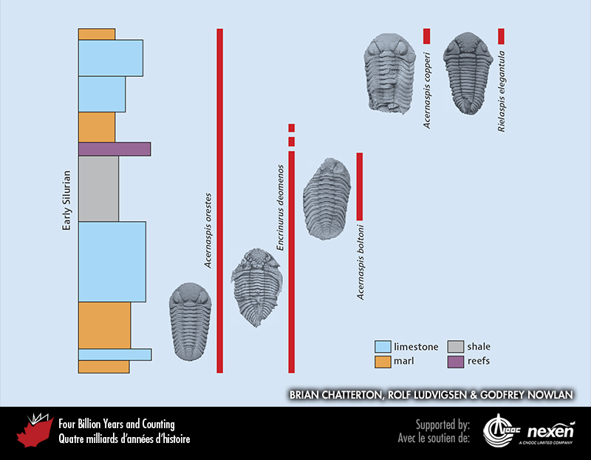
Notes:
The ranges of several species of trilobite (Chapter 4) in early Silurian rocks as recorded in a sequence on Anticosti Island, Quebec. The coloured column at left shows the rock succession. To the right are illustrations of key trilobite species and the parts of the succession in which they are found—that is, their ranges. The ranges of the different species allow us to date the rocks in a relative sense: for example, a bed containing Acernaspis orestes, Acernaspis boltoni, and Encrinurus deomenos is older than a bed containing Acernaspis orestes, Acernaspis copperi, and Rielaspis elegantula. The use of fossils to date rocks in a relative sense is called biostratigraphy. It is the historical basis for the development of the geological time scale and still plays a vital role. It works because organisms have evolved over time. ADAPTED FROM MATERIALS PROVIDED BY BRIAN CHATTERTON AND ROLF LUDVIGSEN.
_______________________________
All photographic and graphic images (henceforth referred to as images) posted on this site are copyright of the persons and/or institutions indicated in the caption directly associated with each image. The copyright holders have agreed that you may use their images for educational, non-commercial purposes only and provided that they are credited in each instance of use. For all other uses you must contact the copyright holder.

Slide 7
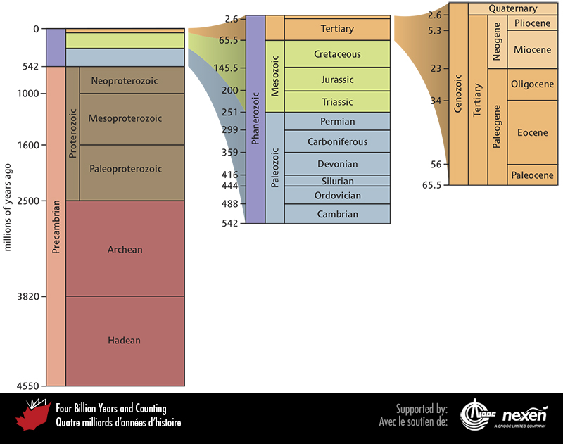
Notes:
The geological time scale. The blocks to the right provide additional detail for the Phanerozoic and Cenozoic. The time scale is based on a combination of fossil ranges, radiometric dating, and other physical data.
_______________________________
All photographic and graphic images (henceforth referred to as images) posted on this site are copyright of the persons and/or institutions indicated in the caption directly associated with each image. The copyright holders have agreed that you may use their images for educational, non-commercial purposes only and provided that they are credited in each instance of use. For all other uses you must contact the copyright holder.

Slide 8
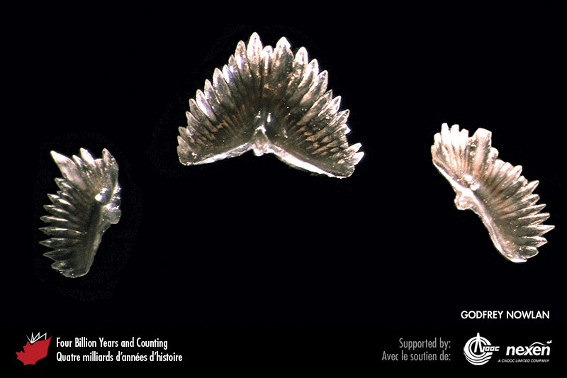
Notes:
Conodonts, tooth-like mouth parts of early fish-like chordates (Chapter 4), are important microfossils for dating Ordovician marine rocks. The centre specimen is about 1 millimetre across. GODFREY NOWLAN.
_______________________________
All photographic and graphic images (henceforth referred to as images) posted on this site are copyright of the persons and/or institutions indicated in the caption directly associated with each image. The copyright holders have agreed that you may use their images for educational, non-commercial purposes only and provided that they are credited in each instance of use. For all other uses you must contact the copyright holder.

Slide 9
Notes:
Technicians at the Geological Survey of Canada offices in Ottawa use an instrument called a SHRIMP II ion microprobe to determine the age of tiny mineral crystals. Reproduced with the permission of Natural Resources Canada 2013, courtesy of the Geological Survey of Canada.
_______________________________
All photographic and graphic images (henceforth referred to as images) posted on this site are copyright of the persons and/or institutions indicated in the caption directly associated with each image. The copyright holders have agreed that you may use their images for educational, non-commercial purposes only and provided that they are credited in each instance of use. For all other uses you must contact the copyright holder.

Slide 10
Notes:
Zircon crystals such as these, set in the eye of a needle for scale, are ideal for the radiometric dating of igneous rocks. Zircons can also provide ages for many metamorphic rocks because these minerals resist changes in composition resulting from high temperatures and pressures. REPRODUCED WITH THE PERMISSION OF NATURAL RESOURCES CANADA 2013, COURTESY OF JULIE PERESSINI.
_______________________________
All photographic and graphic images (henceforth referred to as images) posted on this site are copyright of the persons and/or institutions indicated in the caption directly associated with each image. The copyright holders have agreed that you may use their images for educational, non-commercial purposes only and provided that they are credited in each instance of use. For all other uses you must contact the copyright holder.

Slide 11
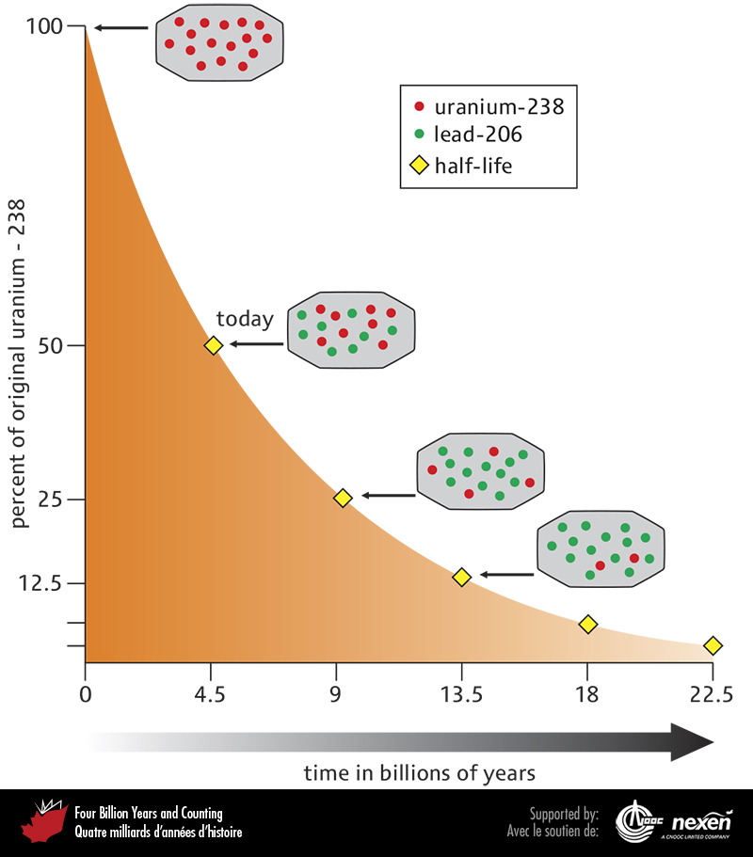
Notes:
The rate of change of uranium-238 (red dots) to lead-206 (green dots) over 22,500 million years. One half-life, in this case 4,500 million years, indicates when half of the uranium-238 atoms present at the start of the half-life interval have changed to lead-206 atoms. ADAPTED FROM VARIOUS SOURCES.
_______________________________
All photographic and graphic images (henceforth referred to as images) posted on this site are copyright of the persons and/or institutions indicated in the caption directly associated with each image. The copyright holders have agreed that you may use their images for educational, non-commercial purposes only and provided that they are credited in each instance of use. For all other uses you must contact the copyright holder.

Slide 12
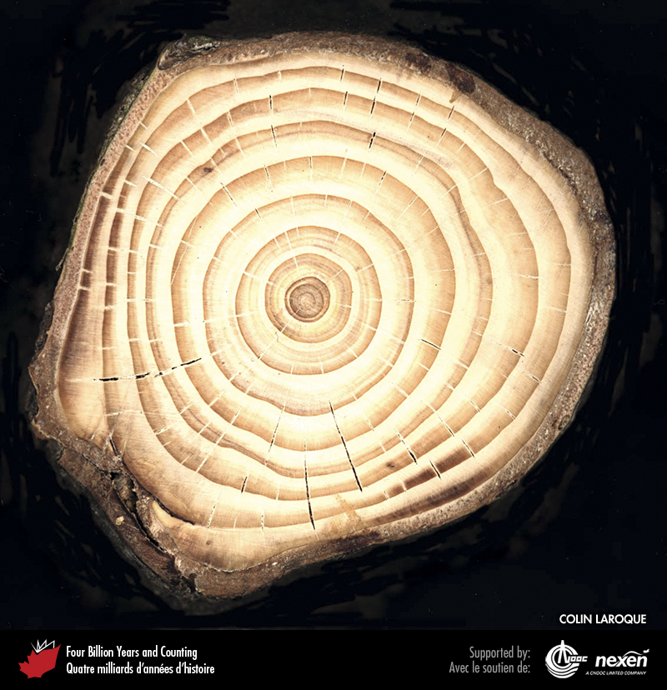
Notes:
Tree-ring counts have helped calibrate radiocarbon dates back to about 26,000 years ago. This technique, known as dendrochronology, is based on each ring of a tree representing one year’s growth. COLIN LAROQUE.
_______________________________
All photographic and graphic images (henceforth referred to as images) posted on this site are copyright of the persons and/or institutions indicated in the caption directly associated with each image. The copyright holders have agreed that you may use their images for educational, non-commercial purposes only and provided that they are credited in each instance of use. For all other uses you must contact the copyright holder.

Slide 13
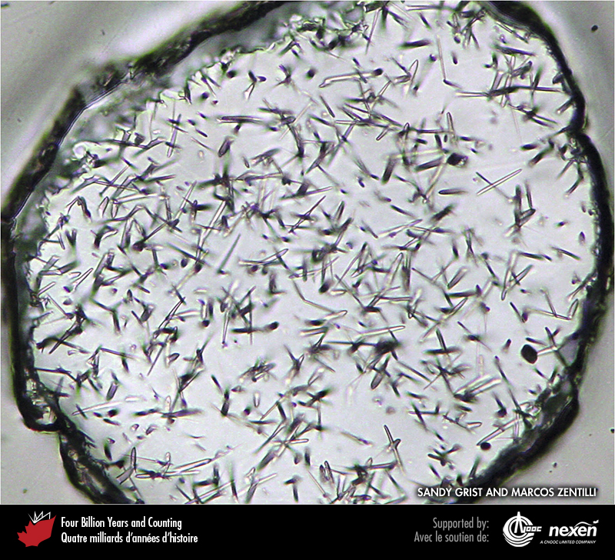
Notes:
Fission tracks in a grain of apatite. The tracks mark the path of subatomic particles produced by radioactive decay within a crystal. SANDY GRIST AND MARCOS ZENTILLI.
_______________________________
All photographic and graphic images (henceforth referred to as images) posted on this site are copyright of the persons and/or institutions indicated in the caption directly associated with each image. The copyright holders have agreed that you may use their images for educational, non-commercial purposes only and provided that they are credited in each instance of use. For all other uses you must contact the copyright holder.

Slide 14
Notes:
Collecting samples for cosmogenic isotope dating from a glacially deposited boulder near Peggys Cove, Nova Scotia. JOHN GOSSE.
_______________________________
All photographic and graphic images (henceforth referred to as images) posted on this site are copyright of the persons and/or institutions indicated in the caption directly associated with each image. The copyright holders have agreed that you may use their images for educational, non-commercial purposes only and provided that they are credited in each instance of use. For all other uses you must contact the copyright holder.

Slide 15
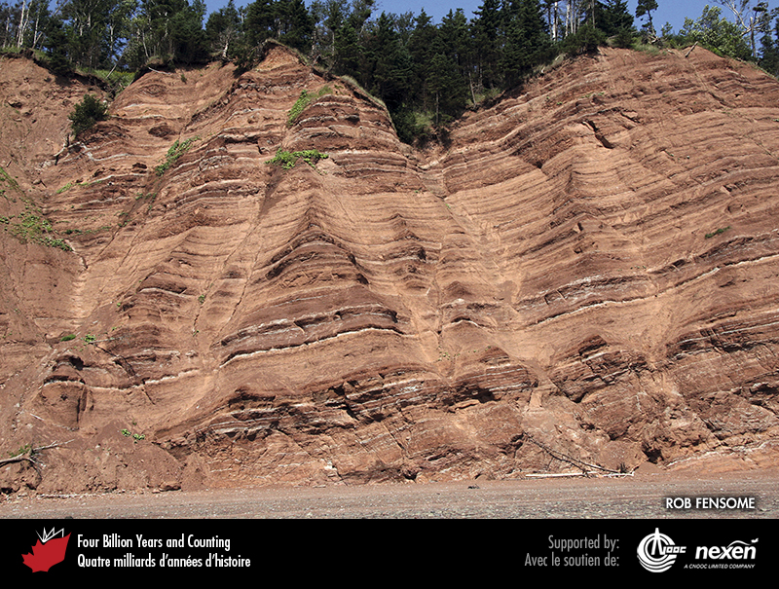
Notes:
The cyclicity in the layers of these non-marine Triassic sedimentary rocks at Five Islands, Nova Scotia, may have been controlled by astronomical cycles. Such rhythmic bedding can help geologists get a sense of the time that it took for sedimentary sequences to accumulate. ROB FENSOME.
_______________________________
All photographic and graphic images (henceforth referred to as images) posted on this site are copyright of the persons and/or institutions indicated in the caption directly associated with each image. The copyright holders have agreed that you may use their images for educational, non-commercial purposes only and provided that they are credited in each instance of use. For all other uses you must contact the copyright holder.

Slide 16
Notes:
Fortune Head, Newfoundland, the site of the “golden spike” for the base of the Cambrian, and therefore the Precambrian-Cambrian boundary. The boundary, marked by the tip of the geologist’s hand occurs within a continuous sedimentary sequence, so enabling the analysis of an uninterrupted series of fossils. SUSAN JOHNSON.
_______________________________
All photographic and graphic images (henceforth referred to as images) posted on this site are copyright of the persons and/or institutions indicated in the caption directly associated with each image. The copyright holders have agreed that you may use their images for educational, non-commercial purposes only and provided that they are credited in each instance of use. For all other uses you must contact the copyright holder.

Slide 17
Notes:
Green Point, western Newfoundland, site of the “golden spike” marking the base of the Ordovician, and hence the Cambrian-Ordovician boundary. JAMES STEEVES, COPYRIGHT PARKS CANADA.
_______________________________
All photographic and graphic images (henceforth referred to as images) posted on this site are copyright of the persons and/or institutions indicated in the caption directly associated with each image. The copyright holders have agreed that you may use their images for educational, non-commercial purposes only and provided that they are credited in each instance of use. For all other uses you must contact the copyright holder.

