Slide 1
CHAPTER 2 Part 2 of 2
All photographic and graphic images (henceforth referred to as images) posted on this site are copyright of the persons and/or institutions indicated in the caption directly associated with each image. The copyright holders have agreed that you may use their images for educational, non-commercial purposes only and provided that they are credited in each instance of use. For all other uses you must contact the copyright holder.

Slide 2
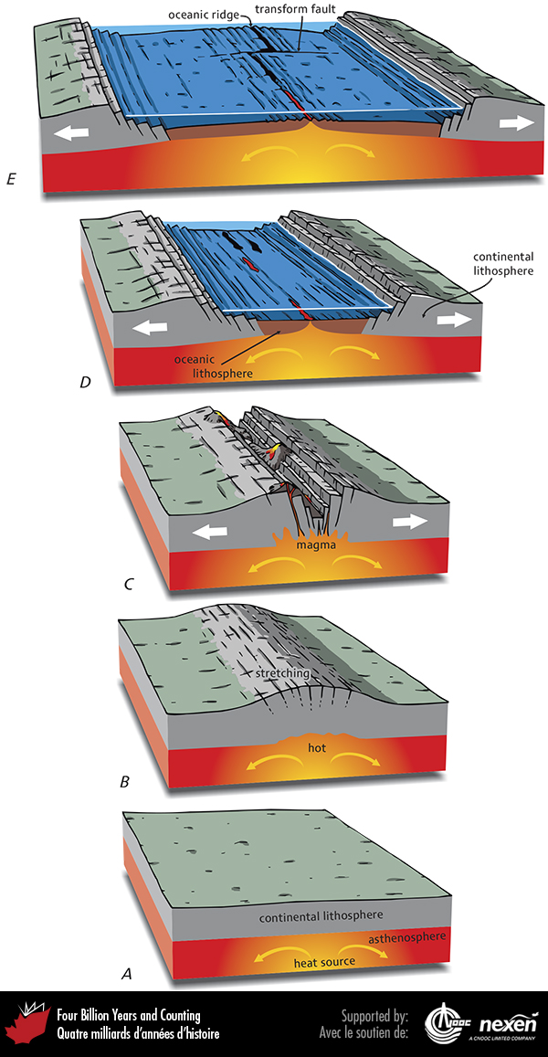
Notes:
Stages in the breakup of a continent to form a new ocean. A shows undisturbed continental lithosphere overlying asthenosphere. Energy sources in the mantle heat, stretch, and weaken the continental lithosphere, sometimes causing doming (B). Eventually the continental lithosphere rifts and volcanic rocks are extruded (C). The rifted continental lithosphere may split and the two sides drift apart, creating two continents and leaving a small ocean basin in between, as in Baffin Bay and the Red Sea (D). Continuing separation leads to formation of a large ocean basin such as the modern Atlantic Ocean (E).
_______________________________
All photographic and graphic images (henceforth referred to as images) posted on this site are copyright of the persons and/or institutions indicated in the caption directly associated with each image. The copyright holders have agreed that you may use their images for educational, non-commercial purposes only and provided that they are credited in each instance of use. For all other uses you must contact the copyright holder.

Slide 3
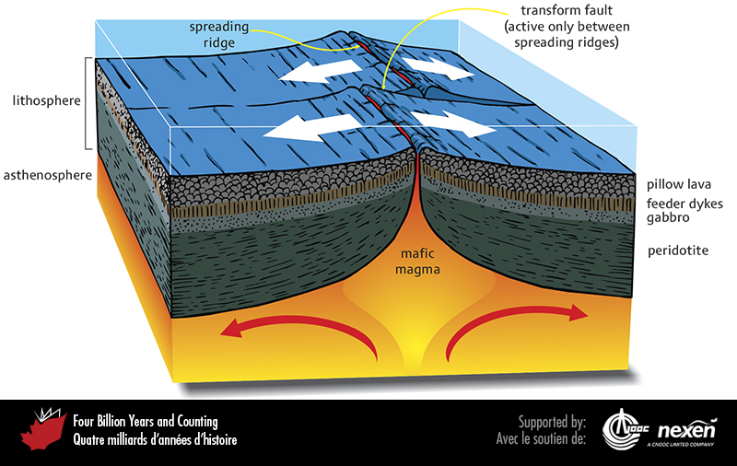
Notes:
The structure beneath an oceanic spreading ridge.
_______________________________
All photographic and graphic images (henceforth referred to as images) posted on this site are copyright of the persons and/or institutions indicated in the caption directly associated with each image. The copyright holders have agreed that you may use their images for educational, non-commercial purposes only and provided that they are credited in each instance of use. For all other uses you must contact the copyright holder.

Slide 4
Notes:
Part of the Mid-Atlantic Ridge outcrops in Iceland, as shown here near Thingvellir, where the rift at the centre of the ridge is clearly visible. This marks the boundary between the North American and Eurasian plates. Christopher Harrison.
_______________________________
All photographic and graphic images (henceforth referred to as images) posted on this site are copyright of the persons and/or institutions indicated in the caption directly associated with each image. The copyright holders have agreed that you may use their images for educational, non-commercial purposes only and provided that they are credited in each instance of use. For all other uses you must contact the copyright holder.

Slide 5
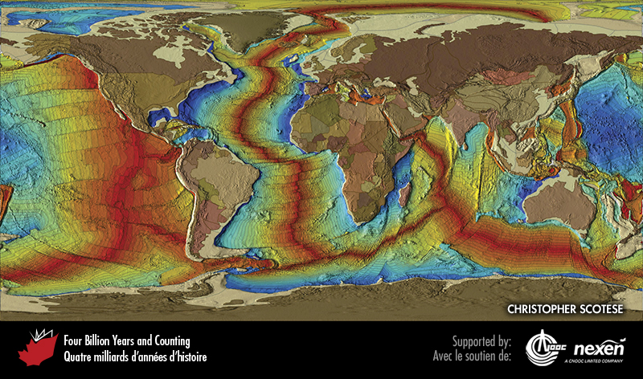
Notes:
Time of formation of ocean floor has been revealed through paleomagnetism and radiometric dating (Chapter 3) and is shown on the map by the colour pattern. Red through yellow represents ocean floors formed between 70 million years ago and the present, and pale green through dark blue represents ocean floors created between about 180 and 70 million years ago. The growth rate of Pacific Ocean floor is about three times that of the Atlantic, as reflected by the wider colour bands in the former. The symmetrical spreading in the Atlantic and Indian oceans is in marked contrast with the asymmetrical pattern in the Pacific Ocean, a result of the Americas overriding huge areas of the eastern Pacific floor. The light tan colour represents continental shelves and continents are in various brown to pastel shades that indicate countries. CHRISTOPHER SCOTESE.
_______________________________
All photographic and graphic images (henceforth referred to as images) posted on this site are copyright of the persons and/or institutions indicated in the caption directly associated with each image. The copyright holders have agreed that you may use their images for educational, non-commercial purposes only and provided that they are credited in each instance of use. For all other uses you must contact the copyright holder.

Slide 6
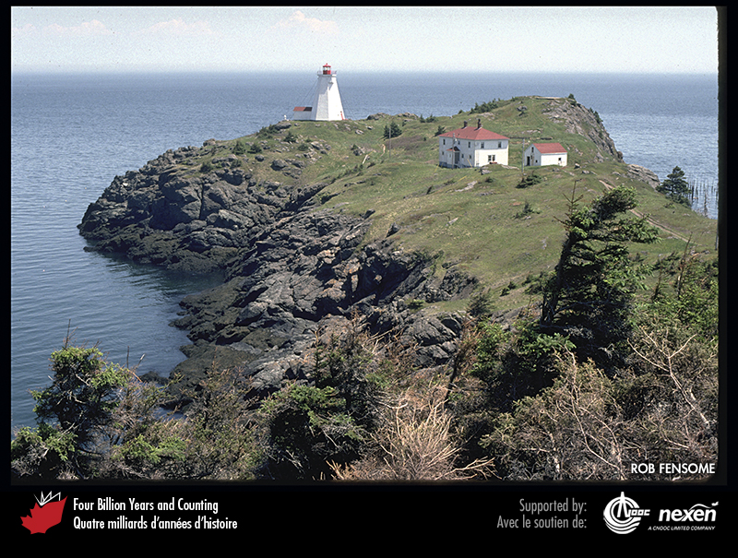
Notes:
Ancient volcanic rocks underlie the Swallowtail Light on Grand Manan Island, New Brunswick. Although the exact age of these rocks is unknown, they are older (perhaps much older) than about 400 million years and formed on a microcontinent called Ganderia, which originated on the southern margin of the Iapetus Ocean but eventually fused with the ancient continent of Laurentia to the north when the ocean closed (chapters 7 and 8). ROB FENSOME.
_______________________________
All photographic and graphic images (henceforth referred to as images) posted on this site are copyright of the persons and/or institutions indicated in the caption directly associated with each image. The copyright holders have agreed that you may use their images for educational, non-commercial purposes only and provided that they are credited in each instance of use. For all other uses you must contact the copyright holder.

Slide 7
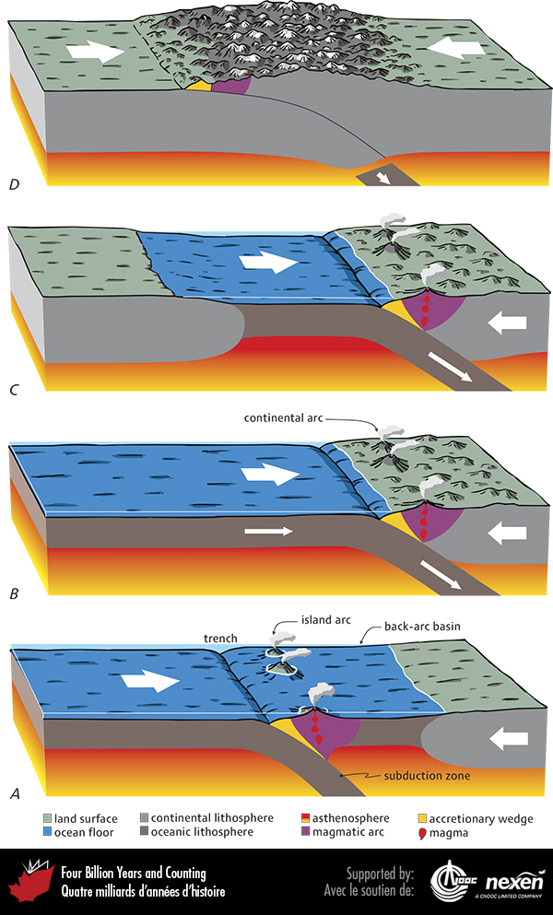
Notes:
Different kinds of convergent plate margins. When the lithosphere disappears at trenches by subduction into the mantle, chains of volcanoes and bodies of magma are generated in magmatic arcs in the overriding plate. The arrows indicate relative motion of the plates. A shows a setting such as that in the present western Pacific. shows a setting such as today’s eastern Pacific margin. C shows a similar situation to B, but with another continent approaching. D shows a continuation of this process—the two continents have collided and one is being thrust beneath the other, a process that will eventually stall, shutting down subduction and causing changes in plate interactions and boundaries.
_______________________________
All photographic and graphic images (henceforth referred to as images) posted on this site are copyright of the persons and/or institutions indicated in the caption directly associated with each image. The copyright holders have agreed that you may use their images for educational, non-commercial purposes only and provided that they are credited in each instance of use. For all other uses you must contact the copyright holder.

Slide 8
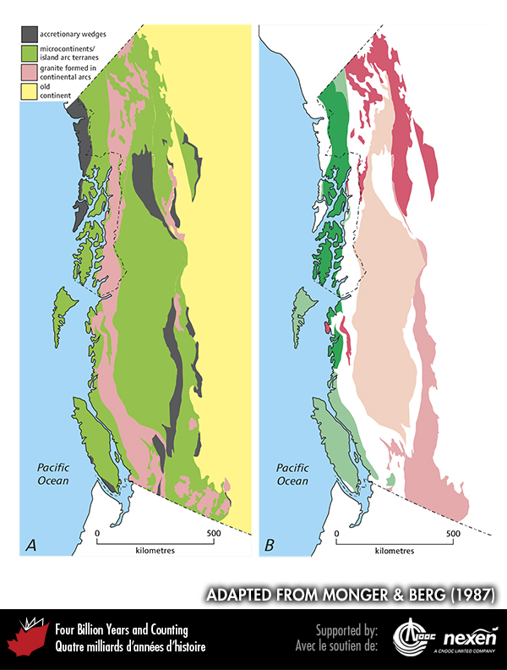
Notes:
Anatomy of the still-active Cordilleran Orogen in Canada. A shows the distribution of: accretionary wedges; microcontinents, which commonly incorporate remnants of island magmatic arcs and granites. B shows the distribution of the various major microcontinent/island arc terranes in the Cordillera, names and details of which will be introduced in later chapters. Adapted from Monger and Berg (1987), courtesy of the US Geological Survey.
_______________________________
All photographic and graphic images (henceforth referred to as images) posted on this site are copyright of the persons and/or institutions indicated in the caption directly associated with each image. The copyright holders have agreed that you may use their images for educational, non-commercial purposes only and provided that they are credited in each instance of use. For all other uses you must contact the copyright holder.

Slide 9
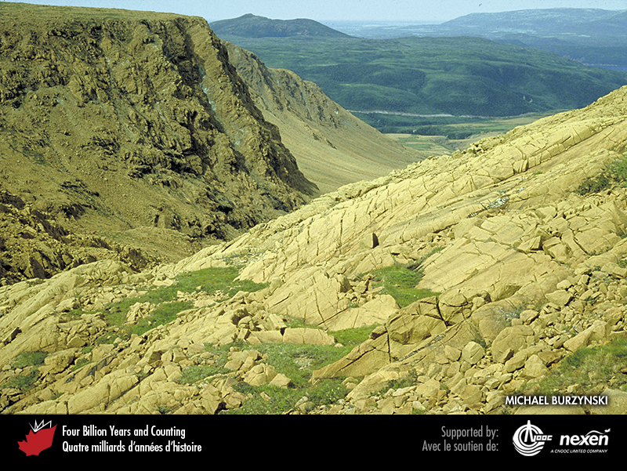
Notes:
Ultramafic mantle rocks, part of a suite of rocks known as ophiolites, are exposed in Gros Morne National Park of Canada, Newfoundland. These rocks were thrust up about 480 million years ago (Chapter 7). The brown colour and lack of vegetation are characteristic of outcrops of ultramafic rocks. MICHAEL BURZYNSKI.
_______________________________
All photographic and graphic images (henceforth referred to as images) posted on this site are copyright of the persons and/or institutions indicated in the caption directly associated with each image. The copyright holders have agreed that you may use their images for educational, non-commercial purposes only and provided that they are credited in each instance of use. For all other uses you must contact the copyright holder.

Slide 10
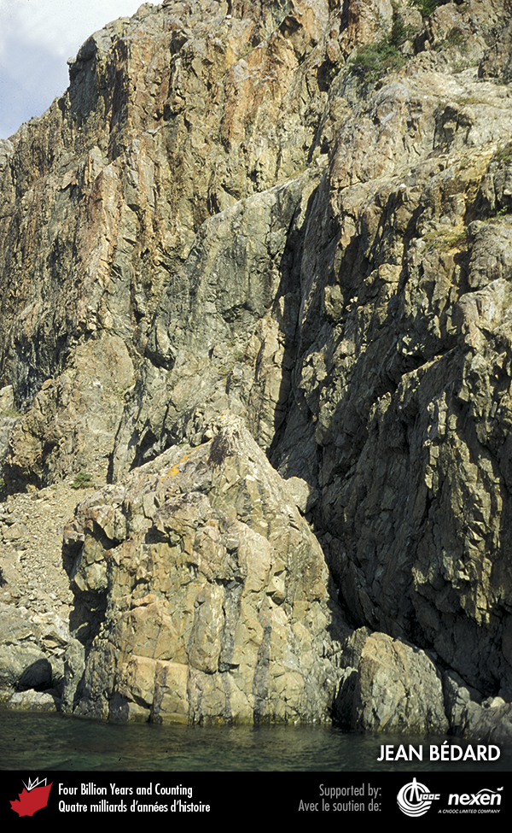
Notes:
The almost vertical structures in this cliff are the solidified remains of feeder dykes that supplied magma to spreading ridges. Such dykes are preserved in ophiolite suites. This example is from Gros Morne National Park of Canada, Newfoundland. JEAN BÉDARD.
_______________________________
All photographic and graphic images (henceforth referred to as images) posted on this site are copyright of the persons and/or institutions indicated in the caption directly associated with each image. The copyright holders have agreed that you may use their images for educational, non-commercial purposes only and provided that they are credited in each instance of use. For all other uses you must contact the copyright holder.

Slide 11
Notes:
Basaltic lava flow on Kilauea volcano, Hawaii, perhaps the world’s most famous hot spot. This photo was taken about 4 metres from the lava. LASZLO PODOR.
_______________________________
All photographic and graphic images (henceforth referred to as images) posted on this site are copyright of the persons and/or institutions indicated in the caption directly associated with each image. The copyright holders have agreed that you may use their images for educational, non-commercial purposes only and provided that they are credited in each instance of use. For all other uses you must contact the copyright holder.

Slide 12
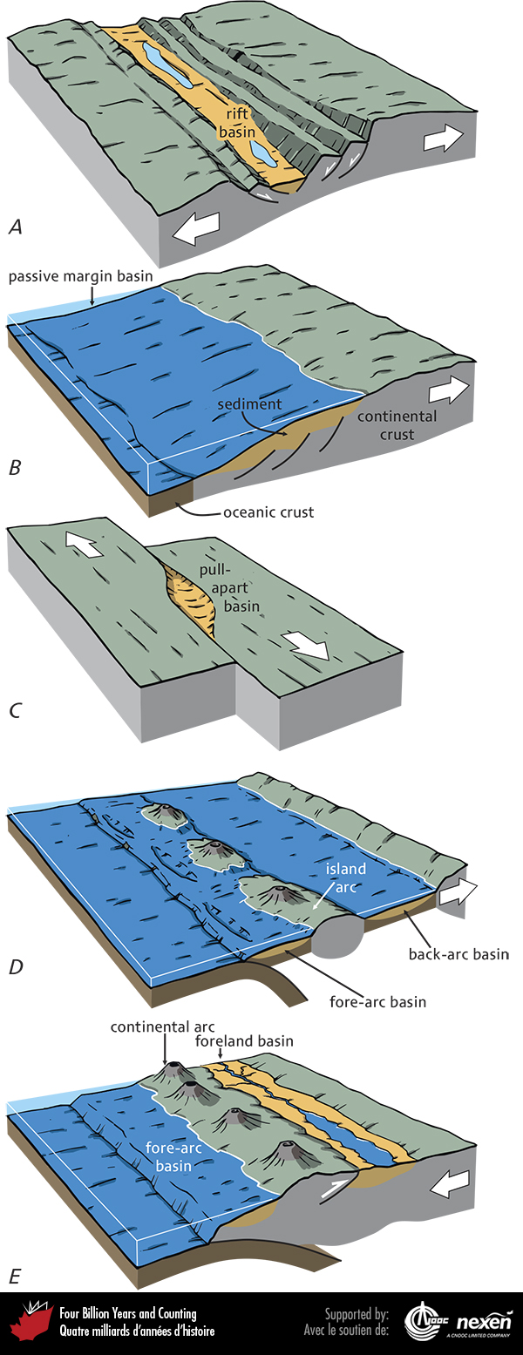
Notes:
The relationships between sedimentary basins and plate tectonics. Extensional plate tectonic settings with rift basins formed during rifting (A) and passive margin basins formed during drifting (B). Pull-apart basins, which are never large, can occur in transform tectonic settings (C). Convergent-plate settings may include fore-arc basins between the trench and magmatic arc (D, E), back-arc basins between the magmatic arc and continent (D), and foreland basins, depressed by the overloading of the lithosphere as continental crust piles up through thrust-faulting and folding (E).
_______________________________
All photographic and graphic images (henceforth referred to as images) posted on this site are copyright of the persons and/or institutions indicated in the caption directly associated with each image. The copyright holders have agreed that you may use their images for educational, non-commercial purposes only and provided that they are credited in each instance of use. For all other uses you must contact the copyright holder.

Slide 13
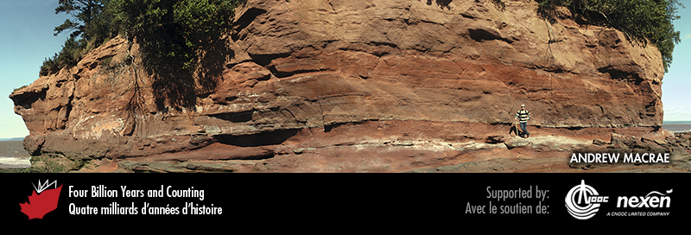
Notes:
These fluvial sedimentary rocks (redbeds) at Burntcoat Head, on the south shore of the Minas Basin, Nova Scotia, were deposited in a rift basin over 200 million years ago (Chapter9). Andrew MacRae.
_______________________________
All photographic and graphic images (henceforth referred to as images) posted on this site are copyright of the persons and/or institutions indicated in the caption directly associated with each image. The copyright holders have agreed that you may use their images for educational, non-commercial purposes only and provided that they are credited in each instance of use. For all other uses you must contact the copyright holder.

