Slide 1
CHAPTER 11 Part 3 of 3
All photographic and graphic images (henceforth referred to as images) posted on this site are copyright of the persons and/or institutions indicated in the caption directly associated with each image. The copyright holders have agreed that you may use their images for educational, non-commercial purposes only and provided that they are credited in each instance of use. For all other uses you must contact the copyright holder.

Slide 2
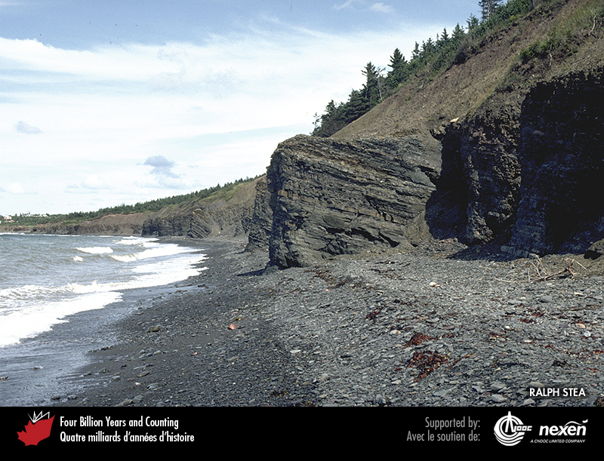
Notes:
The bench at the top of the jutting cliff of Silurian strata at Arisaig, Nova Scotia, marks a raised beach cut by the sea during the Sangamon interglaciation about 125,000 years ago. Above this beach is till deposited during the last glaciation. RALPH STEA.
_______________________________
All photographic and graphic images (henceforth referred to as images) posted on this site are copyright of the persons and/or institutions indicated in the caption directly associated with each image. The copyright holders have agreed that you may use their images for educational, non-commercial purposes only and provided that they are credited in each instance of use. For all other uses you must contact the copyright holder.

Slide 3
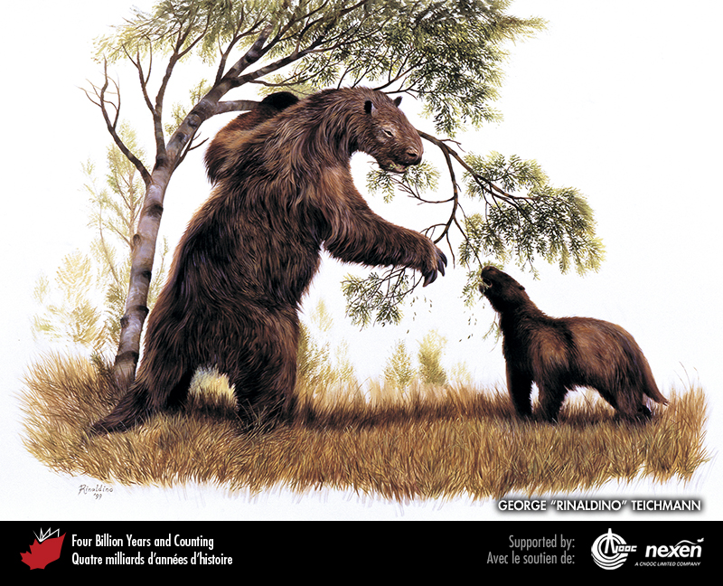
Notes:
The ground sloth Megalonyx, which lived in Beringia during the Ice Age, could have been up to 3 metres long and weighed about 850 kilograms. GROUND SLOTH BY GEORGE “RINALDINO” TEICHMANN, COPYRIGHT 1999.
_______________________________
All photographic and graphic images (henceforth referred to as images) posted on this site are copyright of the persons and/or institutions indicated in the caption directly associated with each image. The copyright holders have agreed that you may use their images for educational, non-commercial purposes only and provided that they are credited in each instance of use. For all other uses you must contact the copyright holder.

Slide 4
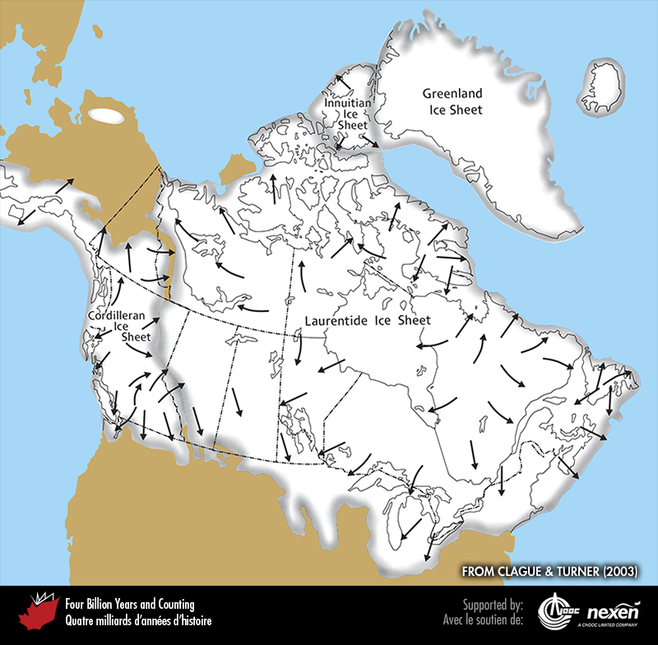
Notes:
Ice cover over North America and adjacent areas during the last glacial maximum, about 19,000 years ago. The arrows show directions of ice flow from the major ice centres. ADAPTED FROM A GRAPHIC BY RICHARD FRANKLIN FOR CLAGUE AND TURNER (2003), USED WITH PERMISSION FROM TRICOUNI PRESS.
_______________________________
All photographic and graphic images (henceforth referred to as images) posted on this site are copyright of the persons and/or institutions indicated in the caption directly associated with each image. The copyright holders have agreed that you may use their images for educational, non-commercial purposes only and provided that they are credited in each instance of use. For all other uses you must contact the copyright holder.

Slide 5
Notes:
Ring Mountain, a tuya northwest of Whistler, British Columbia, was active during the last glaciation. PAUL ADAM.
_______________________________
All photographic and graphic images (henceforth referred to as images) posted on this site are copyright of the persons and/or institutions indicated in the caption directly associated with each image. The copyright holders have agreed that you may use their images for educational, non-commercial purposes only and provided that they are credited in each instance of use. For all other uses you must contact the copyright holder.

Slide 6
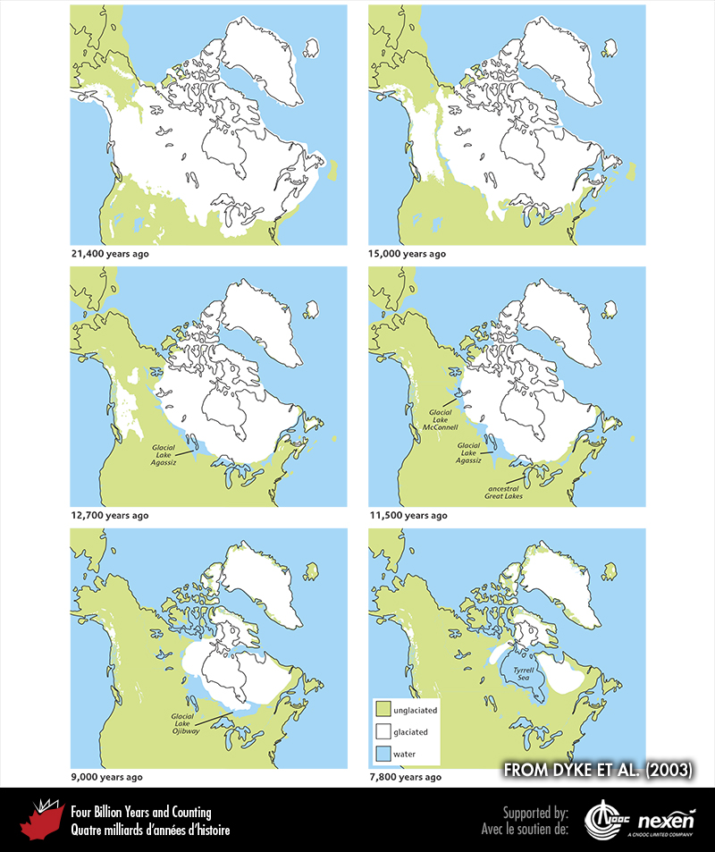
Notes:
Stages in the deglaciation of North America and adjacent regions from 21,400 to 7,800 years ago. ADAPTED FROM DY KE ET AL. (2003).
_______________________________
All photographic and graphic images (henceforth referred to as images) posted on this site are copyright of the persons and/or institutions indicated in the caption directly associated with each image. The copyright holders have agreed that you may use their images for educational, non-commercial purposes only and provided that they are credited in each instance of use. For all other uses you must contact the copyright holder.

Slide 7
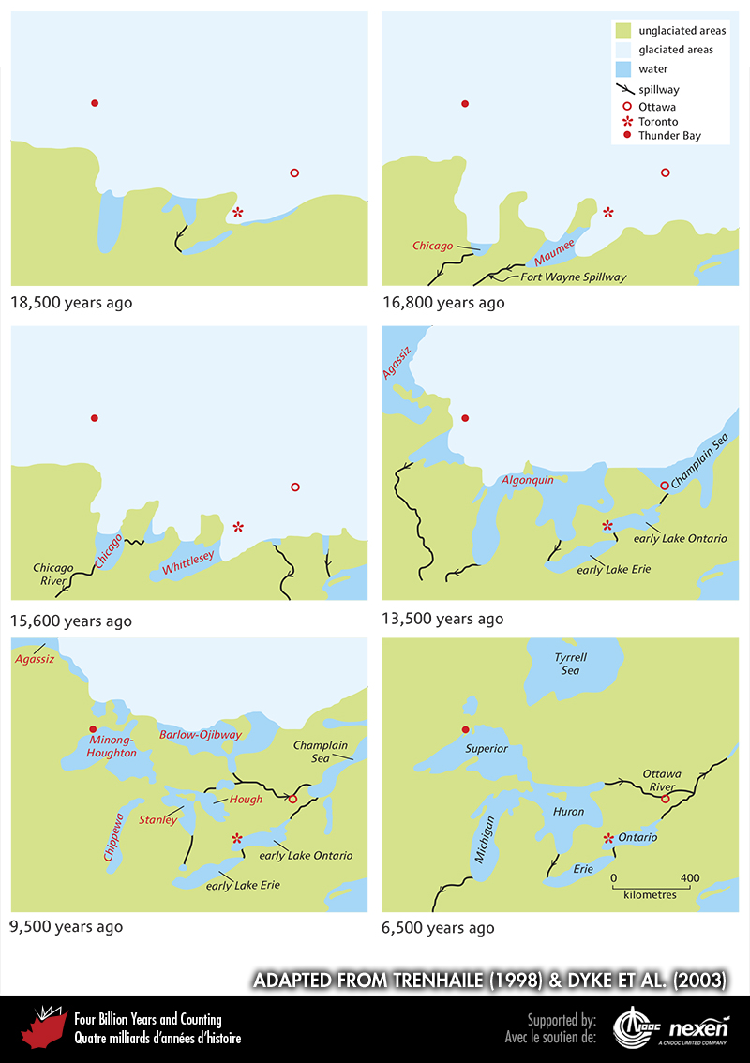
Notes:
Stages in the evolution of the Great Lakes from 18,500 to 6,500 years ago. Glacial lakes are labelled in red. ADAPTED FROM TRENHAILE (1998) AND DYKE ET AL. (2003).
_______________________________
All photographic and graphic images (henceforth referred to as images) posted on this site are copyright of the persons and/or institutions indicated in the caption directly associated with each image. The copyright holders have agreed that you may use their images for educational, non-commercial purposes only and provided that they are credited in each instance of use. For all other uses you must contact the copyright holder.

Slide 8
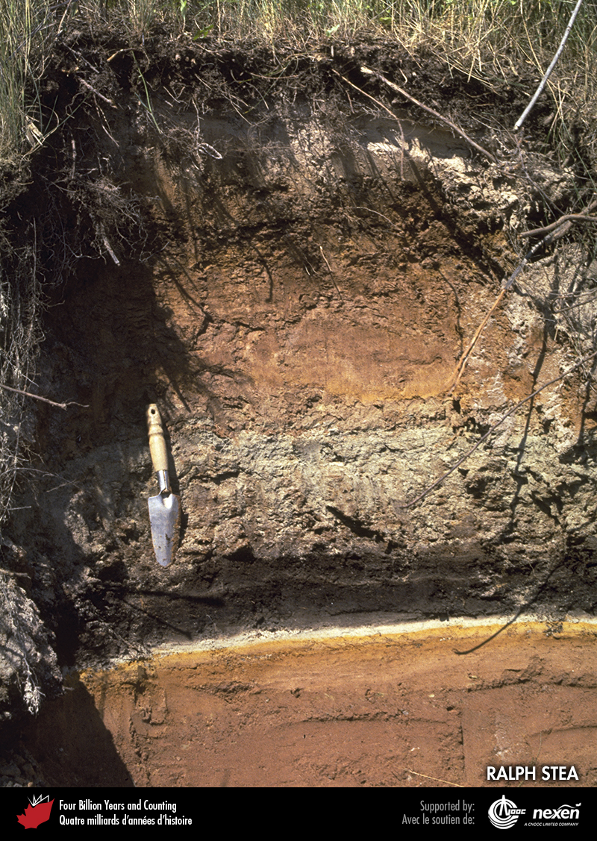
Notes:
This excavated section in sediments near Lismore, Nova Scotia, records rapid climate change at the end of the last glaciation. Reddish sediments at the base were deposited about 14,000 years ago in a glacial lake centred over the present-day Northumberland Strait. The glacial-lake sediments are capped by black peat and pale reddish to cream-coloured clay, which formed during a warmer phase from about 14,000 to 12,500 years ago in a forested landscape. The overlying sequence of reddish sediments was deposited when ice re-advance blocked local drainage and re-established the glacial lake. This occurred during the cooler Younger Dryas. Above the upper lake deposit is the modern soil. RALPH STEA.
_______________________________
All photographic and graphic images (henceforth referred to as images) posted on this site are copyright of the persons and/or institutions indicated in the caption directly associated with each image. The copyright holders have agreed that you may use their images for educational, non-commercial purposes only and provided that they are credited in each instance of use. For all other uses you must contact the copyright holder.

Slide 9
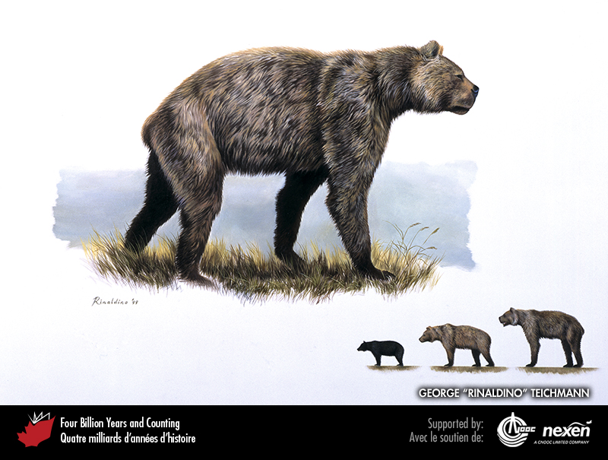
Notes:
Remains of the giant short-faced bear, a laurasiathere that in life may have weighed up to 900 kilograms, have been found in Yukon and on the Prairies. This animal was the largest carnivorous land mammal to have lived in North America. The inset compares the size of a giant short-faced bear (right), a grizzly bear (centre), and a black bear (left). GIANT SHORT-FACED BEAR BY GEORGE “RINALDINO” TEICHMANN, COPYRIGHT 1999.
_______________________________
All photographic and graphic images (henceforth referred to as images) posted on this site are copyright of the persons and/or institutions indicated in the caption directly associated with each image. The copyright holders have agreed that you may use their images for educational, non-commercial purposes only and provided that they are credited in each instance of use. For all other uses you must contact the copyright holder.

Slide 10
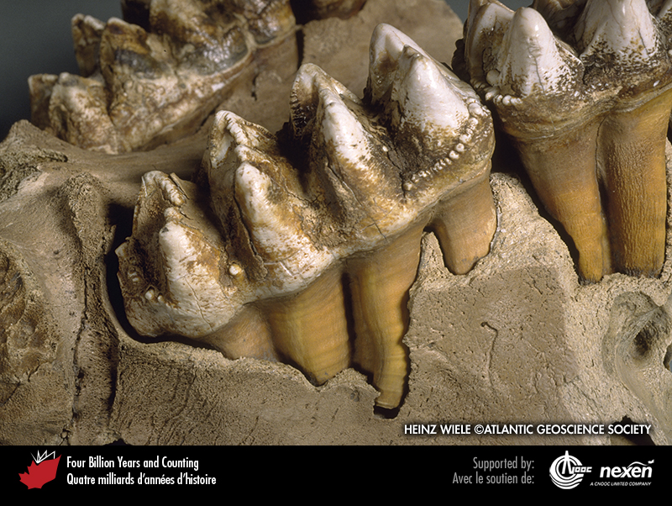
Notes:
Teeth in the lower jaw of a 75,000-year-old mastodon found near Milford, Nova Scotia. HEINZ WIELE, COURTESY OF THE ATLANTIC GEOSCIENCE SOCIETY; SPECIMEN COURTESY OF THE NOVA SCOTIA MUSEUM.
_______________________________
All photographic and graphic images (henceforth referred to as images) posted on this site are copyright of the persons and/or institutions indicated in the caption directly associated with each image. The copyright holders have agreed that you may use their images for educational, non-commercial purposes only and provided that they are credited in each instance of use. For all other uses you must contact the copyright holder.

Slide 11
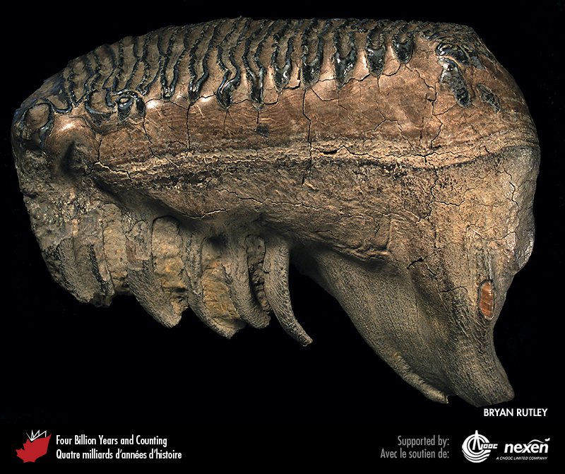
Notes:
Pleistocene mammoth tooth found on the bank of the Porcupine River about 30 kilometres west of Old Crow, Yukon. BRYAN RUTLEY, SPECIMEN PROVIDED BY ALEJANDRA DUK-RODKIN.
_______________________________
All photographic and graphic images (henceforth referred to as images) posted on this site are copyright of the persons and/or institutions indicated in the caption directly associated with each image. The copyright holders have agreed that you may use their images for educational, non-commercial purposes only and provided that they are credited in each instance of use. For all other uses you must contact the copyright holder.

Slide 12
Notes:
Bison were the main prey of the first hunters in what is now Canada. This aerial view shows wood bison in Wood Buffalo National Park of Canada in northern Alberta and southern Northwest Territories. W. LYNCH, COPYRIGHT PARKS CANADA.
_______________________________
All photographic and graphic images (henceforth referred to as images) posted on this site are copyright of the persons and/or institutions indicated in the caption directly associated with each image. The copyright holders have agreed that you may use their images for educational, non-commercial purposes only and provided that they are credited in each instance of use. For all other uses you must contact the copyright holder.

Slide 13
Notes:
Aboriginal hunters used to drive bison over the cliff at Head-Smashed-In Buffalo Jump, Alberta. HANS WIELENS.
_______________________________
All photographic and graphic images (henceforth referred to as images) posted on this site are copyright of the persons and/or institutions indicated in the caption directly associated with each image. The copyright holders have agreed that you may use their images for educational, non-commercial purposes only and provided that they are credited in each instance of use. For all other uses you must contact the copyright holder.

Slide 14
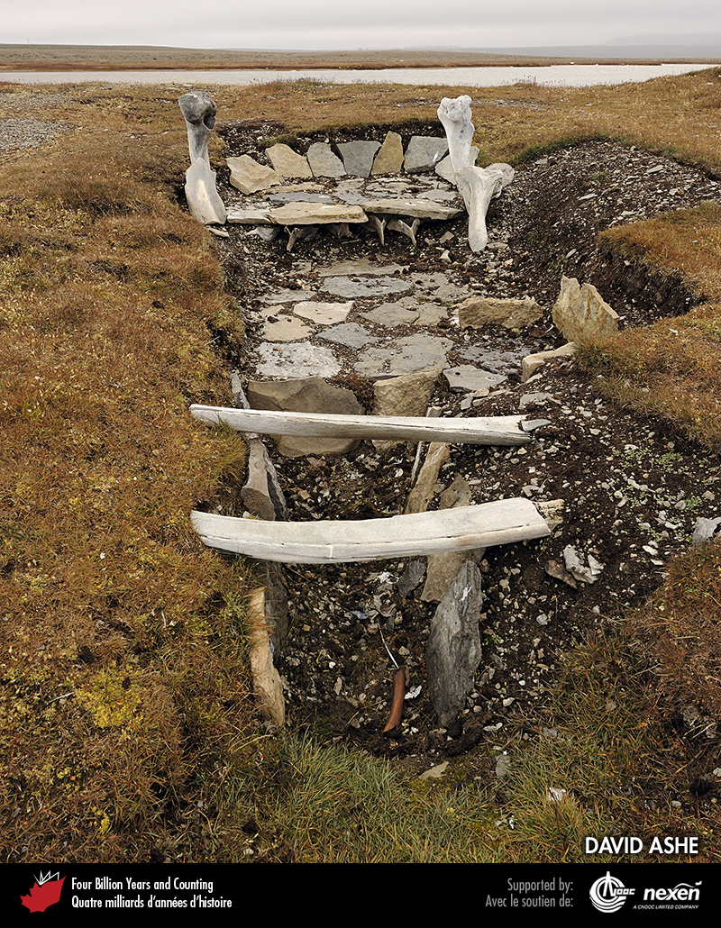
Notes:
Thule Inuit archaeological site near Resolute, Cornwallis Island, Nunavut. DAVID ASHE.
_______________________________
All photographic and graphic images (henceforth referred to as images) posted on this site are copyright of the persons and/or institutions indicated in the caption directly associated with each image. The copyright holders have agreed that you may use their images for educational, non-commercial purposes only and provided that they are credited in each instance of use. For all other uses you must contact the copyright holder.

