Slide 1
BOX 7
All photographic and graphic images (henceforth referred to as images) posted on this site are copyright of the persons and/or institutions indicated in the caption directly associated with each image. The copyright holders have agreed that you may use their images for educational, non-commercial purposes only and provided that they are credited in each instance of use. For all other uses you must contact the copyright holder.

Slide 2
Notes:
A receptaculitid from the Ordovician Tyndall Stone (Chapter 8). Receptaculitids may represent an extinct type of calcareous alga. ROB FENSOME, SPECIMEN COURTESY OF THE UNIVERSITY OF SASKATCHEWAN.
_______________________________
All photographic and graphic images (henceforth referred to as images) posted on this site are copyright of the persons and/or institutions indicated in the caption directly associated with each image. The copyright holders have agreed that you may use their images for educational, non-commercial purposes only and provided that they are credited in each instance of use. For all other uses you must contact the copyright holder.

Slide 3
Notes:
Cross-section of the stem of a Devonian plant akin to Psilophyton, an early tracheophyte from Dalhousie Junction, New Brunswick. PATRICIA GENSEL.
_______________________________
All photographic and graphic images (henceforth referred to as images) posted on this site are copyright of the persons and/or institutions indicated in the caption directly associated with each image. The copyright holders have agreed that you may use their images for educational, non-commercial purposes only and provided that they are credited in each instance of use. For all other uses you must contact the copyright holder.

Slide 4
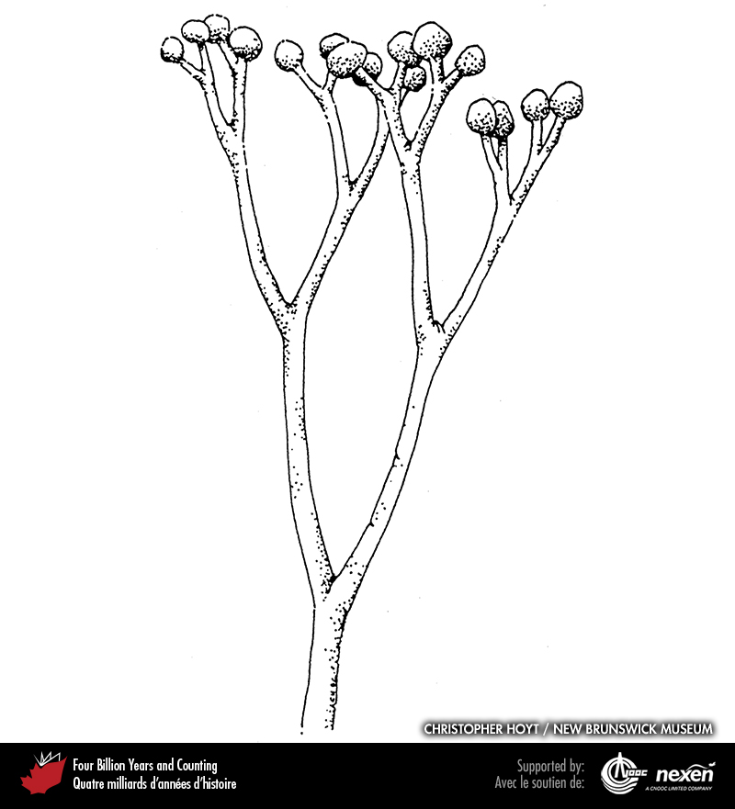
Notes:
Sketch of Cooksonia, an early vascular plant found in Devonian strata at Dalhousie Junction, New Brunswick. CHRISTOPHER HOYT AND THE NEW BRUNSWICK MUSEUM.
_______________________________
All photographic and graphic images (henceforth referred to as images) posted on this site are copyright of the persons and/or institutions indicated in the caption directly associated with each image. The copyright holders have agreed that you may use their images for educational, non-commercial purposes only and provided that they are credited in each instance of use. For all other uses you must contact the copyright holder.

Slide 5
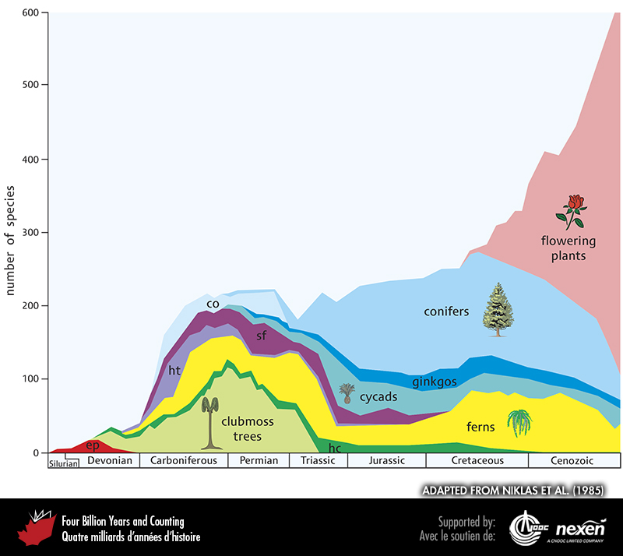
Notes:
Distribution of the main groups of vascular plants through time. Abbreviations: co = cordaites, ep = early plants, hc = herbaceous clubmosses, ht = horsetails, and sf = seed ferns. ADAPTED FROM NIKLAS E T AL. (1985).
_______________________________
All photographic and graphic images (henceforth referred to as images) posted on this site are copyright of the persons and/or institutions indicated in the caption directly associated with each image. The copyright holders have agreed that you may use their images for educational, non-commercial purposes only and provided that they are credited in each instance of use. For all other uses you must contact the copyright holder.

Slide 6
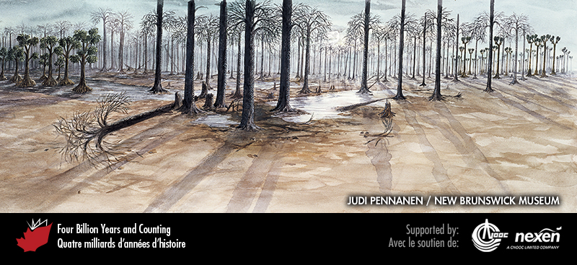
Notes:
Scene from a late Carboniferous forest. The dominant trees are clubmosses, with many specimens of Lepidodendron (centre) and, in the distance at right, Sigillaria. To the left is a grove of the early gymnosperm Cordaites. PAINTING BY JUDI PENNANEN, COURTESY OF THE NEW BRUNSWICK MUSEUM.
_______________________________
All photographic and graphic images (henceforth referred to as images) posted on this site are copyright of the persons and/or institutions indicated in the caption directly associated with each image. The copyright holders have agreed that you may use their images for educational, non-commercial purposes only and provided that they are credited in each instance of use. For all other uses you must contact the copyright holder.

Slide 7
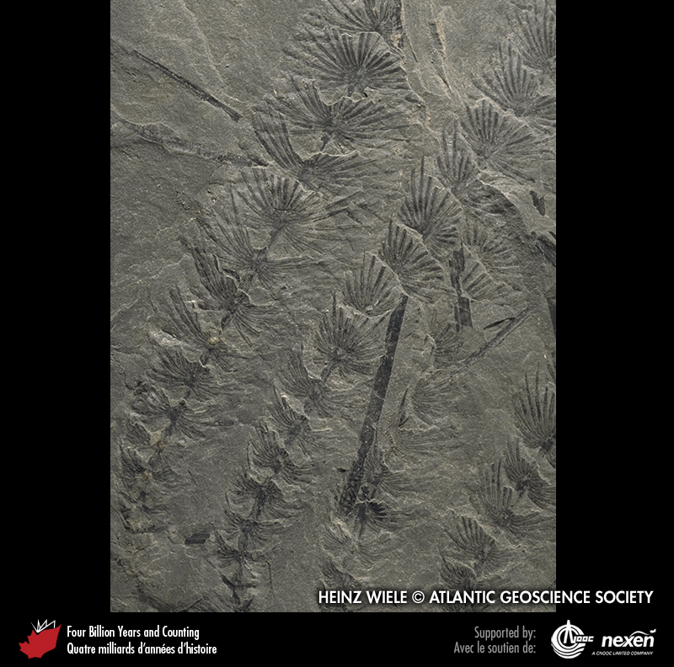
Notes:
Whorl-shaped leaves known as Asterophyllites represent the foliage of the fossil horsetail, Calamites. Several branches with leaves are preserved in this specimen from Minto, New Brunswick. HEINZ WIELE, COURTESY OF THE ATLANTIC GEOSCIENCE SOCIETY; SPECIMEN COURTESY OF THE NEW BRUNSWICK MUSEUM.
_______________________________
All photographic and graphic images (henceforth referred to as images) posted on this site are copyright of the persons and/or institutions indicated in the caption directly associated with each image. The copyright holders have agreed that you may use their images for educational, non-commercial purposes only and provided that they are credited in each instance of use. For all other uses you must contact the copyright holder.

Slide 8
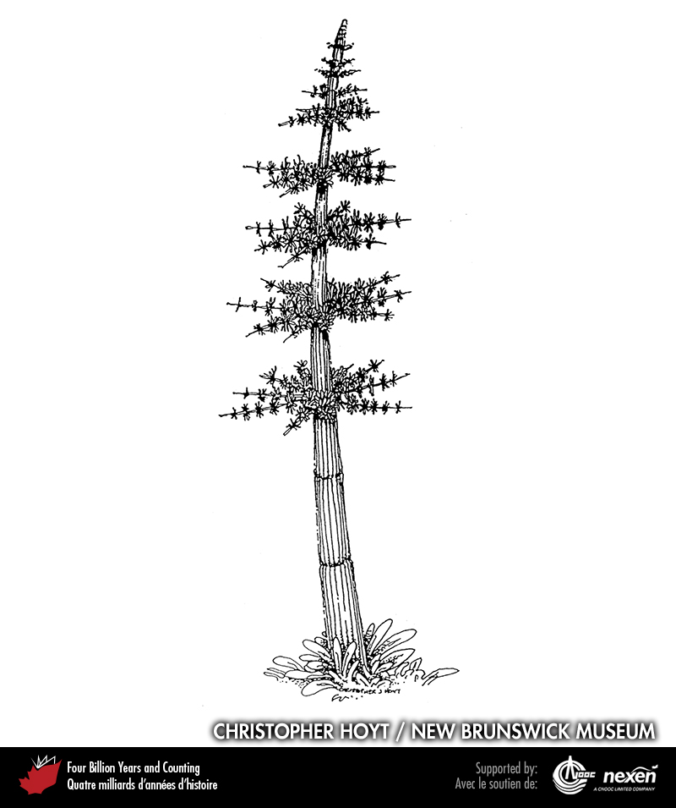
Notes:
Sketch of the horsetail tree Calamites. CHRISTOPHER HOYT AND THE NEW BRUNSWICK MUSEUM.
_______________________________
All photographic and graphic images (henceforth referred to as images) posted on this site are copyright of the persons and/or institutions indicated in the caption directly associated with each image. The copyright holders have agreed that you may use their images for educational, non-commercial purposes only and provided that they are credited in each instance of use. For all other uses you must contact the copyright holder.

Slide 9
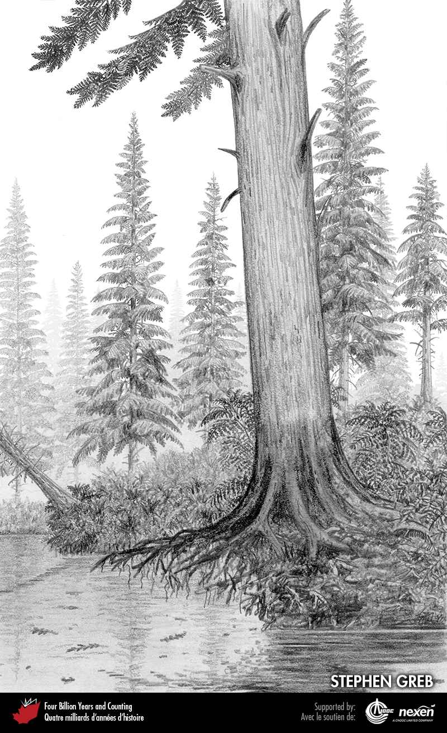
Notes:
Archaeopteris is among the earliest known plants to have had wood, the evolution of which gave rise to trees and the first forests. Archaeopteris has been found in late Devonian strata, for example, at Miguasha, Quebec, and in the Canadian Arctic. STEPHEN GREB.
_______________________________
All photographic and graphic images (henceforth referred to as images) posted on this site are copyright of the persons and/or institutions indicated in the caption directly associated with each image. The copyright holders have agreed that you may use their images for educational, non-commercial purposes only and provided that they are credited in each instance of use. For all other uses you must contact the copyright holder.

Slide 10
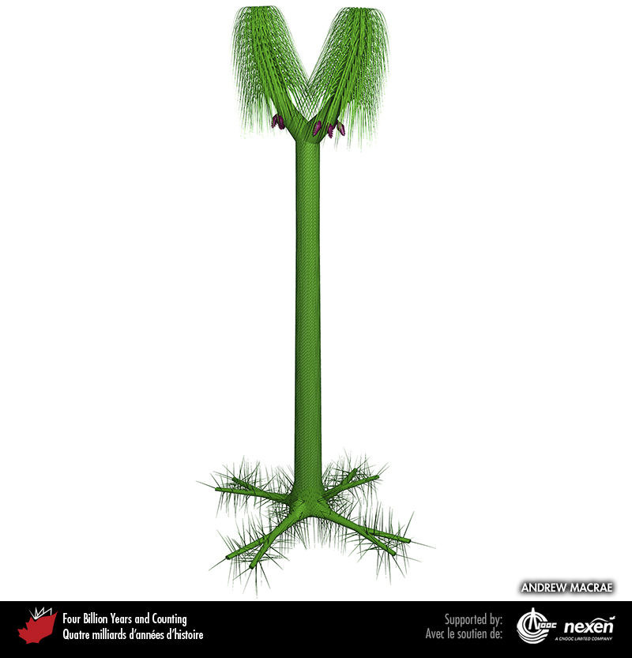
Notes:
Reconstruction of the clubmoss tree Sigillaria. ANDREW MACRAE.
_______________________________
All photographic and graphic images (henceforth referred to as images) posted on this site are copyright of the persons and/or institutions indicated in the caption directly associated with each image. The copyright holders have agreed that you may use their images for educational, non-commercial purposes only and provided that they are credited in each instance of use. For all other uses you must contact the copyright holder.

Slide 11
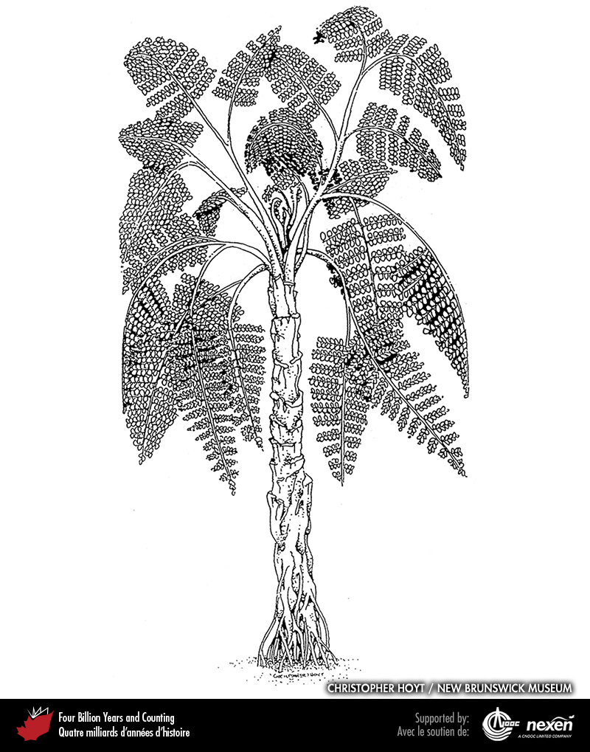
Notes:
Some early seed plants, such as Medullosa, resembled ferns but reproduced with seeds; hence they are known as seed ferns. CHRISTOPHER HOYT AND THE NEW BRUNSWICK MUSEUM.
_______________________________
All photographic and graphic images (henceforth referred to as images) posted on this site are copyright of the persons and/or institutions indicated in the caption directly associated with each image. The copyright holders have agreed that you may use their images for educational, non-commercial purposes only and provided that they are credited in each instance of use. For all other uses you must contact the copyright holder.

Slide 12
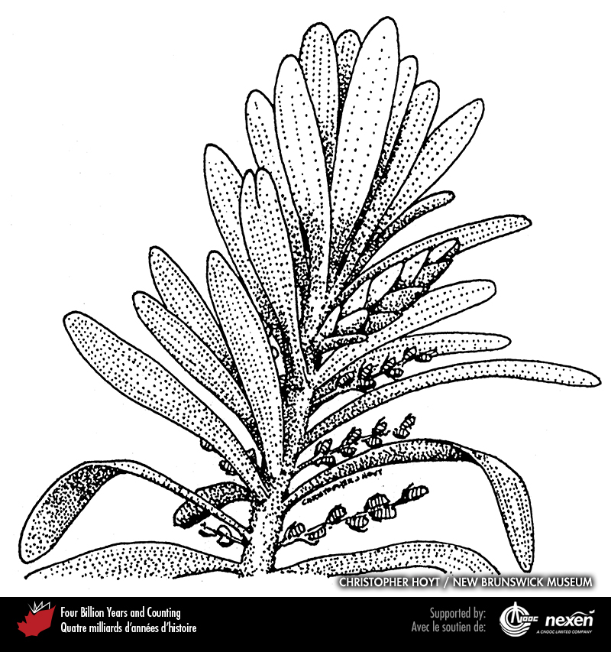
Notes:
Leaves and cones of the gymnosperm Cordaites, a widespread form in Late Carboniferous nonmarine strata of the Maritimes Basin (Chapter 8). CHRISTOPHER HOYT AND THE NEW BRUNSWICK MUSEUM.
_______________________________
All photographic and graphic images (henceforth referred to as images) posted on this site are copyright of the persons and/or institutions indicated in the caption directly associated with each image. The copyright holders have agreed that you may use their images for educational, non-commercial purposes only and provided that they are credited in each instance of use. For all other uses you must contact the copyright holder.

Slide 13
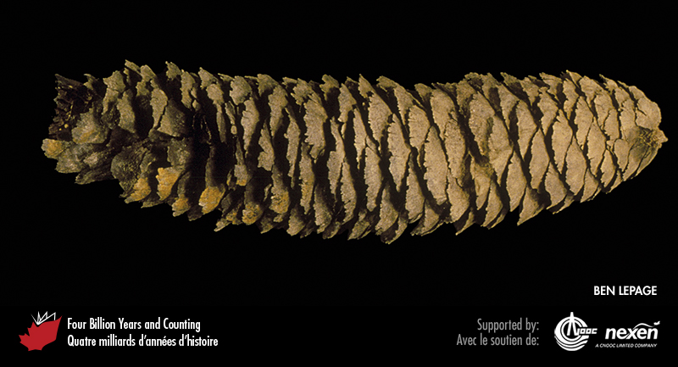
Notes:
A spruce cone from Eocene fluvial deposits on Axel Heiberg Island, Nunavut. BEN LEPAGE.
_______________________________
All photographic and graphic images (henceforth referred to as images) posted on this site are copyright of the persons and/or institutions indicated in the caption directly associated with each image. The copyright holders have agreed that you may use their images for educational, non-commercial purposes only and provided that they are credited in each instance of use. For all other uses you must contact the copyright holder.

Slide 14
Notes:
Flower calyx of Florissantia quilchenensis from Eocene lake deposits at Quilchena, British Columbia. ROLF MATHEWES.
_______________________________
All photographic and graphic images (henceforth referred to as images) posted on this site are copyright of the persons and/or institutions indicated in the caption directly associated with each image. The copyright holders have agreed that you may use their images for educational, non-commercial purposes only and provided that they are credited in each instance of use. For all other uses you must contact the copyright holder.

Slide 15
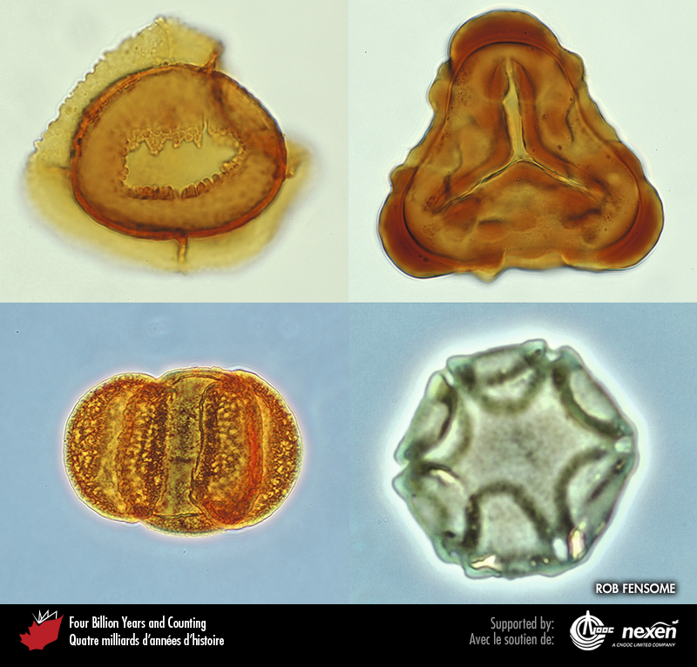
Notes:
Microscopic spores and pollen are far more common as fossils in many sedimentary rocks than larger plant fossils such as leaves and stems. Spores and pollen have played a significant role in dating rocks, unravelling past environments and revealing plant evolution. These artificially stained examples from Atlantic Canada are a Cretaceous liverwort spore (top left), a Cretaceous fern spore (top right), a Tertiary conifer pollen grain (bottom left), and a Tertiary angiosperm pollen grain (bottom right). ROB FENSOME.
_______________________________
All photographic and graphic images (henceforth referred to as images) posted on this site are copyright of the persons and/or institutions indicated in the caption directly associated with each image. The copyright holders have agreed that you may use their images for educational, non-commercial purposes only and provided that they are credited in each instance of use. For all other uses you must contact the copyright holder.

